Slide 1
Cytogenetic & genetic syndromes
Submitted by
Dr. Amal Mohammed Ali
Medical genetic department
2022

Slide 2
Genetics
Genetics is the scientific study of genes and hereditary characteristics and properties also how passed from parents to offspring as a result of changes in DNA sequence.

Slide 3
Changes in genes can prevent the gene from doing its job normally , for example some differences in DNA, can lead to incorrectly formed proteins that can’t perform their functions.
Also, genetic variations can influence how people respond to certain medicines or a person’s likelihood of developing a disease, Because parents pass their genes on to their children, some diseases tend to cluster in families, similar to other inherited traits. In most cases, multiple genes are involved.

Slide 4
Studying genetics can help doctors develop better medications or a cure for currently incurable diseases such as cancer and the rest of syndromes.

Slide 5
Cytogenetics
Cytogenetics is the study of chromosomes and chromosome abnormalities, Chromosome analysis is an important laboratory test for:
Birth defects,
Mental retardation,
Miscarriage,
Infertility & recurrent abortion
And cancer.

Slide 6
Cytogenetics included:
1- Medical cytogenetic
2- Cancer cytogenetic

Slide 7
Obtaining Cells
Obtained cells by 4 methods:
Peripheral blood
Bone marrow
Solid tissue specimens
Amniotic fluid
Fetal Cell sorting

Slide 8
Peripheral blood

Slide 9
Bone marrow aspration

Slide 10
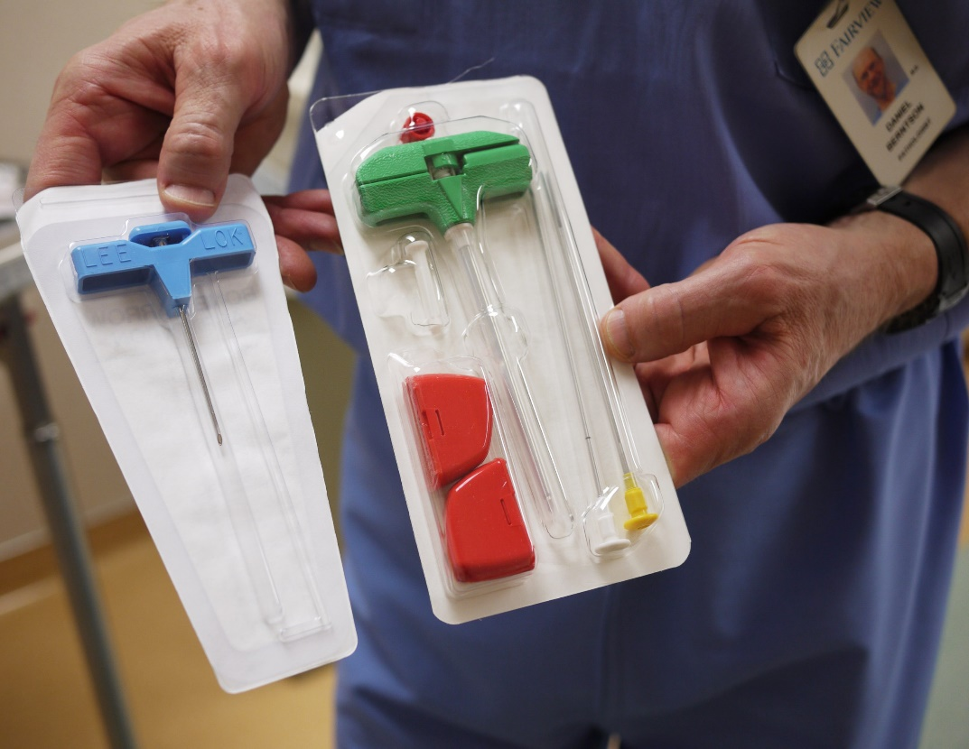
Bone marrow

Slide 11
Solid tissue specimens

Slide 12
Amniotic fluid

Slide 13
Fetal Cell sorting

Slide 14
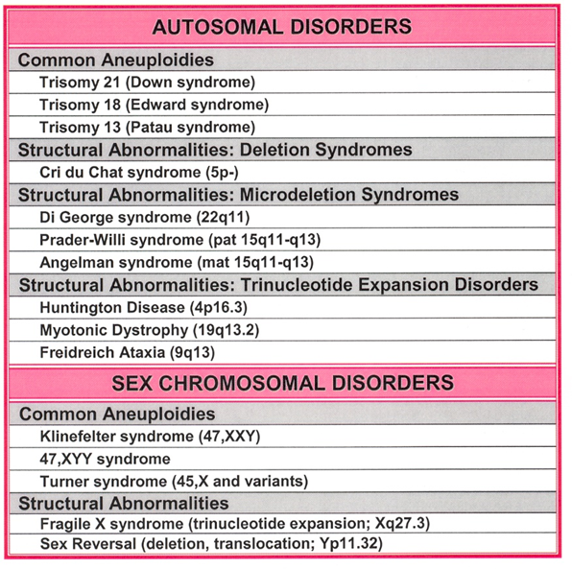

Slide 15
Syndromes
Down syndrome
Turner syndrome
Recurrent abortion
Inter sex

Slide 16
Down s Syndrome

Slide 17
Down s Syndrome Karyotype

Slide 18
Down s Syndrome Karyotype

Slide 19
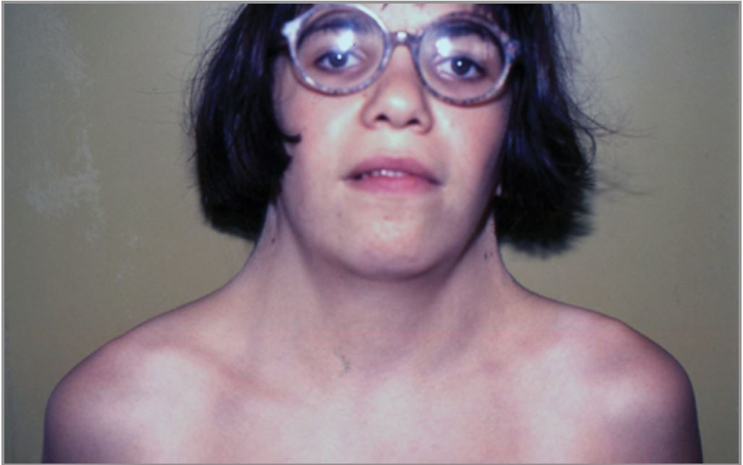
Turner Syndrome

Slide 20
Turner Syndrome Karyotype

Slide 21
Turner Syndrome Karyotype

Slide 22
Klinefelter Syndrome

Slide 23
Klinefelter Syndrome Karyotype

Slide 24
Inter Sex

Slide 26
Genetic counseling
Genetic counseling is the process of providing information about genetic conditions, diagnostic testing, and risks in other family members, within the framework of nondirective counseling.
Genetic counselors are non-physician members of the medical genetics team who specialize in family risk assessment and counseling of patients regarding genetic disorders.
The precise role of the genetic counselor varies somewhat depending on the disorder. When working alongside geneticists, genetic counselors normally specialize in pediatric genetics which focuses on developmental abnormalities present in newborns, infants or children.
The major goal of pediatric counseling is attempting to explain the genetic basis behind the child's developmental concerns in a compassionate and articulated manner that allows the potentially distressed or frustrated parents to easily understand the information. As well, genetic counselors normally take a family pedigree, which summarizes the medical history of the patient's family. This then aids the clinical geneticist in the differential diagnosis process and help determine which further steps should be taken to help the patient

Slide 30
Thank you

