Slide 1
Mosaicism
Lecturer PhD. Asmaa Amer Almukhtar
Medical Genetics Department/ICCMGR
Nov 2023

Slide 2
Normal karyotype
What is the mosaicism?
Who is the responsible about it?
Types of mosaicism.
How it creates?

Slide 3
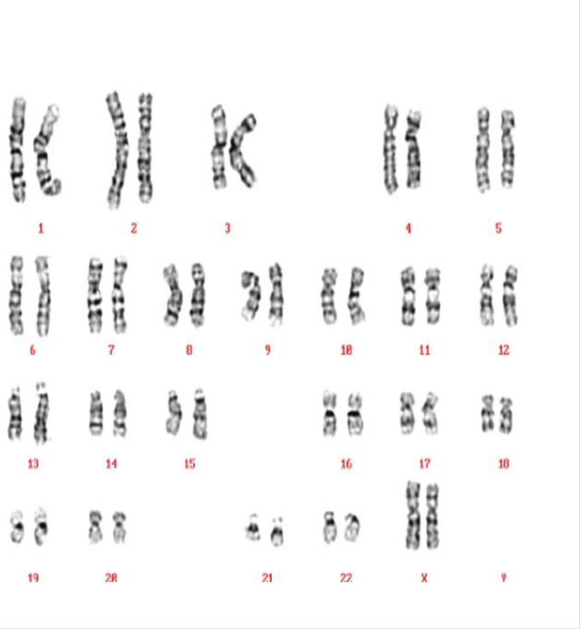
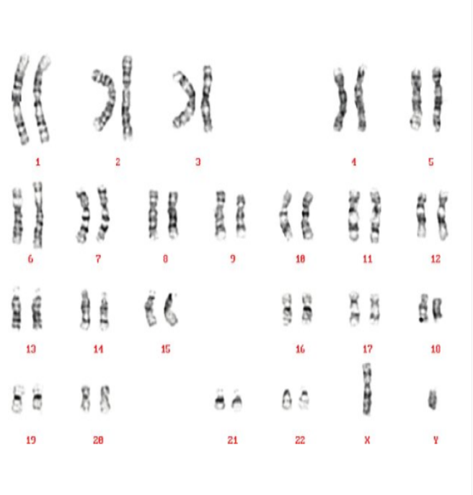
Normal female human karyotype
46,XX
Normal Male Human Karyotype
46,XY

Slide 4
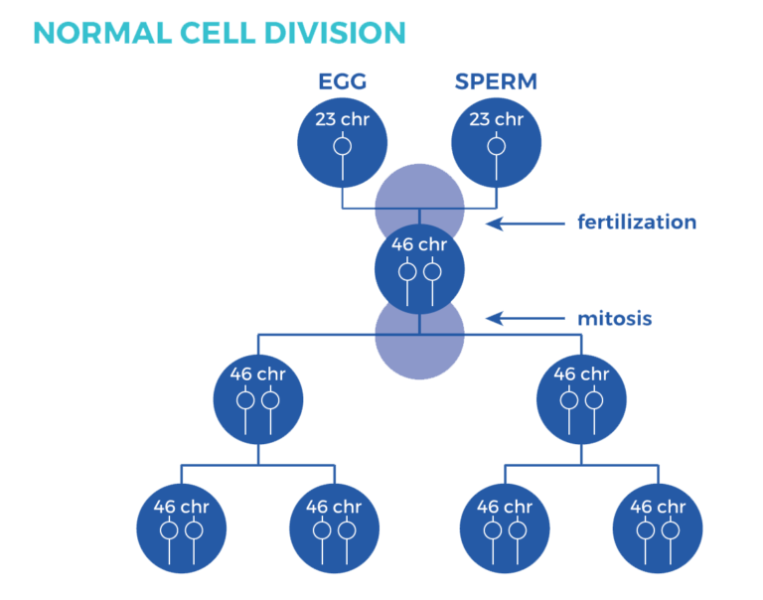

Slide 5
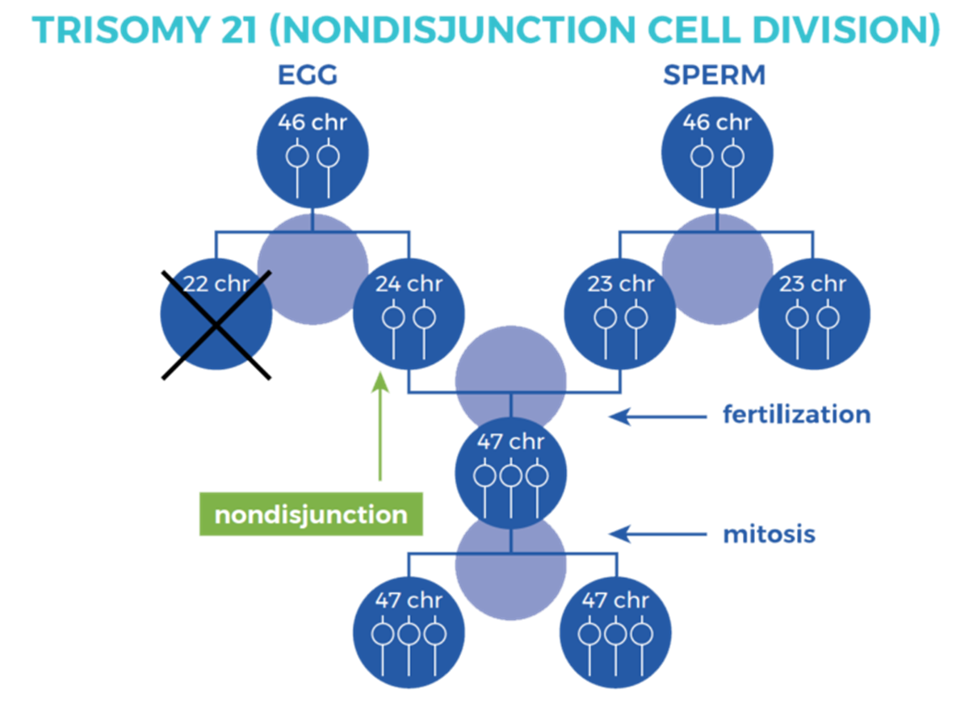

Slide 6
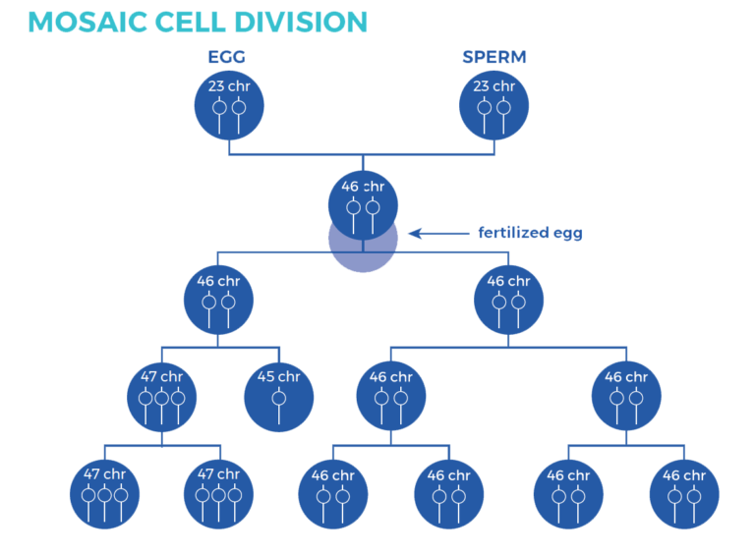

Slide 7
Mosaicism is the possession of multiple genetically different cell lines in a single person. Most chromosomal mosaicism involves the sex chromosomes and occurs because of defects in mitosis in an early embryo. Normally, chromosomes duplicate and separate equally in mitotic division. Mosaicism can occur when the chromosomes fail to separate (mitotic nondisjunction) or fail to migrate (anaphase lag). In general, the greater the proportion of abnormal cell lines, the more abnormal the phenotype. The earlier in embryonic development an abnormal cell is established, the higher the percentage of abnormal cells in that person.

Slide 8
Chromosomal mosaicism is the presence of two (or more) cell lines with different karyotypes, originating from a single zygote. The mosaic must be distinguished from the so-called chimera, which contains two cell lines with different karyotypes, but they come from two zygotes. In humans, we know the 46,XX/46,XY chimera, a very rare genetic associated with true hermaphroditism, probably most chimeras escape detection

Slide 9
The association between gametogenesis and mitosis after fertilization
It is well known that uniform aneuploidy, which is derived from meiotic chromosomal malsegregation, is critically dependent on maternal age. The current mainstream thinking believes that errors in maternal meiosis, especially the MI, are the main factors leading to aneuploidy ,while the paternal meiosis errors only account for 1% .The reason can be attributed to the following: there is a rigorous checkpoint in the process of male spermatogenesis, which can effectively avoid the development of abnormal chromosomes while in the process of oogenesis, such checkpoints are often lacking or not strict enough. Further, in the process of oogenesis, oocytes are stored in follicular pools since the fetal period and arrested in the prophase of meiosis I until ovulation occurs years later. During this long-term period, cohesion of sister chromatids is deteriorated with maternal age .Thus, oogenesis is more prone to errors than spermatogenesis.

Slide 10
autosome trisomies (trisomy 21, 13, 18) occur less often in mosaicis. trisomy 8 is also known , which occurs only in mosaic form in live births . Mosaic always arises postzygotic, i.e. nondisjunction during mitotic division or loss of a chromosome during division of a trisomic or normal zygote. The ratio of cell lineages then depends on which division the nondisjunction or loss of the chromosome occurred in and on how viable the abnormal cells are. E.g. postzygotic nondisjunction or loss of a chromosome affecting the autosomes would lead to the extinction of the monosomic line (monosomy of the autosomes is lethal even at the cellular level). Mosaicism resulting from the loss of one chromosome from a trisomic zygote results in a mosaic of normal and trisomic cell lines.

Slide 11
Non-disjunction
Non-disjunction is the failure of sister chromatids to separate during mitosis. Instead of separating, the entire chromosome (two chromatids) is pulled to one cell, creating a cell with a monosomy and another cell with a trisomy .
The degree of mosaicism(the percentage) depend on the time of non disjunction
Anaphase lagging
Anaphase lagging is the failure of a single chromatid to be incorporated into the nucleus resulting in a monosomy of that chromosome in one cell and a disomy in the corresponding chromosome in the other cell. Anaphase lagging occurs when the chromatid fails to attach to the spindle or when the chromatid attaches to the spindle but then fails to be incorporated in the nucleus. If this mechanism occurs prior to differentiation, then the organism will contain two distinct cell lines, thereby creating a general mosaic. If this event occurs after differentiation in the trophoblast, then the placenta will contain a normal and monosomic cell line, an example of CPM.
Endoreplication
Endoreplication is the replication of a chromosome without division. This results in a trisomic chromosome in one cell and a disomic chromosome in the other. Chromosome gain is believed to derive from two mechanisms, a cell cycle malfunction in which a chromosome is replicated without subsequent cytokinesis or when mitosis is initiated and shortly thereafter shutdown, resulting in a replicated chromosome. Regardless of the mechanism, the result is the same: the gain of a single chromosome (Fig. 2E). Another name for endoreplication is polyploidy. Polyploidy has been shown to exist in blood, gut, skin and brain .

Slide 12
Uniparental disomy
Non-disjunction, anaphase lagging and endoreplication lead to aneuploidy. However, there are mitotic events that lead to mosaicism, but still present a disomic cell line. Instead of chromosomes presenting in a gain or loss fashion, a phenomenon known as uniparental disomy (UPD) can occur. As UPD implies, there are two chromosomes present; however, instead of one maternal and paternal chromosome, there are two copies of either a maternal or paternal chromosomes. This may be the result of a trisomic rescue event after an error during meiosis (Fig. 2F). The most frequent chromosome that UPD occurs in is chromosome 15, where two paternal copies is referred to as Angelman syndrome or two maternal copies is known as Prader-Willi syndrome. Other chromosomes that can present with UPD are chromosomes 7, 11 and 16 (Kaluosek et al., 1992).
Abnormalities in spindles are also more prevalent in older women.
The centrosome is inherited from the sperm and is responsible for the first mitotic divisions within the human embryo The disruption of the sperm centrosome can produce mosaicism in the preimplantation embryo

Slide 13
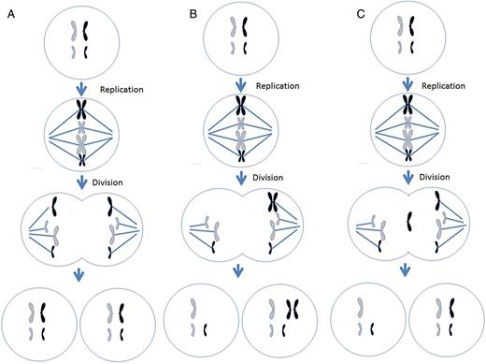
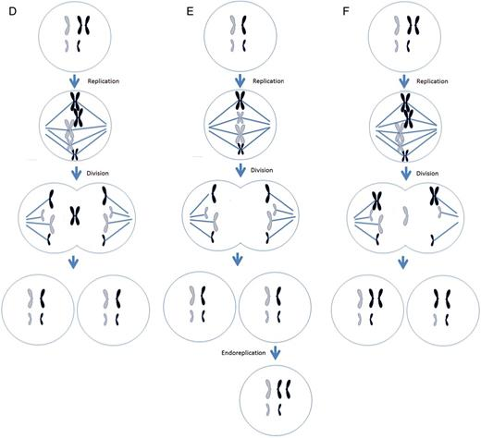
Different mechanisms leading to chromosome malsegregation in humans. For each figure, two different chromosomes are present, black chromosomes are paternal in origin and white are maternal in origin. (A) Proper segregation of chromosomes during mitosis. (B) A mitotic non-disjunction event in a paternal chromosome. (C) An anaphase lagging event involving a paternal chromosome. (D) A trisomy rescue event involving a paternal chromosome. (E) An endoreplication event involving a paternal chromosome. (F) A trisomy rescue event with uniparental disomy in the paternal chromosomes.

Slide 14
Mosaicism limited to the placenta
Mosaicism may be limited to the placenta . The literature reports that a relatively high percentage (1-2%) of first-trimester embryos are mosaics of trisomic and disomic (normal) lines, which was found when examining chorionic villus cells. Because mosaicism is not confirmed in most fetuses, such mosaicism is called confined placental mosaicism ( CPM =confined placental mosaicism). However, some of these fetuses or neonates may show uniparental disomy.

Slide 15
Pseudomosaicism
During prenatal cytogenetic examination we can encounter so-called pseudomosaicism. Unlike true mosaicism, which is actually present in the cells of an individual, pseudomosaicism arises when cells are cultivated in tissue culture.

Slide 16
Lyonization
Inactivation of the X chromosome or lyonization occurs in the early stages of development (approximately at the stage of an embryo consisting of 100-200 cells) if the karyotype contains more than one X chromosome (most often in the case of a normal female karyotype 46,XX; however, it also occurs in male individuals sex with Klinefelter syndrome - karyotype 47,XXY and in other pathological karyotypes with more than one X chromosome so that in the final state there is only one active X chromosome in the cell). Inactivation of the X chromosome is random in each cell of the embryo , but also permanent, because all other cells arising from the division of this cell will already have the same inactivated chromosome, whether of maternal or paternal origin. The inactivated X chromosome in this way represents a deposit of highly condensed chromatin, visible as the so-called Barr body or sex chromatin. Individuals with monosomy 45,X, as well as 46,XY males, do not have a Barr body. The inactivation process is controlled by a regulatory region known as the X-inactivation center (XIC). In this region there is, among other things, the gene for non-coding RNA XIST ( X inactive specific transcript (non-protein coding) ; Xq13.2; and several of its regulators including the TSIX gene ( TSIX transcript, XIST antisense RNA ; Xq13.2; .It is the RNA product of the XIST gene that induces changes in the conformation of the X chromosome, which ultimately lead to its inactivation.
Genes stored in the pseudoautosomal region of the X chromosome are not inactivated.
The inactivation of the X chromosome is also called the Lyonization process in honor of the British geneticist Mary Frances Lyon (1925-2014), who first described this process in 1961.

Slide 17


