Slide 1

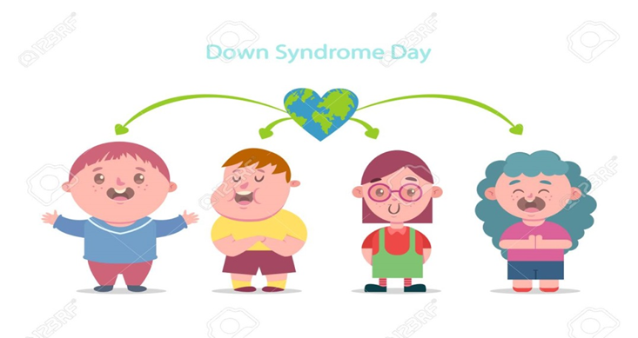
Lecturer Asmaa A. Almukhtar ,Phd.
2023
Medical genetics department
Iraqi center for cancer and medical genetic research

Slide 2
Normal Human karyotype
What is the Down syndrome Types?
Down syndrome karyotypes
Down syndrome frequency
Cases Referred for Karyotype Analysis to ICCMGR
What the advantage of genetic analysis for Down syndrome?

Slide 3
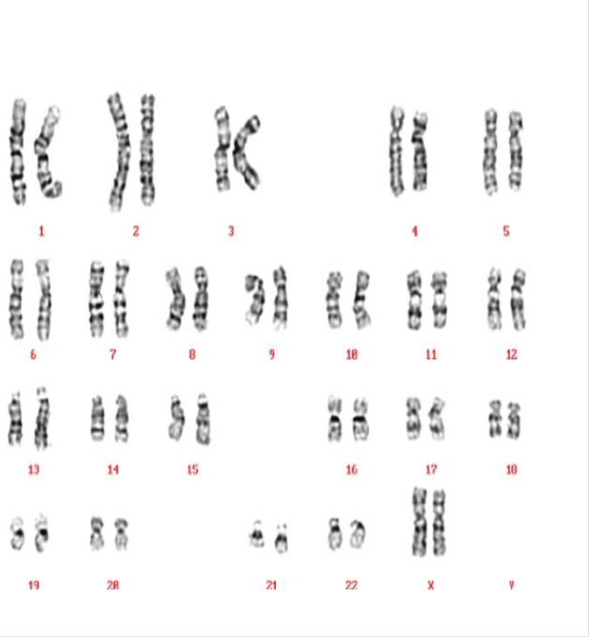
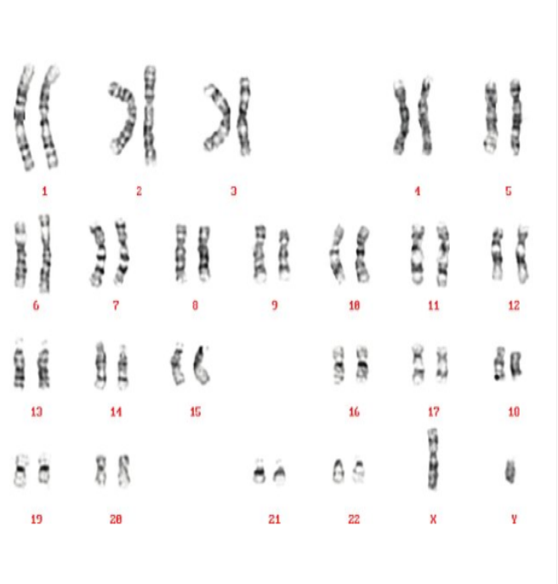
Normal female human karyotype
46,XX
Normal Male Human Karyotype
46,XY

Slide 4
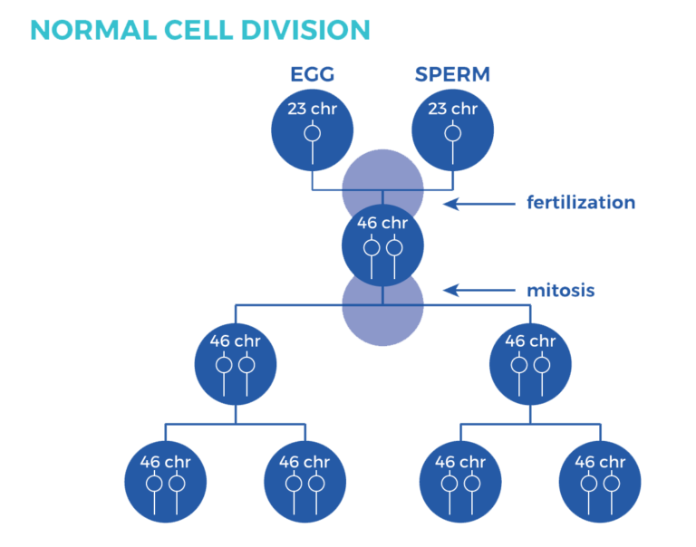

Slide 5
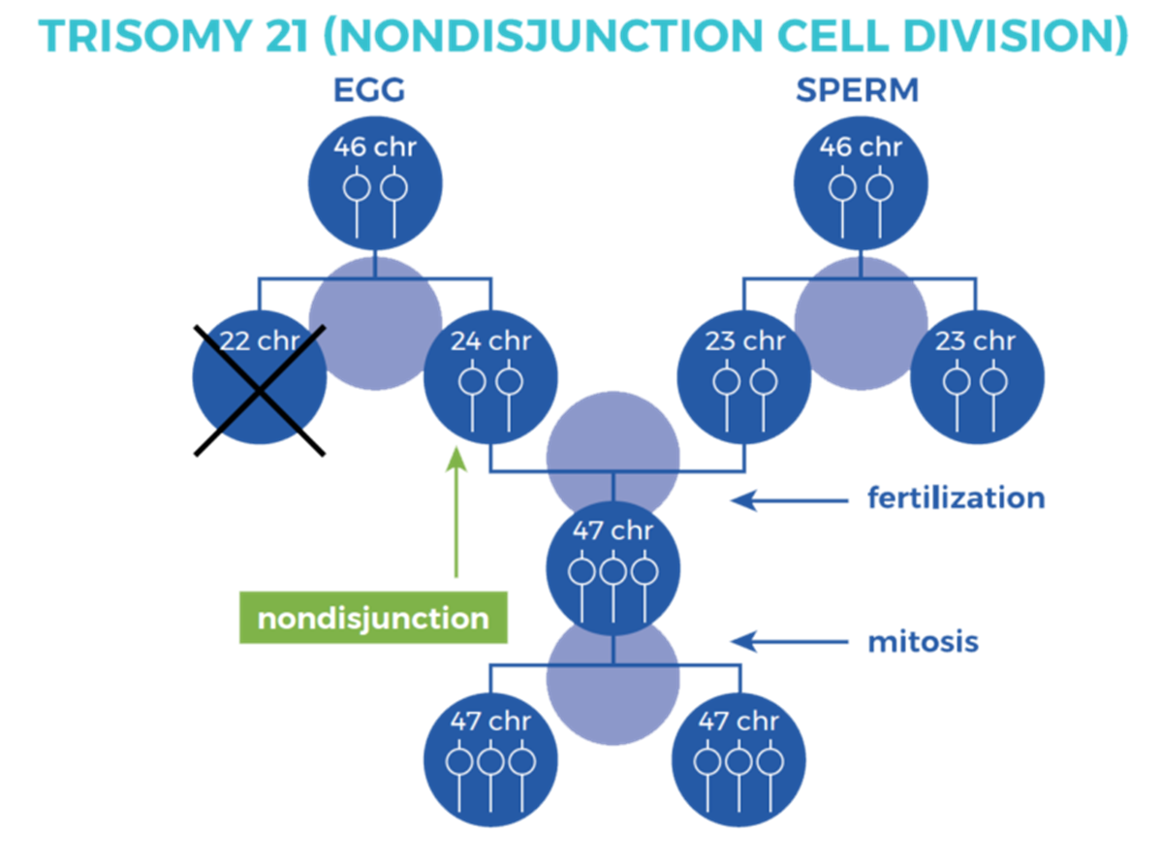

Slide 6
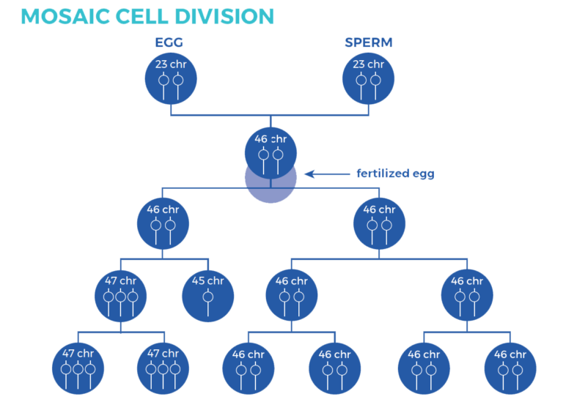

Slide 7
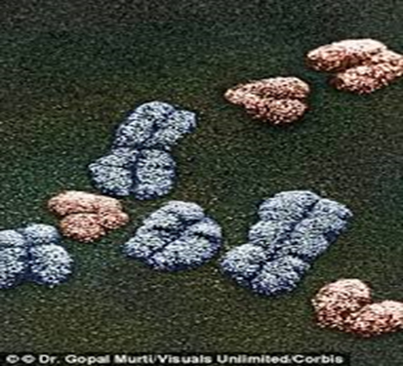
The Down syndrome (DS) is the well-known trisomy, which is caused by additional copy of chromosome 21.
Down syndrome types:
Trisomy DS 47,XX,+21or 47,XY,+21.
Mosaic DS :
47,XX,+21/46,XX,+21
47XY,+21/46,XY,+21.
DS translocation of (14,21) shown 46,XX,+21 t(14,21).
46,XY,+21 t(14,21).
Partial trisomy

Slide 8
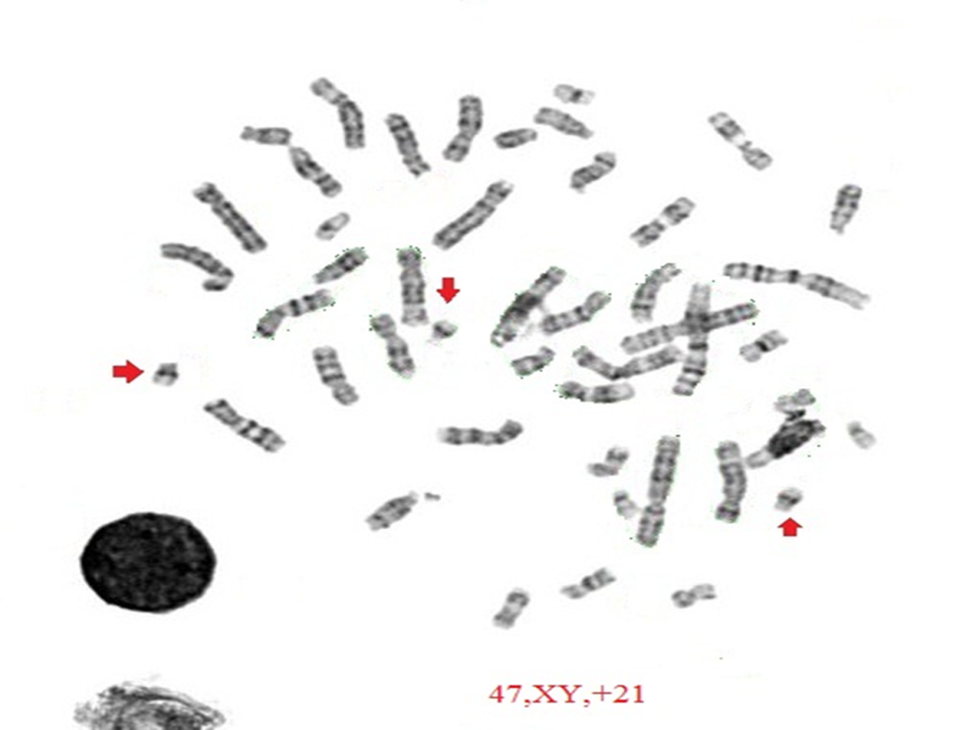
47,XY,+21

Slide 9
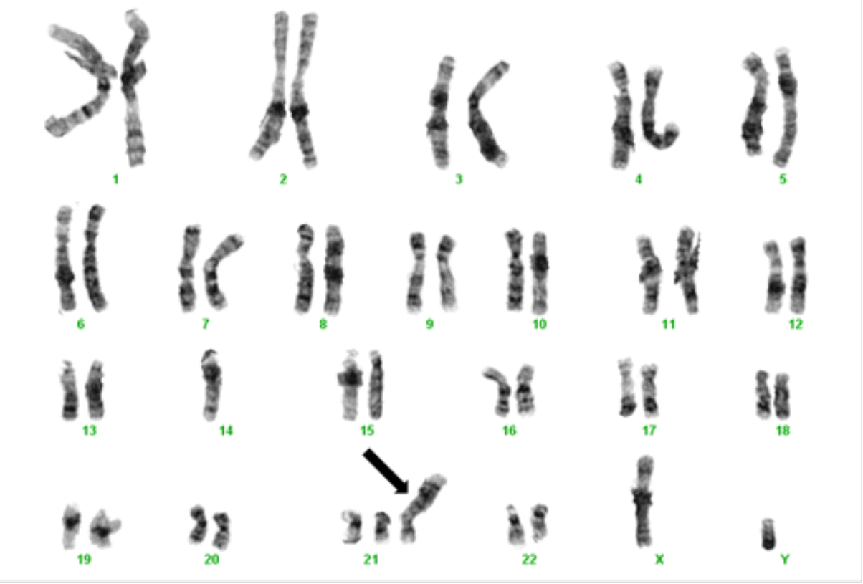
Down syndrome translocation 14,21
47,XY ,t(14,21

Slide 10
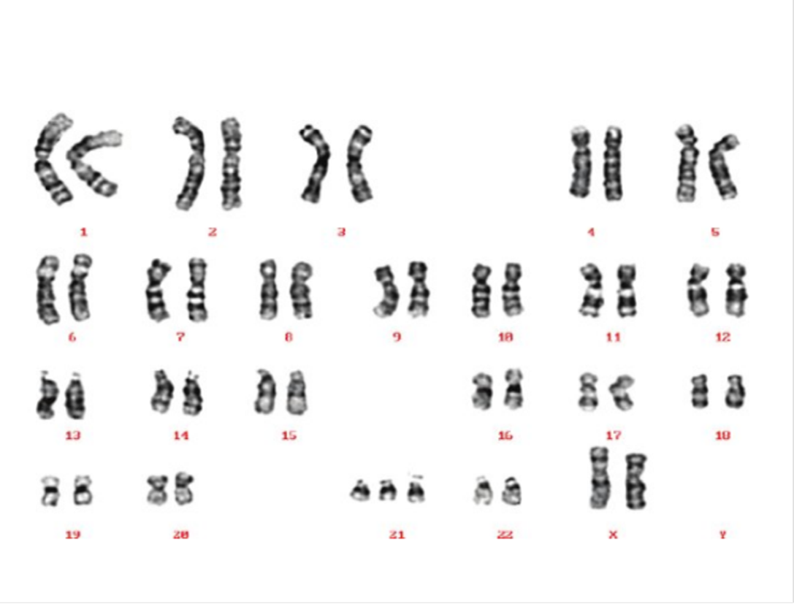
Down Syndrome: Trisomy Female Karyotype
47,XX,+21

Slide 11
Down syndrome occurs 1:800
DS incidence 95%.
Translocation between chromosome 14 and chromosome 21. 46,XY,t (14,21):4%.
Mosaic DS :1%.
(Mosaism refers to the presence of genetically distinct groups of cells within somatic and germ line tissues).
Trisomy

Slide 12
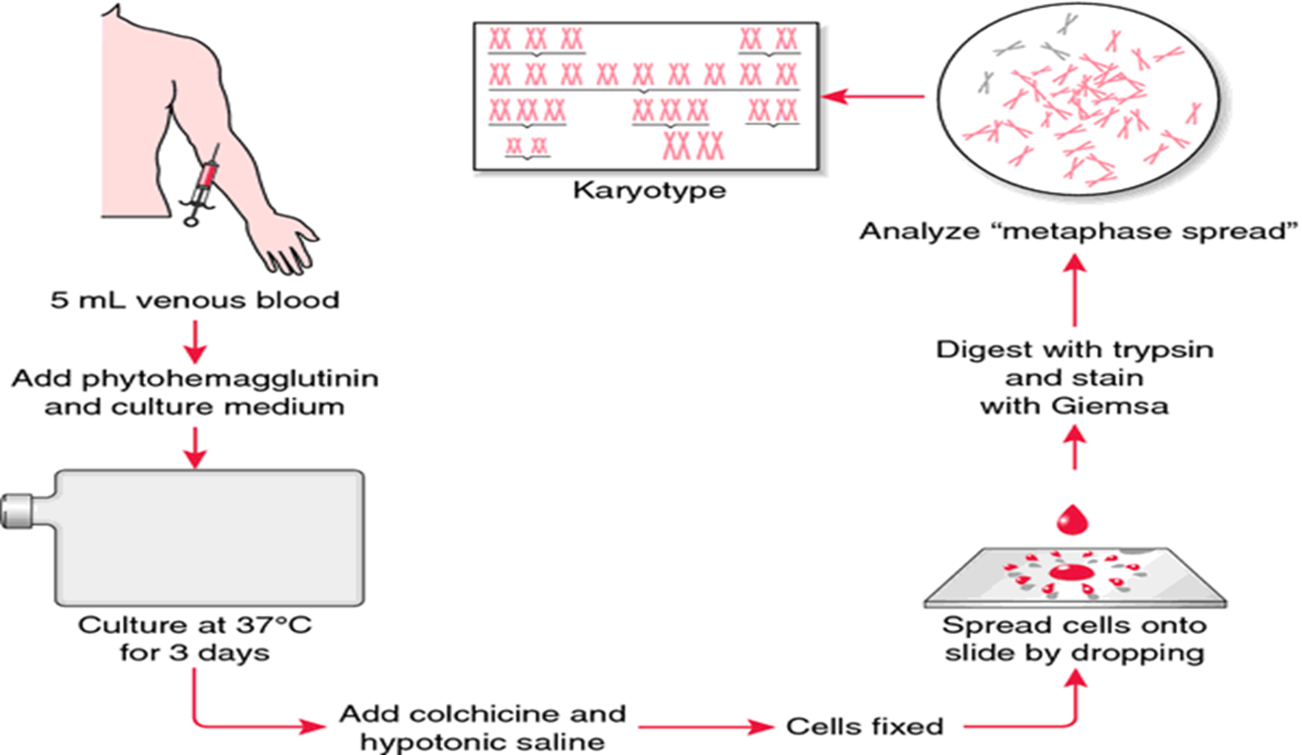

Slide 13
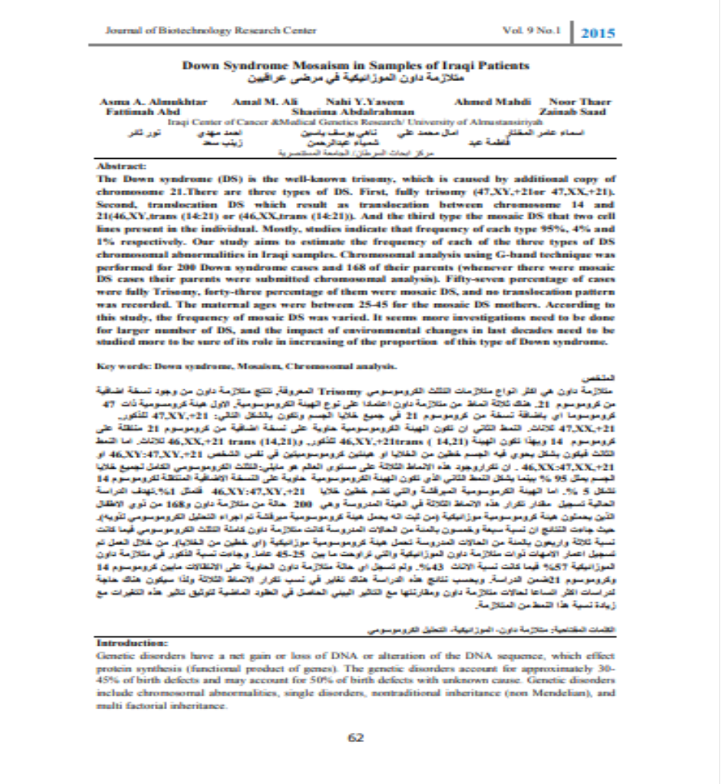


Slide 15

According to this study, the frequency of mosaic DS was varied from expected. It seems that more investigations need to be done for larger number of DS, and the impact of environmental changes in last decades need to be studied more to be sure of its role among local of the proportion of this type of Down syndrome.

Slide 17

Thank you

