Slide 1

Unlocking the Secrets of Chromosomal Analysis Reports
Asmaa A. Almukhtar .PHD
Lecturer
Medical Genetic Department
ICCMGR
2023

Slide 2
Introduction to Chromosomal Analysis
Reading &Writing a Chromosomal Analysis Report
How to write the chromosomal analysis report?
The symbols and abbreviates
The order for writing the diagnostic chromosomes
Interpreting the Results of a Chromosomal Analysis
Conclusion

Slide 3
Introduction to Chromosomal Analysis
Chromosomal analysis is a process of examining the chromosomes of a cell for any abnormalities. It is used to diagnose and monitor genetic disorders re-abortions, birth defects, and chromosomal abnormalities. It is also used to detect chromosomal changes associated with cancer and other genetic diseases. Chromosomal analysis is a powerful tool can be used to determine the sex of a fetus and to identify any chromosomal abnormalities in a fetus.
Additionally, it Chromosomal analysis can also be used to detect genetic mutations, which can help identify individuals at risk for certain diseases.
The process of chromosomal analysis involves taking a sample of cells from an individual, such as a blood or skin sample, and examining them under a microscope.
The cells are then stained G-banding using trypsin and Giemsa stain to make the chromosomes visible. The chromosomes are then analyzed to identify any abnormalities.

Slide 4
Reading &Writing a Chromosomal Analysis Report
Writing a chromosomal analysis report is a complex process that requires a great deal of knowledge and experience. The report should include a summary of the findings, a description of the sample, and a list of any abnormalities that were found. It is important to use clear and concise language when writing the report, and to provide as much detail as possible.
It is also important to include any relevant medical information, such as family history or other medical conditions, as this can help provide additional context for the results of the analysis. Finally, it is important to consult with a medical professional if there are any questions or concerns about the results of the analysis.

Slide 5
Interpreting the Results of a Chromosomal Analysis
Interpreting the results of a chromosomal analysis can be difficult, as the results can be complex and difficult to understand. It is important to read the report carefully and make sure all the information is correct. The report should include a description of the sample, the results of the analysis, and any abnormalities that were found.
It is important to understand the terminology used in the report, as this can help make the process of interpreting the results easier.

Slide 6
How to read karyotype?
Metaphases with solid chromosomes
Metaphases were treated with Trypsin and Giemsa Stain for Banding
Structural Abnormalities
Numerical Abnormalities

Slide 7
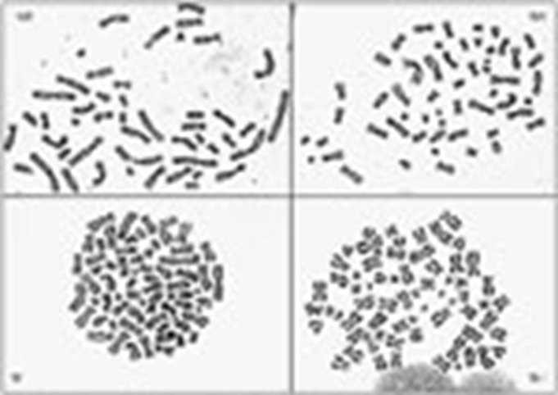
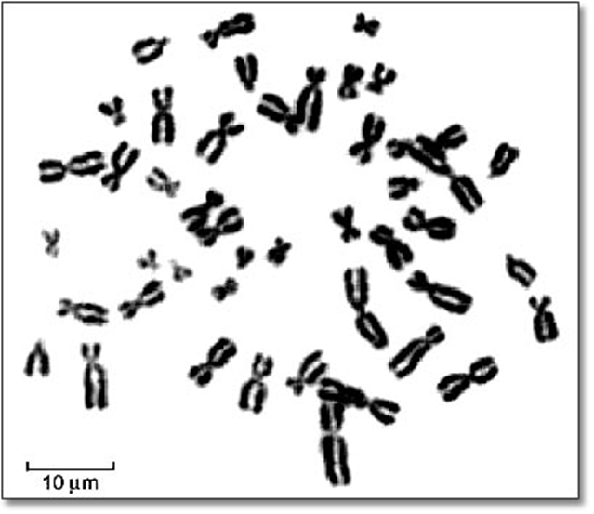
Metaphases with solid chromosomes

Slide 8

Metaphases were treated with Trypsin and Giemsa Stain for Banding

Slide 9
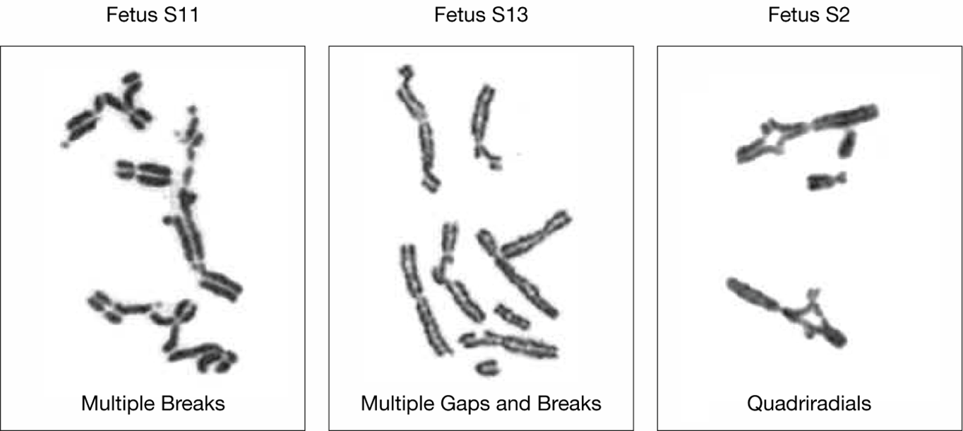
Structural Abnormalities

Slide 10
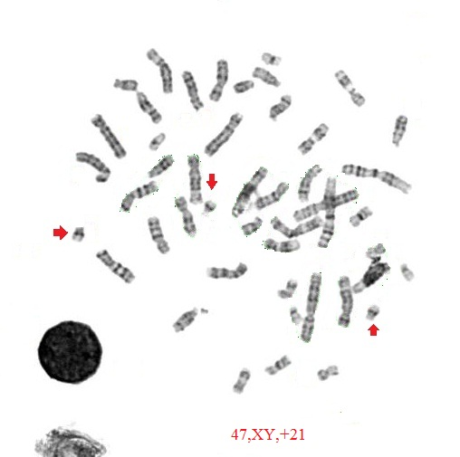
Numerical Abnormalities

Slide 11




How read karyotype?
Reading or Writing a chromosomal analysis report can be challenging, as the terminology and formatting can be confusing. However, understanding the basic structure of the report can help make the process easier. ISCN is the perfect guide for such mission.

Slide 12
Symbols and abbreviated terms
add = additional material of unknown origin.
Chtb= chromatid break.
del = deletion.
dmin = double minute.
der = derivative.
dup = duplication.
i = isochromosome.
inv = inversion.
ins = insertion.
PCD= premature centromere division.
t = translocation.
mar = marker chromosome of unknown origin.
*when there are more than defect at the same chromosome then write the defect according alphabetical order within the complex karyotype

Slide 13
Order of writing formula
Ploidy numerical abnormalities are listed before structure changes and determine if they near haploid, diploid ,tetraploid…
Sex chromosome are specified (X chromosome is presented before Y chromosome…so there abnormalities.
Arrange numerical abnormalities according order for chromosome, while arrange of structural abnormalities according their alphabetical order according to their aberatived term of abnormalities.
Normal female 2n= 46,XX.
Normal male 2n=46,XY.

Slide 14
Ploidy level ,sex chromosome,(+) or (-) before a chromosome is indicate to gain or loss of particular chromosome
e.g 26,X,+4,+6,+21
A near haploid karyotype with 2 copies of chromosomes,4,6,21 and single copy of rest chromosomes.
e.g 71,XXX,+8,+10
A near triploid karyotype with four copies of chromosome 8, and four copies of chromosome 10 and three copies of rest chromosomes.

Slide 15

Quiz: 48,XX,+X,+14…..?

Slide 16
What are the normal chromosomes vs chromosomal changes?
The variable features of normal chromosomes
Complex karyotype.

Slide 17

Normal karyotype and normal variable chromosome features.
Karyotype with one or two changes.
Karyotype with more than two changes.
Complex karyotype.

Slide 18
Normal karyotype and normal variable chromosome features.
Variation in Heterochromoatic segment ,Satellites Stalks and Satellites.
Heterochromatin(1,3,6,9,16,22,X,Y).
Satellites (13,14,15,21,22,Y)
16qh+ (increase in length of the heterochromatin on the long arm of chromosome 16).
21ps+( increase in length of satellite on the short arm of chromosome 21)
Yqh- (decrease in length of long arm of chromosome y).

Slide 19
Karyotype with one or two changes
69,XXX,del(7)(p11.2)
Two normal chromosomes 7 and one with a deletion of a short arm
45,XX,dic(13;15)(q22;q24)
A one dicentric chromosome replaces two normal chromosomes 13,15
46,XX,inv(3)(q21q26.2)
the karyotype should be written as 46,XX,-3,+inv(3)(q21q26.2)
An inversion in one copy of chromosome 3

Slide 20
Complex karyotype with more than two changes
46,XX,der(1)t(1;3)(p32;q21)t(1;11)(q25;q13).
45,XX,der(5,7)t(3;5)(q21;q22)t(3;7)(q29:p13).
Mosaic:
46,XX [20]+46,XX,del 6p[5].
Means 80% of cells were normal, while 20% of the cells with structural defect in short arm of chromosome 6.
47,XX,+21 [30]+46,XX [3].
Means 93% of cells gain additional copy of chromosome 21(Down syndrome),while 7% of the cells were normal.

Slide 21
Conclusion
Chromosomal analysis is a powerful tool that can be used to diagnose and monitor genetic disorders, birth defects, and chromosomal abnormalities. It is important to understand the process of reading and writing a chromosomal analysis report, as this can help make the process easier. Additionally, it is important to consult with a medical professional if there are any questions or concerns about the results of the analysis, and to consult with other professional who had experience and the right knowledge to detect the abnormalities in chromosomal analysis to be a powerful tool for understanding the genetic makeup of an individual.

Slide 22



