Slide 1
Polymorphism and Sequencing investigation of MTHFR gene in Polycystic Ovarian Syndrome Patients in Iraq
By :Lecturer Dr. Asmaa Amer Almukhtar
ICCMGR/Medical Genetics Department
October / 2021

Slide 2
Introduction
The polycystic ovarian syndrome is one of the diseases that affect women in reproductive age resulting in infertility and sub-infertility. Furthermore, it may continue with its complication beyond the reproductive age if there was a mismanagement. PCOS, the syndrome ,is the frequent endocrine disorder with anovulation , hyperandrogenism, polycystic ovary, metabolic disorders, endometrial dysplasia, non-insulin dependent diabetes mellitus (Type II), dyslipidemia , hypertension, still without certain known causes. However, it seems to be a multifactorial etiology in which different causes can be combined, including, environmental factors , life style the genetic factors .
One of the genetic factors that may have an effect in complicated PCOS is the MTHFR gene. The previous studies on the association of PCOS and MTHFR gave different opinions for MTHFR role in PCOS. They explained that the differences in gene polymorphism could be due to ethnic differences among their studies communities .

Slide 3
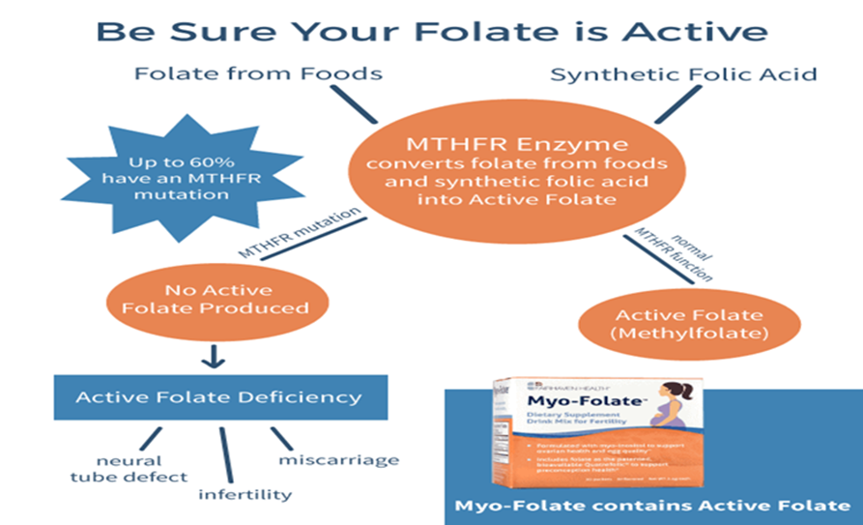
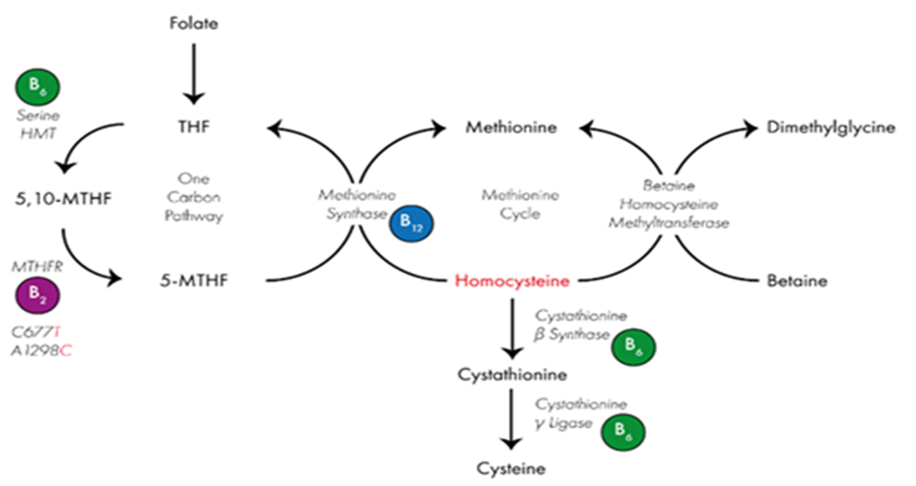
MTHFR gene
Methylenetetrahydrofolate reductase (MTHFR) gene produce one of key the enzymes involved in folate metabolism and it catalyzes the irreversible conversion of 5,10-methylenetetrahydrofolate to 5-methyltetrahydrofolate. The latter constitutes the major circulating form of folate, which acts as a methyl donor for the remethylation of homocysteine to methionine. Two common polymorphisms in the MTHFR gene,rs1801133 C677T (Ala222Val) )and rs1801131(A1298C (Glu429Ala)), have been shown to decrease the enzymatic activity resulting in elevated plasma homocysteine levels ,and these were subsequently were linked to many diseases.

Slide 4
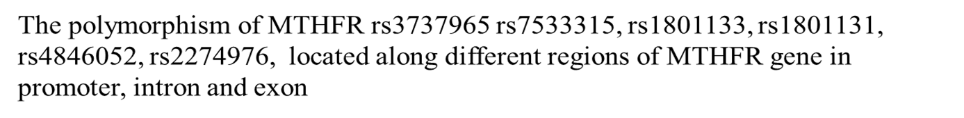

Slide 5
Aims of this study:
First of all, this study aims to investigate the genetic polymorphism of some regions in MTHFR gene in in Arab female patients with PCOS in Iraq compared to apparently healthy people. Then, examine the association among biochemical parameters ( including lipid profile and HbA1C), body mass index , Folate levels ,plasma Homocysteine levels with these genetic polymorphism. Therefore, the research procedures is as follows :
1. Detection of genetic polymorphism of MTHFR gene of promoter region and Exon 8 by PCR amplification and DNA sequencing .
2. Detection of genetic polymorphism of MTHFR gene of exon 5, exon12 and intron 3 by PCR amplification and RFLIP.
3. Evaluation of plasma Folate, Homocysteine level by ELISA.
4. The biochemical and clinical parameters examined are lipid profile, HbA1C and BMI.

Slide 6
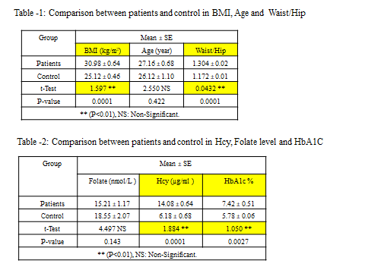
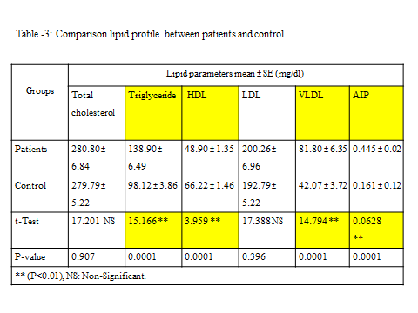
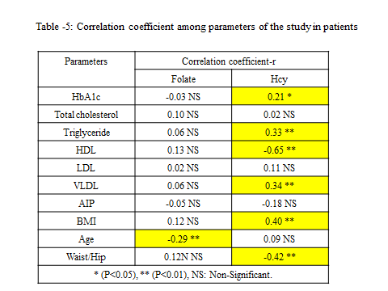
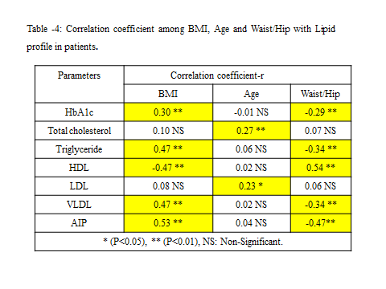

Slide 7
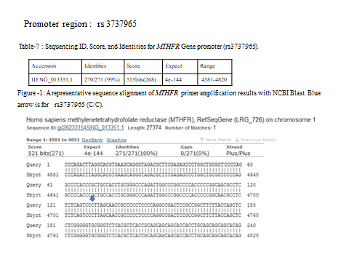
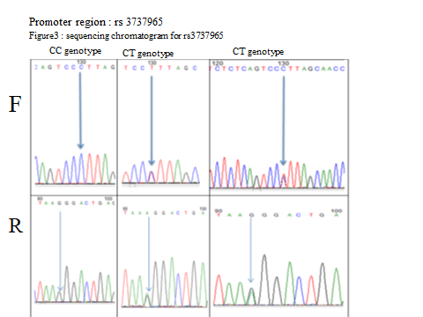
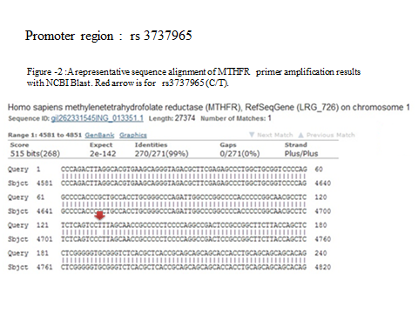

Slide 8
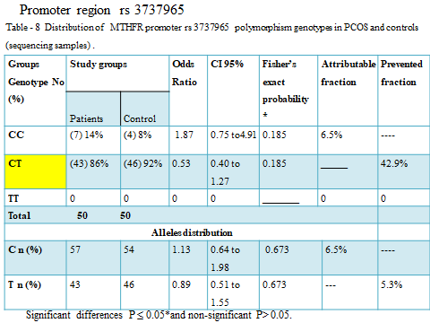
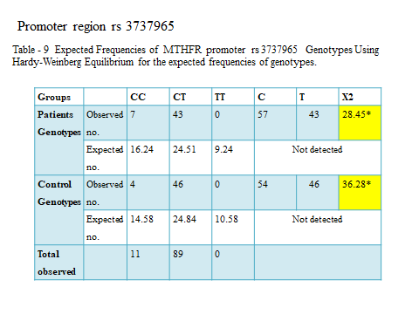

Slide 9
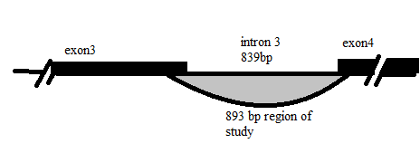
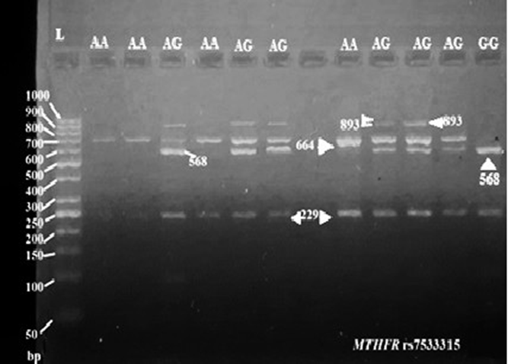
Intron3 region: rs 7533315
Figure -4 shown the segment undergo the study cover the whole region of intron 3.
Figure -5: PCR Product of the of the MTHFR rs7533315 ,the size 893bp. After digestion with PeaI/ Sph-Hi Restriction Enzyme the results were three bands: 96+229+568 bp as GG genotype; five bands: 96+229+568+664+893bp as AG genotype ; Two bands: 229+664bp as AAgenotype, 2% Agarose Gel Electrophoresis, for 2hrs, 70volts/cm. DNA ladder (50).

Slide 10
Intron3 region: rs 7533315
Table -12 Distribution of MTHFR Intron3 rs 7533315 polymorphism genotypes in PCOS and controls (RFLP samples)
Groups Genotype | Study groups Patients Control |  | Odds Ratio | CI 95% | Fisher’s exact probability * | Attributable fraction | prevented fraction
AA | (1) 2% | (3) 6% | 0.32 | 0.04 to 1.56 | 0.172 | ---- | 68.0%
AG | (48)96% | (46)92% | 2.09 | 0.61 to 8.16 | 0.253 | 52.1% | ___
GG | (1) 2% | (1) 2% | 1.00 | 0.10 to 9.76 | 0.621 | protective factor is the same in groups Patients and Control
Total 50 50
Alleles distribution
A | 0.50 | 0.47 | 1.13 | 0.65 to 1.97 | 0.674 | 11.3% | ----
G | 0.50 | 0.43 | 1.33 | 0.76 to 2.32 | 0.326 | 24.6% | --

Slide 11
rs 7533315
Table - 13: Expected Frequencies of MTHFR Intron3 rs 7533315 Genotypes Using Hardy-Weinberg Equilibrium.
Groups |  | AA | AG | GG | A | G | X2
Patients Genotypes | Observed no. | 1 | 48 | 1 | 50 | 50 | 42.32*
 | Expected no. | 12.5
25 | 12.5 | Not detected
Control Genotypes | Observed no. | 3 | 46 | 1 | 54 | 46 | 35.53*
 | Expected no. | 13.52 | 24.96 | 11.52 | Not detected
Total observed |  | 4 | 94 | 2
Significant differences (X² ˃3.84) between observed and expected frequencies for both patients and control group

Slide 12
rs 7533315
F
Figure -6 :with red arrow point to AA normal homozygote rs7533315 that locate in the genomic location 10478 and chromosomal location1:11800626,while in Figure -31 the red arrow point to the mutant heterozygote of rs 7533315AG,Figure -32 the red arrow point to GG mutant homozygote of rs 7533315

Slide 13
rs 7533315
Figure -7:Representative sequence alignment of MTHFR gene of intron3 compared with standard MTHFR gene intron3, obtained from Gene Bank. “Query” represents samples from this study; “Sbject” is a reference sequence from the National Center Biotechnology Information (NCBI). Red arrow to the rs 7533315 which located at genomic location 10478, chromosomal location 1: 11800626 . Black arrows refer to other substitutions . black arrows point to rs 17037390,rs 35464336 and rs13306567 respectively.

Slide 14
Intron3 region rs 7533315
Figure -8 Representative sequence alignment of MTHFR gene of intron3 compared with standard MTHFR gene intron3, obtained from Gene Bank. “Query” represents samples from this study; “Sbject” is a reference sequence from the National Center Biotechnology Information (NCBI).; red arrow refers to the rs 7533315 which located at genomic location 10478, chromosomal location 1: 11800626 . Black arrows refer to other substitutions in rs 17037390, rs 35464336 and rs 13306567. Another variation was inversion of segment 10783-10786.

Slide 15
rs 7533315
Figure -9 Representative sequence alignment of MTHFR gene of intron3 compared with standard MTHFR gene intron3, obtained from Gene Bank. “Query” represents samples from this study; “Sbject” is a reference sequence from the National Center Biotechnology Information (NCBI). Red arrow refers the rs 7533315 which located at genomic location 10478, chromosomal location 1: 11800626. Black arrows refer to other substitutions in rs 17037390,rs 35464336 and rs 2066471.

Slide 16
rs 7533315
Figure -10 :Representative sequence alignment of MTHFR gene of intron3 compared with standard MTHFR gene intron3, obtained from Gene Bank. “Query” represents samples from this study; “Sbject” is a reference sequence from the National Center Biotechnology Information (NCBI). red arrow refers to the rs 7533315 which located at genomic location 10478, chromosomal location 1: 11800626. Blue arrows refer to insertion which leads to frame shift. Black arrow refer to substitution G˃T at g:10739

Slide 17
Intron region rs7533315
Table -14:Study parameters level according to genotyping of rs7533315 in PCOS patients.
Parameters | Mean ± SE |  |  | LSD value
 | AA(1) | AG(48) | GG(1)
Folate (nmol/L ) | --- | 14.59 ± 1.17 | 16.00 ± 0.00 | 16.73 NS
Hcy (µg/ml ) | 10.00 ± 0.00 | 14.31 ± 0.64 | 11.00 ± 0.00 | 10.74 NS
HbA1c % | 5.20 ± 0.00 | 7.41 ± 0.51 | 5.80 ± 0.00 | 8.526 NS
Total cholesterol (mg/dl) | 332.00 ± 0.00 | 280.86 ± 6.87 | 259.00 ± 0.00 | 116.28 NS
Triglyceride (mg/dl) | 108.00 ± 0.00 b | 136 .96 ± 6.20 b | 245.00 ± 0.00 a | 101.92 *
HDL (mg/dl) | 48.00 ± 0.00 | 48.70 ± 1.37 | 45.00 ± 0.00 | 23.25 NS
LDL (mg/dl) | 262.00 ± 0.00 | 200.90 ± 6.95 | 165.00 ± 0.00 | 117.89 NS
VLDL (mg/dl) | 42.00 ± 0.00 b | 79.87 ± 5.96 b | 193.00 ± 0.00 a | 99.59 *
AIP | 0.152 ± 0.14 b | 0.309 ± 0.02 ab | 0.445 ± 0.28 a | 0.252 *
BMI (kg/m²) | 33.94 ± 0.00 | 30.82 ± 0.62 | 39.91 ± 0.00 | 10.74 NS
Waist/Hip | 1.125 ± 0.00 | 1.171 ± 0.01 | 1.191 ± 0.00 | 1.485 NS
* (P<0.05, NS: Non-Significant. Means having with the different letters in same row differed significantly.

Slide 18
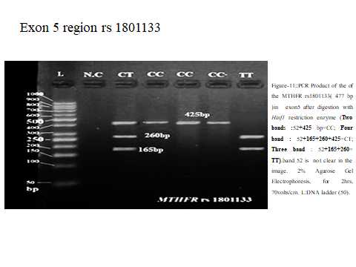
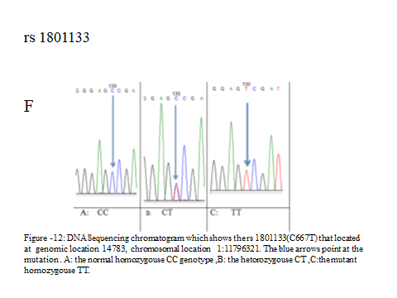
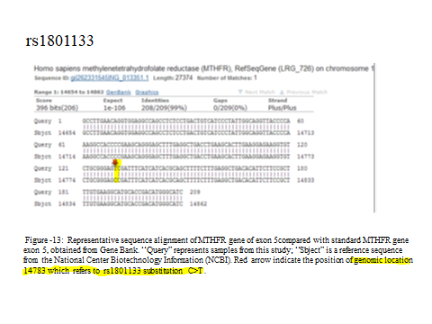

Slide 19
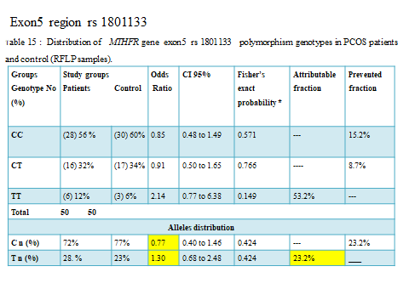
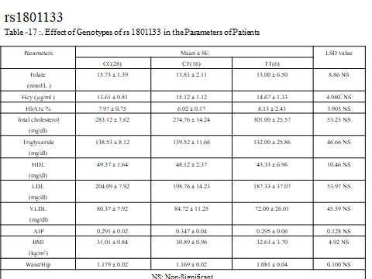
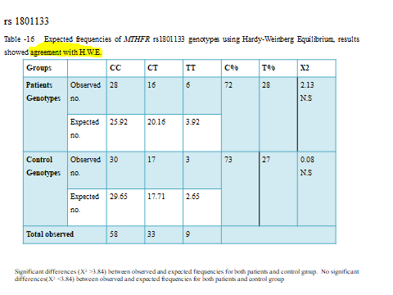

Slide 20
Exon8 region rs 1801131
18
18
19

Slide 21
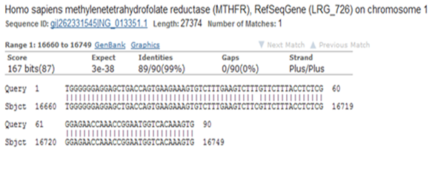
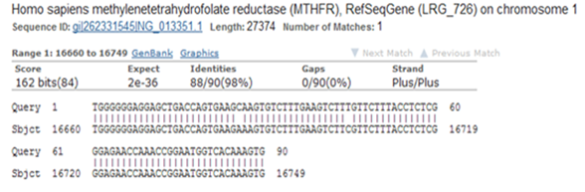
Exon 8 region rs 1801131 and rs4846051
Figure -14 representative sequence alignment of MTHFR gene of exon 8 compared with standard MTHFR gene exon 8, obtained from Gene Bank. “Query” represents samples from this study; “Sbject” is a reference sequence from the National Center Biotechnology Information (NCBI). Blue arrow indicate the position of g:16685 which refers to rs1801131 AA genotype .red arrow indicates the position of g:16704 refers to rs4846051 C>T.
Figure -15 representative sequence alignment of MTHFR gene of exon 8 compared with standard MTHFR gene exon 8, obtained from Gene Bank. “Query” represents samples from this study; “Sbject” is a reference sequence from the National Center Biotechnology Information (NCBI). Red arrows indicate the position of g:16685 which refers to rs1801131 A>C and g:16704 refers to rs4846051 C>T.

Slide 22
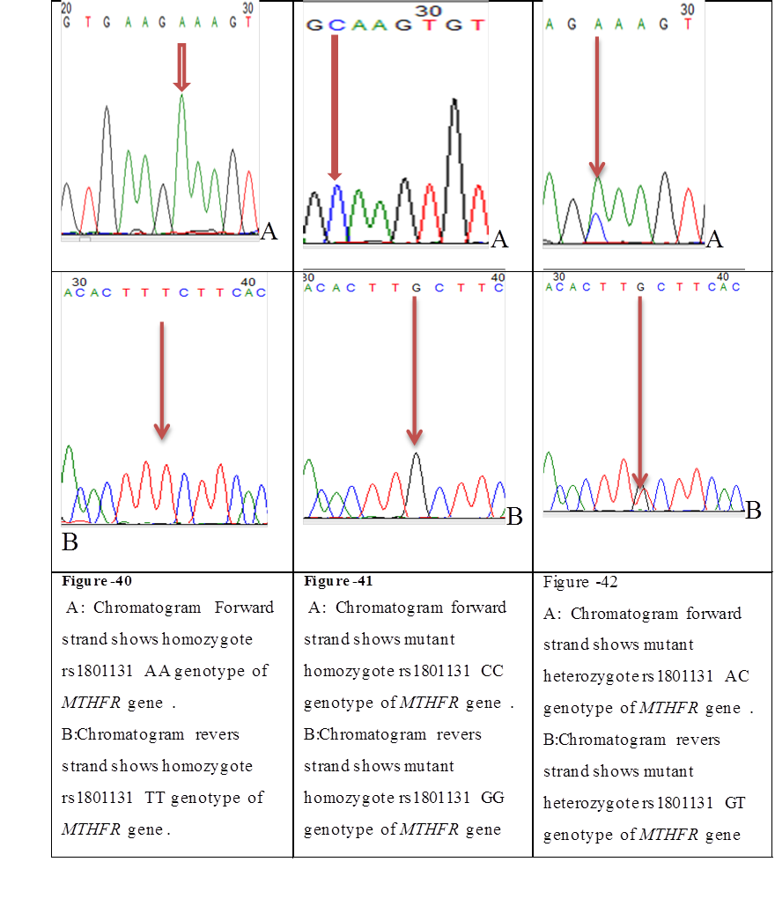
Exon8 region rs1801131
Figure17:represent genotype investigated by chromatogram
AA genotype
CC genotype
AC genotype
F
R

Slide 23
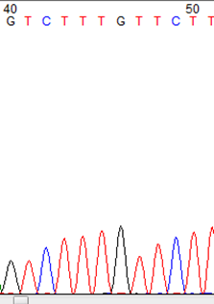
Exon 8 region rs 4846051
TT genotype
Figure -18: Chromatogram shows homozygote rs486051 TT genotype of MTHFR gene located at the genomic location 16704 in the chromosomal location 1 : 11794400 pointed by blue arrow.
F

Slide 24
Exon 8 region rs1801131
Table - 20 Distribution of MTHFR exon 8 rs 1801131 polymorphism genotypes in PCOS and controls (sequencing samples).
Highly significant differences P ≤ 0.01**and non-significant P˃ 0.01.

Slide 25
Table -21 : Expected Frequencies of MTHFR rs1801131 Genotypes Using Hardy-Weinberg Equilibrium for the expected frequencies of genotypes, results showed departure from H.W.E

Slide 26
Table -22 Effect of Genotype of rs1801131 in the Parameters of Patients.
Parameters | Mean ± SE |  |  | LSD value
 | AA(12) | AC(36) | CC(2)
Folate (nmol/L ) | 15.50 ± 1.83 | 15.12 ± 1.51 | 7.50 ± 0.50 | 10.43 NS
Hcy (µg/ml ) | 14.47 ± 1.31 | 13.96 ± 0.73 | 14.67 ± 2.40 | 4.941 NS
HbA1c % | 7.91 ± 0.81 | 7.13 ± 0.68 | 6.50 ± 1.06 | 3.916 NS
Total cholesterol (mg/dl) | 267.68 ± 11.63 | 287.06 ± 8.31 | 292.67 ± 26.98 | 53.40 NS
Triglyceride (mg/dl) | 124.37 ± 10.16 | 146.54 ± 8.15 | 125.00 ± 30.92 | 46.81 NS
HDL (mg/dl) | 50.56 ± 2.56 | 47.63 ± 1.63 | 49.00 ± 4.35 | 10.68 NS
LDL (mg/dl) | 187.87 ± 10.43 | 206.24 ± 9.14 | 220.00 ±26.15 | 54.14 NS
VLDL (mg/dl) | 72.25 ± 9.68 | 87.04 ± 8.18 | 66.67 ± 28.75 | 45.74 NS
AIP | 0.215 ± 0.02 b | 0.442 ± 0.03 a | 0.380 ± 0.14 ab | 0.178 *
BMI (kg/m²) | 31.27 ± 1.08 | 30.89 ± 0.83 | 31.74 ± 1.74 | 4.934 NS
Waist/Hip | 1.160 ± 0.02 | 1.167 ± 0.01 | 1.258 ± 0.09 | 0.101 NS
* (P<0.05), NS: Non-Significant. Means having with the different letters in same row differed significantly.

Slide 27
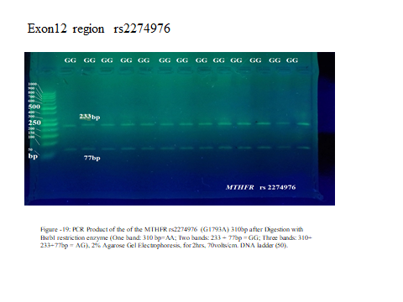
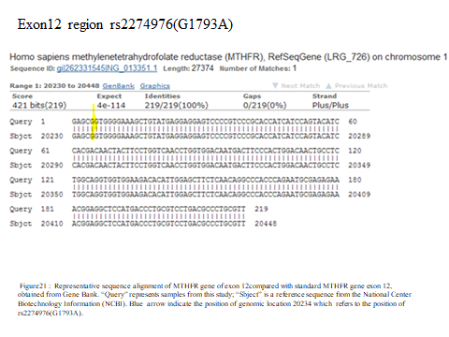
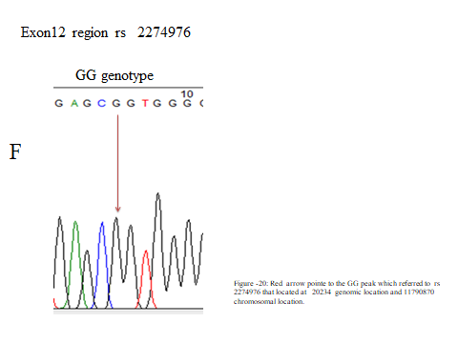

Slide 28
Conclusions:
1 . The CT genotype of rs 3737965 is the common genotype in population of study .The allele C is etiological factor associated with the disease while allele T is the protective agent. CT genotype has a significant effect in decreasing levels of HbA1c .
2.The AG is the common genotype in population of study at rs7533315 polymorphism, rs 7533315 has significant effect with the disease and the metabolism of TG and VLDL and AIP. This SNP may have a role in development of CVD in PCOS.
3. Rs 1801133 shows , that C allele has protective effect, while T allele has etiological positive association for disease .
4. Both AC genotype and C allele show at rs1801131 highly significant positive association with disease.

Slide 29
AC genotype show at rs1801131 and AG genotype at rs7533315 could be biomarker for predicted CVD produced from PCOS.
The investigation for rs1801131 polymorphism is required for people with recurrent miscarriage to avoid toxic effect of folic acid as treatment , thus we recommend the physicians to give 5-methyltetrahydrofolate ( levomefolic acid) instead folic acid to avoid homocysteine accumulation

Slide 30
