Slide 1
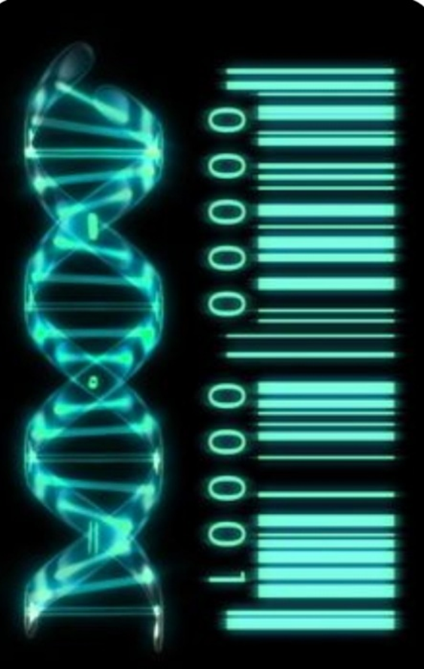
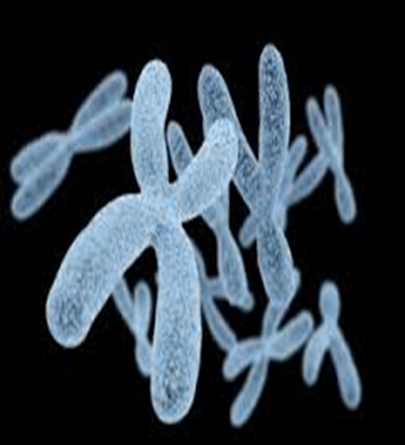
Introduction into Cytogenetic
Asmaa A. Almukhtar .PHD
Lecturer
Medical Genetic Department
ICCMGR
2021
A

Slide 2
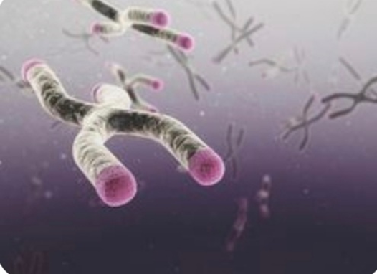
Cytogenetics
The study of genetic material state on cellular level rather than molecular ,and during any step of mitosis.

Slide 3
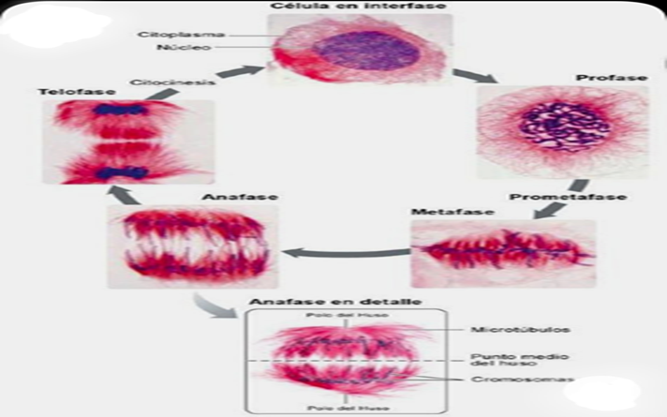
Blastogenic index
Mitotic index
Chromosomal Aberrations and banding
Sister chromatid exchange(SCE)
Replicative index
Micronuclei ( MN )
in situ hybridization

Slide 4
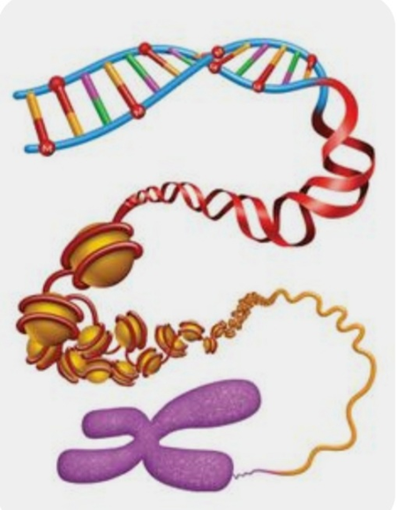
What are chromosomes?
The DNA in an individual chromosome is one, long molecule which is highly coiled and condensed.
Chromosomes are the cellular structures that carry genes
Chromosomes are distinct dense bodies found in
the nucleus of cells , composed of protein and DNA.

Slide 5
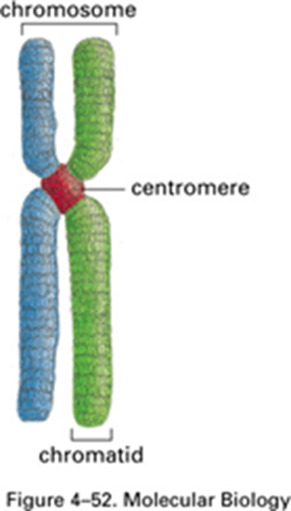
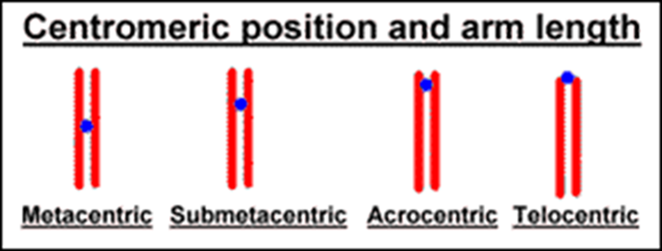
Each chromosome is visualized as two chromatids that are joined at a central constriction called the centromere.
The centromere divides the chromosomes into two arms: a short arm (P) and a long arm (q)
Position of centromere metacentric, acrocentric, sub-metacentric and telocentric.

Slide 6
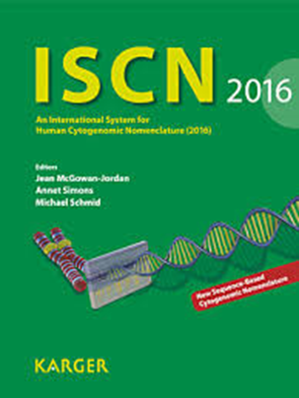
Human Chromosome Nomenclature
ISCN (2016)
International System for Human Cytogenetic Nomenclature; most recent edition pub. 2016
Provides standardized “grammatical” rules for the designation of cytogenetic findings
The nomenclature depend on size of chromosome, centromere position and the specific bands.
There are 46chromosomes
23pairs, 22 pairs are autosomes and one sex pair.

Slide 7
Group A(1-3)
Group B (4-5)
Group C(6-12,X)
Group D (13-15)
Group E (16-18)
Group F (19-20)
Group G (21-22,Y)

Slide 8
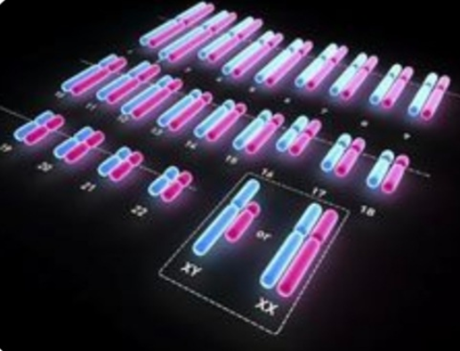
23 pairs of chromosomes, each pair from one of parents

Slide 10
The chromosomal preparation protocol

Slide 11
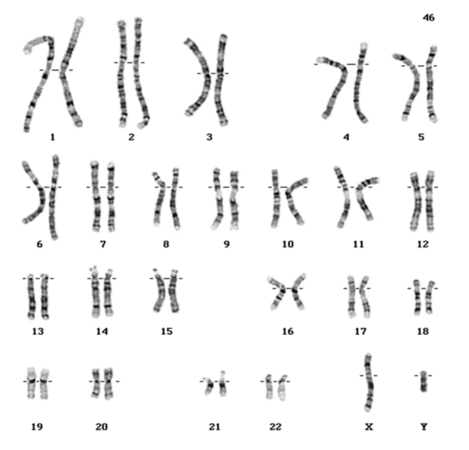
Metaphase spread and karyotype

Slide 13
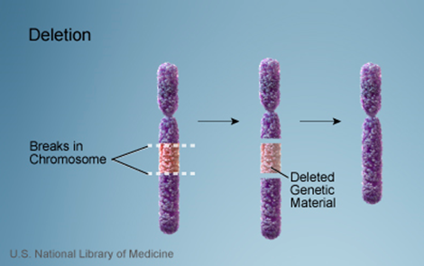
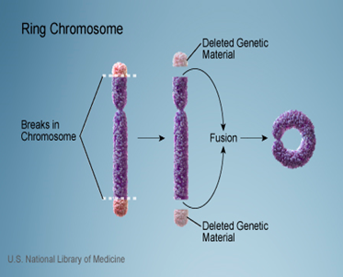
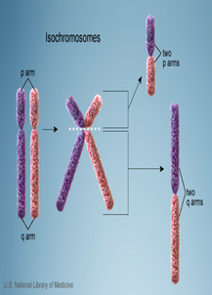
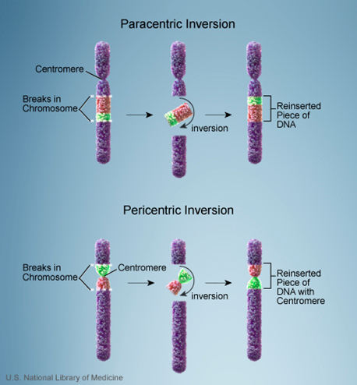
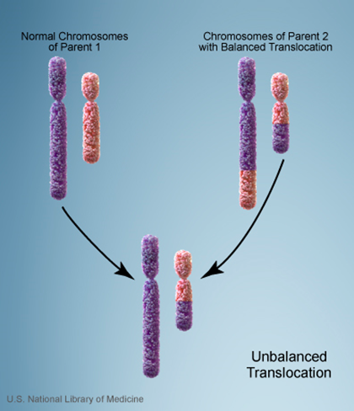
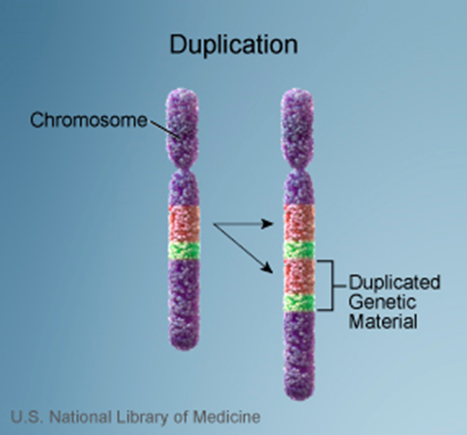
Chromosomal changes could be either numerical , structural or both of them

Slide 14
Numerical and structural changes at the same cell

Slide 15
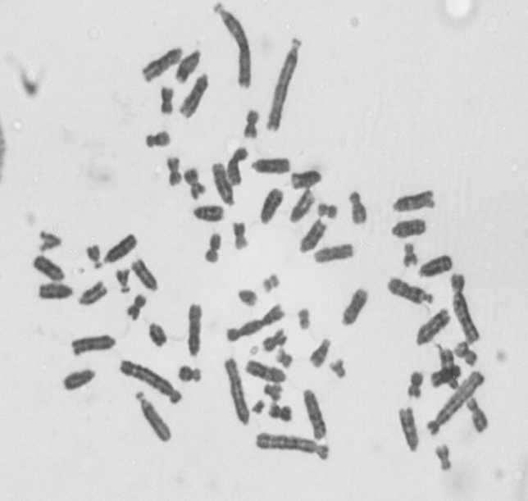
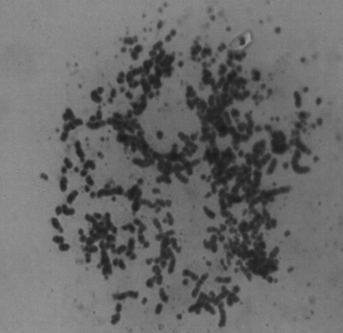
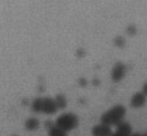
Dicentric
Double minutes
HSR

