Slide 1
المركز العراقي لبحوث السرطان والوراثة الطبية / الجامعة المستنصرية
Circulating tumor cells
and microRNAs
as biomarkers for cancer
م. د. زينب سعد عبد الغني
رئيس قسم الاحياء الجزيئي

Slide 2
Cancer diagnosis

Slide 3
The ideal properties of biomarker should be:
disease specific
able to differentiate between pathologies
rapid and significant release during pathology development
long life in sample, rapid, simple, accurate and inexpensive for detection
un affected by environmental conditions
present in accessible body fluid.

Slide 4
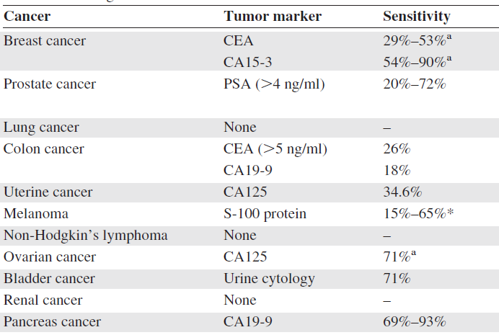
Breast cancer can be diagnosed by careful physical examination, mammography, ultrasound (U/S), magnetic resonance imaging (MRI) and breast biopsy.
With recent technological advances, gene expression profiling is used also to detect early breast cancer and predict their prognostic outcomes.

Slide 5
Blood as a real time liquid biopsy

Slide 6
Circulating tumor cells are the message of metastasis

Slide 7
Aims of research on CTCs

Slide 8
Nucleic acid (DNA /RNA) as blood-based biomarkers

Slide 13
CTC sepration

Slide 14
Some facts
Disseminated tumor cells –MC seen in bone marrow of patients with varied cancer
Seen in 20-40% patients who are clinical N0M0
Seen even in cancers which conventionally have low rate of bone metastases
Significant correlation between detection od DTCs and metastatic relapse
Not all patients with DTCs relapse (50%)

Slide 15
Some hypothesis
A fraction of CTC in early stage cancers represent putative metastatic stem cells
CTCs can be used to monitor response to systemic (anti-metastatic ) therapy
The “lead interval” between biomarker detection and overt metastases provides an intermediate window between early detection and metastasis disease, enabling treatment.

Slide 16
Methods for CTC detection
Physical and biological properties
Capture and enrichment –morphological and phenotypic characteristics of tumor cells
(depending on size, density and protein expression)
3. CTC characterization:
* IHC
* PCR

Slide 19
Enrichment methods
Isolation by size of epithelial tumor cells
Density gradient : tumor cells have lower density than other cells
Based on immnomagnatic techniques : separation depending on specific surface markers ...
Most commonly used ,
CellSearch, MACS,
differentiate tumor cells from other cells.
Positive selection for cytokeratin and negative selection for CD-45.
more sensitive than size ad density based methods

Slide 20
CTC identification
IHC : CK, CEA tumor markers and identifies intact cells (preserves the cell)
PCR : assess DNA/RNA changes specific to tumor cells. Amplifies minute quantities of tumor RNA ..
More sensitive ( false +ve : non-CTC mRNA)
Different markers: k-ras and p53, expression mRNA of: CEA, CK20 , CK19

Slide 23
Weaknesses : challenges in CTC detection
isolating, quantifying and molecular characterizing CTCs
Very little standardization and automation of processes :
- Laborious sample preparation procedures
- High intra and inter lab. differences reproducibility

Slide 24
Opportunities : the promise of CTCs
Prospective validation of CTCs against conventional biomarkers
Markers assessment to guide choice of personalized therapy
Identify new therapeutics targets
- Mutation analysis of CTCs
- can enable targeted therapy alternative to invasive biopsies

Slide 25
Threats
Has to compete with other biomarkers for reliability, feasibility of performance
Expensive technology
Labor intensive

Slide 26
Hence, currently available approaches enable enumeration of carcinoma-derived CTCs with high sensitivity and specificity as prerequisite for estimation of prognosis and therapeutic monitoring of cancer patients.
Moreover, phenotypic characterization of CTCs regarding the expression of selected therapeutic targets has already been included in clinical decision making and first assay formats for genomic as well as transcriptomic and epigenetic analyses of CTCs up to the single cell level were established to complement quantification of CTCs.

Slide 27
Comparably less efforts have been directed towards uncovering the expression of microRNAs (miRNAs) in CTCs. Increasing numbers of miRNAs which are small non-coding RNAs have been described to regulate gene expression by interfering with mRNAs at posttranscriptional level. Acting on a multitude of different transcripts, miRNAs are capable to influence various processes associated with tumor development and progression.
While miRNA expression was comprehensively studied in tumor tissues and in plasma and serum of cancer patients by now, the current review summarizes results of several proof-of-concept studies aimed to analyze miRNA expression in CTCs.
Investigation of CTCs is of utmost interest especially in the metastatic setting where tumor tissues are only rarely available. Although not yet ready as additional biomarker to characterize CTCs, CTC miRNA analysis holds great promise to improve knowledge of regulatory mechanisms involved in tumor cell dissemination and might provide insights into the cellular origin of circulating miRNAs.

Slide 28
What is a miRNA?
Small single stranded RNAs (21-25 nucleotides) but derived from larger precursors (double stranded RNAs)
Non-coding sequences
Form imperfect stem-loop structures (hairpin)
Hybridize by incomplete base-pairing to several sites in the 3’-untranslated regions of target mRNAs
Negative regulators of gene expression (Postranscriptional and Translational regulation )
Role in disease and cancer still in research

Slide 29
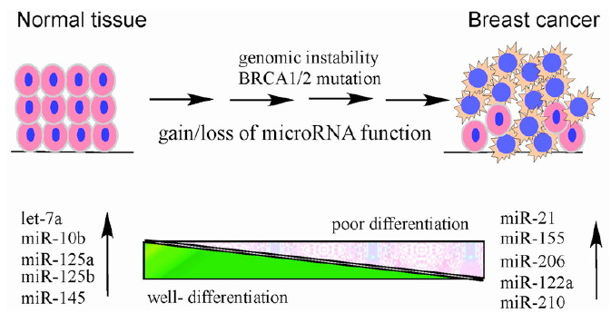
The increasing number of studies that prove the presence of miRNAs in circulating (serum/plasma) increases the chance of using this miRNAs as a good biomarker for cancer and other diseases.

Slide 30
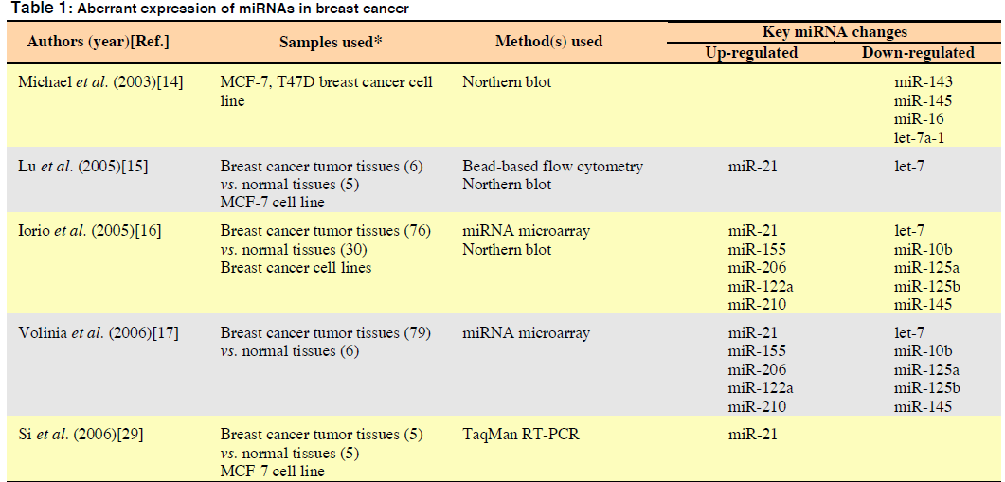

Slide 31
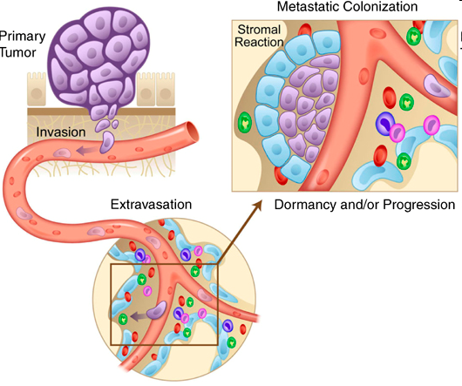
Circulating Tumor Cells
CTCs
tumor cells shed into
the blood stream
Motivation for detection
Study biology of metastasis
Diagnose, detect, monitor cancer in patients without invasive biopsy
The bone marrow niche: habitat to hematopoietic and mesenchymal stem cells, and unwitting host to molecular parasites
Y Shiozawa, A M Havens, K J Pienta and R S Taichman

Slide 33
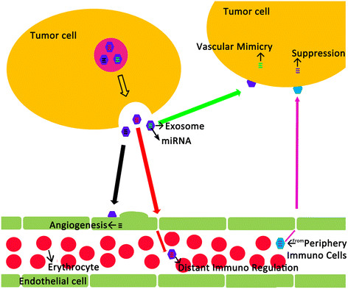

Slide 34
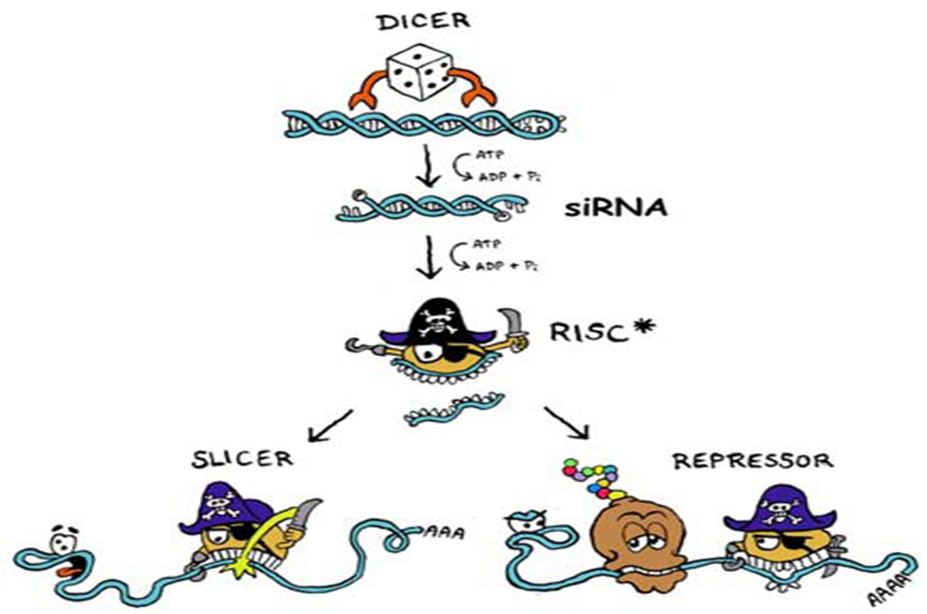

Slide 36
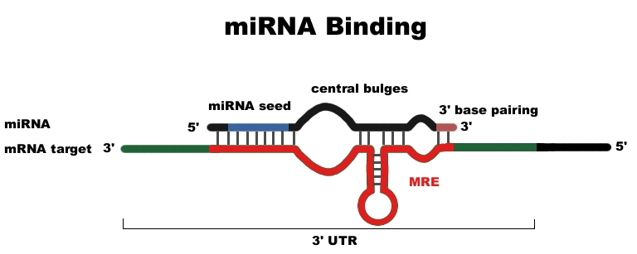
miRNA Binding
The MRE is known as the “miRNA recognition element.” This is simply the sequence in the target that an miRNA binds to mRNA

Slide 38
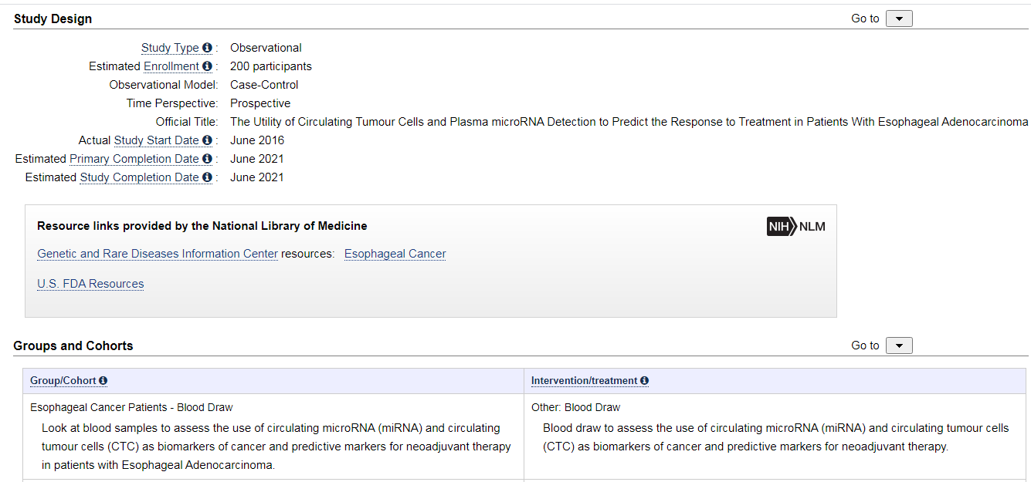

Slide 39
Conclusion
Liquid biopsies looking at circulating tumour cells (CTCs), circulating tumour DNA (ctDNA), and miRNAs are of great interest in the management of cancers.
However, there is no consensus to define which may be the best combining both sensitivity and specificity for each step of cancer management due to the multiple differences in detection and analysis.
It is necessary to standardize the methods of analysis for each biomarker in order to find the best sensitivity and specificity and offer the patients tailored therapies.

Slide 40
Moreover, we have to keep in mind that a possible multitude of markers/molecules can exist: different types of cancers use different pathways but most of the time pathways involving different molecules interlock.
By analysing a panel of biomarkers, we can then offer optimal management for cancer diagnosis, treatment and follow-up to our patients.

Slide 41
In summary
deregulation of certain miRNAs, including among others miRs-16, -21, -31, -200 and -210 which are of paramount importance for maintenance of EMT/MET and metastatic progression was demonstrated in CTCs.
Clinical significance of these results, however, remains to be elucidated on larger patient cohorts enrolled in well-defined clinical trials.
The major challenge for future studies will be the assessment of standardized methods for sample collection and storage, enrichment and isolation of CTCs and miRNA analyses to ensure comparability of different studies and to shed more light on the potential of miRNAs in CTCs as blood-based biomarkers.

Slide 42
Conclusions
Lots of new technologies in the field of liquid biomarkers
None routinely used; lack evidence of improved outcomes
Mostly research initiatives, but slowly being incorporated into trials
Future standard of care?

Slide 43
Hope it will be easy for you
You can fell free to contact me
zaynab.saad@iccmgr.org
Thank you for attending this workshop

