Slide 1
Noah A. Mahmood, PhD Biochemistry
Iraqi Center for Cancer and Medical Genetics Researches

Slide 5
Application of ELISA
Presence of antigen or the presence of antibody in a sample can be evaluated.
Determination of serum antibody concentrations in a virus test.
Used in food industry when detecting potential food allergens.
Applied in disease outbreaks- tracking the spread of disease e.g. HIV, bird flu, common, colds, cholera, etc.

Slide 7
Principle
ELISAs are typically performed in 96-well polystyrene plates. The serum is incubated in a well, and each well contains a different serum.
Antibodies or antigens present in serum are captured by corresponding antigen or antibody coated on to the solid surface.
To detect the bound antibodies or antigens, a secondary antibodies that are attached to an enzyme such as peroxidase or alkaline phosphatase are added to each well.
After an incubation period, the unbound secondary antibodies are washed off. When a suitable substrate is added, the enzyme reacts with it to produce a color.
This color produced is measurable as a function or quantity of antigens or antibodies present in the given sample. The intensity of color/ optical density is measured at 450nm. The intensity of the color gives an indication of the amount of antigen or antibody.

Slide 10
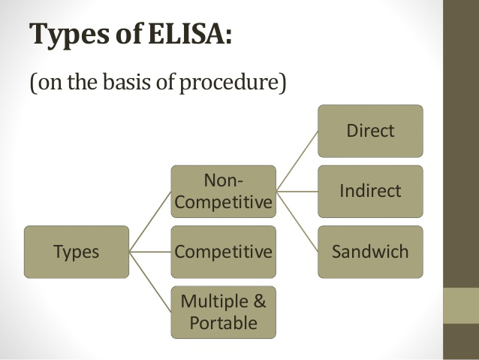

Slide 12
Advantages
Faster than other ELISA – the technique has fewer steps.
Less prone to error – as less reagents and fewer steps are required`
Disadvantages
Antigen immobilization is not specific - may cause higher background noise than indirect ELISA.
Mainly because all proteins in the sample, including the target protein, will bind to the plate
Less flexible - each target protein needs a specific conjugated primary antibody
No signal amplification - reduces assay sensitivity

Slide 14
Indirect ELISA
Antibody can be detected or quantitatively determined by indirect ELISA. In this technique:
Antigen is coated on the microtiter well. Serum or some other sample containing primary antibody is added to the microtiter well and allowed to react with the coated antigen.
Free primary antibody is washed away and the bound antibody to the antigen is detected by adding an enzyme conjugated secondary antibody that binds to the primary antibody.
Unbound secondary antibody is then washed away and a specific substrate for the enzyme is added. Enzyme hydrolyzes the substrate to form colored products.
The amount of colored end product is measured by spectrophotometric plate readers that can measure the absorbance of all the wells of 96-well plate.

Slide 16
Advantages
Increased sensitivity, since more than one labeled antibody is bound per primary antibody.
A wide variety of labeled secondary antibodies are available commercially.
Maximum immunoreactivity of the primary antibody is retained because it is not labeled.
Versatile because many primary antibodies can be made in one species and the same labeled secondary antibody can be used for detection.
Flexibility, since different primary detection antibodies can be used with a single labeled secondary antibody.
Cost savings, since fewer labeled antibodies are required.
Different visualization markers can be used with the same primary antibody.
Disadvantages
Cross-reactivity might occur with the secondary antibody, resulting in nonspecific signal.
An extra incubation step is required in the procedure.

Slide 17
Sandwich ELISA
Antigen can be detected by sandwich ELISA. In this technique:
Antibody is coated on the micro titer well. A sample containing antigen is added to the well and allowed to react with the antibody attached to the well, forming antigen-antibody complex.
After the well is washed, a second enzyme-linked antibody specific for a different epitope on the antigen is added and allowed to react with the bound antigen.
Then after unbound secondary antibody is removed by washing. Finally substrate is added to the plate which is hydrolyzed by enzyme to form colored products.

Slide 18
Sandwich ELISA

Slide 19
Sandwich ELISA
Advantages
High specificity, since two antibodies are used the antigen is specifically captured and detected.
Suitable for complex samples, since the antigen does not require purification prior to measurement.
Flexibility and sensitivity, since both direct and indirect detection methods can be used.

Slide 20
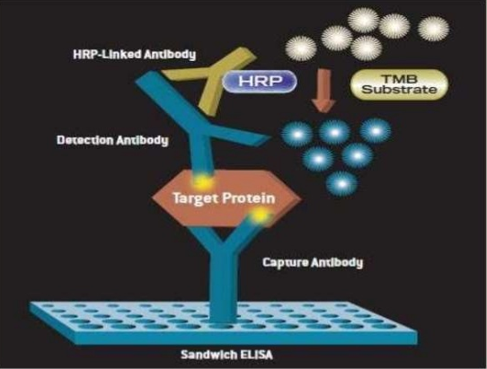

Slide 22
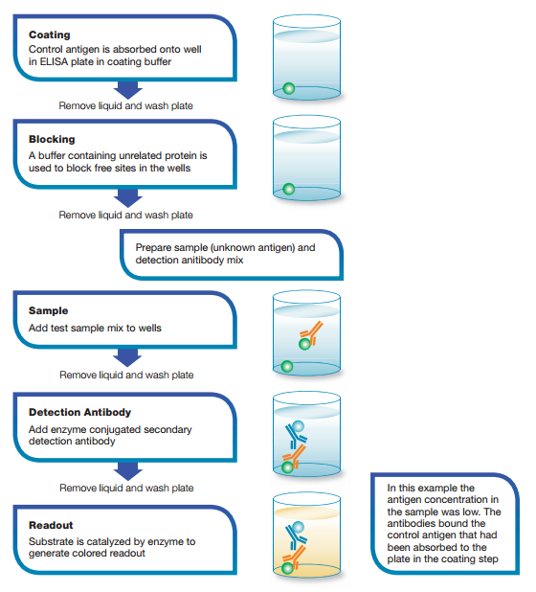

Slide 23
This test is used to measure the concentration of an antigen in a sample. In this test,
Antibody is first incubated in solution with a sample containing antigen.
The antigen-antibody mixture is then added to the microtitre well which is coated with antigen.
The more the antigen present in the sample, the less free antibody will be available to bind to the antigen-coated well.
After the well is washed, enzyme conjugated secondary antibody specific for isotype of the primary antibody is added to determine the amount of primary antibody bound to the well.
The higher the concentration of antigen in the sample, the lower the absorbance.

Slide 25
Advantages
High specificity, since two antibodies are used.
High sensitivity, since both direct and indirect detection methods can be used.
Suitable for complex samples, since the antigen does not require purification prior to measurement.

Slide 30
