Slide 2
Role in cancer prevention
Noah A. Mahmood, PhD Biochemistry
Iraqi Center for Cancer and Medical Genetics Researches

Slide 5
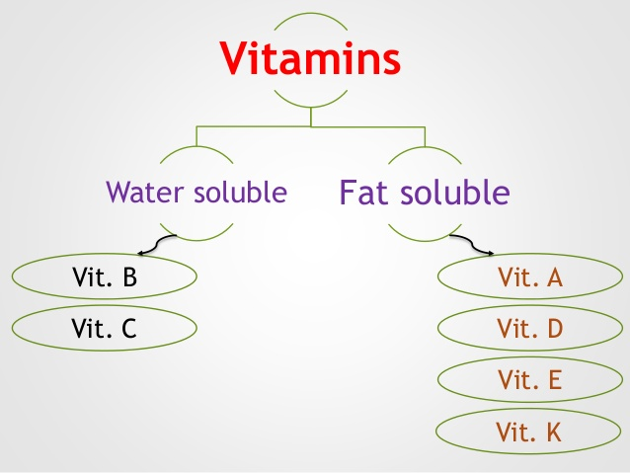

Slide 7
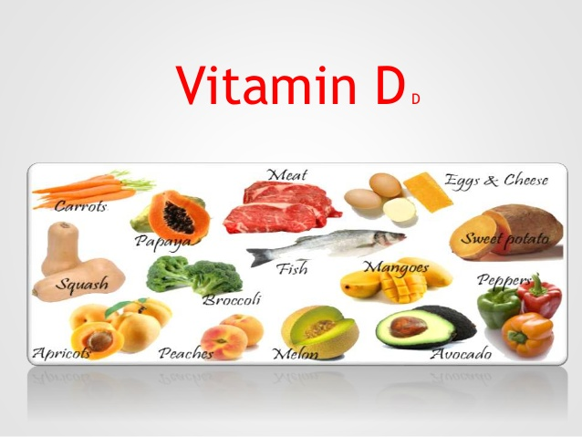

Slide 8
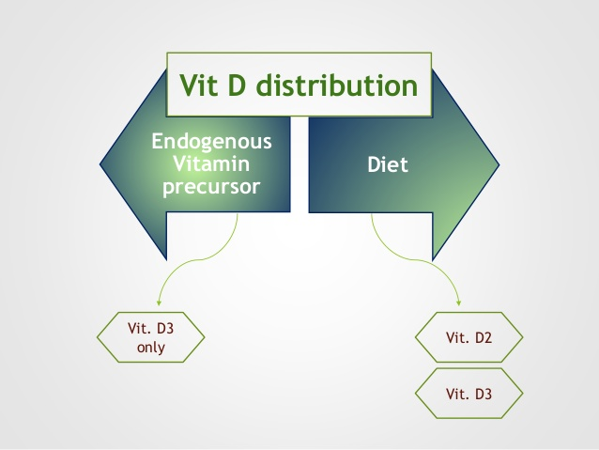
Vitamin D
Vitamin D is a fat soluble vitamin
Vit D is a sterol, is contains steroid nucleus ( cyclopentanoperhydrophenantherne ring)
Forms of vitamin D

Slide 9
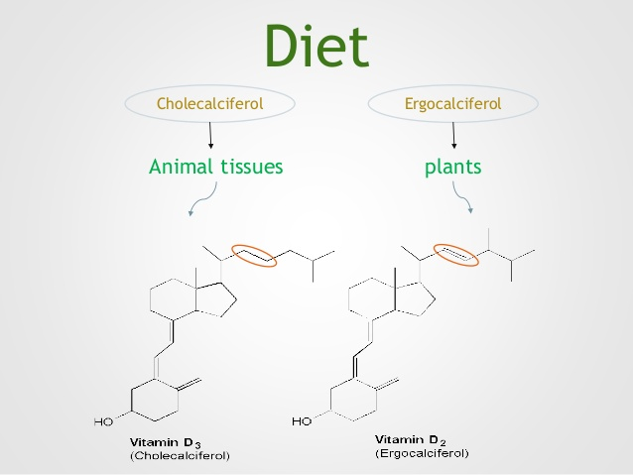

Slide 18
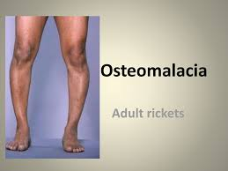
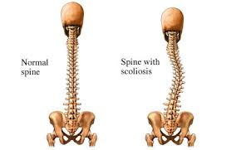
Osteomalacia

Slide 19
Factors Affecting Vitamin D Status
Vitamin D status is affecting by factors that regulate its production in the skin and by factors affecting its absorption or metabolism
Factor Regulate production
Skin pigmentation
Dressing codes
Season
Aging
Sunscreen use
Air pollution
Factors regulation absorption
Diet with less fatty acid
Malabsorption syndromes
Celiac disease
Chronic pancreatitis
Cystic fibrosis
Reduced magnesium level

Slide 23
Anti Neoplastic Action of Vitamin D3
1,25(OH)2 D3
(Calcitriol)
Increase in P21 and P27 expression Decease in CDKs, Cyclins, MYC and RB expression | Proliferation
Increase BAX Decrease in BCL-2 Increase sensitivity to radiation and chemotherapy | Apoptosis
Myeloid leukemia cell differentiation into monocytes Increase expression of differentiation factors such as Casein, Adhesion proteins, lipid, prostate differentiation factors and E-cadherin | Differentiation
Inhibit of expression of COX-2, PG receptor, Stress Kinase and NF-kB signaling. Increase 15-PGDH and MAPKP5 expression. | Inflammation
Decrease expression of MMP9, Plasmogin Activator,α6 and β4 Integrin. Increase TIMP1 and E-Cadherin expression. | Invasion and Metastasis
Decrease HIFα, VEGF, IL-8, Tenascin C and PGE2 level. | Angiogenesis

Slide 29
Conclusion
The role of vitamin D in cancer prevention is strongly suggested by epidemiology observation and potential mechanisms have been identified by experimental studies.
The promising results from both observation and laboratory studies should used in a new era of intervention studies of vitamin D and cancer risk.
Because many public health scientists are already clamoring for high level of vitamin D supplementation for bone and other health, randomized trial of vitamin D and cancer risk should be undertaken speedily.

Slide 30
If the promise of vitamin D holds, a brief walk in the sun may turn out to be a step toward cancer prevention

