Slide 1
Biosafety and
Waste Management
PhD Biochemistry
Noah A. Mahmood

Slide 2

Objectives
At the end of this module, you will be able to:
Adhere to personal health and safety practices
Maintain a clean and organized workspace
Disinfect and dispose of infectious materials
Take appropriate actions following accidental exposure to potentially infectious specimen
Follow written safety procedures and keep proper safety records

Slide 3
Topics
Work habits (personal, work space, material)
Proper disposal of sharps and waste
Handling chemicals
Disinfection of work areas
Safety documentation

Slide 4
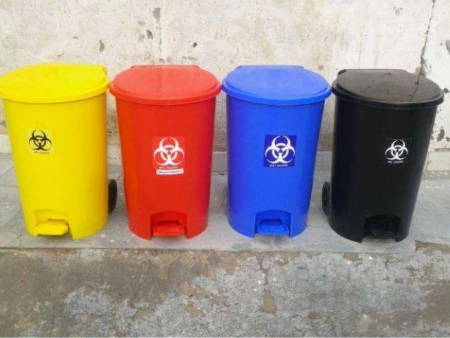

Slide 5
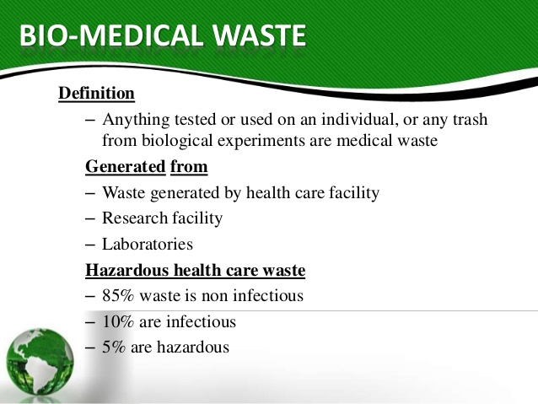

Slide 6
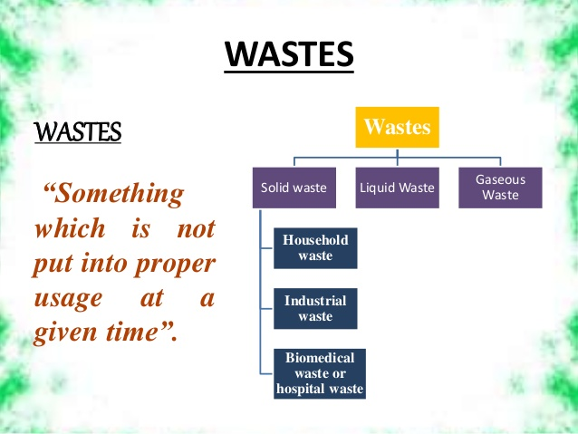

Slide 7
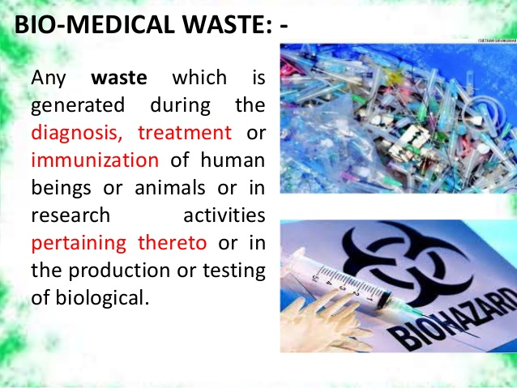

Slide 8
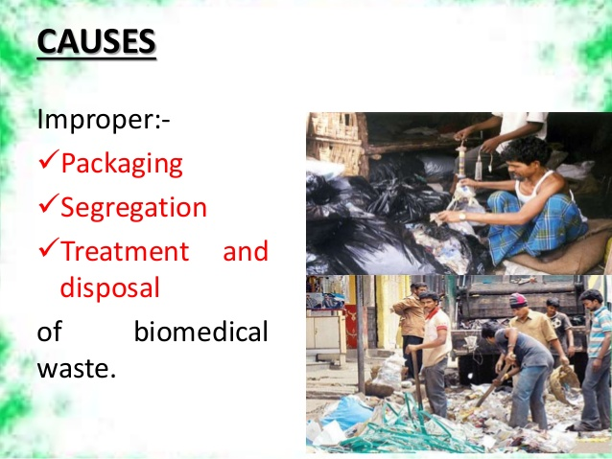

Slide 9
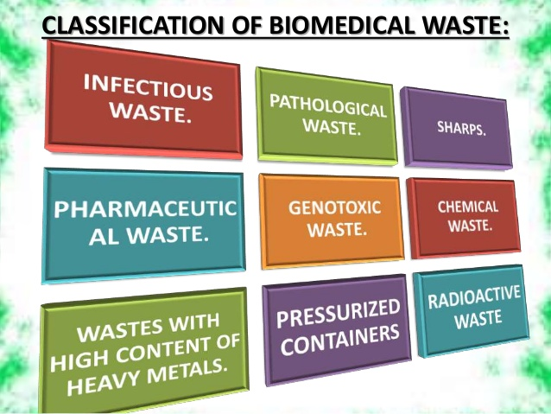

Slide 10
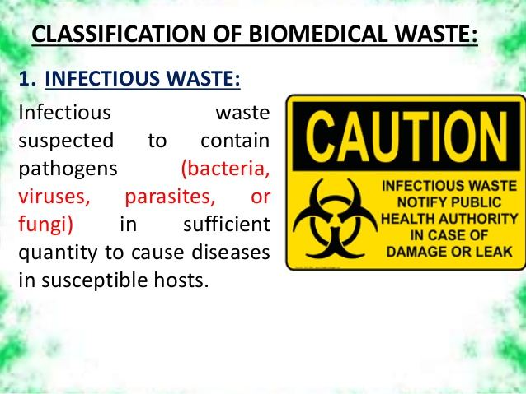

Slide 11
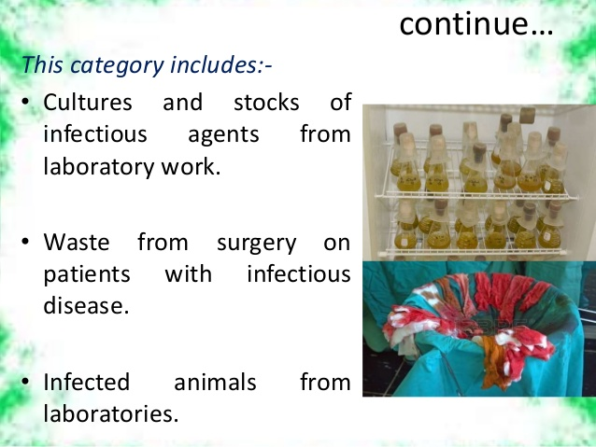

Slide 12
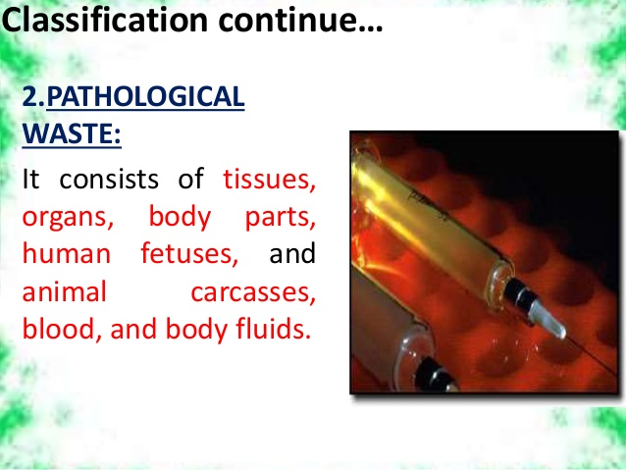

Slide 13
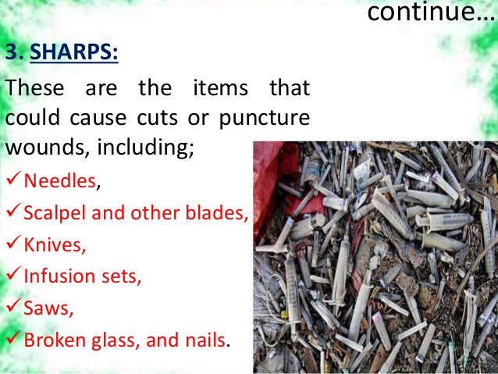

Slide 14
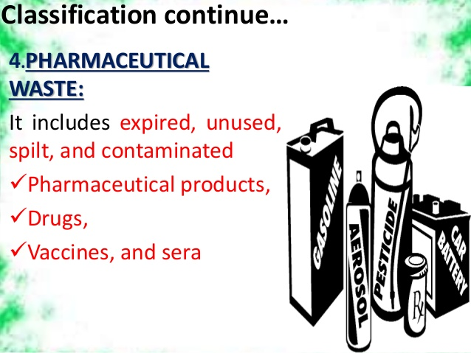

Slide 15
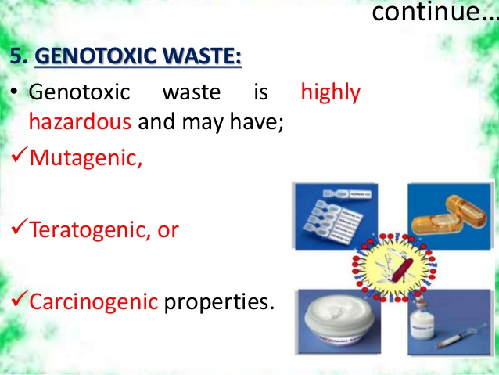

Slide 16
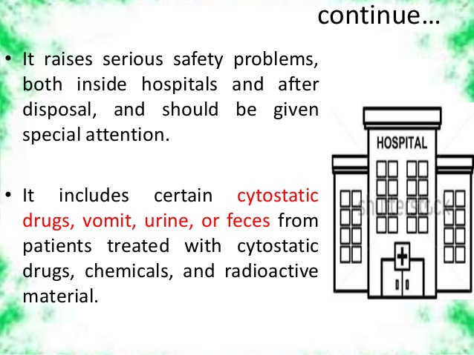

Slide 17
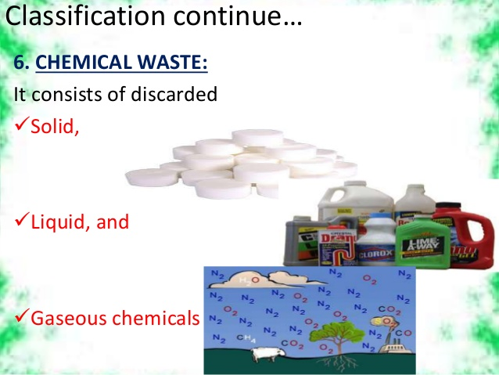

Slide 18
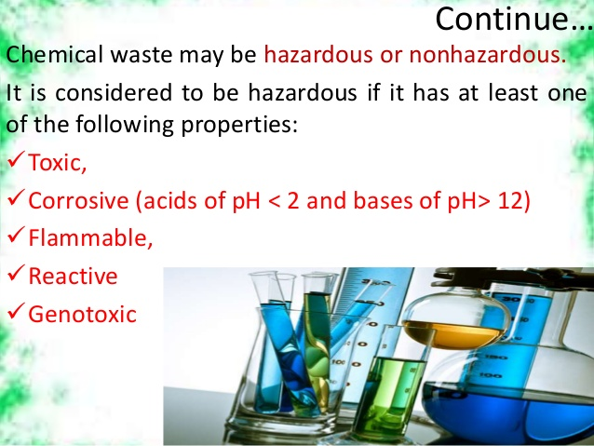

Slide 19
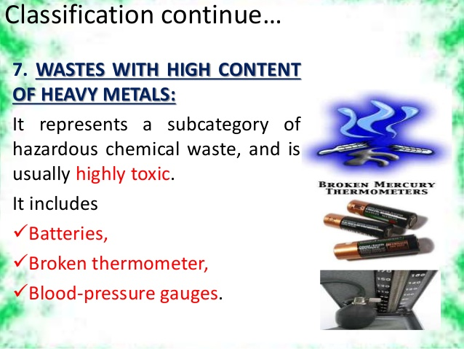

Slide 20
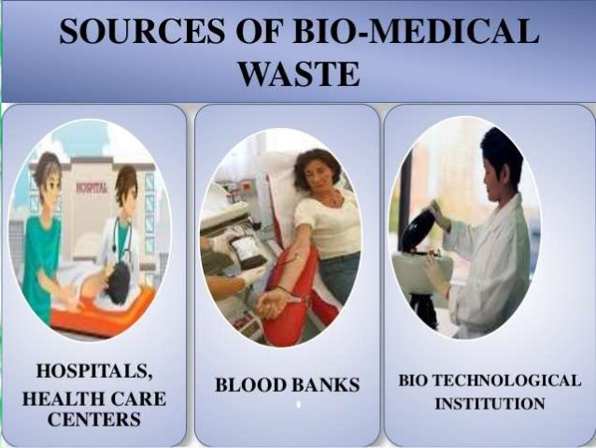

Slide 21
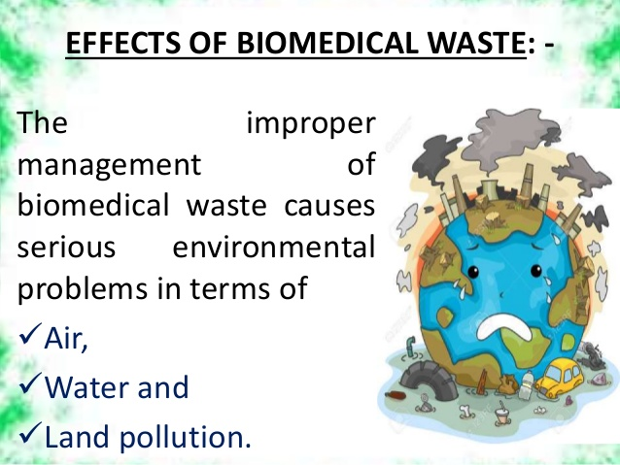

Slide 22
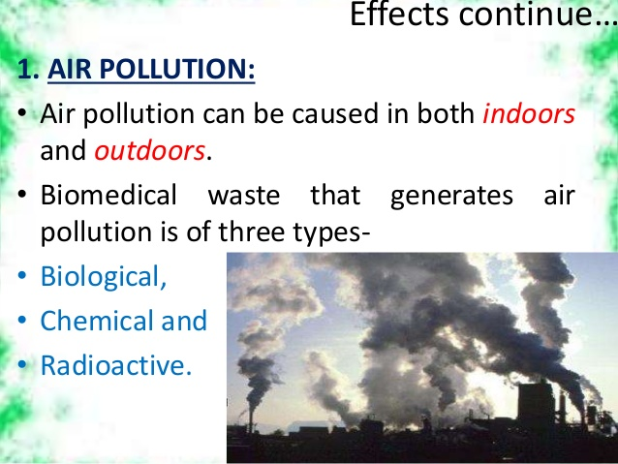

Slide 23
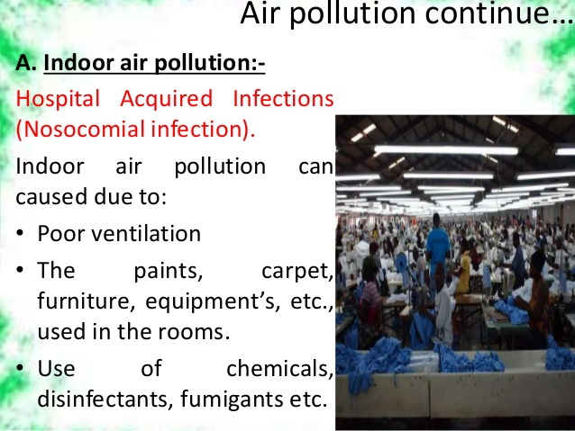

Slide 24


Slide 25
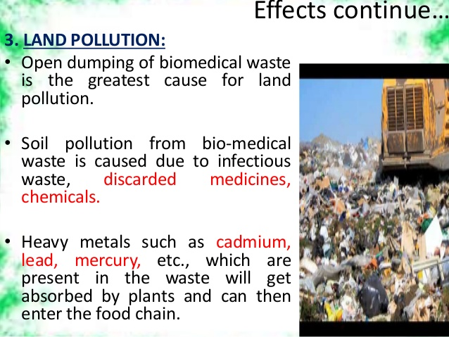

Slide 26
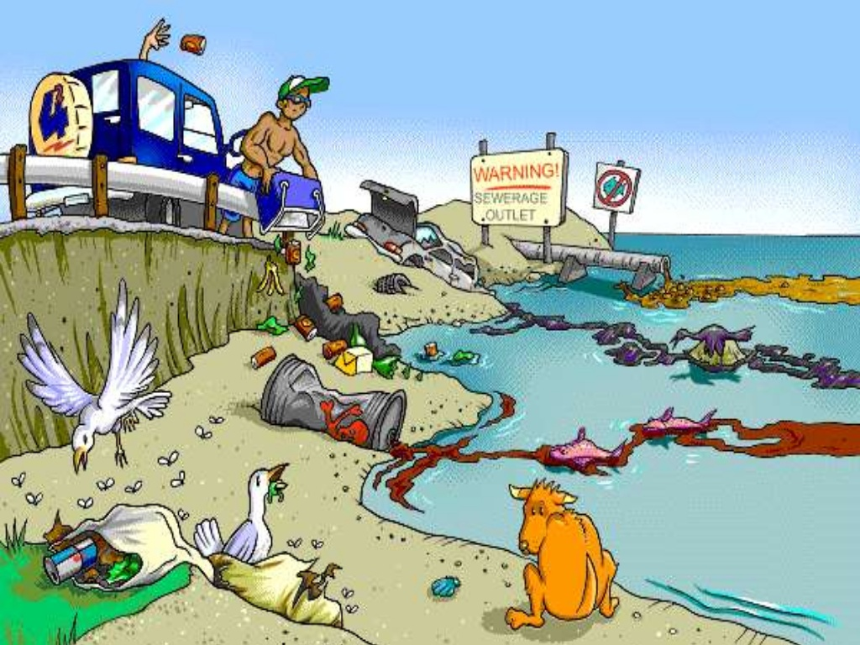

Slide 27
Why Is Safety Important?
Coming in contact with human blood or blood products (plasma, serum, etc.), or with certain chemicals used in the laboratory, is potentially hazardous.
Safety involves taking precautions to protect you and coworkers against infection, injury or poisoning.

Slide 28
What Else Needs Protection?
Other people who may come in contact with testing by-products.
Protect integrity of test products.
Protect environment from hazardous material

Slide 29
work habits
What are universal precautions?
What can each lab worker do to maintain personal safety?

Slide 30
Universal or Standard Precautions
Every specimen should
be treated as though
it is infectious.

Slide 31
Apply Safety Practices Throughout the Testing Process
Before Testing (Pre-analytical)
  Specimen collection
  Specimen preparation
  Specimen transport
Testing (Analytical)
  Testing
After Testing (Post-analytical)
  Disposal

Slide 32
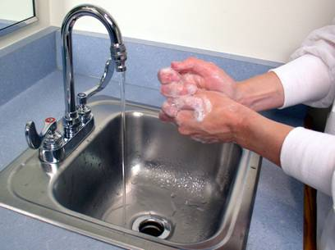
Develop Personal Safe Work Habits
Wash hands before and after entering the lab
Change gloves frequently
Wear lab coat or apron
Dispose of contaminated sharps and waste immediately after testing
1

Slide 33
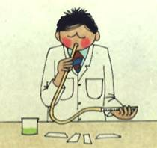
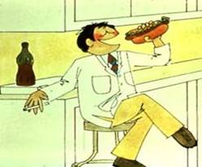
Develop Safe Personal Work Habits
Pipetting by mouth is strictly forbidden.
Never eat, drink or smoke at the test site.
Keep food out of the laboratory/testing site refrigerator
2

Slide 34
Maintain Clean and Orderly Work Space
Keep work areas uncluttered and clean
Disinfect work surfaces daily
Restrict or limit access when working
Keep supplies locked in a safe and secure area
Keep emergency eye wash units in working order and within expiry date
Biohazard

Slide 35
proper disposal of sharps and waste
Take Precautions to Avoid Needle Stick Injury
What can cause needle stick injury?
Lack of concentration
Inexperience
Lack of concern for others
Improper disposal of sharps

Slide 36
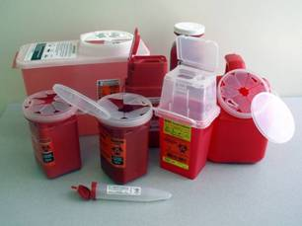
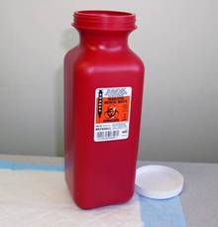
Drop Used Sharps in
Special Containers
WASTE

Slide 37
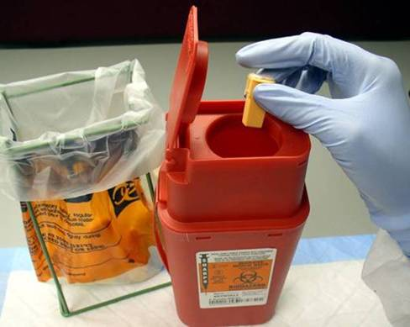
Do’s and Don’ts: Sharps and Waste Containers
Do Not break, bend, re-sheath or reuse lancets, syringes or needles
Do Not shake sharps containers to create space
1

Slide 38
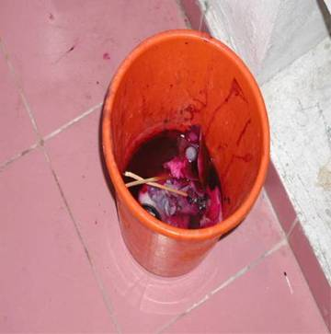
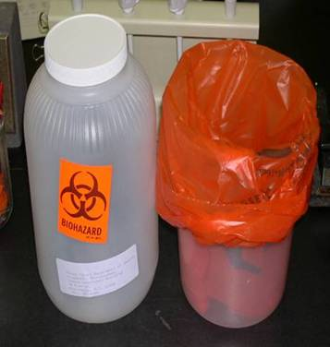
Do’s and Don’ts: Sharps and Waste Containers
What’s wrong with this picture?
2

Slide 39
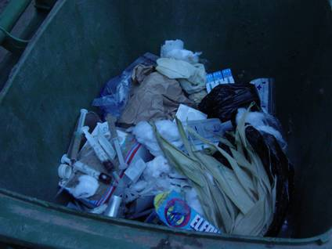
Never Place Needles or Sharps in Office Waste Containers

Slide 40
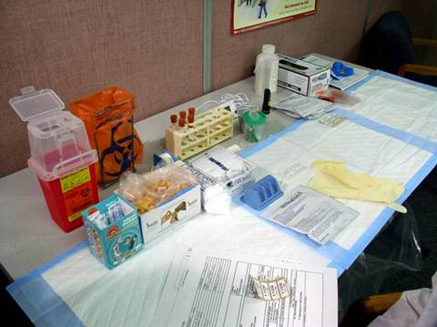
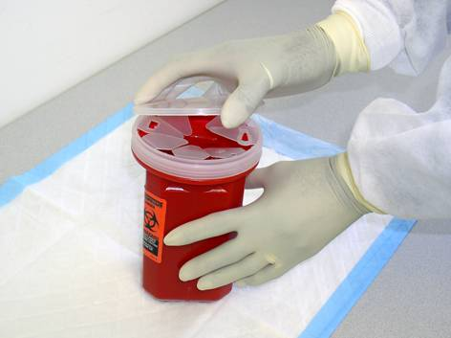
Sharps Containers Must Be:
Placed near workspace
Closed when not in use
Sealed when ¾ full

Slide 41
Policy for Handling Sharps
User responsible for disposal of sharps
Must dispose of sharps after each test
Must place sharps in sharps boxes
Do not drop sharps on the floor or in the office waste bin
Place sharps container near your workspace
Seal and remove when box is ¾ full
Incinerate all waste.

Slide 42
Incineration of Waste
Incineration is burning of contaminated waste to destroy and kill micro-organisms.
Incineration:
  Is effective against potential re-use
  Protects environment
  Must be supervised

Slide 43
Handling chemicals
How to properly handling different kinds of chemicals in the workplace

Slide 44
Chemical Hazards in the Genotyping Laboratory
Why hazardous?
  Ignitable
  Corrosive
  Reactive
  Toxic
Examples:
Guanidinium thiocyanate, commonly used in lysis buffers
  Never mix with bleach! (HCl, HCN gas released)
Ethidium Bromide (mutagen)
  DNA staining in agarose gels, buffers
Acrylamide (neurotoxin)
  In Gene assay, for making gels
  Less hazardous after polymerization

Slide 45
Disinfection of work areas
How can we disinfect work areas to ensure the safety of workplace?
Disinfection
Kills germs and pathogens
Keeps work surface clean
Prevents cross-contamination
Reduces risks of infection

Slide 46
In Case of a Spill or Splash
Evacuate Room and notify others to leave the room and post a warning sign for No entry
Remove all contaminated clothing and /or lab coat and place in a biohazard bag
Wash all exposed skin with antiseptic soap and water
Inform supervisor
Decontaminate the area: Assemble clean-up materials
  Large spill - Cover with paper towels and soak with 10% household bleach and allow to stand for 10-30 minutes
  Small spill - Wipe with paper towel soaked in 10% bleach
Dispose all contaminated towels in biohazard bag and dispose it properly

Slide 47
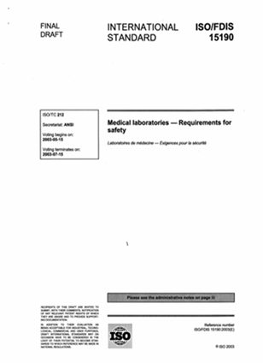
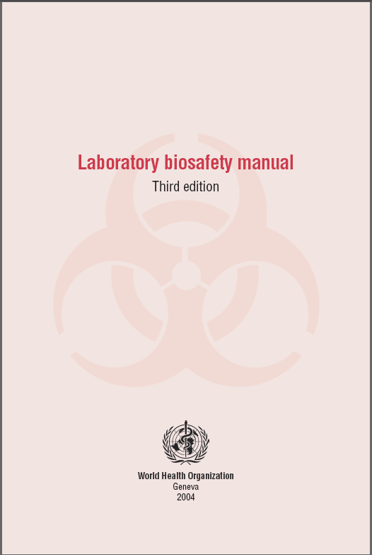

Safety References
www.who.int/csr/resources/publications/biosafety/WHO_CDS_CSR_LYO_2004_11/en/
www.cdc.gov/od/ohs/pdffiles/4th%20BMBL.pdf
Notes:
Emphasize: The WHO safety manual is available in many languages on the web site.

Slide 48
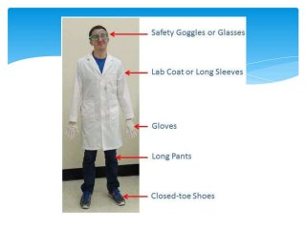

Slide 49


