Slide 1
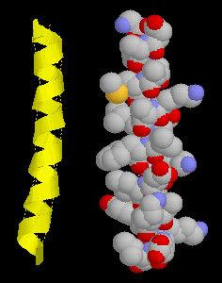
PURIFICATION AND ELECTROPHORESIS OF PROTEIN
المدرس المساعد:نيران علي ثامر
ماجستير كيمياء حياتية سريرية

Slide 2
protein; isolation ;purification
Chromatography
Electrophoresis

Slide 3
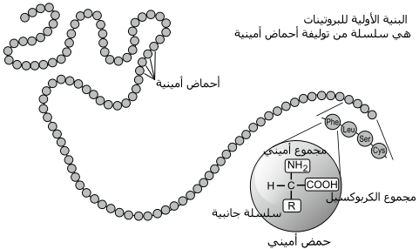

Slide 4
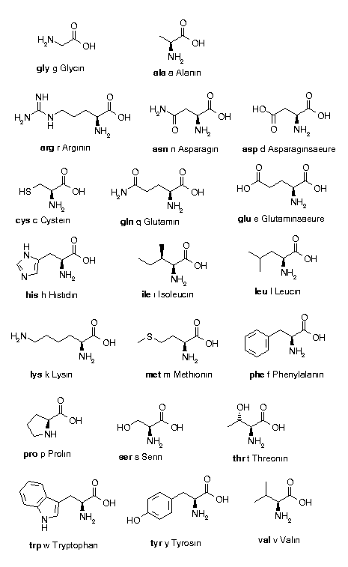

Slide 5
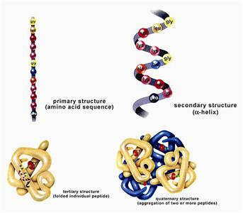

Slide 6
I. Protein Isolation
A. Selection of a Protein Source-often can obtain the same or similar protein from several different sources chose a source with
. which can be obtained in large amounts and has..
high concentration of the protein
. molecular cloning techniques allow production and purification
of proteins from E. coli, yeast or other cells.
B. Method of solubilization
. serum proteins or secreted proteins are already soluble
. otherwise cells must be broken up
osmotic lysis; perhaps aided by enzymes or chemicals to weaken cell membranes (detergents solvents, or lysozyme for bacteria(
mechanical disruption by grinding, blending, homogenizing or ultrasonic disruption
3. filter or centrifuge crude lysate to remove cell debris (membranes, cell walls etc, )

Slide 7
C. Stabilization of proteins--proteins are delicate
. may be denatured by high temperature
keep solution at appropriate temperature, usually fairly cold .
can use denaturation of some proteins to help purify a protein which is stable at high temperature
2. Proteases are enzymes which break peptide bonds.
maintain conditions which inhibit proteases ==> low temperature or change in pH or addition of chemical inhibitors.
may use proteases to digest labile proteins if the protein of interest is stable to proteases.

Slide 8
D. Assay of Proteins-need some way of measuring the concentration of a specific protein, so we know when we're doing something right
enzymes can be measured by the reactions they catalyze--either measure products produced or reactants used up
. other proteins may be measured by their biological effects: ability to bind specific molecules or the effect of a hormone on cells, tissue or organism.
. Immunochemical techniques-can produce antibodies which bind specifically to particular proteins

Slide 9
E. General Strategy of Protein Purification-fractionate based on different characteristic
Proteins are purified by fractionation procedures in a series of steps.
Charge
ion exchange chromatography
Electrophoresis
Isoelectric focusing
2. Polarity
adsorption chromatography
paper chromatography
reverse-phase chromatography
hydrophobic interaction chromatography

Slide 10
3. Size
gel electrophoresis
gel filtration chromatography
ultracentrifugation
dialysis and ultrafiltration
II. Solubilities of Proteins
Effects of Salt Concentration
1 . salting in : at low concentrations of salt, solubility of the proteins usually increase.
2. salting out –at high concentrations of salt , solubility of the protein decreased sharply (precipitate),because the salt ions bind most of the water molecules
Salt ions compete with protein globules for water and, eventually, at a sufficiently high concentration, strip the water of aqueous shell. Aqueous salt solution becomes a poor solvent for proteins, which precipitate out.

Slide 11
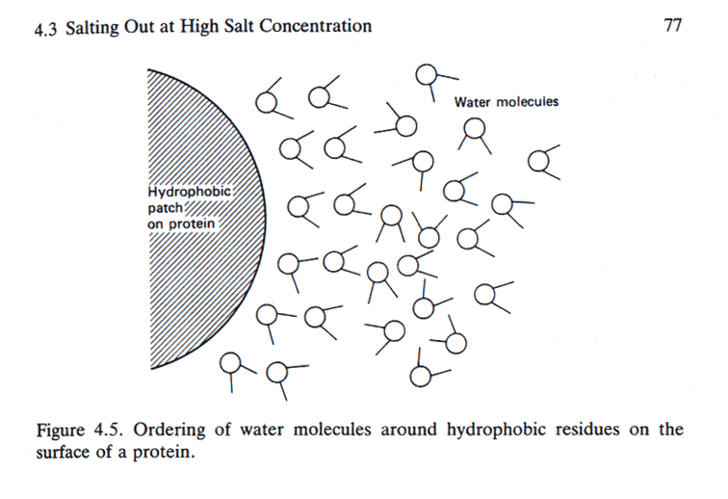
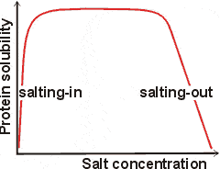
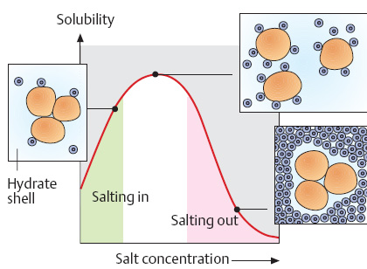

Slide 12
The number and distribution of charges,
nonionic polar groups,
and hydrophobic residues on the surface of the protein
The size and shape of the protein .
determines the concentration of the salt needed to cause precipitation of the protein.
B. Effects of pH
All proteins have an isoelectric point, pI, a pH at which they have no net charge, and they are least soluble at their pI because there are no net electrostatic repulsions between protein molecules:. Different proteins have different pI's, so one can manipulate the relative solubilities of a mixture of proteins by changing the pH.
C. Crystallization
Once a protein is reasonably pure, one may try to crystallize it which is the ultimate criterion of purity.

Slide 13
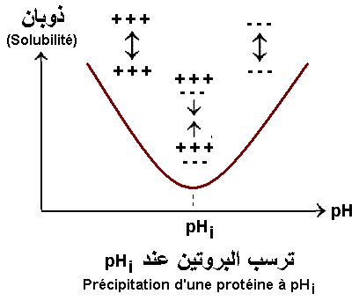

Slide 14
kinetic of protein precipitation involve the following.
First, the protein environment is altered by the addition of a precipitating agent, causing the solution to become unstable disrupting bipolarity .
Second, solid phase appears as small spherical ‘‘primary’’ particles of solid protein, which grow by diffusional transport of protein molecules to the solid surface.
Third, primary particles aggregate as a result of convective transport and lead to floc formation.
Finally, the aggregate (floc) size is limited by hydrodynamic disruption of the aggregates, generating smooth and uniform precipitate particles. maximizing the aggregate’s size and density.

Slide 15
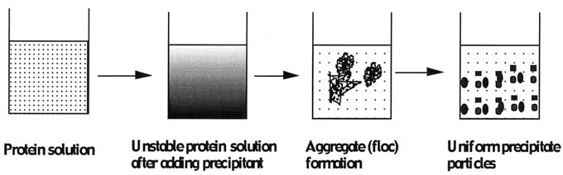

Slide 16
III. Chromatographic Separations
One of the most power class of separation procedures is chromatography; this technique can take various forms based upon the physical apparatus
column chromatography,
paper chromatography,
or thin layer chromatography –
. All depend upon having a mobile phase, usually a liquid, and a stationary phase, usually a solid coated with a liquid. The sample is applied in the mobile phase which passes down the column (or paper or thin layer plate) and the different solutes move at different speeds depending upon their relative affinities for the mobile and stationary phases; we say that they partition between the mobile and stationary phases.

Slide 17
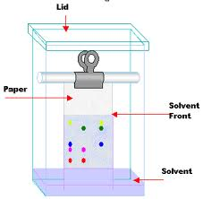
Paper chromotography

Slide 18
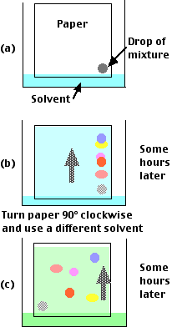

Slide 19
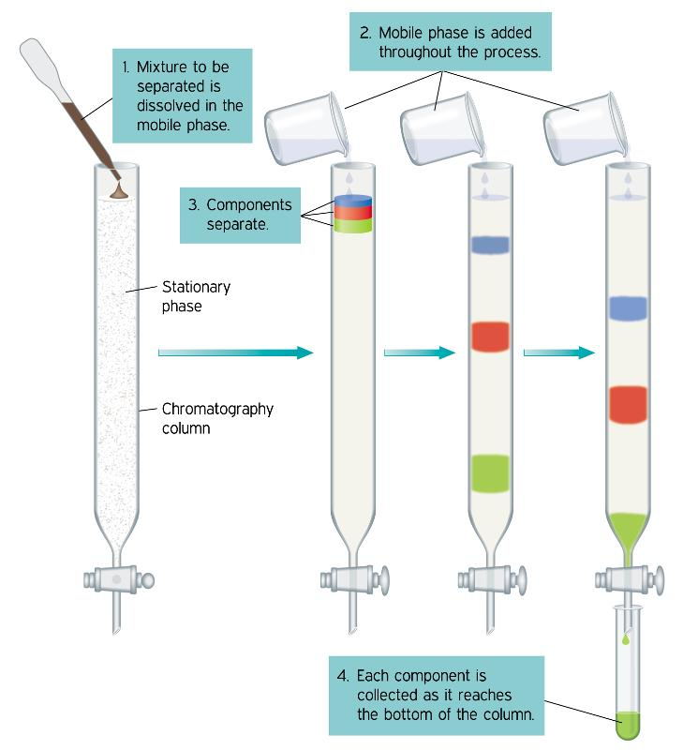
Column chromotography

Slide 20
The Chromatographic Matrix
A chromatographic matrix should.
(1) be insoluble in the buffer.
(2) hydrophilic.
(3) easily activated and coupled to a ligand (for affinity
chromatography .
(4) have large or small pores accessible to the protein
(5) have a large surface area.
(6) be physically and chemically stable to withstand
the conditions during sterilization.

Slide 21
A variety of materials have been used as matrices. These include
--inorganic materials glass, silica, and hydroxyapatite;
-synthetic organic polymers like polyacrylamide,
polystyrene, and polysaccharides .
agarose based (e.g., Sepharose and Superose) -
dextran based (e.g., Sephadex) -
cellulose based (e.g., Sephacel).-

Slide 22
A. Ion Exchange Chromatography--adsorption chromatography
. Stationary Phase -- chemically bound charged groups with counter ions bound; these may be positively charged groups which bind anion)anion exchanger) or negatively charged groups which bind cations )cation exchanger)
2. Mobile Phase -- an aqueous buffer solution characterized by: pH and ionic strength
3 . Eluting Ion Exchange Columns -- molecules usually adsorb tightly in the buffer in which they're applied ==> must weaken this interaction.
Increase ionic strength (most common method): F = q₁ q₂ / D r²
q₁and q₂ are the charges on 2 groups, r is the distance between the groups, and D is the dielectric constant of the solvent which is increased with higher ionic strength thus weakening the force between the solute and the ion exchanger. Another way to look at this is that other ions in the buffer compete for the ion exchanger binding site.
change pH -- changes the charges on the molecules being separated; also can change the charge of a weak ion exchanger
These changes can be made stepwise by changing the buffer reservoir (step gradient) or as gradient -- by mixing two buffers

Slide 23
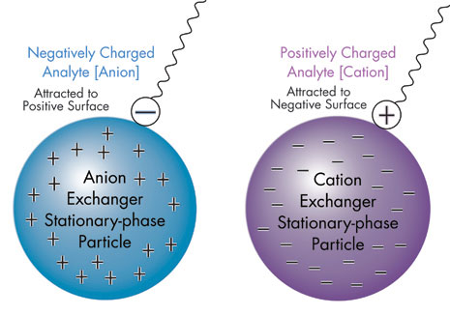

Slide 24
B. Gel Filtration Chromatography
1. Column Packing -- spherical porous beads of defined size crosslinked dextrans -- Sephadex (Pharmacia(
crosslinked polyacrylamide -- Bio-Gel P (Bio-Rad(
crosslinked agarose -- Sepharose (Pharmacia) or Biogel A (Bio-Rad). Agarose beads have very large pores and are, therefore, good for separating very large molecules
other materials developed by other companies
2. Gel beads are designed to have a distribution of pore sizes around a mean pore size. The mean pore size and the distribution determines the size range of molecules which can be separated.
3. Dialysis is a form of molecular Filtration.
C. Affinity Chromatography
based upon specific binding of the target protein to a particular ligand which is bound to an inert matrix.

Slide 25
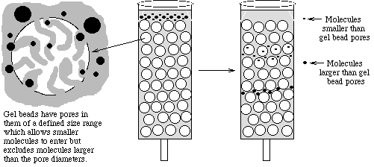

Slide 26
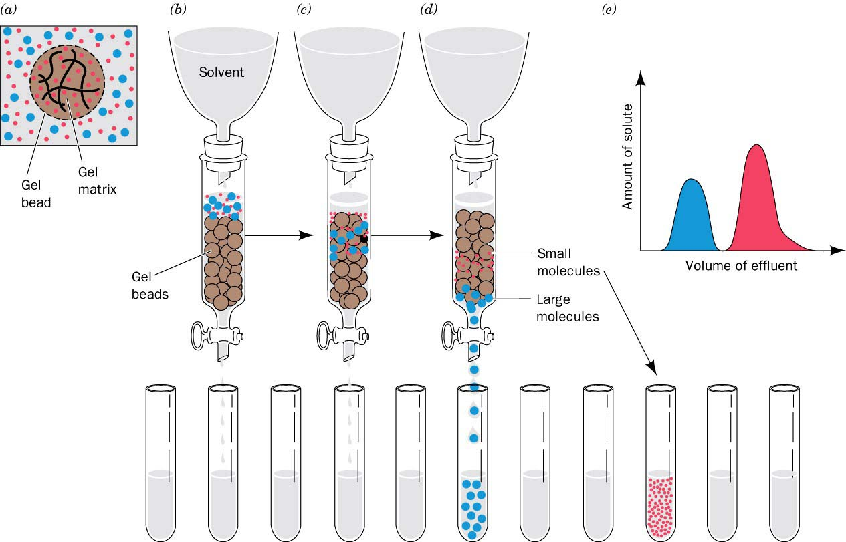

Slide 27
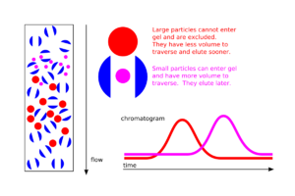

Slide 28
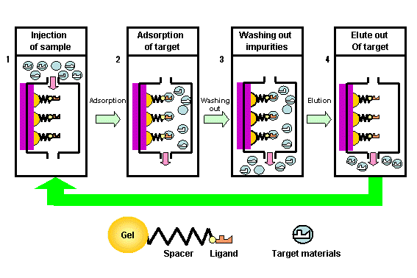

Slide 29
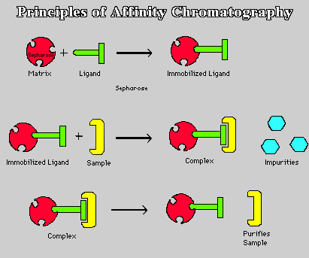

Slide 30
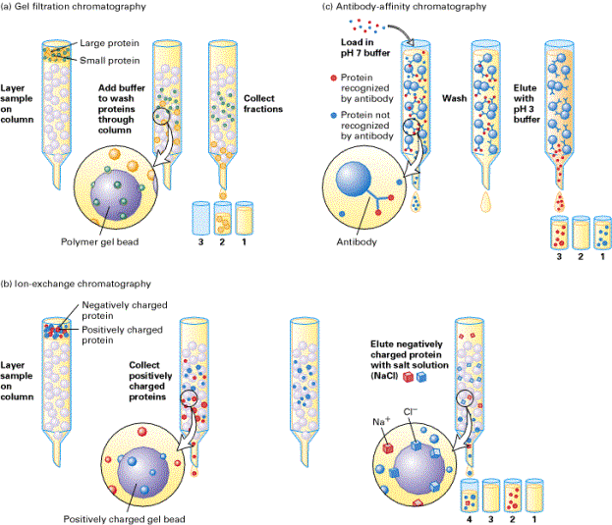

Slide 31
D. Other Chromatographic Techniques
1. Reverse Phase Chromatography stationary phase is more hydrophobic liquid adsorbed to inert matrix
mobile phase is more hydrophilic liquid
2. Hydrophobic Interaction Chromatography--similar to reverse phase chromtography but with less densely packed hdrophobic groups ==> less denaturing.
3. HPLC = High Performance Chromatography--a form of column chromatogrpahy with very small particles in the stationary phase to increase resolution; speed increased by using very high pressures. Commonly used in reverse phase mode but also with ion exchange, gel filtration, or hydrophobic interaction.

Slide 32
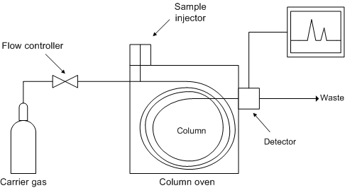
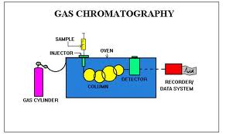
Gas chromotography

Slide 33
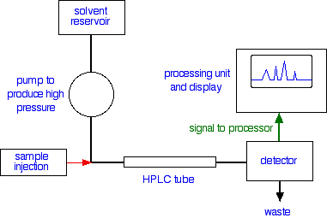
HPLC( High performance liquid chromotography

Slide 34
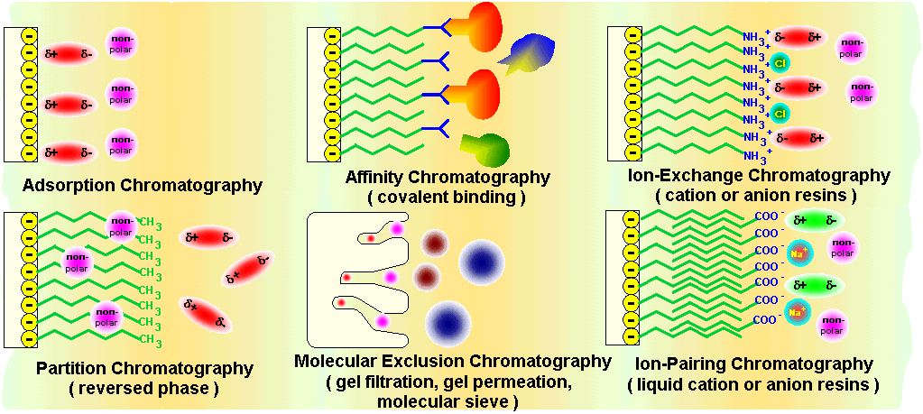

Slide 35
spleen cells cytoplasm was applied on top of sepharose 6B gel filtration column. Flow rate was 30 ml /hrs, 5ml fraction collected.

Slide 36
Electrophoresis
Protein Electrophoresis is used to separate
mixtures of protein (e.g., from cells, subcellular fractions,
column fractions, or immunoprecipitates) inorder
to investigate subunit compositions
to verify homogeneity of protein samples
to purify proteins for use in further application

Slide 37
ElectrophoresiS
A. Macromolecule is accelerated by a force )like sedimentation)
F = q E
[q is the net charge on the molecule; E is the electric field strength experienced by the molecule]
2. This causes an acceleration until the velocity, v, causes a frictional force equal to but opposite in direction to the applied force
F = qE=fv
3. Zonal: most common mode used
sample is applied in a zone (small region: a spot on moistened paper or a band on a gel) and an applied field causes the molecules to separate into zones based upon different U's.
Like Zonal sedimentation, need some way of stabilizing the zones to prevent mechanical mixing (from vibrations) or convection mixing (from temperature differences -- a particularly severe problem with resistance heating caused by the electric field.

Slide 38
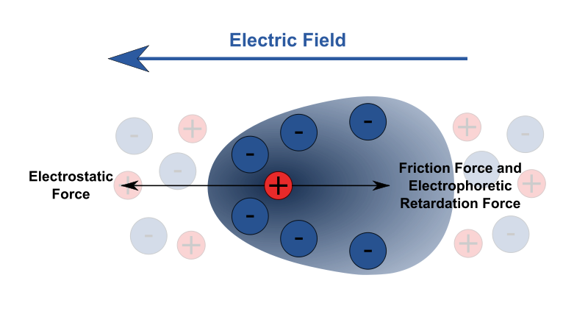

Slide 39
Gel electrophoresis is a method used in clinical chemistry to separate proteins by charge and or size (IEF agarose, essentially size independent) and in biochemistry and molecular biology to separate a mixed population of DNA and RNA fragments by length, to estimate the size of DNA and RNA fragments or to separate proteins by charge.
Nucleic acid molecules are separated by applying an electric field to move the negatively charged molecules through an agarose matrix. Shorter molecules move faster and migrate farther than longer ones because shorter molecules migrate more easily through the pores of the gel. This phenomenon is called sieving.
Proteins are separated by charge in agarose because the pores of the gel are too large to sieve proteins. Gel electrophoresis can also be used for separation of nanoparticles

Slide 40
4- Gel electrophoresis media ;
- Three types
Starch Gel -- swollen potato starch granules (little used now except for prep isoelectric focusing)
Agarose Gel -- purified large MW polysaccharide (from agar) ==> very open (large pore) gel used frequently for large DNA molecules
Polyacrylamide Gels -- most commonly used gel because they are very stable and can be made at a wide variety of concentrations or even with a gradient of concentrations ==> large variety of pore sizes
Acrylamide Concentrations -- typically 5-20% by weight (5%, 7.5%, 10%, 12.5%, 15%, 20% are commonly used values) ==> gel is mostly water.
Acrylamide polymerizes in head-to-tail fashion to form long polymers which form a complex network held together by bis-acrylamide crosslinks. The cris-crossing polymers create pores in the gel; the size of pores is determined by the acrylamide concentraion.
5-. Acrylamide can be polymerized into any desired shape -- two shapes used for electrophoresis
Tube Gels -- polymerize in glass tubing ==> cylindrical shape
Slab Gels -- polymerize between glass plates _--

Slide 41
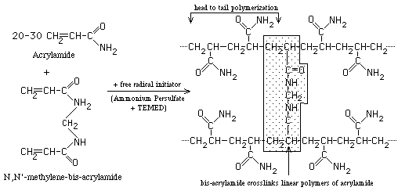

Slide 42
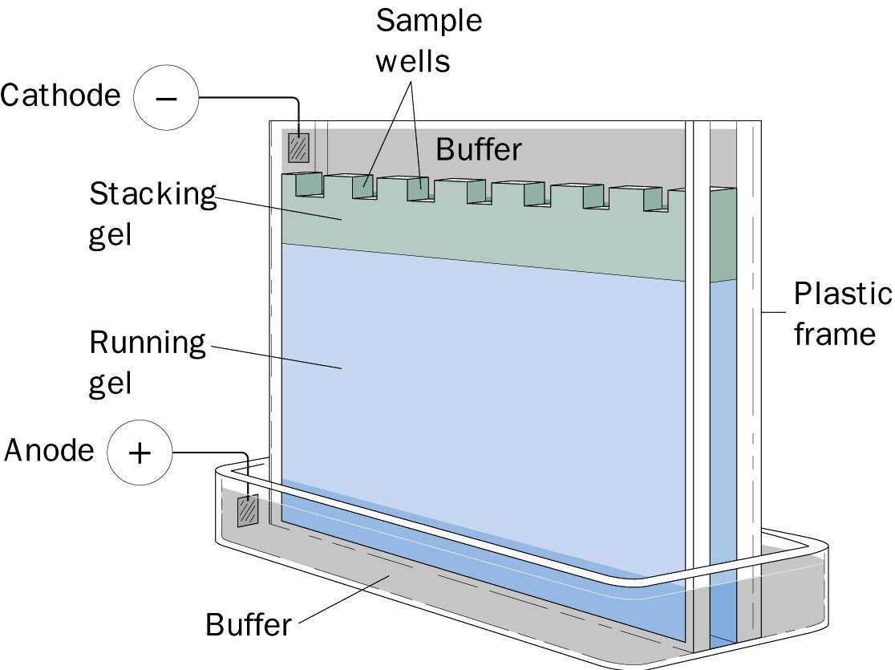

Slide 43
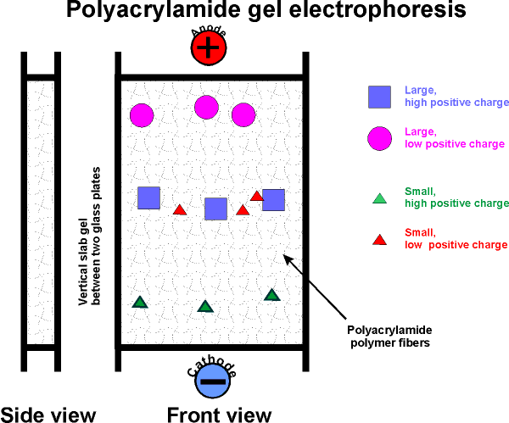

Slide 44
B. SDS PolyAcrylamide Gel Electrophoresis -- SDS PAGE
Sodium Dodecyl Sulfate = Sodium Lauryl Sulfate: CH3(₎₎₍CH2) ₁₁ SO⁻³Na⁺
This is a detergent because it contains a hydrophobic region, the CH3 )CH2) 11 tail, attached to a hydrophilic group, SO3-Na+, making it amphipathic. It is a very strong detergent which denatures proteins by binding to the polypeptide backbone
estimation of purity and molecular weight makes use of the detergent sodium dodecyl sulfate (SDS).
Na+ - SO4(CH2)11CH3
SDS binds to most proteins in amounts proportional to the molecular weight of the protein, about one molecule of SDS for every two amino acid residues.
SDS, net negative charge, rendering the intrinsic charge of the protein insignificant and conferring on each protein a similar charge-to-mass ratio.
Electrophoresis in the presence of SDS therefore separates proteins almost exclusively on the basis of mass (molecular weight).

Slide 45
Sodium dodecyl sulfate – polyacrylamide gel electrophoresis (SDS-PAGE) is the most direct method for assessing in a fast and reproducible manner, the relative molecular weight (Mr) of denatured polypeptide chains and the purity of a protein preparation.
In SDS-PAGE, the sample to be applied to the gel is first treated with the anionic detergent SDS which denatures the proteins in the sample and binds tightly to the protein molecules. The SDS molecules confer a relatively uniform negative charge to the polypeptide in proportion to its length. When an electric current is applied across the gel, all proteins will migrate through the gel matrix toward the anode.
In this way, SDS-PAGE separates proteins according to size because the SDS-coated proteins have a uniform charge:mass ratio. Proteins with less mass travel more quickly through the gel than those with larger mass because of the sieving effect of the gel matrix

Slide 46


Slide 47
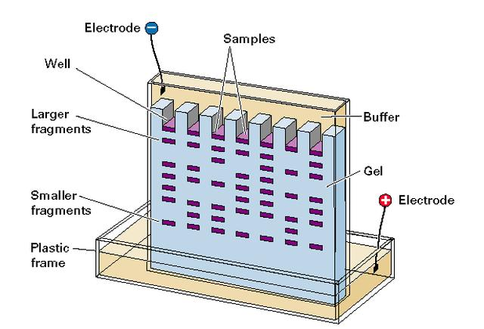

Slide 48
. C.IsoElectric Focusing: All protein charges vary from a net positive charge at low pH (-COOH and –NH3+ forms of acidic and basic functional groups) through 0 at some intermediate pH to a net negative charge (-COO- and -NH 3forms) at high pH.
1. pI - IsoElectric Point: pH at which a protein has a net 0 charge (positive and negative charges balance). Depends mostly on the amino acid composition and a little on the tertiary structure
2. Create a pH gradient in a gel: Can be done on a slab (vertical or horizontal) or a tube.
the final positions of each band depend only on an intrinsic property of the proteins, their pI's, and not on where they started in the gel
D. Two-Dimensional Electrophoresis: There are many variations; all basically combine 2 types of electrophoresis

Slide 49
Proteins Electrophoresis carried out in gels made up of the cross-linked polymer (polyacrylamide).
The polyacrylamide gel acts as a molecular sieve, slowing the migration of proteins approximately in proportion to their charge-to-mass ratio.
µ = V / E = Z / f
µ, The electrophoretic mobility of the molecule.
V, the velocity of the particle molecule,
E, moving force of the molecule(electrical potential)
Z, the net charge of the molecule.
f, frictional coefficient.----- reflects in part a protein’s shape.
Different PAA Concentrations for different purposes

Slide 50
NonSDS-PAGE , Denatured SDS-PAGE, Nondenatured
The proteins are visualized by adding a dye such as Coomassie blue, which binds to proteins but not to the gel itself.
In compares' with the positions to which proteins of known molecular weight migrate in the gel, the position of an unidentified protein can provide a measure of its molecular weight.
If the protein has two or more different subunits, the subunits will generally be separated by the SDS treatment and a separate band will appear for each

Slide 51
Reagents and Buffers.
Acrylamide-bisacrylamide(30%).
dissolving 29.2 gm of acrylamide and 0.8 gm of bisacrylamide in 50 ml of distilled water. When the acrylamide was completely dissolved, the volume is completed to 100 ml with distilled water. The solution is stored in a refrigerator at 4°C in a dark bottle for no longer than one month.
2-Concentrated Resolving Gel Buffer (1.5 M Tris-HCl, pH 8.8).
dissolving 18.2 gm of Tris-HCl in 80 ml of distilled water. The pH adjust to 8.8 with 1N HCl, and the volume completed to 100 ml with distilled water. It was stored at 4°C in a refrigerator.

Slide 52
Most modern commercial equipment is color-coded so that the red or positive terminal of the power supply is connected to the red lead of the gel apparatus. The red lead goes to the lower buffer chamber. The black lead is connected to the black or negative terminal and goes to the upper buffer chamber.
In slab gel electrophoreses negatively charged proteins or nucleic acids move to the positive electrode in the lower buffer chamber (an anionic system).
Proteins separated in cationic (+) systems. In these gels, the proteins are positively charged because of the very low pH of the gel buffers (e.g., acetic acid/urea gels for histone separations) or a cationic detergent (e.g., CTAB).
Proteins move toward the negative electrode (cathode) the polarity is reversed compared to SDS-PAGE: the red lead from the lower buffer chamber is attached to the black outlet of the power supply, and the black lead from the upper buffer chamber is attached to the red outlet of the power supply.

Slide 53
Power supplies usually have more than one pair of outlets. The pairs are connected in parallel with each other internally.
gel is connected directly to the outlets of a power supply, then these gels are connected in parallel = voltage is the same across each gel.
power supply reads 100 V, then each gel has 100 V across its electrodes. The total current, however, is the sum of the individual currents
Therefore, under constant current it is necessary to increase the current for each additional gel that is connected to the power supply.
Two identical gels require double the current to achieve the same starting voltages and electrophoresis separation times.

Slide 54
3- Concentrated Stacking Gel Buffer (0.5 M Tris-HCl, pH 6.8).
dissolving 6 gm Tris-HCl in 50 ml of distilled water. The pH was adjusted to 6.8 with 1N HCl; volume was completed to 100 ml with distilled water. Solution was stored at 4°C in a refrigerator.
4- Sodium Dodecyl Sulfate Solution 10% (SDS).
Prepared by dissolving 10 gm SDS in 50 ml of distilled water and the volume was completed to 100 ml with distilled water.
5- Stock Sample Buffer (0.06 M Tris-HCl pH 6.8, 2% SDS, 10% glycerol, and 0.025% bromophenol blue)
mixing of the following;
0.5 M Tris acid pH 6.8 …………………………..1.2 ml
10% SDS ……………………………………………..2.0 ml
Glycerol …………………………….........................1.0 ml
0.5% bromophenol blue (w/v water)......0.5 ml
Sucrose ……………………………………………….0.2 gm/ml
Water …………………………………………………4.8 ml
The mixture was stored at room temperature.

Slide 55
6- Ammonium per Sulfate (10% as catalyst).
Freshly prepared on the analysis day by dissolving 0.1 gm of ammonium persulfate in 1 ml of distilled water.
7- TEMED (N, N, N, N-tetramethylene diamine).
prepared immediately before use by adding 0.5-1.0 µl/ml of the final solution volume.
8- Electrode Buffer pH 8.3
Tris-base ...….……………..3 gm.
Glycine ………………….…..14.4 gm.
SDS (10% w/v)….……….10 ml.
Distilled water ……..…… 1L.
9- Stacking Gel Buffer
Prepared by mixing the following ingredients:
Tris-HCl buffer (0.5 M pH 6.8) ……………….20 ml
SDS (10%)……………..……………………………….1.6 ml
Distilled water …………….…………………………18.4 ml
10- Resolving Gel Buffer
Prepared by mixing the following ingredients:
buffer( 1.5 M pH 8.8) …………….20 ml
SDS (10%)……………………….………………….1.6 ml
Distilled water …………………………………..18.4 ml
11: Fixing Solution
Prepared by dissolving 100 gm of tricholoracetic acid in 500 ml of distilled water, 400 ml of absolute methanol was added, the volume brought to 1 L with distilled water.

Slide 56
12- Staining Solution.
mix methanol, glacial acetic acid, and coomassie brilliant blue G-250 in a final concentration of 45% with 9% and 0.05% respectivly.
13-Destaining Solution.
mix methanol, acetic acid, and distilled water in final volumes of 1:4:5 respectivly.
1- Resolving Gel Preparation 10%
mix the following volumes of the previously prepared stock solutions: Acrylamide-bisacrylamide (30%) ……..5.0 ml
SDS (10%)………………………………………....0.1 ml
Resolving gel buffer …………………………3.75 ml
D. W. ...……….…………………………………….6.25 ml
This mixture must be degassed under vacuum. Ammonium persulphate and TEMED must be added at the ratios of 50µl / ml and 5µl / ml of the final volume, respectively.

Slide 57
2- Stacking Gel Preparation
prepare at concentration of 5% by mixing the following:
acrylamide-bisacrylamide (30%)….……...1.3 ml
SDS (10%) …………………………………………..0.1 ml
Stacking gel buffer …………...……………….…2.5 ml
D. W………… ………………………………………….6.1 ml
The mixture shoud be degassed under vacuum. 50 µl of 10% of ammonium persulphate and 10 µl of TEMED were added to each 10 ml of degassed monomer solution immediately before casting.
3- Resolving Gel Casting.
The 10 % resolving gel was applied to the electrophoresis unit. Its surface was immediately overlaid with water saturated butanol and lefted for 45 minutes to 1 hrs at room temperature to polymerize. butanol was removed after gel polymerization, the gel surface was rinsed with D.W. The stacking gel was added at the same way and lifted to polymeriz. The cast comb was then inserted in between the glasses and removed after hardening of the stacking gel.

Slide 58
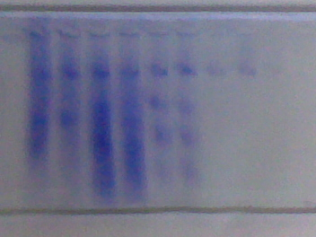
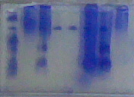
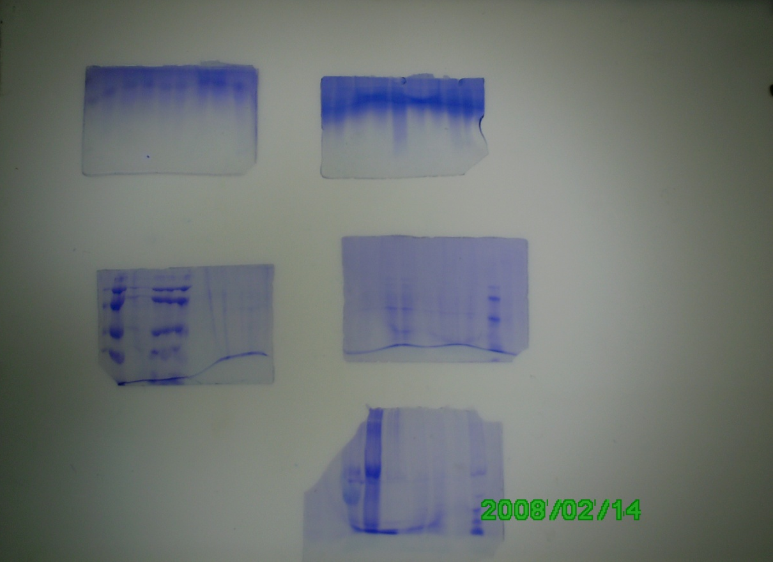

Slide 59
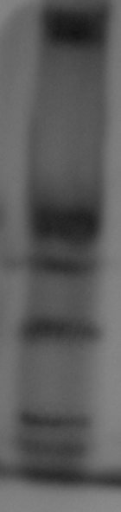
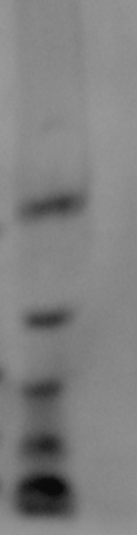
Phosphorylase 94 kDa
Albumin 67 kDa
Ovalbumin 43 kDa
Carbonic anhydrase 30 k Da
Trypsin inhibitor 20 kDa
α- Lactalbumin 14.4 kDa

Slide 60
Relative mobility = distance of the protein band / total distance
10%SDS- PAGE

Slide 61
THANK YOU

