Slide 1
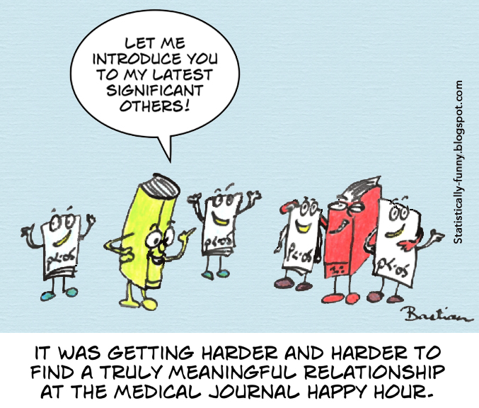

Slide 2
Many journals require confidence intervals, but most textbooks and studies discuss P values only for the null hypothesis of no effect.
This exclusive focus on null hypotheses
in testing not only contributes to
misunderstanding of tests and under appreciation of estimation
but also obscures the close relationship between P values and confidence intervals,
as well as the weaknesses they share.

Slide 3
Computations of p-values date back to the 1700s
Where they were computed for the human sex ratio at birth, and used to compute statistical significance compared to the null hypothesis of equal probability of male and female births.
John Arbuthnot studied this question in 1710
examined birth records in London for each of the 82 years from 1629 to 1710.
John Arbuthnot (1710). "An argument for Divine Providence, taken from the constant regularity observed in the births of both sexes" (PDF). Philosophical Transactions of the Royal Society of London. 27 (325–336): 186–190. doi:10.1098/rstl.1710.0011.
Stigler, Stephen M. (1986). The History of Statistics: The Measurement of Uncertainty Before 1900. Harvard University Press. pp. 225–226. ISBN 978-0-67440341-3.

Slide 4
In the 1770s , Pierre-Simon Laplace, instead used a parametric test,
He concluded by calculation of a p-value that the excess was a real, but unexplained, effect.
The p-value was first formally introduced by Karl Pearson, in his Pearson's chi-squared test, using the chi-squared distribution and notated as capital P.
The p-values for the chi-squared distribution (for various values of χ2 and degrees of freedom), now notated as P, was calculated in (Elderton,1902), collected in (Pearson 1914, pp. xxxi–xxxiii, 26–28, Table XII).
The use of the p-value in statistics was popularized by Ronald Fisher, and it plays a central role in his approach to the subject.
In his influential book Statistical Methods for Research Workers (1925), Fisher proposed the level p = 0.05, or a 1 in 20 chance of being exceeded by chance, as a limit for statistical significance, and applied this to a normal distribution (as a two-tailed test), thus yielding the rule of two standard deviations (on a normal distribution) for statistical significance (see 68–95–99.7 rule)

Slide 5
Through the 1960s it was a standard practice in many fields to report P values with the star attached to indicate:
one star to indicate P < 0.05
and two stars to indicate P < 0.01.
Occasionally three stars were used to indicate P < 0.001.
While Fisher developed this practice of quantifying the strength of evidence against null hypothesis some eminent statisticians where not accustomed to the subjective interpretation inherent in the method

Slide 6
If the level demanded for ‘significant’ is 0.05 or lower
and the P value that emerge is 0.06,
the investigator may be ready to discard a well-designed, excellently conducted, thoughtfully analyzed, and scientifically important experiment because it failed to cross the Procrustean boundary demanded for statistical approbation.

Slide 7
This confusion, perpetuated by medical journals, textbooks of statistics, reviewers and editors, have almost made it impossible for research report to be published without statements or notations such as, “statistically significant” or “statistically insignificant” or “P<0.05” or “P>0.05”.
“can we get rid of P-values?”. the answer :“practical experience says no-why?”

Slide 8
Italicisation, capitalisation and hyphenation of the term varies.
For example”
AMA (American medical association) style uses "P value"
APA (American psychological association) style uses "p value“ >>> academic documents .. Journals
American Statistical Association uses "p-value"

Slide 9
All hypothesis tests ultimately use a p-value to weigh the strength of the evidence (what the data are telling you about the population).
The p-value is a number between 0 and 1 and interpreted in the following way:
A small p-value (typically ≤ 0.05) indicates strong evidence against the null hypothesis, so you reject the null hypothesis.
A large p-value (> 0.05) indicates weak evidence against the null hypothesis, so you fail to reject the null hypothesis.
p-values very close to the cutoff (0.05) are considered to be marginal (could go either way). Always report the p-value so your readers can draw their own conclusions.

Slide 10
Definition
One advantage is that the P-value provides an intuitive measure of the strength of evidence in the data against H0.
The P-value is the probability, calculated assuming that the null hypothesis is true, of obtaining a value of the test statistic at least as contradictory to H0 as the value calculated from the available sample.

Slide 11
The P-value is a probability.
This probability is calculated assuming that the null hypothesis is true.
Beware: The P-value is not the probability that H0 is true, nor is it an error probability!
To determine the P-value, we must first decide which values of the test statistic are at least as contradictory to H0 as the value obtained from our sample.

Slide 12
Examples
P-value = 0.250
In this case, fully 25% of all possible test statistic values are at least as contradictory to H0 as the one that came out of our sample.
So our data is not all that contradictory to the null hypothesis.
P-value = 0.0018
Here, only 0.18% (much less than 1%) of all possible test statistic values are at least as contradictory to H0 as what we obtained.
Thus the sample appears to be highly contradictory to the null hypothesis.

Slide 13
More generally:
The smaller the P-value, the more evidence there is in the sample data against the null hypothesis and for the alternative hypothesis.
That is, H0 should be rejected in favor of Ha when the P-value is sufficiently small.
So what constitutes “sufficiently small”?

Slide 14
Thus if the P-value exceeds the chosen significance level, the null hypothesis cannot be rejected at that level.
reject H₀ if P-value ≤ α
do not reject H₀ if P-value > α
But if the P-value is equal to or less than α, then there is enough evidence to justify rejecting H₀.
In Example: we calculated P-value = 0.0012.
Then using a significance level of 0.01,
we would reject the null hypothesis in favor of the alternative hypothesis because 0.0012 ≤ .01.

Slide 15
However, suppose we select a significance level of only .001, which requires more substantial evidence from the data before H₀ can be rejected. In this case we would not reject H₀ because .0012 ≤ .001.
How does the decision rule based on the P-value compare to the decision rule employed in the rejection region approach?
The two procedures—the rejection region method and the P-value method—are in fact identical.

Slide 17
Q. A significant test result (P ≤ 0.05) means that the test hypothesis is false or should be rejected?
A. No! A small P value simply flags the data as being unusual if all the assumptions used to compute it (including the test hypothesis) were correct; it may be small because there was a large random error or because some assumption other than the test hypothesis was violated (for example, the assumption that this P value was not selected for presentation because it was below 0.05).
P ≤ 0.05 only means that a discrepancy from the hypothesis prediction (e.g., no difference between treatment groups) would be as large or larger than that observed no more than 5 % of the time if only chance were creating the discrepancy (as opposed to a violation of the test hypothesis or a mistaken assumption).

Slide 19
Q. A non-significant test result (P > 0.05) means that the test hypothesis is true or should be accepted?
No! A large P value only suggests that the data are not unusual if all the assumptions used to compute the P value (including the test hypothesis) were correct. The same data would also not be unusual under many other hypotheses. Furthermore, even if the test hypothesis is wrong, the P value may be large because it was inflated by a large random error or because of some other erroneous assumption (for example, the assumption that this P value was not selected for presentation because it was above 0.05).
P > 0.05 only means that a discrepancy from the hypothesis prediction (e.g., no difference between treatment groups) would be as large or larger than that observed more than 5 % of the time if only chance were creating the discrepancy.

Slide 20
Q. A large P value is evidence in favor of the test hypothesis?
A. No! In fact, any P value less than 1 implies that the test hypothesis is not the hypothesis most compatible with the data, because any other hypothesis with a larger P value would be even more compatible with the data.
A P value cannot be said to favor the test hypothesis except in relation to those hypotheses with smaller P values. Furthermore, a large P value often indicates only that the data are incapable of discriminating among many competing hypotheses (as would be seen immediately by examining the range of the confidence interval).
For example, many authors will misinterpret P = 0.70 from a test of the null hypothesis as evidence for no effect, when in fact it indicates that, even though the null hypothesis is compatible with the data under the assumptions used to compute the P value, it is not the hypothesis most compatible with the data—that honor would belong to a hypothesis with P = 1. But even if P = 1, there will be many other hypotheses that are highly consistent with the data, so that a definitive conclusion of “no association” cannot be deduced from a P value, no matter how large.

Slide 21
Q. Lack of statistical significance indicates that the effect size is small?
A. No! Especially when a study is small, even large effects may be “drowned in noise” and thus fail to be detected as statistically significant by a statistical test.
A large null P value simply flags the data as not being unusual if all the assumptions used to compute it (including the test hypothesis) were correct; but the same data will also not be unusual under many other models and hypotheses besides the null. Again, one must look at the confidence interval to determine whether it includes effect sizes of importance.

