Slide 1
بِسْمِ اللهِ الرَّحْمَنِ الرَّحِيْمِ
﴿ وَمَنْ يَتَّقِ اللَّهَ يَجْعَلْ لَهُ مَخْرَجًا (٢) وَيَرْزُقْهُ مِنْ حَيْثُ لَا يَحْتَسِبُ وَمَنْ يَتَوَكَّلْ عَلَى اللَّهَ فَهُوَ حَسْبُهُ إِنَّ اللَّهَ بَالِغُ أَمْرِه قَدْ جَعَلَ اللَّهُ لِكُلِّ شَيْءٍ قَدْرًا (٣) ﴾
صدق الله العظيم
سورة الطلاق جزء من الاية 2-3

Slide 2
Detection of serum microRNA as early biomarkers for incidence of breast cancer in Iraqi women
Al-Nahrain University
College of Science/ Biotechnology Department
Supervised by
Dr. Hameed M. Jasim Dr. Nahi Y. Yassen
Professor Professor

Slide 3
Introduction

Slide 4
Cancer
The division of normal cells is precisely controlled. New cells are only formed for growth or to replace dead cells.
Cancerous cells divide repeatedly out of control even though they are not needed, they crowd out other normal cells and function abnormally. They can also destroy the correct functioning of major organs.

Slide 5
Breast Cancer
Breast Cancer occurs when a mutation takes place in the cells that line the lobules (that manufacture milk) or more commonly in the ducts (that carry the milk to the nipple).
The area around the center of the breast is where most cancers occur.
It is fairly rare for cancers to form in the fat or non-glandular tissues of the breast.

Slide 6
The diagnosis of breast cancer in women represents the major problems for early detection, accurate staging and monitoring of breast cancer. Thus, there is still need to develop a cost-effective and accurate screening method for this cancer and discover new biomarkers to improve diagnosis, prognosis and prediction.
The goal of screening for early breast cancer detection is to find the cancer before it starts to cause symptoms. Screening used to find a disease, such as cancer, in people who do not have any symptoms. Early detection means using an approach that lets breast cancer get diagnosed earlier than otherwise might have occurred.

Slide 7
Breast cancer can be diagnosed by careful physical examination, mammography, ultrasound (U/S), magnetic resonance imaging (MRI) and breast biopsy. With recent technological advances, gene expression profiling is used also to detect early breast cancer and predict their prognostic outcomes.

Slide 8
The increasing number of studies that prove the presence of miRNAs in circulating (serum/plasma) increases the chance of using this miRNAs as a good biomarker for cancer and other diseases.
miRNA expression levels are aberrantly altered in breast cancer such as miR-21, miR-155 and miR-10b are over expressed; whereas miR-221, miR-125b and miR-145 are down regulated, which highlight the importance of microRNA as a good biomarker in serum/ plasma of breast cancer patients.

Slide 9
What is a miRNA?
Small single stranded RNAs (21-25 nucleotides) but derived from larger precursors (double stranded RNAs)
Non-coding sequences
Form imperfect stem-loop structures (hairpin)
Hybridize by incomplete base-pairing to several sites in the 3’-untranslated regions of target mRNAs
Negative regulators of gene expression (Postranscriptional and Translational regulation )
Role in disease and cancer still in research

Slide 10
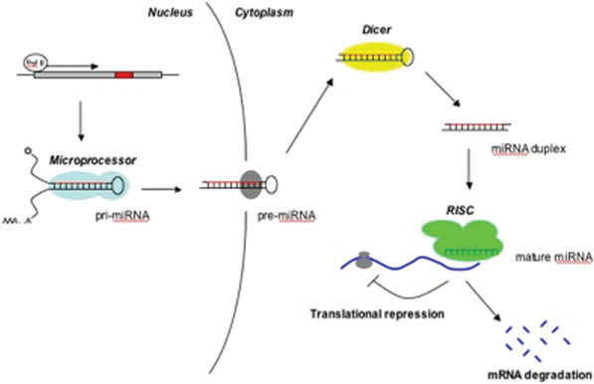
Biogenesis of miRNA

Slide 12
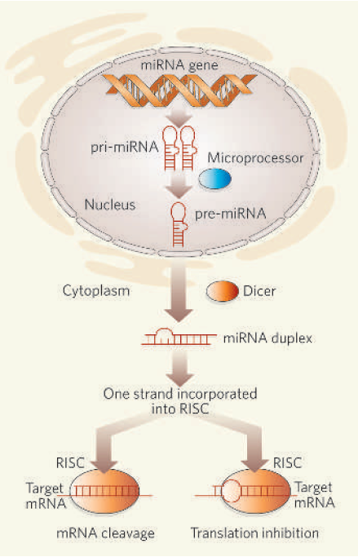
↑ Match with target (degree of complementarity)
= ↑ Prob. of degradation
Possibly each miRNA may target multiple genes
miRNA ≠ siRNA
Biochemically indistinguishable
Single vs double-stranded
Repression vs degradation
Post-Transcriptional Gene Silencing (PTGS) vs TransIational Inhibition

Slide 13
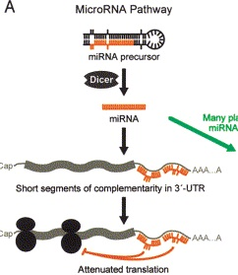
A model for miRNA function

Slide 14
SERUM AND BODY FLUID MiRNAs AS BIOMARKERS
Multiple miRNAs have been characterized not only in serum but also in tears, urine, breast milk, seminal fluid, saliva, amniotic fluid, cerebrospinal fluid and peritoneal fluid
A select number of miRNAs may serve as diagnostic markers for different tumor types
The ideal properties of biomarker should be disease specific, able to differentiate between pathologies, rapid and significant release during pathology development, long life in sample, rapid, simple, accurate and inexpensive for detection, un affected by environmental conditions and present in accessible body fluid.

Slide 15
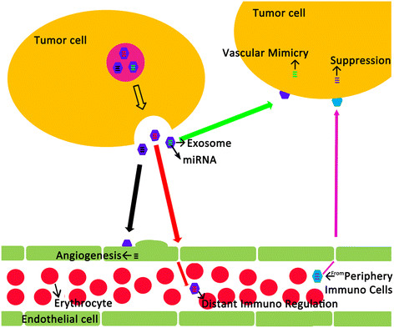

Slide 16
This study was aimed to:
Measuring the levels of estrogen and progesterone hormones in serum of Iraqi breast cancer and healthy women.
Detection of microRNAs molecules in the serum samples of Iraqi breast cancer and healthy women.
Detection of microRNAs molecules in the plasma samples of breast cancer and healthy women.
Measuring of the levels of circulating microRNAs in serum samples by determine the fold expression of the detected microRNAs in all samples.
Determine the presence of some biomarkers associated with breast cancer by determine the apoptotic genes such as p53, p21, Bcl2, Bax and TWIST.

Slide 17
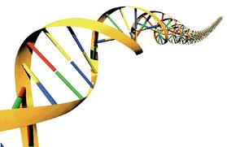
Methodology

Slide 18
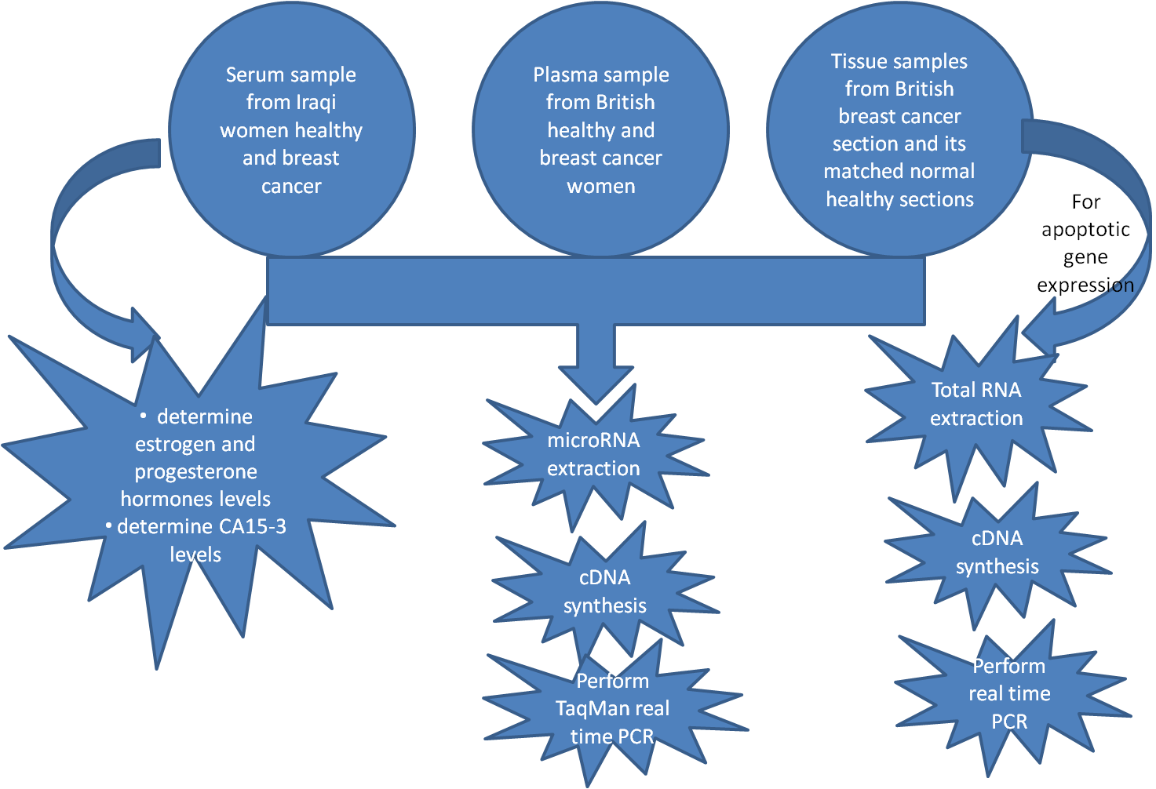

Slide 19
Step 1
Extraction of microRNA
Step 2
Conversion of miRNA to cDNA by TaqMan Probe
Step 3
Perform TaqMan qPCR assay
Step 4
Determine fold expression of each miRNAs in each sample

Slide 20
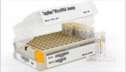
microRNA TaqMan assay contents:
One tube containing miRNA-specific RT primer TaqMan PCR Master Mix (2X)
• TaqMan microRNA assay (20X) One tube containing a mix of:
– miRNA-specific forward PCR primer
– specific reverse PCR primer
– miRNA-specific TaqMan MGB probe
The selected microRNAs were: let7a, miR-21, miR-15b, miR-26b, miR-27a, miR-34a, miR-34b, miR-429, mir-205, miR-218, miR-222, miR-378 and miR-191 (as endogenous control).

Slide 21
TaqMan Probe
Oligonucleotides that contain a fluorescent dye, typically on the 5' base, and a quenching dye, typically located on the 3' base.
During PCR, when the polymerase replicates a template on which a TaqMan probe is bound, the 5' exonuclease activity of the polymerase cleaves the probe.
This separates the fluorescent and quenching dye. Fluorescence increases in each cycle, proportional to the rate of probe cleavage.
5’Fluorophore
3’Quencher
C
G
G
C
Fluorescing
C
C
G
G

Slide 22
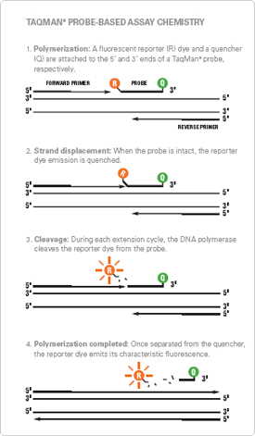
Taqman Probes
Fluorescence-labeled oligonucleotides
(TaqMan® probe)
TaqMan probes are complementary to a region
of the target gene
The 5' to 3' exonuclease activity
of the polymerase cleaves the probe, releasing the fluorophore into solution

Slide 23
Results

Slide 24
Case | Sample | Age (year) | Weight (Kg) | Marital Status | No. of child | Side of mass | Family history
1 | Normal | 63 | 65 | Married | 3 | Left | None
2 | Normal | 64 | 90 | Married | 8 | Left | None
3 | Normal | 42 | 72 | Married | 0 | None | Untie
4 | Normal | 40 | 80 | Married | 5 | None | None
5 | Normal | 40 | 60 | Married | 8 | Right | Sister
6 | Normal | 22 | 50 | Single | 0 | Left | None
7 | Cancer | 50 | 95 | Married | 3 | Left | None
8 | Cancer | 56 | 70 | Married | 0 | Right | None
9 | Cancer | 63 | 70 | Married | 0 | Left | None
10 | Cancer | 47 | 88 | Married | 9 | Left | None
11 | Cancer | 50 | 80 | Married | 7 | Left | None
12 | Cancer | 36 | 85 | Single | 0 | Right | Untie
13 | Cancer | 45 | 59 | Married | 0 | Left | None
14 | Cancer | 50 | 60 | Married | 2 | Left | None
15 | Cancer | 50 | 70 | Married | 2 | Right | None
16 | Cancer | 46 | 75 | Married | 6 | Right | None
17 | Cancer | 36 | 70 | Single | 0 | Right | None
18 | Cancer | 50 | 80 | Married | 1 | Both | None
19 | Cancer | 73 | 80 | Married | 5 | Left | None
20 | Cancer | 32 | 90 | Married | 4 | Right | None
21 | Cancer | 54 | 80 | Married | 3 | Left | Untie
History of Iraqi women (healthy and other diagnosed with breast cancer)

Slide 25
Case | Sample | Age (year) | Estrogen (pg/ml) | Progesterone (ng/ml) | CA 15-3 (U/ml) | BIRADS * result
1 | Normal | 63 | 15.51 | 0.356 | 13.18 | 1
2 | Normal | 64 | 17.69 | 0.514 | None | 1
3 | Normal | 42 | 155.3 | 0.31 | 16.48 | 2
4 | Normal | 40 | 46.35 | 0.392 | 6.10 | 2
5 | Normal | 40 | 38.28 | 0.263 | 14.31 | 1
6 | Normal | 22 | 128..9 | 0.955 | 13.77 | None
7 | Cancer | 50 | 25.29 | 0.324 | 9.97 | 4
8 | Cancer | 56 | 18.92 | 0.077 | 70.65 | Metastasis
9 | Cancer | 63 | 32.3 | 0.323 | 9.93 | Ductal Carcinoma
10 | Cancer | 47 | 205.3 | 0.434 | 15.41 | 4
11 | Cancer | 50 | 248 | 0.226 | 14.26 | 3
12 | Cancer | 36 | 130.9 | 6.03 | 22.22 | 4
13 | Cancer | 45 | 119.7 | 0.193 | 4.89 | 4
14 | Cancer | 50 | 188.2 | 0.06 | 19.89 | 4
15 | Cancer | 50 | 22.6 | 0.599 | 14.76 | 3
16 | Cancer | 46 | 27.26 | 0.181 | 3.72 | None
17 | Cancer | 36 | 101.5 | 0.302 | 18.66 | Zero
18 | Cancer | 50 | 23.85 | 0.402 | None | 4
19 | Cancer | 73 | 14.88 | 0.436 | 23.94 | 3
20 | Cancer | 32 | 220 | 9.5 | 18.97 | 4
21 | Cancer | 54 | 25.98 | 0.176 | 29.9 | 5
Table 1: Hormones level and CA15-3 status in serum of Iraqi women
**Fluctuation in the levels of hormones and no perfect indication in result of CA15-3
BIRADS: Breast Imaging-Reporting and Data System. BI-RADS Assessment Categories are:
0: Incomplete,
1: Negative,
2: Benign finding(s),
3: Probably benign,
4: Suspicious abnormality,
5: Highly suggestive of malignancy,
6: Known biopsy – proven malignancy.

Slide 26
Iraqi Serum samples
Figure 1: qRT-PCR results of miRNAs expressions.
* Expression of Let-7a was higher in serum of Iraqi breast cancer women;
* Expression of miR-21 was higher in serum of Iraqi breast cancer women.

Slide 27
Iraqi Serum samples
Figure 2: qRT-PCR results of miRNAs expressions.
* Expression of miR-26b was lower in serum of Iraqi breast cancer women;
* Expression of miR-429 was lower in serum of Iraqi breast cancer women compared to healthy group.

Slide 28
British Plasma samples
Figure 3: qRT-PCR results of miRNAs expressions.
* Expression of Let-7a was higher in british plasma samples of breast cancer women;
* Expression of miR-26b was higher in british plasma samples of breast cancer women

Slide 29
Figure 4: qRT-PCR results of miRNAs expressions.
* Expression of miR-222 was lower in plasma of british breast cancer women;
* Expression of miR-27a was lower in plasma of british breast cancer women compared to healthy group.

Slide 30
Plasma / Serum | Up/Down Expression | Novel Non Significant microRNAs
Serum plasma | up | miR-15b
Serum | up | miR-378
serum | up | miR-218
Serum | down | miR-222
Serum | up | miR-27a
Plasma | Up | miR-429
Plasma | Down | miR-34a
plasma | Down | miR-34b

Slide 31
British Tissue samples
Figure 5: qRT-PCR results of miRNAs expressions.
* Expression of miR-21 was higher in tissue sections from british breast cancer women;
* Expression of miR-429 was higher in tissue sections from british breast cancer women compared to its matched normal tissues.

Slide 32
Figure 6: qRT-PCR results of miRNAs expressions.
* Expression of miR-26b was lower in tissue sections from british breast cancer women;
* expression of miR-378 was lower in tissue sections from british breast cancer women compared to its matched normal tissues.

Slide 33
Apoptotic genes
Figure 7: qRT-PCR results of genes expressions.
* Expression of p53 gene was lower in tissue sections from british breast cancer women;
* expression of p21 gene was lower in tissue sections from british breast cancer women;

Slide 34
Apoptotic genes
Figure 8: qRT-PCR results of genes expressions.
* Expression of TWIST gene was higher in in tissue sections from british breast cancer women;
* Expression of Bax gene was higher in in tissue sections from british breast cancer women

Slide 35
Apoptotic genes
Figure 9: qRT-PCR results of genes expressions.
* Expression of BRCA2 gene was higher in tissue sections from British breast cancer women

Slide 36
Conclusions
Estrogen and progesterone hormones levels did not show a perfect indication for early diagnosis of breast cancer and their changes may be due to menopause status, and also CA15-3 biomarker did not represent ideal indicator for early incidence of breast cancer.
Let-7a and miR-21 were found to be over expressed in serum samples of Iraqi breast cancer women compared with healthy controls,
While miR-26b and miR-429 were found to be novel biomarkers in detection of breast cancer in serum samples of Iraqi women because of their down- regulation in patients compared with healthy controls.

Slide 37
Let-7a and miR-26b were found to be over expressed in plasma samples of British breast cancer women compared with healthy controls and represent novel biomarkers in detection of breast cancer in plasma samples. Whereas miR-27a and miR-222 were found to be down- regulated in plasma samples of British breast cancer women compared with healthy controls and represent novel biomarkers.
In tissues sections of British breast cancer women, the expression of miR-21 and miR-429 (the novel) were up-regulated in cancer sections compared to its matched normal breast tissues,
while miR-378 and miR-26b were found to be down-regulated in tissues of British breast cancer women so regarded as novel biomarkers in detection of breast cancer in tissue sections.
The expression of apoptotic genes in British breast cancer women: P53 and P21 were significantly down regulated in British breast cancer tissues compared to normal its matched tissues
while Bax, TWIST and BRCA2 were significantly up-regulated in the same groups.

Slide 38
Recommendations
Further studies are required to identify the expression of these microRNAs (used in current study) in serum of other types of cancers for example lung cancer, prostate cancer, gastric cancer etc, as an early diagnosis of cancer using microRNAs
Investigate the expression of other novel microRNAs in plasma/ serum of breast cancer women as early diagnosis in detection of breast cancer
Study the correlation between obesity with miRNA expression in a way to determine miRNA expression changes in obese people.
Determine the correlation between age and telomere expression with miRNA expression to determine the role of miRNA in telomere shortening in cancer cells.

