Slide 1
Real time PCR results analysis
Presented by
Dr. Zaynab Saad
Researcher at molecular biology dep.

Slide 2
Real time PCR is the most accurate method to detect :
Copy number of each gene
Amount of gene expression
Efficiency of drugs
Virus infection
Different type of Pathogens
( CMV, streptococcus, mycobacterium, HIV & … )
Methylation of DNA
Different type of mutations

Slide 3
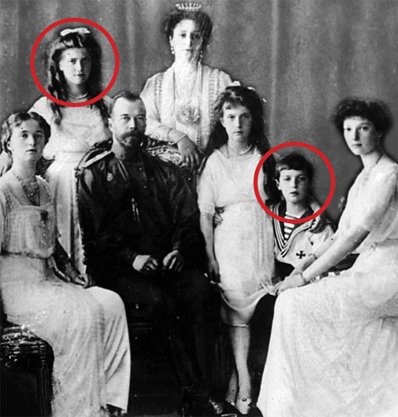
Real time PCR in forensic medicine
The main task in The Forensic Medicine is to investigate deaths from unnatural causes.
Forensic science has embraced the use of DNA molecular biology tools for diagnostic purposes more than any other scientific field.
The process of routine forensic human identification involves sensitive PCR and can be performed successfully on most evidence materials found at a crime scene.
This real-time technology monitors the accumulation
of PCR product with each cycle and allows assessment of each sample individually during the exponential growth phase.quantification assay has proven to be highly sensitive,specific,rapid, cost-effective and flexible assay for analysis of forensic casework samples.
DNA tests performed by a U.S. laboratory have proved that bone fragments exhumed in the Ural Mountains in 2007 belong to two children of Russia's last czar.

Slide 4
Many Software's
1 ) Light Cycler® Relative Quantification Software
The first commercially available software was the Light Cycler® Relative Quantification Software (2001).
2 ) REST
In 2002, the relative expression software tool (REST ) was established as a new tool.
3 ) Q-Gene
is able to perform a statistical test of the real-time data. Q-Gene manages and expedites the planning, performance and evaluation of quantitative real-time PCR experiments.
4 ) qBASE
QBASE is an Excel®-based tool for the management and automatic analysis of real-time quantitative PCR data.

Slide 5
more…
5 ) SoFAR
The algorithms implemented in SoFAR (distributed by Metralabs) allow fully automatic analysis of real-time PCR data obtained with a Roch LightCycler® (Roche Diagnostics) instrument. The software yields results with considerably increased precision and accuracy of real-time quantification.
6 ) DART-PCR
DART-PCR (Data Analysis for Real-Time PCR) provides a simple means of analyzing real-time PCR data from raw fluorescence data.This allows an automatic calculation of amplification kinetics, as well as performing the subsequent calculations for the relative quantification and calculation of assay variability.

Slide 6
Research Plan
Nucleic acid extraction
RNA Electrophoresis and cDNA synthesis
Perform quantitation
by real time PCR
Analysis of real time PCR data

Slide 7
RubisCO Primer Sets
Start Length Tm %G+C Seq
Primer Set A
Left Primer 276 20 60.69 45 AAATGGATGGGTTCCTTGCT
Right Primer 422 20 59.58 50 AAGACCTGGGTTGCATCAGT
Product Size: 147
Primer Set B:
Left Primer 216 22 59.87 50 GTCGTACCTTCCTGATTTGTCC
Right Primer 375 20 59.96 55 GGTCCAGTATCTGCCATCGT
Product Size: 160

Slide 8
Data Analysis Work Flow
Examine Data OPD File containing Data Output
NTC
Melt Curve
Amp Plots
Extract Amp Plots, Melt Curve and Raw Data using ICycler Software
Excel Data Analysis
Data Presentation and Interpretation

Slide 9
Melt Curve Analysis
Melt Curve used to Assess Specificity of Rxn
Do you have a single amplification peak or multiple amplification peaks?
Single Peak= Single Product
Multiple Peaks= Multiple Products
What is the peak melt temperature and how does this correlate with the expected melt peak temperature?
To further verify that you have amplified correct product can sequence amplification product

Slide 10
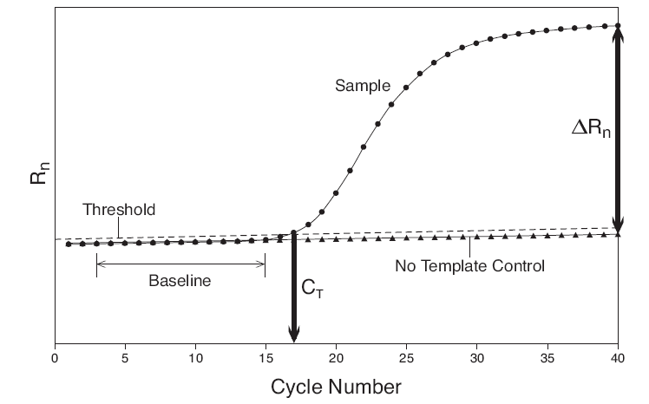
The Basic of Real time PCR
Log fluorescence (Rn)
Baseline – The baseline phase contains all the amplification that is below the level of detection of the real time instrument.
Threshold – where the threshold and the amplification plot intersect defines C_{T}. Can be set manually/automatically
C_{T} – (cycle threshold) the cycle number where the fluorescence passes the threshold
ΔR_{n} – (R_{n}-baseline)
NTC – no template control
ΔRn is plotted against cycle numbers to produce the amplification curves and gives the C_{T} value.

Slide 11
Using the PCR Equation
X_{n}
X_{n} = X₀(1 + E)^{n}
A
X_{n} =PCR product after cycle n
X₀ =initial copy number
E =amplification efficiency
n =cycle number
X₀
cycle number
A difference of 0.1 in amplification efficiency create a five-fold difference in the final ratio of PCR products after 30 cycles.
X_{n} = X₀(1+E)^{n}
Case 1: E = 0.9 Case 2: E = 0.8
X_{n} = 100 (1+0.9)³⁰
X_{n} = 100 (1+0.8)³⁰
X_{n} = 2.3 x 10¹⁰
X_{n} = 4.6 x 10⁹

Slide 12
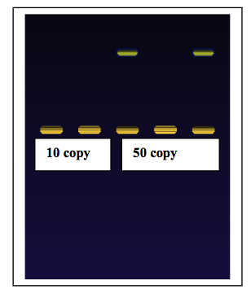
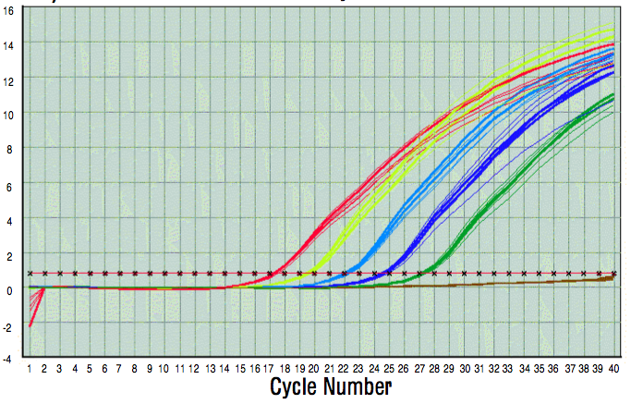
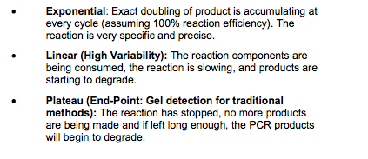
Amplification product detection:
1- end point, EtB, syber green, autoradiography
2- real time.
Standard PCR
Real-Time PCR
Plateau
phase
End Point
Linear
phase
Exponential
phase
Area of detection for
real-time PCR

Slide 13
The kinetics of Real time PCR
Plateau
Amplification is associated with fluorescence.
No need for end point analysis by Gel electrophoresis
CT- 10X baseline mean for cycles 2-10
Always look at the Y axis
Linear vs Log
[PCR Product]
Crossover Threshold

Slide 14
The sciense nad his aannoviation of statstical analysis

Slide 15
What we have to calculate ….

Slide 28
Ping, et al., 2016
Belete Teferedegne 2005
Northern Blot for MCP-1 induction by TNF
These experiments were performed 10 years apart
Real-time RT-PCR
Kinetics is great
Range and sensitivity of Real-time not seen in Northern

Slide 29
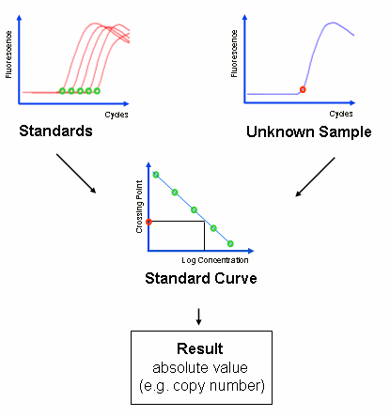

Slide 30
Commonly used standards
Glyceraldehyde-3-phosphate dehydrogenase mRNA
Beta-actin mRNA
MHC I (major histocompatability complex I) mRNA
Cyclophilin mRNA
mRNAs for certain ribosomal proteins
E.g. RPLP0 (ribosomal protein, large, P0; also known as 36B4, P0, L10E, RPPO, PRLP0, 60S acidic ribosomal protein P0, ribosomal protein L10, Arbp or acidic ribosomal phosphoprotein P0)
28S or 18S rRNA

Slide 33
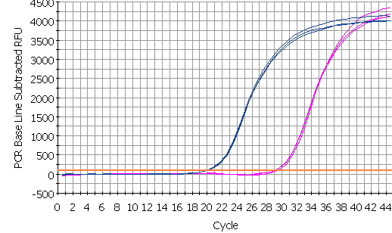
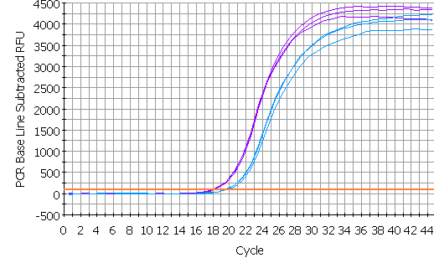
control
Δ Ct = target - ref
B-actin
Δ Ct = 9.70
IL1-b
av =19.93
av =29.63
experiment
Δ Ct = target - ref
IL1-b
Δ Ct = -1.7
B-actin
Difference = ΔCt-ΔCt
= ΔΔCt
= 9.70-(-1.7)
= 11.40
av =18.03
av =19.80
Notes:
The difference between the two delta Ct values (delta delta Ct, represents the corrected shift of the IL1-b. Since in this example in the vitreous treated sample the IL1-b has moved to the left of the standard, it has a negative value, but in maths subtraction of a negative value is equivalent to adding that value - which makes obvious sense (I hope) if you look at the diagram - the total shift is = the two green arrows added together. If the vit il1-b had shifted but remained to the right of the reference curve, the value would then be subtracted from the large green arrow to determine the shift.

Slide 34
Future Use
Researchers hope to achieve 84-91% detection
Will allow faster detection of cancer’s
Allow Doctor’s to customize treatment plan
Increase early detection and survival rates

Slide 35
Data from REST

Slide 36
Data from GraphPad PRISM

Slide 38
Hope it will be easy for you
You can fell free to contact me
zaynab.saad@iccmgr.org
Thank you for attending this workshop

