Slide 1
Lab – 16
Vibrio cholerae

Slide 2
Vibrio cholerae
Is a Gram negative comma-shaped bacterium
motile with a polar flagellum
causes cholera in humans.
The types of V. cholerae according to their antigenic structure;
a-classical type
b- El tor
c- ogawa
d- inaba
  e- hikojima
V. cholerae enters the human body through ingestion of contaminated food or water. The bacterium enters the intestine, imbeds itself in the villi, replicates and releases cholera toxin.

Slide 3
Vibrio cholerae
Laboratory diagnosis:
1. Specimen:
Stool, rarely vomit.
Transport media include
Sea salt medium
Alkaline peptone water. enrichment broth.
2. Staining: gram negative bacilli or comma shaped.

Slide 4
Vibrio cholerae
Culture:
TCBS (Thiosulfate citrate bile salt sucrose medium) is a selective agar medium
Indicator – bromothymol blue .Control is green ( prepared as plates )
After inoculation with suspected bacteria and a 18 to 24 hours’ incubation at 35° to 37°C on TCBS agar, colonies of V. cholerae will appear as yellow, shiny colonies, 2 to 4 mm in diameter.
The yellow color is caused by the fermentation of sucrose in the medium. Sucrose-non-fermenting organisms, such as V. parahaemolyticus, produce green to blue-green colonies.

Slide 5
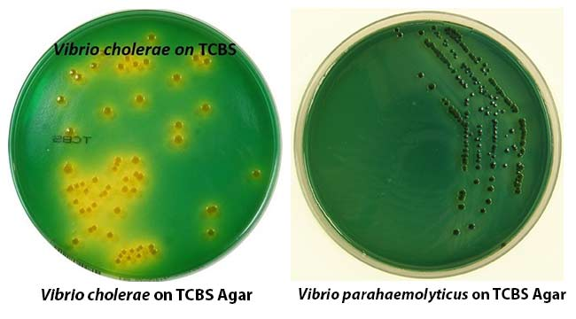
Vibrio cholerae
Thiosulfate-Citrate-Bile Salts-Sucrose (TCBS) Agar

Slide 6
Vibrio cholerae
Biochemical tests:
Vibrio cholerae appears as a late lactose fermenter
Motile
Urease -ve
Oxidase +ve
TSI ; A or k /A Gas –ve, H2S –ve

Slide 7
Vibrio cholerae
IMVIC
C | VI | M | I | Bacteria spp.
+ | + _ | + | + | Vibrio cholerae

Slide 8
Vibrio cholerae
Triple Sugar Iron
TSI
Gas | Slant | Butt | H2S | Bacteria spp.
_ | Acid or Alkaline | Acid | - | Vibrio cholerae

Slide 9
Motility Test
Vibrio cholerae
Bacteria spp.
Vibrio cholerae
motility
+

