Slide 1
Lab – 15
Enterobacteriaceae
Proteus and Pseudomonas

Slide 2
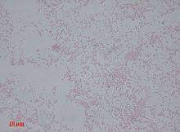
Proteus
Gram-ve , actively motile pleomorphism rods.
Causes UTI, wound infections, pneumonia, septicemia -meningitis.
Four species:
1. Proteus morgani,
2. Proteus vulgaris
3. Proteus mirabilis
4. Proteus rettgeri are distinguished from each other on the bases of fermentation of maltose, mannitol, sucrose .
All Proteus species are indole +ve except Proteus mirabilis.
All Proteus do not ferment mannitol except Proteus rettgeri (late fermenter).

Slide 3
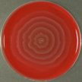
Proteus
Laboratory diagnosis:
1. Specimen: urine, exudates, swabs , Blood, CSF.
2. Smear & staining: G-ve bacilli, peomorphic
3. Culture
1. MacConkey…Proteus appear as a non- lactose fermenter. (pale yellow colonies).
2. EMB…. There is no metallic sheen on EMB.
3. Blood agar…highly motile ( swarming), therefore they produce swarming spread overgrowth on blood agar plate .swarming is characterized by expanding rings (waves) over the surface of blood agar.
Blood agar (swarming)

Slide 4
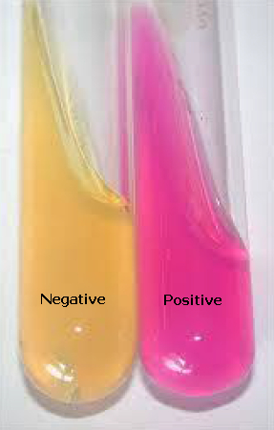
Proteus
4. Biochemical tests
I M Vi C
± + ± ±
TSI K / A Gas +ve H2S +ve
Or ; A / A Gas +ve H2S +ve
Urease test: + ve
Converting the slant of urea agar from yellow color to pink- purple color due to the utilization of urea by urease enzyme(produced by proteus) and the formation of ammonia converting the medium into an alkaline pH and producing a pink purple color by a change in the phenol red indicator.
Urease test

Slide 5
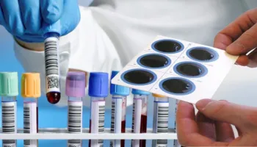
Proteus
5. Serology
Weil- felix test
Certain serotypes of proteus (OX19,OX2,OXK) have cross-reacting Ags with some Rickettsias (obligatory intracellular Gram-negative bacteria, zoonotic pathogens cause infections that disseminate in the blood to many organs). It serves as a useful clinical tool to determine if a person has been infected with rickettsia .
Mixing the serum of a patient suspected to have rickettsia infection with somatic proteus Ag. Ag-Ab agglutination indicating +ve results; ( weil- felix test +ve).

Slide 6
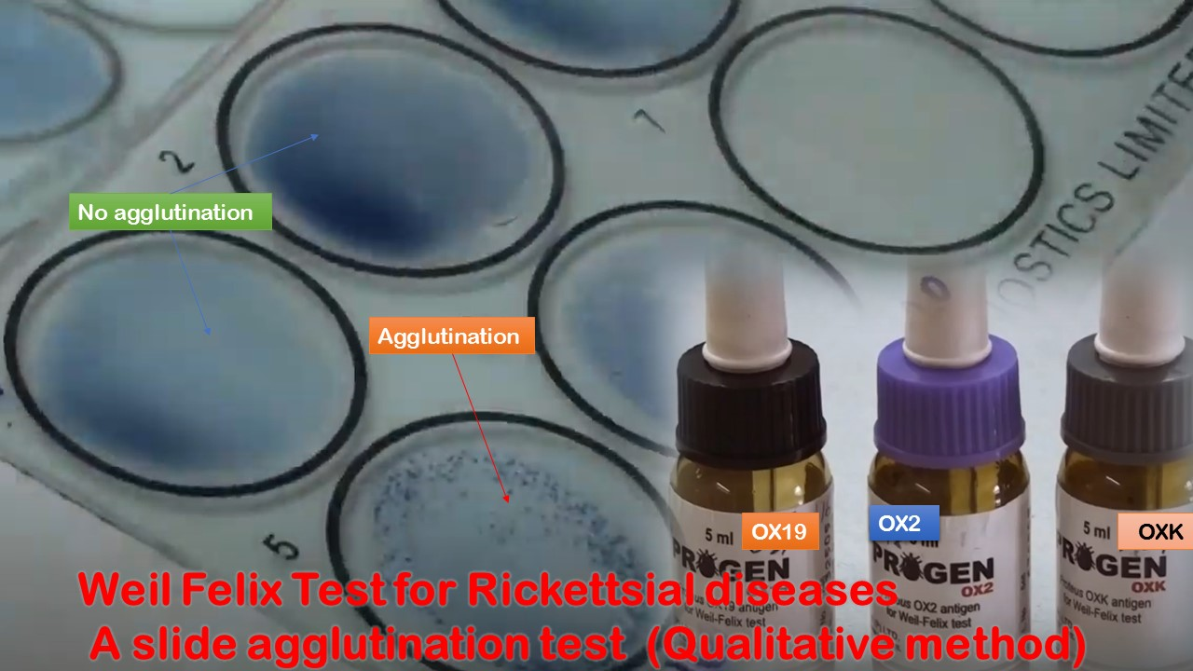
Proteus
The Weil-Felix is based on cross reaction which occur between antibodies produced in acute reckettsial infection with antigens of OX (OX2, OX19, and OXK) strains of proteus sp.
Used to diagnosed typhus, spotted fever and other reckettsial diseases.

Slide 7
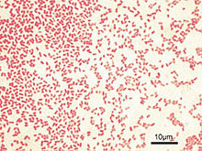
Pseudomonas
Members of this group are saprophytes in water and soil.
Only one spp is pathogenic to human: pseudomonas aerugenosa (pyocyanae)
Gram-negative, non spore forming, rod-shaped bacteria.
Motile species possess polar flagella.
They are strictly aerobic.
The spectrum of clinical disease of P. aerugenosa include:
Skin infection especially at burn site, trauma and wounds.
Urinary tract infection especially following catheterization.
Respiratory tract infection (pneumonia) in patient with cystic fibrosis.
Otitis external and eye infection.
Meningitis after lumber puncture.

Slide 8
Pseudomonas
Pseudomonas pigments
pyocyanin …. Blue color
pyoverdin….green (fluorescent) color
Pyorubin ….. reddish brown color
Pyomelanin …. Black color
Some strains of pseudomonas however do not produce any of these pigments.

Slide 9
Laboratory diagnosis
1. Specimen: urine , pus, blood, CSF, sputum, swab.
2. Staining gram négative non spore former and non capsulated
3. Culture:
MacConkey…… Pseudomonas appears as a non – lactose fermenter.
EMB......there is no metallic sheen on EMB agar.
Nutrient agar.... Pseudomonas aerogenosa produces a blue– green pigment and a fruity aroma.
Milk agar may be added to nutrient agar to give a white background.

Slide 10
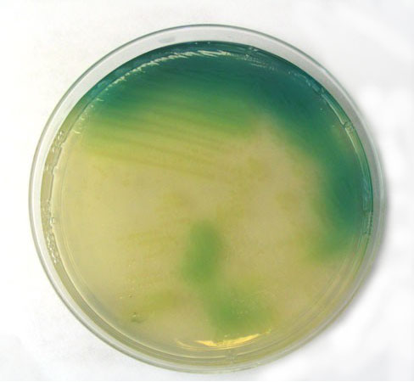
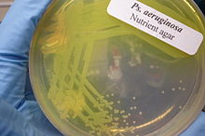
Pseudomonas aerogenosa
Pseudomonas on nutrient agar Pyocyanine Pigment

Slide 11
Pseudomonas aerogenosa
3. Biochemical tests
Ferment glucose with acid production without gas
Oxidase +ve
I M Vi C
- - - +
TSI: no change k/k Gas –ve H2S –ve

Slide 12
Thank You

