Slide 1
Karnaugh map simplification ( k-map )
مادة التصميم المنطقي (logic design )
المرحلة الاولى
استاذ المادة : أ.م أمين عبد الزهرة نور

Slide 2
Karnaugh map:
It is an important method to simplify or minimize a Boolean expression .
It is composed of number of adjacent "cells" . Each cell corresponds to a T.T. row , therefore there must be 2^{n}
Cells in the k-map ( where n=no. of input variables ) .

Slide 3
For two input variables (A&B) :

Slide 4
For three input variables ( A,B,C )

Slide 5
For four input variables ( A,B,C,D ) :

Slide 6
The first step in the minimization method is to implement the T.T. to the K-map.
1’s and 0’s in the output of the T.T. is placed in the cells corresponding to the input variables of the T.T.

Slide 8
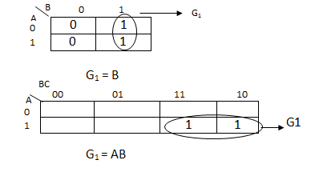
Adjacent cells :
The adjacent cells on k- map are those that differ by only one variable ( only one variable changes from 0 to 1 or 1 to 0 )

Slide 9
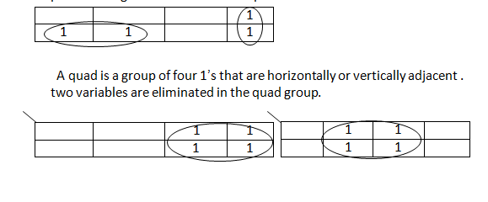
If more than one pair exist on k-map , we can OR the simplified products to get the final Boolean exp.

Slide 10
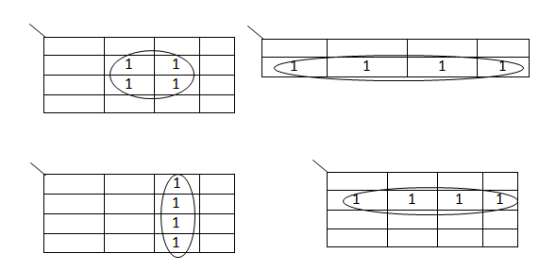

Slide 11
Octet is group of eight 1’s that are horizontally or vertically adjacent , so three variables can be eliminated .

Slide 12
Over lapping :
The same (1) can be used for more than one group

Slide 13
Rolling :

Slide 14
Summary of k-map method :
1-Implement the T.T. to k-map
2-Encircle the octet , quads and pairs . Remember to roll and overlap to get the largest possible group.
3- If any isolated 1’s , encircle each .
4-Write the Boolean exp. By ORing the products
corresponding to the encircle groups.

Slide 15
EX: simplify the following function using k-map F(A,B,C) = ∑ (0,1,2,3,5)

Slide 16
EX: Simplify the following function using k-map F (ABC) = ∑ m₀ , m₁ , m₄ , m₅

Slide 17
EX: Simplify the following function using k-map : F (ABCD) = ∑ (0,2,3,4,6,10,12,13,14)

Slide 20
Don’t care condition :
Some logic ccts. can be designed so that there are certain input conditions for which there are no specified output levels , because these input conditions will never occur.
It is necessary to specify the output for these conditions by either (0) or (1) in order to produce the simplest output exp.

