Slide 1

Third class
Software Design
Software Engineering
2020

Slide 2

Software Design is a process to transform user requirements into some suitable form, which helps the programmer in software coding and implementation
One goal of software design is to derive an architectural rendering of a system.
أحد أهداف تصميم البرامجيات هو استنتاج عرض معماري للنظام
A set of architectural patterns enable a software engineer to reuse design level concepts
مجموعة من الأنماط المعمارية تساعد مهندس البرامجيات من إعادة استخدام فكرة مستوى التصميم

Slide 3
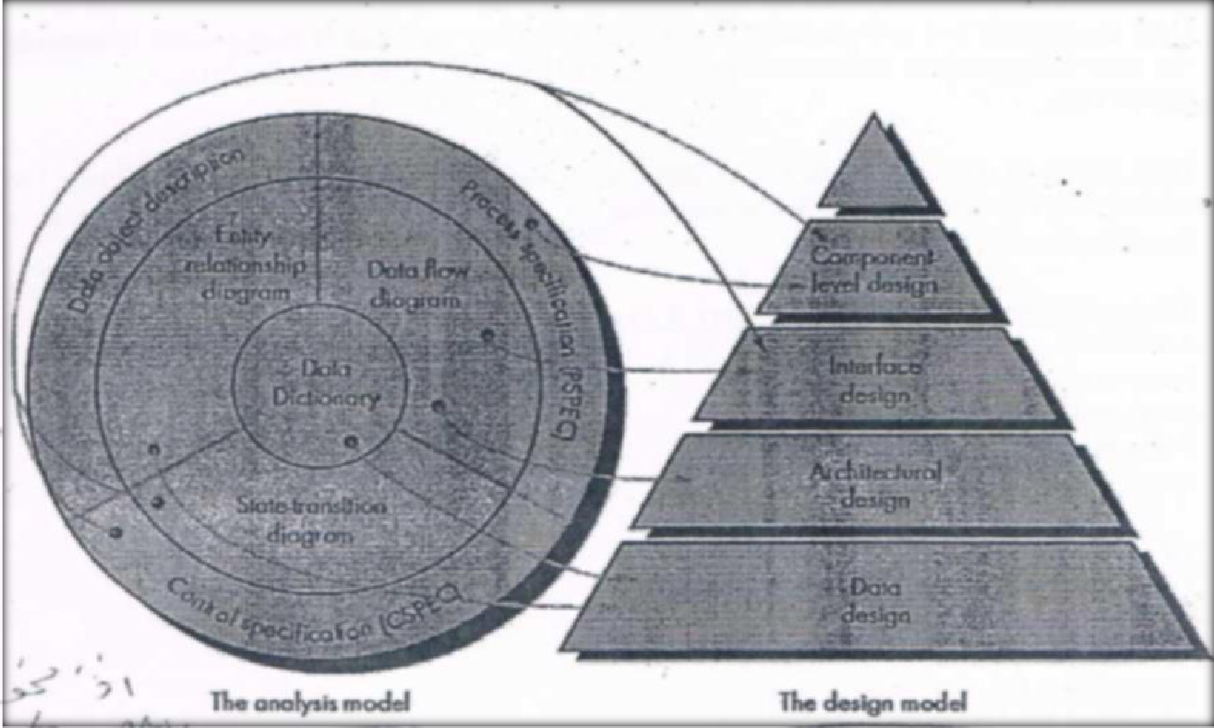
Diagram show translating the analysis model into a software design

Slide 4
  Software Design Levels (Activities of Software Design)
Data Design
Architectural Design
User Interface Design
Procedural Design (Module)

