Slide 1

Third class
Software Engineering
2020

Slide 2
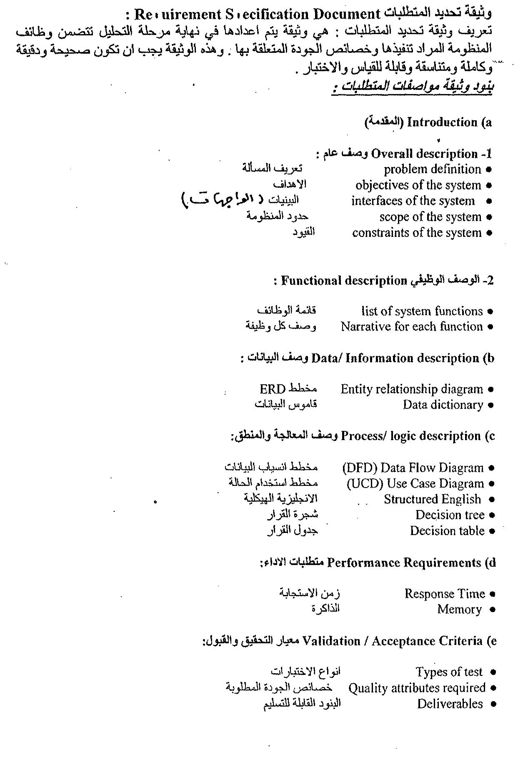

Slide 3
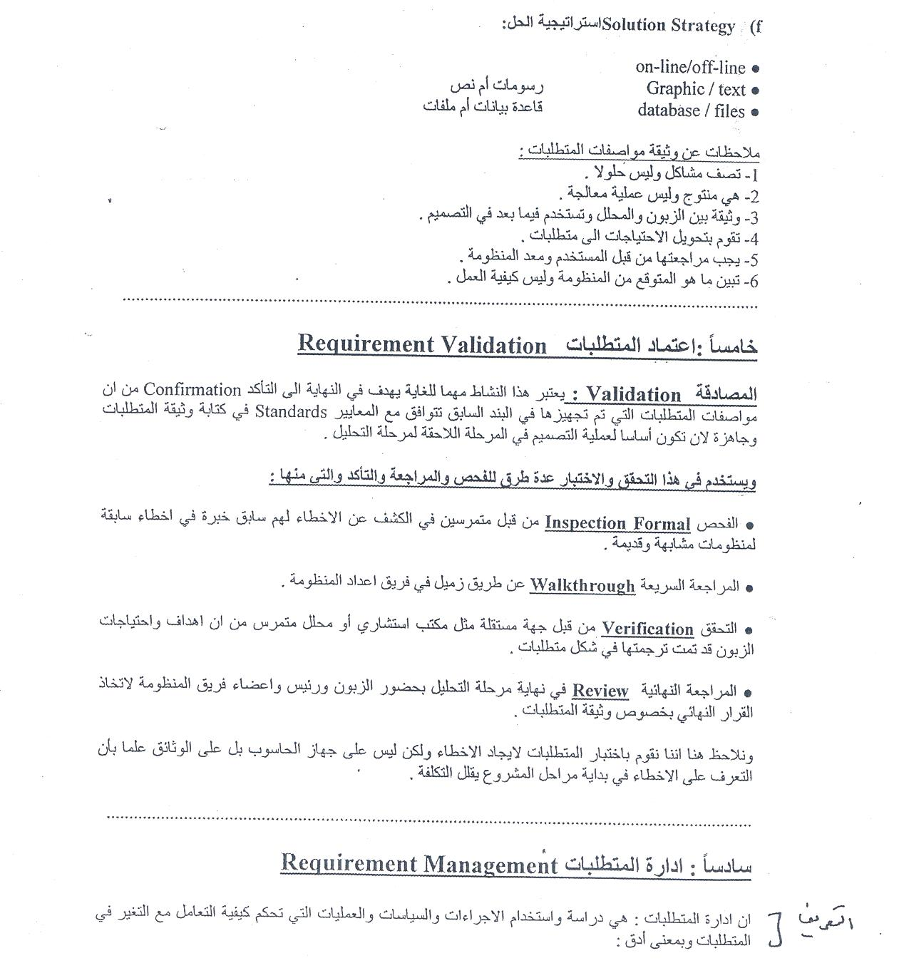

Slide 4
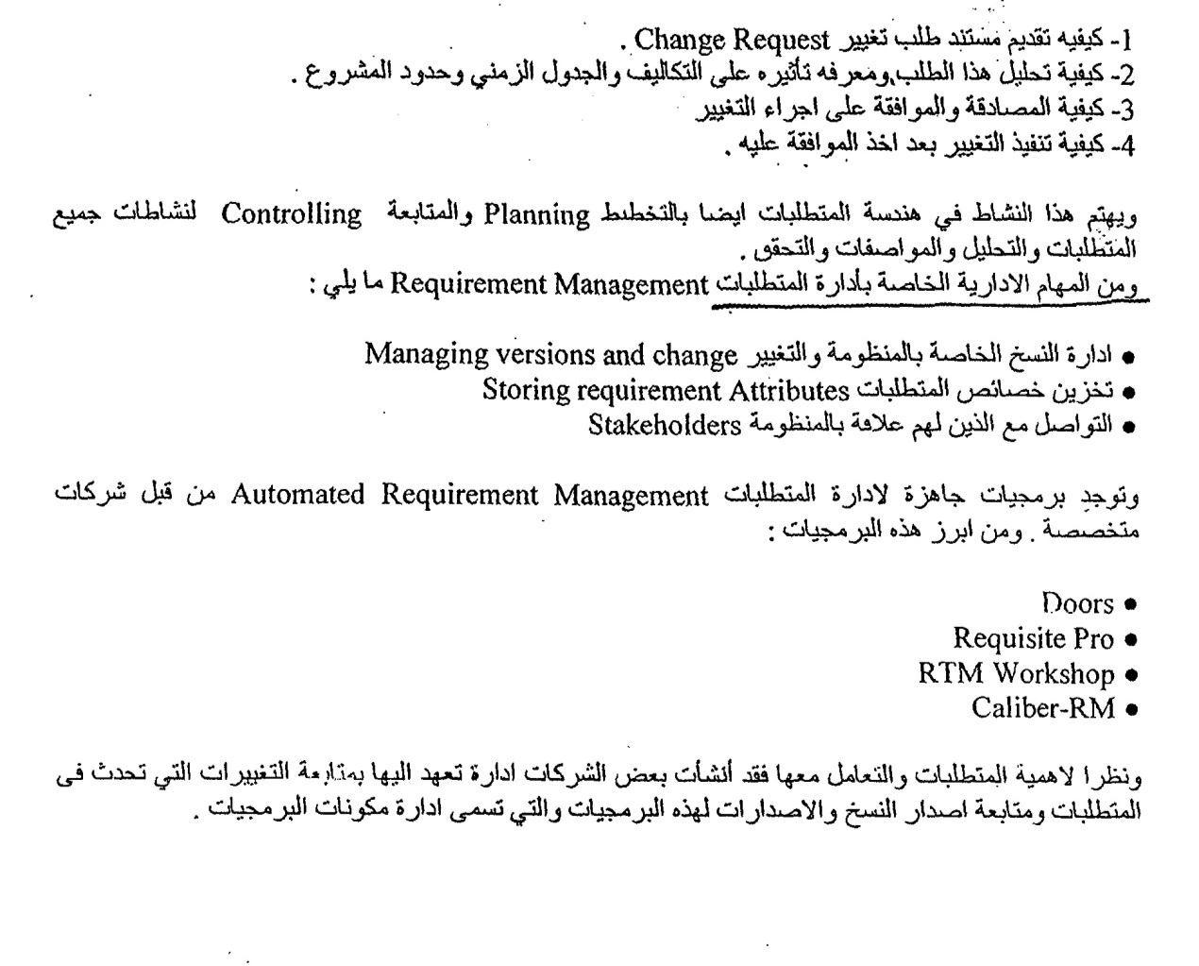

Slide 5
Formal Requirements
Analysis Model
Analysis Model Objectives and Elements of Analysis Model
Data Model
Creating an Entity/Relationship Model
Creating a Data Flow Model

Slide 6
Analysis Model
The analysis model, actually a set of models, is the first technical representation of a system. Over the years many methods have been proposed for analysis modeling, however, two now dominate. The first, structured analysis is a classical modeling method and is described in this chapter. The other approach, object oriented analysis.
نموذج التحليل هو مجموعة من النماذج و يمثل اول تمثيل تقني للنظام. على مر من السنين تم افتراض او اقتراح العديد من الطرق لنمذجة التحليل . على كل حال هناك نموذجان يهيمنان الآن. الأول هو structured analysis هو طريقة الكلاسيكية و سيتم شرحه في هذا الفصل . النموذج الآخر هو
object oriented analysis

Slide 7
Analysis Model Objectives
The analysis model must achieve three primary objectives:
To describe what the customer requires.
لوصف ما يطلبه العميل
To establish a basis for the creation of a software design
لوضع اساس لانشاء تصميم برمجيات
To define a set of requirements that can be validated once the software is built.
لتحديد مجموعة من المتطلبات التي يمكن التحقق من صحتها بمجرد إنشاء البرنامج.

Slide 8
Analysis Model Objectives Cont.
To accomplish these objectives, The analysis model derived during structured analysis takes the form illustrated in Figure of the next slide

Slide 9
