Slide 1
Knowledge Representation
Frames
Assistant Prof. Dr. Emad I Abdul Kareem

Slide 2
Knowledge Representation
1- Predicate logic
2- Semantic net
3- Conceptual graph
4- Frame

Slide 3
Frames
Definitions and Overview
Frame: Data structure that includes all the knowledge about a particular object.
Each Frame Describes One Object

Slide 4
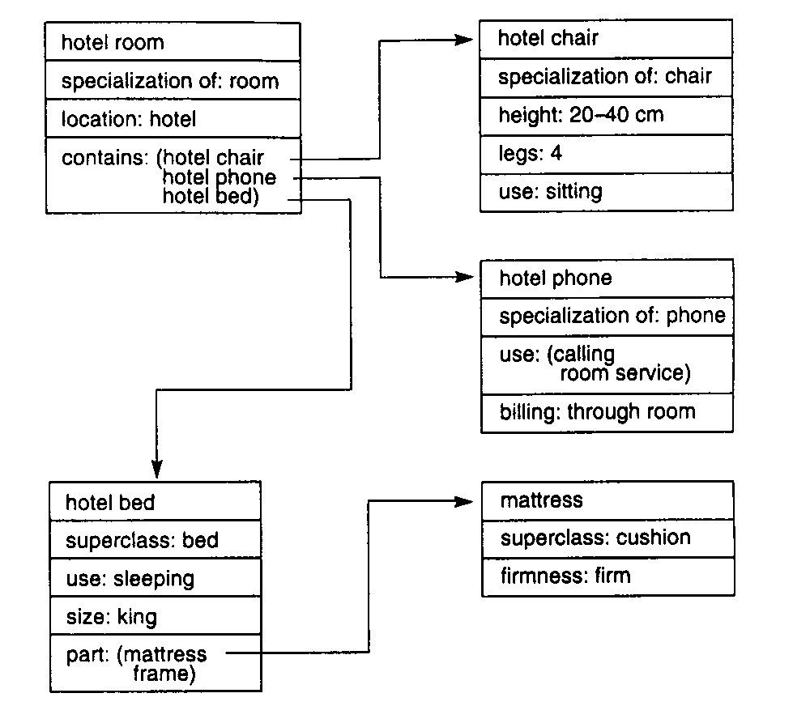
Knowledge organized in a hierarchy for diagnosis of knowledge independence
Form of object-oriented programming for AI and ES.
Frame for a Hotel Room

Slide 5

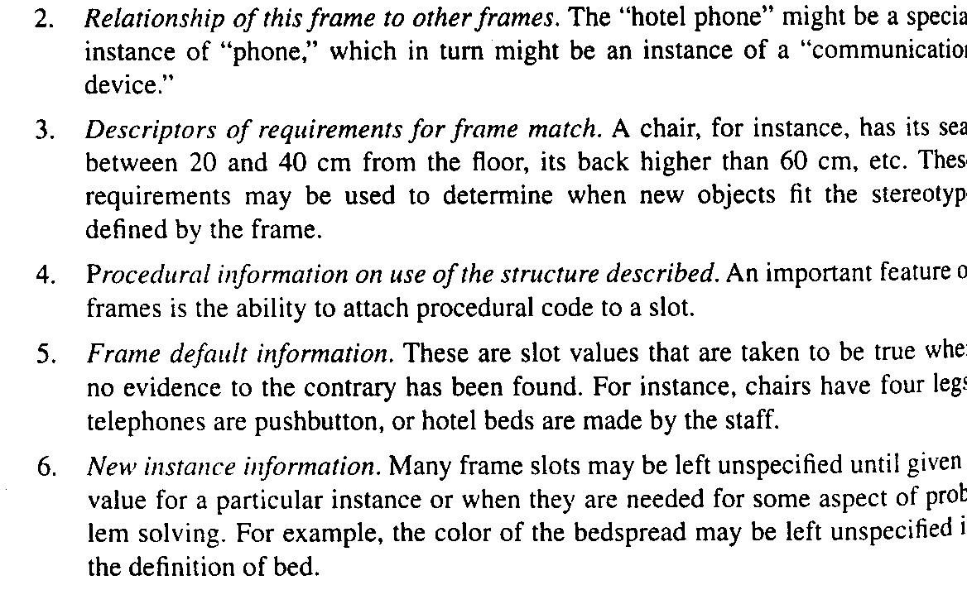
Components of a Frame

Slide 6
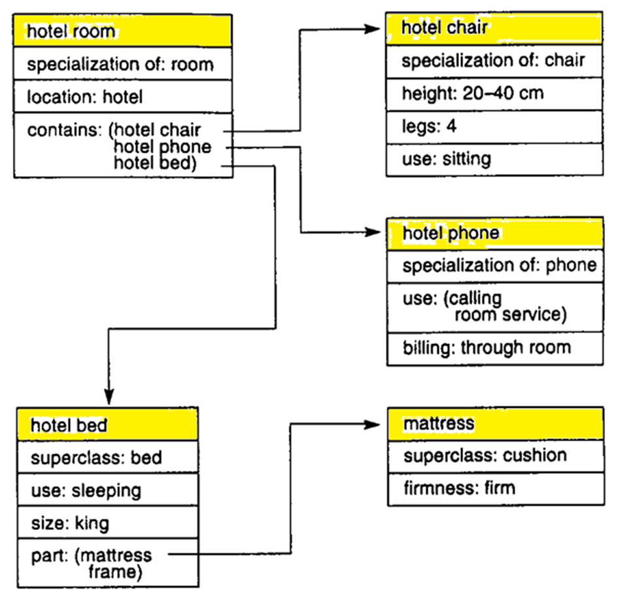
Frame for a Hotel Room

Slide 7
Frame Capabilities
Ability to clearly document information about a domain model; for example, a plant's machines and their associated attributes
Related ability to constrain the allowable values that an attribute can take on
Modularity of information, permitting ease of system expansion and maintenance
More readable and consistent syntax for referencing domain objects in the rules
Platform for building a graphic interface with object graphics
Mechanism that will allow us to restrict the scope of facts considered during forward or backward chaining
Access to a mechanism that supports the inheritance of information down a class hierarchy

Slide 8
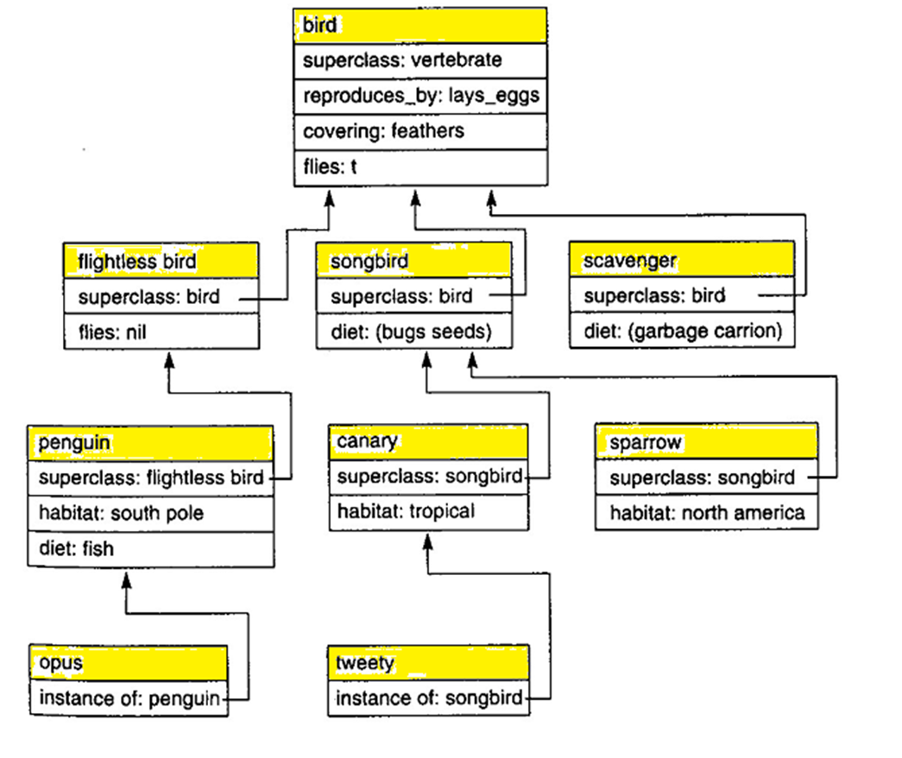
Inheritance – 1: A hierarchy for birds

Slide 9
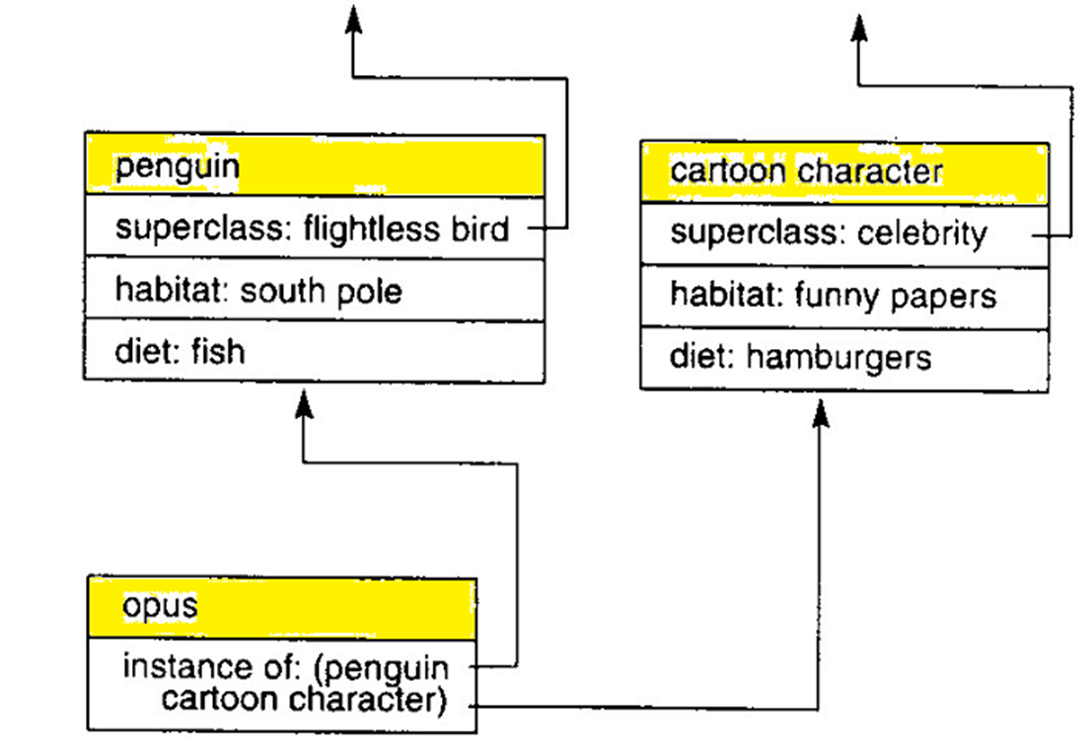
Inheritance - 2 :

Slide 10
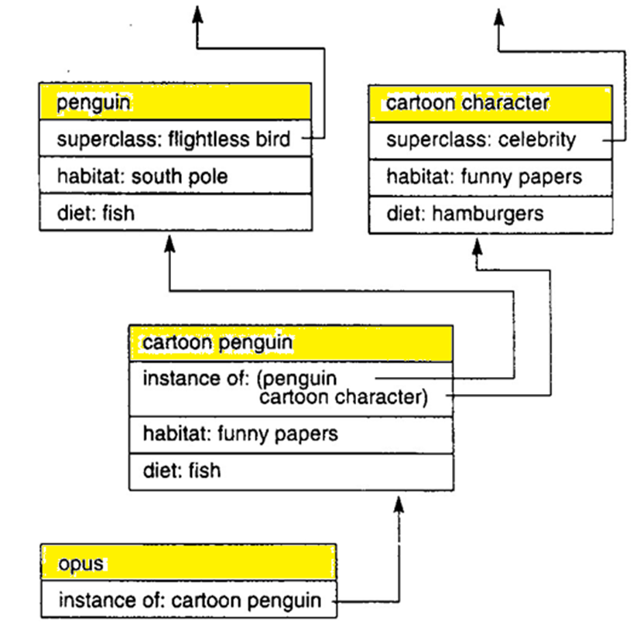
Inheritance - 3 : A new class to resolve ambiguity

Slide 11
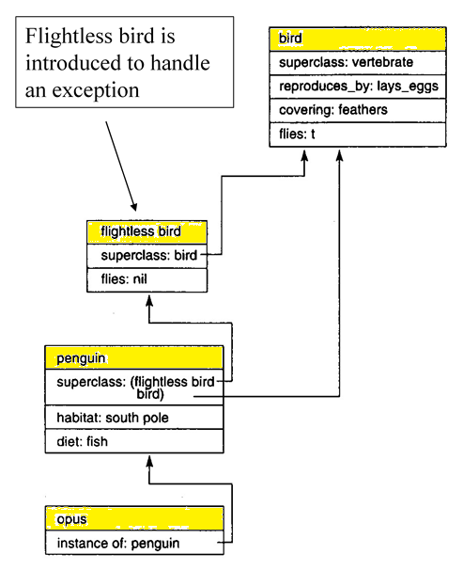
Transitivity of Subclasses
Fixing one problem
– Penguins don’t fly
– Introduce a flightless bird class
Results in other problems
– If subclasses are transitive, we infer a penguin is a bird
– This adds an extra link that introduces problems with multiple inheritance

