Slide 1
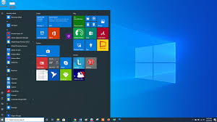
Operating Systems Lab. Lecture 3
Windows 10 Installation

Slide 2
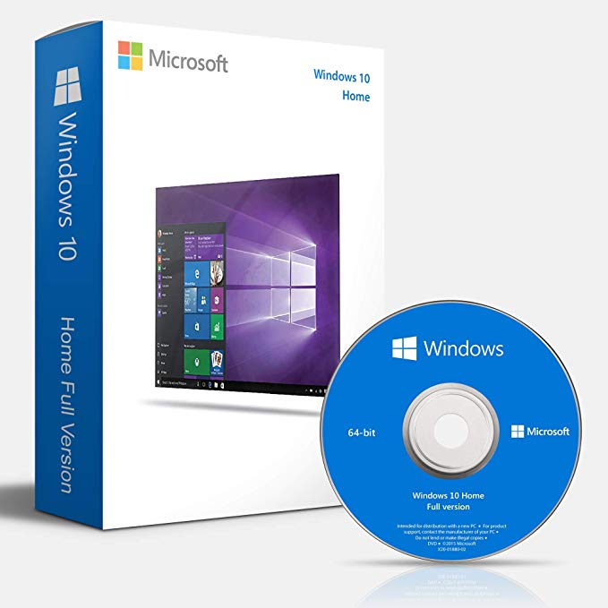
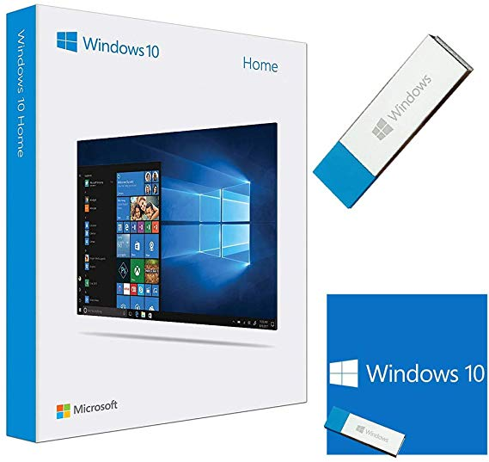
Step 1: Start your computer with the USB flash drive or DVD inserted, and boot from that device

Slide 3
Step 2:

Slide 4
Step 3:
Choose “Install now” option.
If you are installing Windows 10 for the first time, then enter your Windows 10 key or valid Windows 7, 8, or 8.1 key.
If you don’t have key then Skip the request for a product key to activate Windows
If you have already installed Windows 10 on this computer before, click I don’t have a product key. Windows will automatically activate once it’s installed.

Slide 5
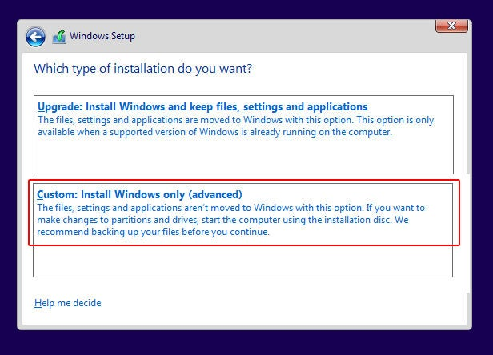
Step 4: select the type of installation
Upgrade: Install Windows and keep files.
Custom: Install Windows only (advanced).
When prompted, choose the Custom: Install Windows only (advanced) option.
This will erase everything on your existing Windows 10 drive (usually C:), so be sure you’ve backed up everything you want to keep before going any further.
Select the custom option to ensure that you are performing a clean install and not an upgrade install.

Slide 6
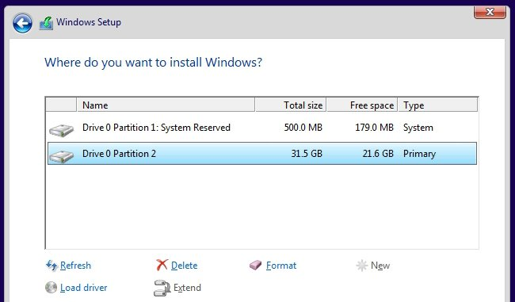
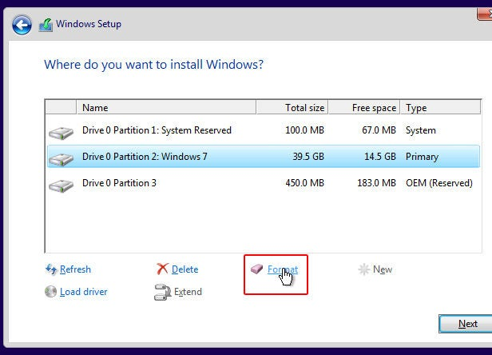
Step 5: Choose Where to Install
Partition your system drive however you like. If you just have a single Windows partition, you can tell the installer to overwrite it.
If you have many partitions, you could delete them all and tell Windows 10 to install itself in the unallocated space.

Slide 7
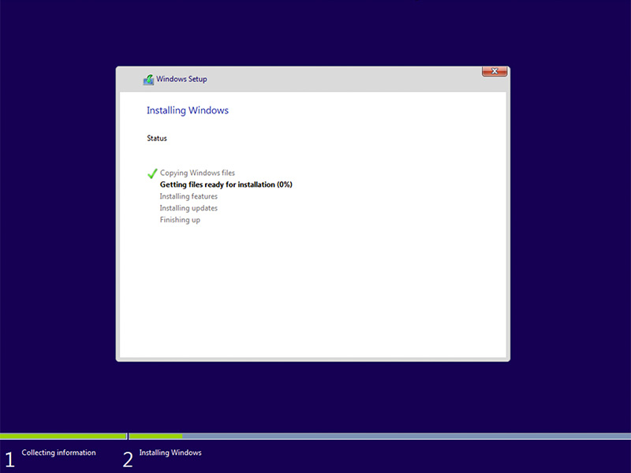
Step 6: Check Activation
The Windows 10 installation will now start.
Copying windows files
Getting files ready for installation (0%).
…..

Slide 8
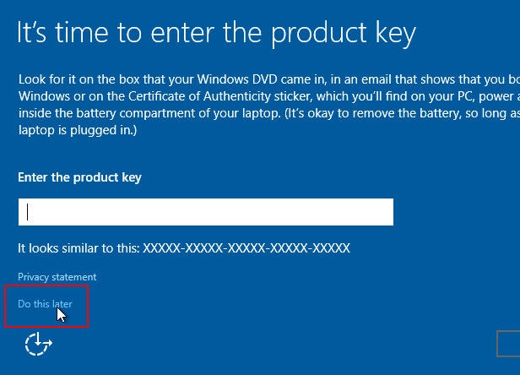
Step 6: Check Activation
When it’s almost complete, you’ll be asked for a product key again, so click the Do this later option at the bottom of the screen and finish the rest of the set up.

Slide 9
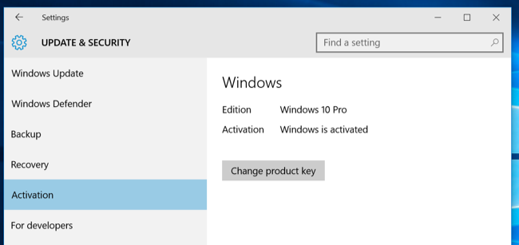
Step 6: Check Activation
After your fresh install of Windows 10 is completed, it should automatically activate itself after you connect to the Internet.
To ensure it activated correctly, open the Start menu and click on Settings.
Click the Update & Security button, and go to the “Activation” tab.

Slide 10
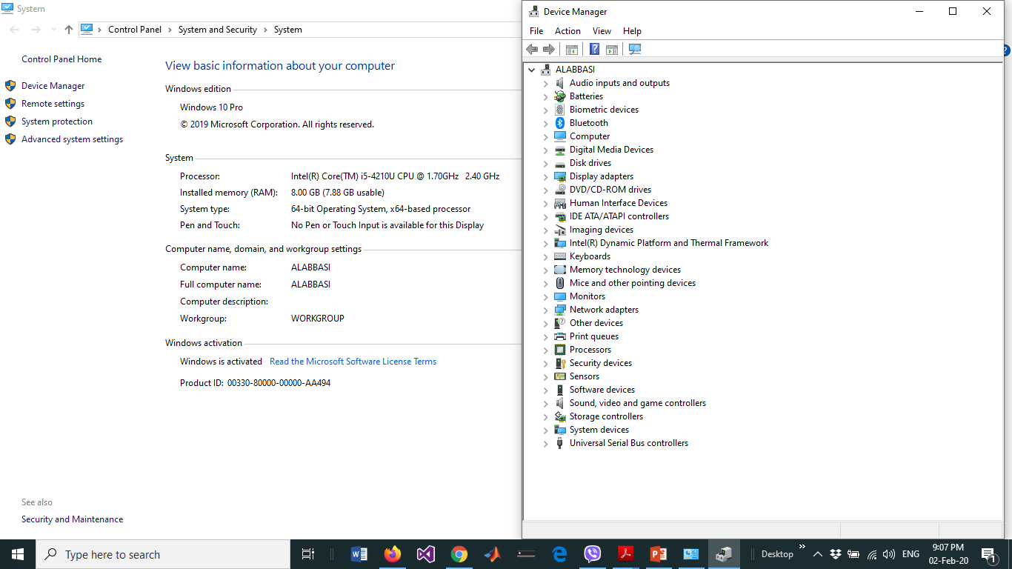
Step 6: Check Activation
Once Windows 10 is installed, You may also need to install the necessary drivers for your PC’s
network or Wi-Fi adapter, etc.

