Slide 1
Tenses
Lesson. 1
Unite one/ Grammar
Written by : Rageed Hussein Al-Hashemy

Slide 2
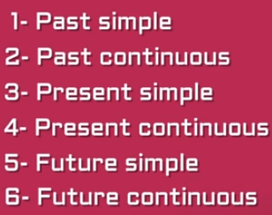
Tenses

Slide 3

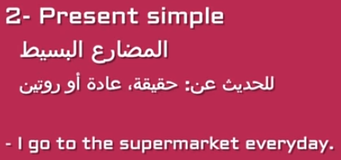

Slide 4
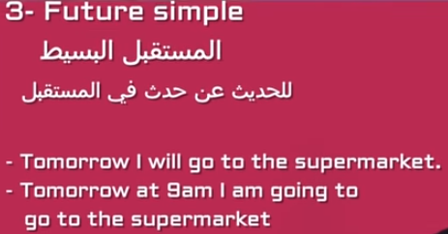
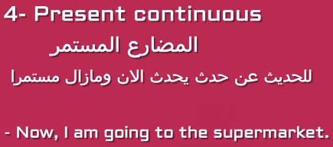

Slide 5
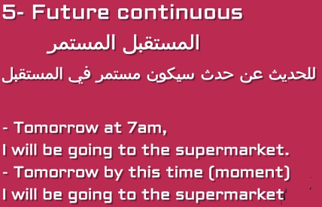
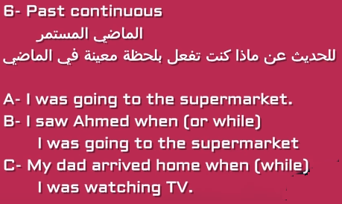

Slide 6
Until next time…

