Slide 1
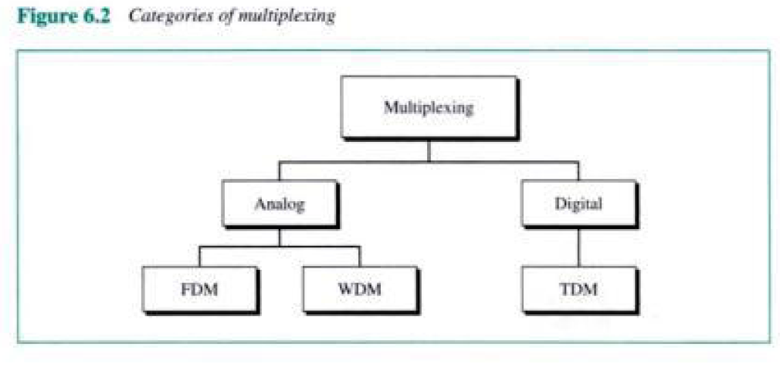

Slide 2
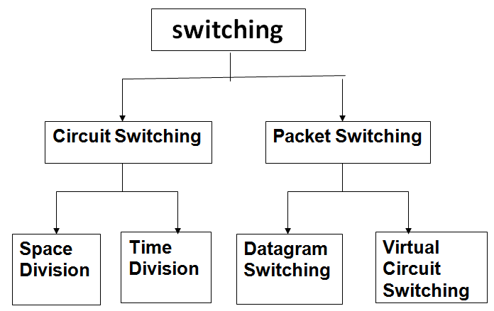

Slide 4
Multiplexing
Analog
Digital
FDM
WDM
TDM
STDM

