Slide 1
Chapter Six: Reference Models
There are two important network architectures, the OSI reference model and the TCP/IP reference model.
Although the protocols associated with the OSI model are rarely used any more, the model itself is actually quite general and still valid, and the features discussed at each layer are still very important.
The TCP/IP model has the opposite properties: the model itself is not of much use but the protocols are widely used.

Slide 2
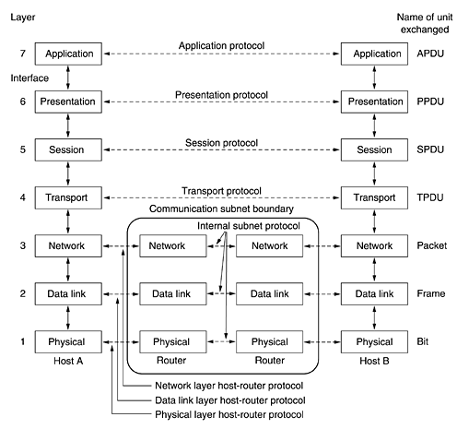
The OSI Reference Model

Slide 3
1- The Physical Layer
1- Ph.L. is concerned with transmitting raw bits over a communication channel.
2- making sure that when one side sends a 1 bit, it is received by the other side as a 1 bit, not as a 0 bit.
3- Typical questions here are:
How many volts should be used to represent a 1 and how many for a 0,
How many nanoseconds a bit lasts,
4- Whether transmission may proceed simultaneously in both directions,
5- How the initial connection is established and how it is torn down when both sides are finished,
6- How many pins the network connector has and what each pin is used for.
7- The design issues here largely deal with mechanical, electrical, and timing interfaces, and the physical transmission medium, which lies below the physical layer.

Slide 4
2- The Data Link Layer
1- D.L.L is to transform a raw transmission facility into a line that appears free of undetected transmission errors to the network layer.
2- Sender break up the input data into data frames andd transmit the frames sequentially.
3- If the service is reliable, the receiver confirms correct receipt of each frame by sending back an acknowledgement frame.
4- Issue is how to keep a fast transmitter from drowning a slow receiver in data.
5- Broadcast networks have an additional issue in the data link layer: how to control access to the shared channel. medium access control sublayer (MAC).

Slide 5
3 The Network Layer
1- controls the operation of the subnet.
2- how packets are routed from source to destination.
3- Routes can be based on :
- static tables that are ''wired into'' the network and rarely changed.
- be determined at the start of each conversation.
- can be highly dynamic.
4- The control of congestion also belongs to the network layer.
5- QoS provided (delay, transit time, jitter, etc.).
6- packet from one network to another:
a-The addressing is different.
b- packet is too large.
c- The protocols may differ, and so on.
7- In broadcast networks, the routing problem is simple, so the network layer is often thin or even nonexistent.

Slide 6
4 The Transport Layer
1- T.L. accept data from above, split it up into smaller units if need be, pass these to the network layer.
2- Ensure that the pieces all arrive correctly at the other end.
3- Isolates the upper layers from the inevitable changes in the hardware technology.
4- Service to provide to the session layer, and, ultimately, to the users of the network (Ex. Reliable). Service is determined when the connection is established.
5- T.L. is a true end-to-end layer, all the way from the source to the destination. In other words, a program on the source machine carries on a conversation with a similar program on the destination machine, using the message headers and control messages.

Slide 7
HIGHER layers:
Lower Layers are mostly concerned with moving bits around
5 The Session Layer: establish sessions
Sessions offer various services: 1- dialog control 2- token management
3- synchronization
6 The Presentation Layer:
1- concerned with the syntax and semantics of the information
2- computers with different data representations to communicate.
3- manages abstract data structures and allows higher-level data structures
7 The Application Layer: 1- contains a variety of protocols
that are commonly needed by users.
2- One widely-used application protocol is HTTP.
3- Other file transfer, electronic mail, and network news.

Slide 8
The TCP/IP Reference Model
The ARPANET was a research network sponsored by the DoD. It eventually connected hundreds of universities and government installations, using leased telephone lines.
When satellite and radio networks were added later, the existing protocols had trouble interworking with them, so a new reference architecture was needed.
1- ability to connect multiple networks in a seamless way .
2- network be able to survive loss of subnet hardware. connections to remain intact as long as the source and destination machines were functioning.
3- a flexible architecture was needed. (Diff. Appl.)
This architecture later became known as the TCP/IP Reference Mode.

Slide 9
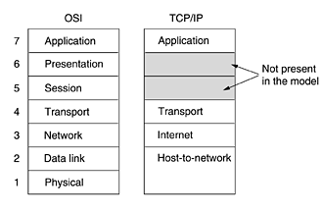
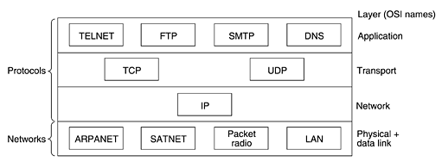

Slide 10
1 The Internet Layer
1- DoD Requirments led to the choice of a packet-switching network based on a connectionless internetwork layer. This layer, called the internet layer, is the linchpin that holds the whole architecture together.
2- permit hosts to inject packets into any network and have them travel independently to the destination.
3- Packets may even arrive in a different order than they were sent.
4- defines an official packet format and protocol called IP.
5- deliver IP packets where they are supposed to go.
6- Packet routing is clearly the major issue.
7- TCP/IP internet layer is similar in functionality to the OSI network layer.

Slide 11
2 The Transport Layer
1- The layer above the internet layer in the TCP/IP model is now usually called the transport layer.
2- It is designed to allow peer entities on the source and destination hosts to carry on a conversation, just as in the OSI transport layer.
3- Two end-to-end transport protocols have been defined here.

Slide 12
A- The first one, TCP (Transmission Control Protocol),
1- is a reliable connection-oriented protocol .
2- allows a byte stream originating on one machine to be delivered without error on any other machine in the internet.
3- It fragments the incoming byte stream into discrete messages and passes each one on to the internet layer.
4- At the destination, the receiving TCP process reassembles the received messages into the output stream.
5- TCP also handles flow control to make sure a fast sender cannot swamp a slow receiver with more messages than it can handle.

Slide 13
B- The second protocol in this layer, UDP (User Datagram Protocol),
1- is an unreliable, connectionless protocol for applications that do not want TCP's sequencing or flow control and wish to provide their own.
2- it is also widely used for one-shot,
3- it is also widely used for client-server-type request-reply queries and
4- it is also widely used for applications in which prompt delivery is more important than accurate delivery, such as transmitting speech or video.
5- Since the model was developed, IP has been implemented on many other networks.

Slide 14
3 The Application Layer
1- The TCP/IP model does not have session or presentation layers.
2- It contains all the higher-level protocols.
3- The early ones included: virtual terminal (TELNET) The virtual terminal protocol allows a user on one machine to log onto a distant machine and work there., file transfer (FTP) The file transfer protocol provides a way to move data efficiently from one machine to another. and electronic mail (SMTP).
4- Many other protocols have been added :
A- the Domain Name System (DNS) for mapping host names onto their network addresses,
B- NNTP, the protocol for moving USENET news articles around,
C- and HTTP, the protocol for fetching pages on the World Wide Web, and many others.

Slide 15
4 The Host-to-Network Layer
1- Below the internet layer is a great void.
2- The TCP/IP reference model does not really say much about what happens here, except to point out that the host has to connect to the network using some protocol so it can send IP packets to it.
3- This protocol is not defined and varies from host to host and network to network.
4-Books and papers about the TCP/IP model rarely discuss it

Slide 16
Comparison of the OSI and TCP/IP Reference Models
OSI Reference Model | TCP/IP Model
1- based on the concept of a stack of independent protocols | 1- based on the concept of a stack of independent protocols
2- the functionality of the layers is roughly similar | 2- the functionality of the layers is roughly similar
3- originally clearly distinguish between service, interface, and protocol | 3- did not originally clearly distinguish between service, interface, and protocol
4- protocols are better hidden and can be replaced relatively easily as the technology changes. | 4- protocols are worse hidden and can be replaced relatively difficultly as the technology changes.
5- devised before the corresponding protocols were invented (model was not biased toward one particular set of protocols, it quite general, designers did not have much experience ) | 5- devised after the corresponding protocols were invented
6- has seven layers | 6- has four layers
7-Both have (inter)network, transport, and application layers others different | 7-Both have (inter)network, transport, and application layers others different

