Slide 1
Chapter Five: Network Software
Protocol Hierarchies
most networks are organized as a stack of layers or levels, each one built upon the one below it. The number of layers, the name, contents, and the function of each layer differ from network to network.
The purpose of each layer is to offer certain services to the higher layers. (No details How)
Each layer is a kind of virtual machine, offering certain services to the layer above it.

Slide 2
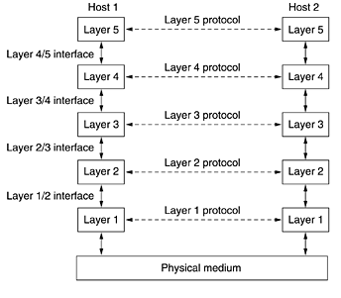

Slide 3
Protocol, Interface, Service
A protocol is an agreement between the communicating parties on how communication is to proceed.
In reality, no data are directly transferred from layer n on one machine to layer n on another machine. (virtual communication is shown by dotted lines and physical communication by solid lines).
Between each pair of adjacent layers is an interface. The interface defines which primitive operations and services the lower layer makes available to the upper one. (minimizing information + Simplify replacing).
Service: is a set of primitive operations that low layer provide to high layer.

Slide 4
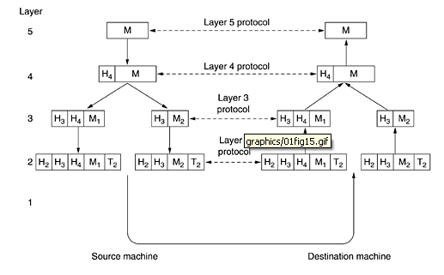

Slide 5
Design Issues for the Layers
mechanism for identifying senders and receivers.
rules for data transfer(s,h-d,f-d)
How many logical channels
Error control(e-d, e-c)
Sequencing
Flow Control
Massage Fragmentation
multiplexing and demultiplexing
Routing
Coding
Encryption

Slide 6
Connection-Oriented and Connectionless Services
-user first establishes a connection.
-uses the connection.
-releases the connection.
Messages reach in order
Message carries the full destination address.
Routed independently.
No establishing conn.
Messages may reach not in order.

Slide 7
quality of service
Reliable : never lose data.
Unreliable : May lose data.
reliable service is implemented by having the receiver acknowledge . (overhead + delay).
Unreliable (meaning not acknowledged) connectionless service is often called datagram service.

Slide 8
The Relationship of Services to Protocols 1
A service is a set of primitives (operations) that a layer provides to the layer above it.
The service defines what operations the layer is prepared to perform on behalf of its users, but it says nothing at all about how these operations are implemented.
A service relates to an interface between two layers, with the lower layer being the service provider and the upper layer being the service user.

Slide 9
The Relationship of Services to Protocols 2
A protocol is a set of rules governing the format and meaning of the packets, or messages that are exchanged by the peer entities within a layer.
Entities use protocols to implement their service definitions. They are free to change their protocols at will, provided they do not change the service visible to their users. In this way, the service and the protocol are completely decoupled.
In other words, services relate to the interfaces between layers. Protocols relate to the packets sent between peer entities on different machines. It is important not to confuse the two concepts.

Slide 10
The Relationship of Services to Protocols 3
The service definition tells what the layer does, not how entities above it access it or how the layer works. It defines the layer's semantics.
A layer's interface tells the processes above it how to access it. It specifies what the parameters are and what results to expect. It, too, says nothing about how the layer works inside.
Finally, the peer protocols used in a layer are the layer's own business. It can use any protocols it wants to, as long as it gets the job done (i.e., provides the offered services). It can also change them at will without affecting software in higher layers.

Slide 11
Some important Services
A- Error Detection And Error Correction (error control)
Error detection is the detection of errors caused by noise or other impairments during transmission from the transmitter to the receiver.
Error correction is the detection of errors and reconstruction of the original, error-free data.
B- Data Compression

