Slide 1
Chapter Four: Network Hardware
''computer network'' to mean a collection of autonomous computers interconnected by a single technology. Two computers are said to be interconnected if they are able to exchange
information.
Use of Computer Network
Business Applications
Home Applications.
Mobile Users
Social Issues

Slide 2
Use of Computer Network 1
.2.1 Business Applications
1- resource sharing.
2- powerful communication medium among employees.
3- Doing business electronically with other companies.
4- Doing business with consumers over the Internet.
4.2.2 Home Applications
Some of the more popular uses of the Internet for home users are as follows:
Access to remote information.
Person-to-person communication.
Interactive entertainment.
Electronic commerce.

Slide 3
Use of Computer Network 2
4.2.3 Mobile Users
Wireless networks are of great value to fleets of trucks, taxis, delivery vehicles, and repairpersons for keeping in contact with home.
Wireless networks are also important to the military
wireless networking and mobile computing are often related
some wireless computers are not mobile
wireless could save money is utility meter reading. If electricity, gas, water, and other meters in people's homes were to report usage over a wireless network, there would be no need to send out meter readers
4.2.4 Social Issues
Networks introduced new social, ethical, and political problems.
-A popular feature of many networks are newsgroups or bulletin boards
- employee rights versus employer rights.
- government versus citizen. (anonymous messages)
- Identity theft is becoming a serious problem

Slide 4
Physical Topology
Is the way in which a network is laid out physically. Two or more devices connect to a link; two or more links form a topology. The topology of a network is the geometric representation of the relationship of all the links and linking devices (usually called nodes) to one another.

Slide 7
Network Hardware
is no generally accepted taxonomy
Transmission Technology and Scale
Transmission technology
A- Broadcast links.
B- Point-to-point links.
Scale
A-LAN
B- MAN
C- WAN

Slide 8
Broadcast networks
Have a single communication channel that is shared by all the machines on the network.
-Short messages, called packets in certain contexts, sent by any machine are received by all the others.
- An address field within the packet specifies the intended recipient. Upon receiving a packet, a machine checks the address field.
- If the packet is intended for the receiving machine, that machine processes the packet; if the packet is intended for some other machine, it is just ignored.
- Broadcast systems generally also allow the possibility of addressing a packet to all destinations by using a special code in the address field. This mode of operation is called broadcasting. transmission to a subset of the machines, something known as multicasting.

Slide 9
point-to-point networks
consist of many connections between individual pairs of machines.
To go from the source to the destination, a packet on this type of network may have to first visit one or more intermediate machines.
- Often multiple routes, of different lengths, are possible, so finding good ones is important in point-to-point networks.
- As a general rule (although there are many exceptions), smaller, geographically localized networks tend to use broadcasting, whereas larger networks usually are point-to-point.
- Point-to-point transmission with one sender and one receiver is sometimes called unicasting.

Slide 10
Local Area Networks (LANs)
Are privately-owned networks within a single building or campus of up to a few kilometers in size.
They are widely used to connect personal computers and workstations in company offices and factories to share resources (e.g., printers) and exchange information.
LANs are distinguished from other kinds of networks by three characteristics:
(1) their size, (2) their transmission technology, and (3) their topology.
LANs may use a transmission technology consisting of a cable to which all the machines are attached
Traditional LANs run at speeds of 10 Mbps to 100 Mbps, have low delay (microseconds or nanoseconds), and make very few errors.
Newer LANs operate at up to 10 Gbps.
Various topologies are possible for broadcast LANs. Bus, Ring and Star are the most common used.

Slide 11
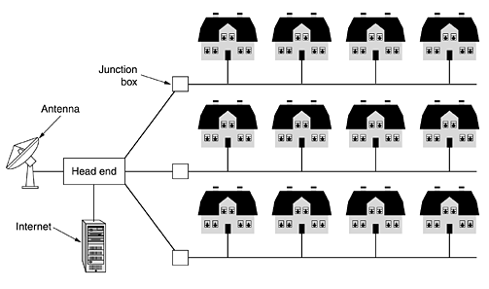
Metropolitan Area Networks (MANs)
Covers a city. The best-known example of a MAN is the cable television network available in many cities.
Cable television is not the only MAN. Recent developments in high-speed wireless Internet access resulted in another MAN, which has been standardized as IEEE 802.16.

Slide 12
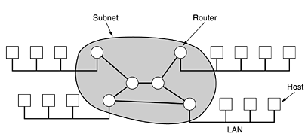
Wide Area Networks (WANs) 1
spans a large geographical area, often a country or continent. It contains a collection of call hosts. The hosts are connected by a communication subnet, or just subnet for short. The hosts are owned by the customers subnet telephone company or Internet service provider
subnet carry messages from host to host
the subnet consists of two distinct components: transmission lines and switching elements.
A subnet organized according to this principle is called a store-and-forward or packet-switched subnet. Nearly all wide area networks (except those using satellites) have store-and-forward subnets. When the packets are small and all the same size, they are often called cells.

Slide 13
Wide Area Networks (WANs) 2
The sending host
1-first cuts the message into packets, each one bearing its number in the sequence.
2-These packets are then injected into the network one at a time in quick succession.
3- The packets are transported individually over the network and deposited at the receiving host,
4- where they are reassembled into the original message and delivered to the receiving process.
Not all WANs are packet switched. A second possibility for a WAN is a satellite system. Each router has an antenna through which it can send and receive. All routers can hear the output from the satellite, and in some cases they can also hear the upward transmissions of their fellow routers to the satellite as well.

Slide 14
Wireless Networks
divided into :
- System interconnection.(interconnecting the components of a computer ((Bluetooth)), use the master-slave paradigm )
- Wireless LANs (WLAN). every computer has a radio modem and antenna, IEEE 802.11
- Wireless WANs (WWAN). cellular telephones is an example of a low-bandwidth wireless system (generations), operate below 1Mbps, IEEE 802.16 High Band Width

Slide 15
Home Networks
In the future most homes will be set up for networking. Every device in the home will be capable of communicating with every other device, and all of them will be accessible over the Internet
Many devices are capable of being networked.
- Computers (desktop PC, notebook PC, PDA, shared peripherals).
- Entertainment (TV, DVD, VCR, camcorder, camera, stereo, MP3).
- Telecommunications (telephone, mobile telephone, intercom, fax).
- Appliances (microwave, refrigerator, clock, furnace, airco, lights).
- Telemetry (utility meter, smoke/burglar alarm, thermostat, babycam).

Slide 16
Internetworks
Many networks exist in the world, often with different hardware and software.
Different, and frequently incompatible networks, be connected, sometimes by means of machines called gateways to make the connection and provide the necessary translation, both in terms of hardware and software.
A collection of interconnected networks is called an internetwork or internet. internet is a collection of LANs connected by a WAN. The only real technical distinction between a subnet and a WAN in this case is whether hosts are present.
An internetwork is formed when networks are interconnected. In our view, connecting a LAN and a WAN or connecting two LANs forms an internetwork, but there is little agreement in the industry over terminology in this area. One rule of thumb is that if different organizations paid to construct different parts of the network and each maintains its part, we have an internetwork rather than a single network. Also, if the underlying technology is different in different parts (e.g., broadcast versus point-to-point), we probably have two networks.

