Slide 1
Chapter Three: Signals and Data Transmission
DATA: Entities convey meaning or information.
SIGNAL: Any electrical quantity such as voltage, current or frequency or electromagnetic field can be used to transmit information.
INFORMATION: is an ordered sequence of symbols
Computer Science Processed, stored, or transmitted data.

Slide 2
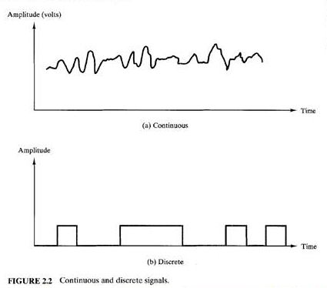
Signals as a function of time
A continuous signal is one in which the signal intensity varies in a smooth fashion over time. (Analog)
A discrete signal is one in which the signal intensity maintains a constant level for some period of time and then changes to another constant level (Digital)

Slide 3
Modulation
Data is superimposed on a carrier current or wave by means of a process called modulation. Signal modulation can be done in either of two main ways: analog and digital.

Slide 4
1.Amplitude Modulation
the carrier signal is modulated so that its amplitude varies with the changing amplitudes of the modulating signal
Amplitude Modulation Band-Width BAM =2B.
B is the Band-Width (B.W.) of the Audio Signal

Slide 5
2. Frequency Modulation
the frequency of the carrier signal is modulated to follow the changing voltage level (amplitude) of the modulating signal.
BFM =2(1 + B) B.
where B is a factor depends on modulation technique with a common value of 4.

Slide 6
3. Phase modulation
phase of the carrier signal is modulated to follow the changing voltage level (amplitude) of the modulating signal.
Phase Modulation Band-Width BPM = 2(1 + B) B.

Slide 7
ANALOG AND DIGITAL DATA TRANSMISSION
Signaling is the act of propagating the signal along a suitable medium.
Transmission is the communication of data by the propagation and processing of signals.
Analog data & Digital data (Definitions)
The principle advantages of digital signaling are that it is generally cheaper than analog signaling and is less susceptible to noise interference .
The principle disadvantage is that the digital signals are severing more from attenuation than do analog signals.

Slide 8
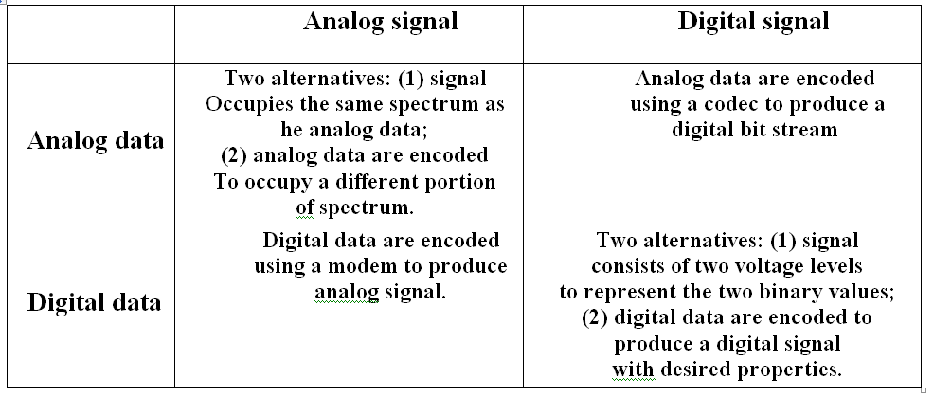
Data To Signals

Slide 9
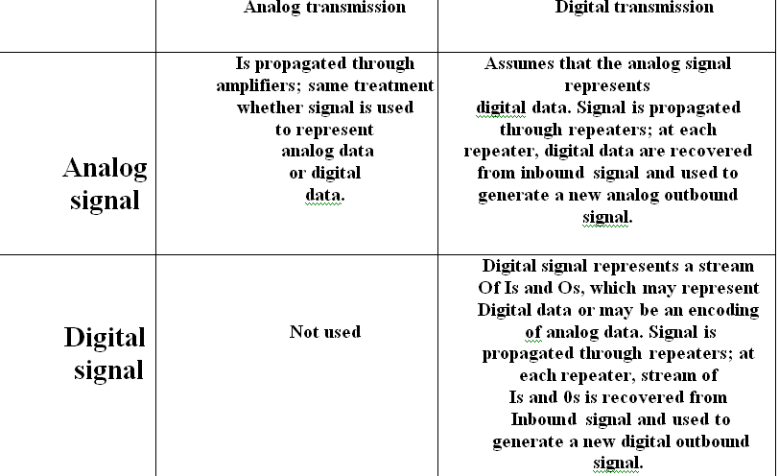
Signals & Transmissions

Slide 10
Why Digital
1- Digital technology.
2- Data integrity.
3- Capacity utilization
4- Security and privacy.
5- Integration.

Slide 11
TRANSMISSION IMPAIRMENT
1. Attenuation: means a loss of energy. When a signal, simple or composite, travels through a medium, it loses some of its energy in overcoming the resistance of the medium. To compensate for this loss, amplifiers are used to amplify the signal
2. Distortion: means that the signal changes its form or shape. Distortion can occur in a composite signal made of different frequencies. Each signal component has its own propagation speed through a medium and, therefore, its own delay in arriving at the final destination. Differences in delay may create a difference in phase if the delay is not exactly the same as the period duration.
3. Noise: is another cause of impairment. Several types of noise, such as thermal noise, induced noise, crosstalk, and impulse noise, may corrupt the signal. Thermal noise is the random motion of electrons in a wire which creates an extra signal not originally sent by the transmitter. Induced noise comes from sources such as motors and appliances.

Slide 12
Channel Capacity
The rate at which data can be transmitted over a given communication path, or channel, under given conditions, is
referred to as the channel capacity.
four concepts here that we are trying to relate to one another
Data rate. This is the rate, in bits per second (bps), at which data can be communicated.
- Bandwidth. This is the bandwidth of the transmitted signal as constrained by the transmitter and by the nature of the transmission medium, expressed in cycles per second, or hertz.
- Noise. The average level of noise over the communications path.
- Error rate. The rate at which errors occur, where an error is the reception of a 1 when a 0 was transmitted, or the reception of a 0 when a 1 was transmitted.

Slide 13
Nyquist & Shannon
Nyquist: channel that is noise-free
C= 2Wlog M
W is the Band-Width, M is Number of Levels
Shannon take noise into consideration
C = W log2 (1+ S/N)
S/N is Signal to noise ratio
signal power
(S/N) dB = 10 log -----------------
noise power

