Slide 1
communications system
The fundamental purpose of a communications system is the exchange of data between two parties.

Slide 2
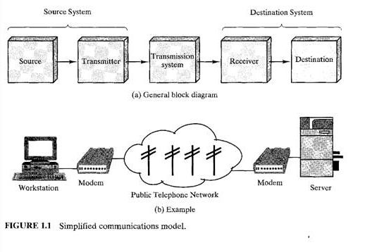
One particular example

Slide 3
A Communication Model: key elements of the model
Source. This device generates the data to be transmitted; examples are telephones
and personal computers.
Transmitter. a transmitter transforms and encodes the information in such a way as to produce electromagnetic signals that can be transmitted across some sort of transmission system. For example, a modem takes a digital bit stream from an attached device such as a personal computer and transforms that bit stream into an analog signal that can be handled by the telephone network.
Transmission System. This can be a single transmission line or a complex network connecting source and destination.
Receiver. The receiver accepts the signal from the transmission system and converts it into a form that can be handled by the destination device. For example, a modem will accept an analog signal coming from a network or transmission line and convert it into a digital bit stream.
Destination. Takes the incoming data from the receiver.

Slide 4
data communications system components

Slide 5
data communications system components
1. Message. The message is the information (data) to be communicated. Popular forms of information include text, numbers, pictures, audio, and video.
2. Sender. The sender is the device that sends the data message. It can be a computer, workstation, telephone handset, video camera, and so on.
3. Receiver. The receiver is the device that receives the message. It can be a computer, workstation, telephone handset, television, and so on.
4. Transmission medium. The transmission medium is the physical path by which a message travels from sender to receiver. Some examples of transmission media include twisted-pair wire, coaxial cable, fiber-optic cable, and radio waves.
5. Protocol. A protocol is a set of rules that govern data communications. It represents an agreement between the communicating devices. Without a protocol, two devices may be connected but not communicating, just as a person speaking French cannot be understood by a person who speaks only Japanese.

Slide 6
Data Representation
Information today comes in different forms such as text, numbers, images, audio, and video.
1. Text
2. Images
3. Audio
4. Video

Slide 7
Data Transmission Mode/Data Flow

Slide 8
Data Transmission Mode/Data Flow
1. Simplex
In simplex mode, the communication is unidirectional, as on a one-way street. Only one of the two devices on a link can transmit; the other can only receive (see Figure 1.2a).
2. Half-Duplex
In half-duplex mode, each station can both transmit and receive, but not at the same time. When one device is sending, the other can only receive, and vice versa (see Figure 1.2b).
3. Full-Duplex
In full-duplex mode (also called duplex), both stations can transmit and receive simultaneously (see Figure 1.2c).
One common example of full-duplex communication is the telephone network.

Slide 9
TRANSMISSION MODES/Data Streams

Slide 10
Parallel Transmission
By grouping, we can send data n bits at a time instead of 1 (Parallel Transmission).
Commuters produce and consume data in groups of bits

Slide 11
Serial Transmission
In serial transmission one bit follows another, so we need only one communication channel rather than n to transmit data between two communicating devices

Slide 12
Asynchronous Transmission
Asynchronous transmission is so named because the timing of a signal is unimportant.
Instead, information is received and translated by agreed upon patterns. Patterns are based on grouping the bit stream into bytes.
Asynchronous here means "asynchronous at the byte level;' but the bits are still synchronized; their durations are the same.
The addition of stop and start bits and the insertion of gaps into the bit stream make asynchronous transmission slower than forms of transmission that can operate without the addition of control information. But it is cheap and effective.
For example, the connection of a keyboard to a computer.

Slide 13
Asynchronous Transmission

Slide 14
Synchronous Transmission
In synchronous transmission, the bit stream is combined into longer "frames," which may contain multiple bytes. Each byte, however, is introduced onto the transmission link without a gap between it and the next one.
In synchronous transmission, we send bits one after another without start or stop bits or gaps. It is the responsibility of the receiver to group the bits.
Timing becomes very important, therefore, because the accuracy of the received information is completely dependent on the ability of the receiving device to keep an accurate count of the bits as they come in.
The advantage of synchronous transmission is speed.
synchronous transmission is faster than asynchronous transmission.

Slide 15
Synchronous Transmission

Slide 16
Isochronous
In real-time audio and video, in which uneven delays between frames are not acceptable, synchronous transmission fails. For example, TV images are broadcast at the rate of 30 images per second; they must be viewed at the same rate. If each image is sent by using one or more frames, there should be no delays between frames. For this type of application, synchronization between characters is not enough; the entire stream of bits must be synchronized. The isochronous transmission guarantees that the data arrive at a fixed rate.

Slide 17
Data Communication Networking
In its simplest form, data communication takes place between two devices that are directly connected by some form of point-to-point transmission medium. Often, however, it is impractical for two devices to be directly, point-to-point connected.
This is so for one (or both) of the following contingencies:
1- The devices are very far apart. It would be inordinately expensive, for example, to string a dedicated link between two devices thousands of miles apart.
2- There is a set of devices, each of which may require a link to many of the others at various times. Examples are all of the telephones in the world and all of the terminals and computers owned by a single organization. Except for the case of a very few devices, it is impractical to provide a dedicated wire between each pair of devices.

Slide 18
network
network is two or more devices connected through links. A link is a communications pathway that transfers data from one device to another. For visualization purposes, it is simplest to imagine any link as a line drawn between two points. For communication to occur, two devices must be connected in some way to the same link at the same time

Slide 19
Types of Connection

Slide 20
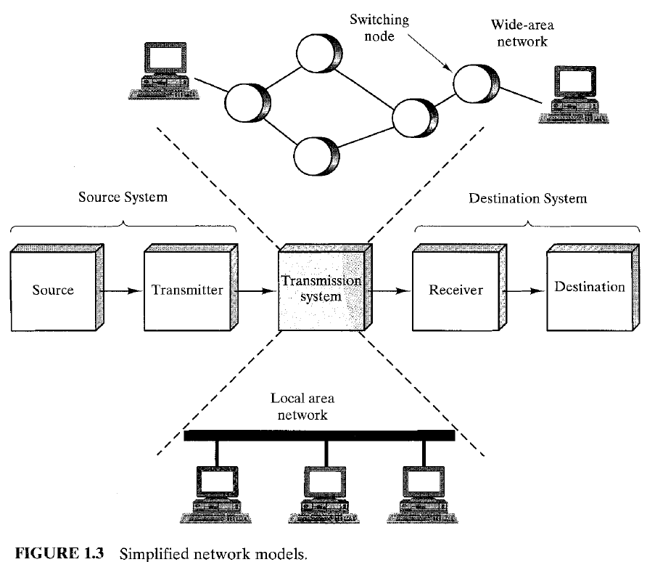
The solution to this problem is to attach each device to a communications network

