Slide 1
Computer System Structures
by
Asst. Lecturer Amal A. Maryoosh

Slide 2
Computer System Operation
A modern, general-purpose computer system consists of a CPU and a number of device controllers that are connected through a common bus that provides access to shared memory.

Slide 3
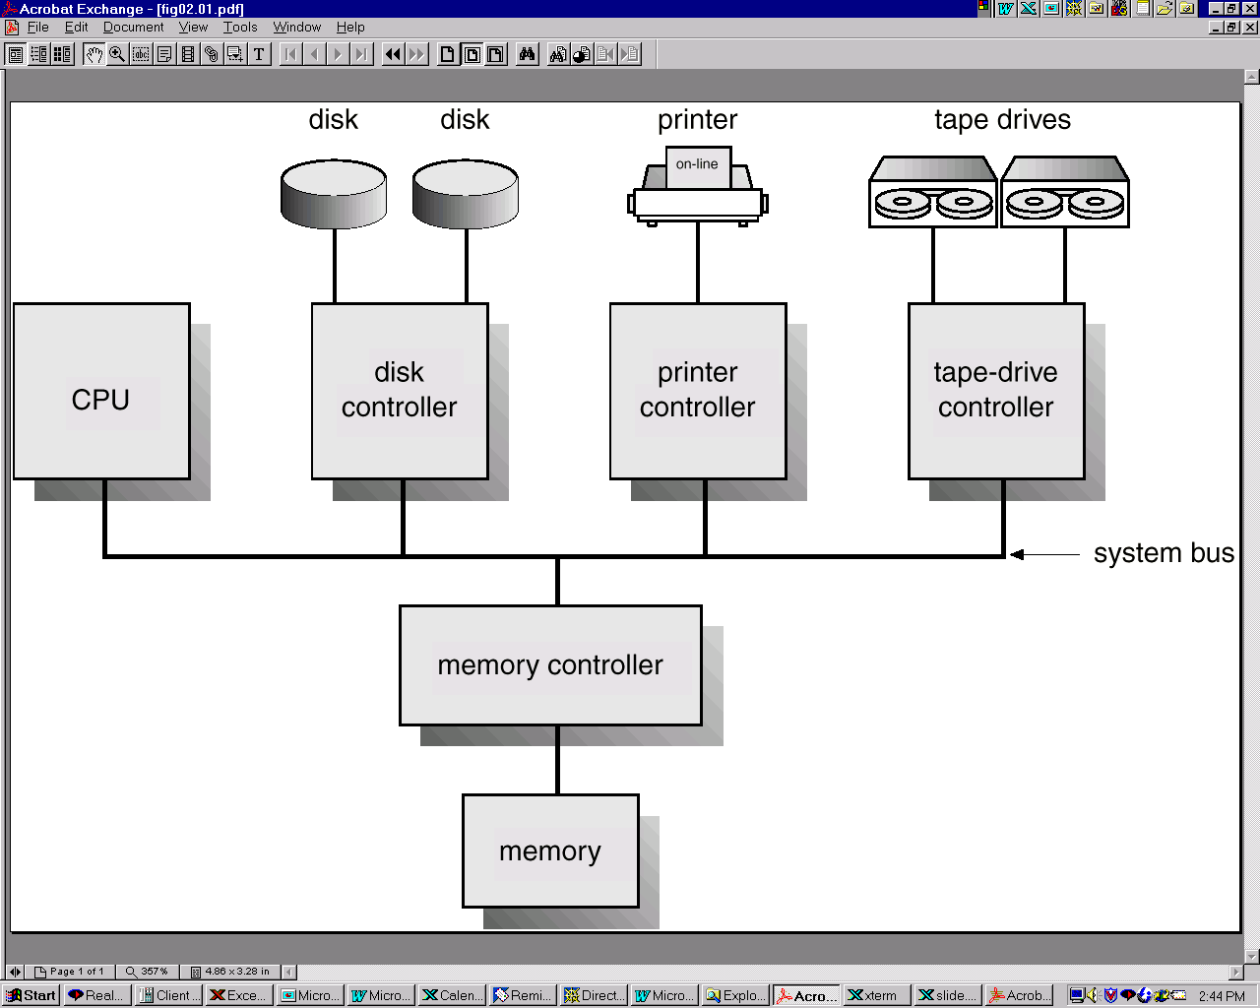

Slide 4
Booting Operation
For a computer to start running, when it is powered up or rebooted, it needs to have an initial program to run. This initial program, or bootstrap program, tends to be simple. Typically, it is stored in read-only memory (ROM) such as firmware (coded instructions that are stored permanently in read-only memory) or EEPROM within the computer hardware. It initializes all aspects of the system, from CPU registers to device controllers to memory contents.

Slide 5
Booting Operation
The bootstrap program must know how to load the operating system and to start executing that system. To accomplish this goal, the bootstrap program must locate and load into memory the operating-system kernel. The operating system then starts executing the first process, such as "init," and waits for some event to occur. The occurrence of an event is usually signaled by an interrupt from either the hardware or the software. Hardware may trigger an interrupt at any time by sending a signal to the CPU, usually by way of the system bus. Software may trigger an interrupt by executing a special operation called a system call.
Booting: is the operation of bringing operating system kernel from secondary storage and put it in main storage to execute it in CPU. There is a program bootstrap which is performing this operation when computer is powered up or rebooted.
Bootstrap: is a simple initial program, it is stored in ROM such as firmware or EEPROM(Electrically Erasable Programmable Read-Only Memory) within the computer hardware.

Slide 6
Functions of Bootstrap program
Initialize all the aspect of the system, from CPU registers to device controllers to memory contents.
Locate and load the operating system kernel into memory then the operating system starts executing the first process, such as “init” and waits for some event to occur.
Types of events are either software events (system call) or hardware events (signals from the hardware devices to the CPU through the system bus and known as an interrupt).

Slide 7
I/O Structure
Each I/O device connected to the computer system through its controller. A device controller maintains some local buffer storage and a set of special-purpose registers. The device controller is responsible for moving the data between the peripheral devices that it controls and its local buffer storage.

Slide 8
I/O Interrupts
To start an I/O operation, the CPU loads the appropriate registers within the device controller. The device controller, in turn, examines the contents of these registers to determine what action to take. For example, if it finds a read request, the controller will start the transfer of data from the device to its local buffer. Once the transfer of data is complete, the device controller informs the CPU that it has finished its operation.

Slide 9
Interrupt: Most devices send a signal (interrupt) to the processor when an event occurs. The operating system can respond a change in device status by notifying processes that are waiting on such events.
Trap or Exceptions: its interrupts generated in response to errors for example (division by zero or invalid memory access). The processor invokes the operating system to determine how to respond (terminate or restart).
Interrupt Vector (IV): it is a fixed locations (an array) in the low memory area (first 100 location of RAM) of operating system when interrupt occur the CPU stops what it is doing and transfer execution to a fixed location (IV) contain starting address of the interrupt of the interrupt service routine (ISR), on completion the CPU resume the interrupted computation.
Interrupt Service Routine (ISR): is it a routine provided to be responsible for dealing with the interrupt.

Slide 10
DMA Structure
A high-speed device, however such as a tape, disk, or communications network-may be able to transmit information at close to memory speeds; the CPU needs two microseconds to respond to each interrupt and interrupts arrive every four microseconds, for example, that does not leave much time for process execution. To solve this problem, direct memory access (DMA) is used for high-speed I/O devices. After setting up buffers, pointers, and counters for the I/O device, the device controller transfers an entire block of data directly to or from its own buffer storage to memory, with no intervention by the CPU. Only one interrupt is generated per block, rather than the one interrupt per byte (or word) generated for low-speed devices. The DMA controller interrupts the CPU when the transfer has been completed.

Slide 11
Storage Structure
Computer programs must be in main memory (RAM) to be executed. Main memory is the only large storage area that the processor can access directly. Each word has its own address.
Interaction is achieved through a sequence of load or store instructions to specific memory addresses. The load instruction moves a word from main memory to an internal register within the CPU, whereas the store instruction moves the content of a register to main memory.
We want the programs and data to reside in main memory permanently.

Slide 12
This arrangement is not possible for the following two reasons:
Main memory is usually too small to store all needed programs and data permanently.
Main memory is a volatile storage device that loses its contents when power is turned off or otherwise lost.
Most computer systems provide secondary storage as an extension of main memory. The main requirement for secondary storage is that it be able to hold large quantities of data permanently. The most common secondary-storage device is a magnetic disk, which provides storage of both programs and data. They are other many media such as floppy disks, hard disks, CD-ROMs, and DVDs.

Slide 13
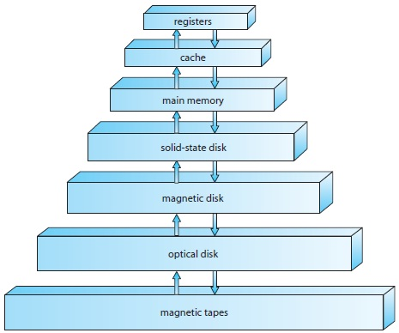
Storage Hierarchy
Low Capacity
High speed
High cost

Slide 14
  Hardware Protection
When we have single user any error occur to the system then we could determine that this error must be caused by the user program, but when we begin to dealing with spooling, multiprogramming, and sharing disk to hold many users data this sharing both improved utilization and increase problems. In multiprogramming system, where one error program might modify the program or data of another program, or even the resident monitor itself. MS-DOS and the Macintosh OS both allow this kind of error.
A properly designed operating system must ensure that an incorrect (or malicious) program cannot cause other programs to execute incorrectly.
Many programming errors are detected by the hardware. These errors are normally handled by the operating system.

Slide 15
Dual-Mode Operation
To ensure proper operation, we must protect the operating system and all other programs and their data from any malfunctioning program. Protection is needed for any shared resource. The approach taken by many operating systems provides hardware support that allows us to differentiate among various modes of execution.
A bit, called the mode bit, is added to the hardware of the computer to indicate the current mode: monitor (0) or user (1). With the mode bit, we are able to distinguish between a task that is executed on behalf of the operating system, and one that is executed on behalf of the user.

Slide 16
I/O Protection
A user program may disrupt the normal operation of the system by issuing illegal I/O instructions, we can use various mechanisms to ensure that such disruptions cannot take place in the system.
One of them is by defining all I/O instructions to be privileged instructions. Thus, users cannot issue I/O instructions directly; they must do it through the operating system, by execute a system call to request that the operating system performing I/O on its behalf. The operating system, executing in monitor mode, checks that the request is valid, and (if the request is valid) does the I/O requested. The operating system then returns to the user.

Slide 17
Memory Protection
To ensure correct operation, we must protect the interrupt vector from modification by a user program. This protection must be provided by the hardware. We need the ability to determine the range of legal addresses that the program may access, and to protect the memory outside that space. We could provide this protection by using two registers, usually a base and a limit register. The base register holds the smallest legal physical memory address; the limit register contains the size of the range. This protection is accomplished by the CPU hardware comparing every address generated in user mode with the registers. Any attempt by a program executing in user mode to access monitor memory or other users' memory results in a trap to the monitor, which treats the attempt as a fatal error

Slide 18
CPU Protection
In addition to protecting I/O and memory, we must ensure that the operating system maintains control. We must prevent a user program from getting stuck in an infinite loop or not calling system services, and never returning control to the operating system. To accomplish this goal, we can use a timer.
A timer can be set to interrupt the computer after a specified period. The period may be fixed (for example, 1/60 second) or variable (for example, from 1 millisecond to 1 second). A variable timer is generally implemented by a fixed-rate clock and a counter.
We can use the timer to prevent a user program from running too long. A simple technique is to initialize a counter with the amount of time that a program is allowed to run.

Slide 19
A more common use of a timer is to implement time sharing. In the most straightforward case, the timer could be set to interrupt every N milliseconds, where N is the time slice that each user is allowed to execute before the next user gets control of the CPU. The operating system is invoked at the end of each time slice to perform various housekeeping tasks. This procedure is known as a context switch. Following a context switch, the next program continues with its execution from the point at which it left off.

