Slide 1
Thick lens –solved problems

Slide 2
Q1: A double convex lens has radii of 5 cm and 20 cm a thickness of 2 cm and an index of 3/2.
Locate both H principal and focal points and compute the image distance for an object 16.4 cm in front of V1. Determine the values of the f.f.l and b.f.l?

Slide 3
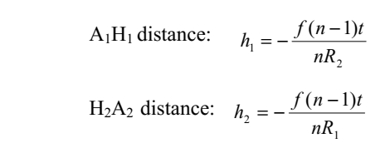

Slide 4
B.f.l= f+ h₂= 8.2 + (-1.1)= 7.1 cm
f.f.l = f+ h₁ = 8.2 -0.27= 7.9 cm
Q2: Two identical bi- convex lens are placed in line with separation of 25.7 mm , each lens has radii of 60 mm and 40 mm a thickness of 20 mm and index of 1.5 .calculate 1) the focal length of each lens and principle points 2) focal length of the system and principals points.?

Slide 5

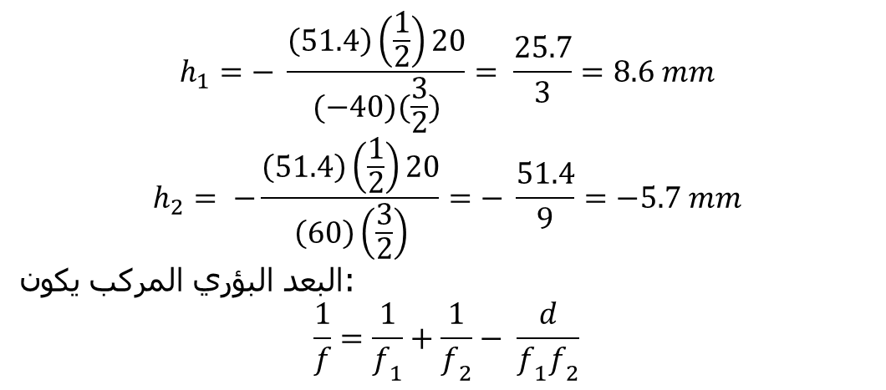
$$h_{1}=− \frac{\left(51.4\right)\left(\frac{1}{2}\right)20}{(−40)(\frac{3}{2})}= \frac{25.7}{3}=8.6 mm$$
$$h_{2}= −\frac{\left(51.4\right)\left(\frac{1}{2}\right)20}{\left(60\right)\left(\frac{3}{2}\right)}=− \frac{51.4}{9}=−5.7 mm$$
البعد البؤري المركب يكون:
$$\frac{1}{f}=\frac{1}{f_{1}}+\frac{1}{f_{2}}− \frac{d}{f_{1}f_{2}}$$

Slide 6
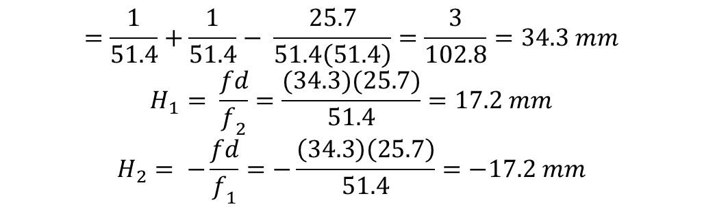
$$=\frac{1}{51.4}+\frac{1}{51.4}− \frac{25.7}{51.4\left(51.4\right)}=\frac{3}{102.8}=34.3 mm$$
$$H_{1}= \frac{fd}{f_{2}}=\frac{(34.3)(25.7)}{51.4}=17.2 mm$$
$$H_{2}= −\frac{fd}{f_{1}}=−\frac{\left(34.3\right)\left(25.7\right)}{51.4}=−17.2 mm$$
Q3: Imagine a compound lens consisting of thin positive lens followed at an interval of 20 cm by a thin negative lens .if theses have focal length of +40 cm and -40 cm ,respectively determine the value of focal length of the system and principal points.

Slide 9
Q4: A bi-concave lens of focal length -60 mm is mounted in a cardboard cylinder 120 mm in front of plano-convex lens of radius 60 mm and index 1.5. find the effective focal length of the system and determine the image which would result from a 3 mm and located 180 mm in front of the device.

