Slide 1
the compound lens system
4.13 Thin lenses in contact

Slide 2
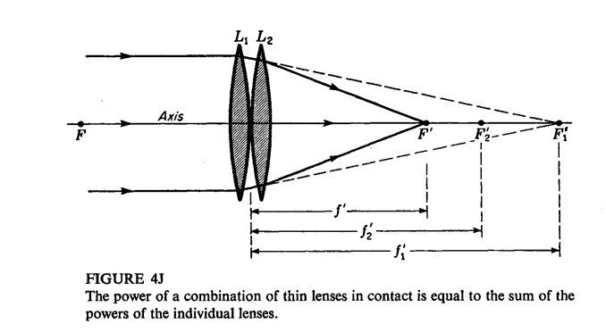

Slide 3
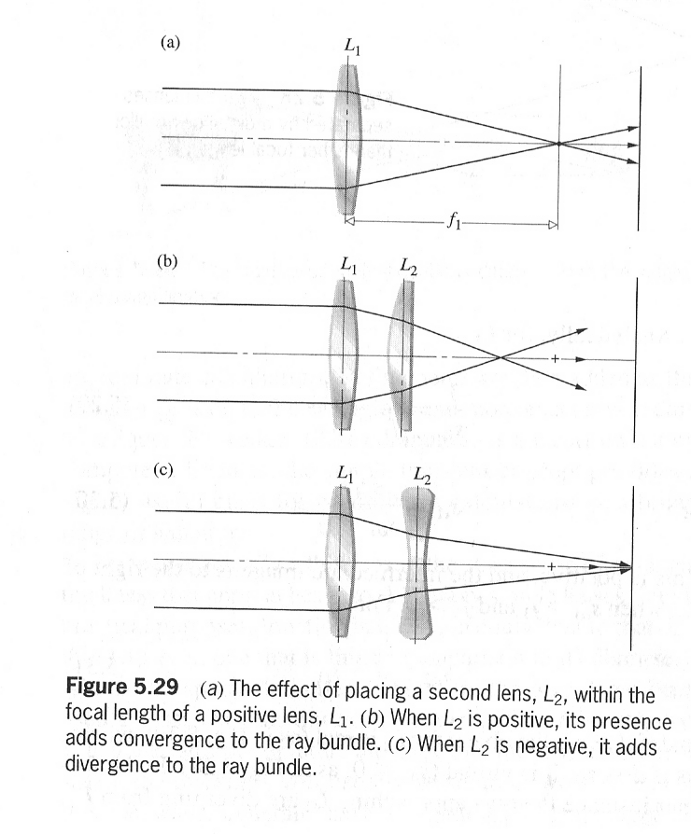
(a) The effect of placing a second lens L₂ within the focal length of a positive lens L₁. (b) when L₂ is positive, its presence adds convergence to the bundle of rays. (c) When L₂ is negative, it adds divergence to the bundle of rays.

Slide 4
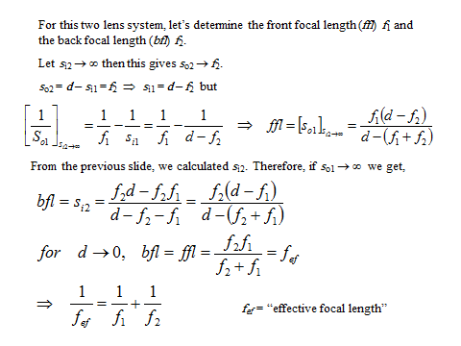

Slide 5
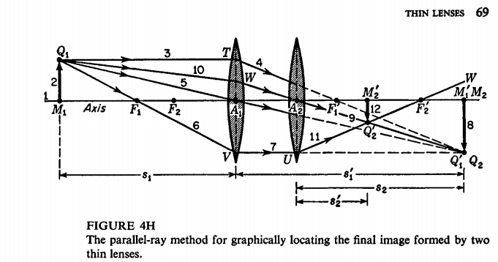
Two thin lenses separated by a distance smaller than either focal length

Slide 6
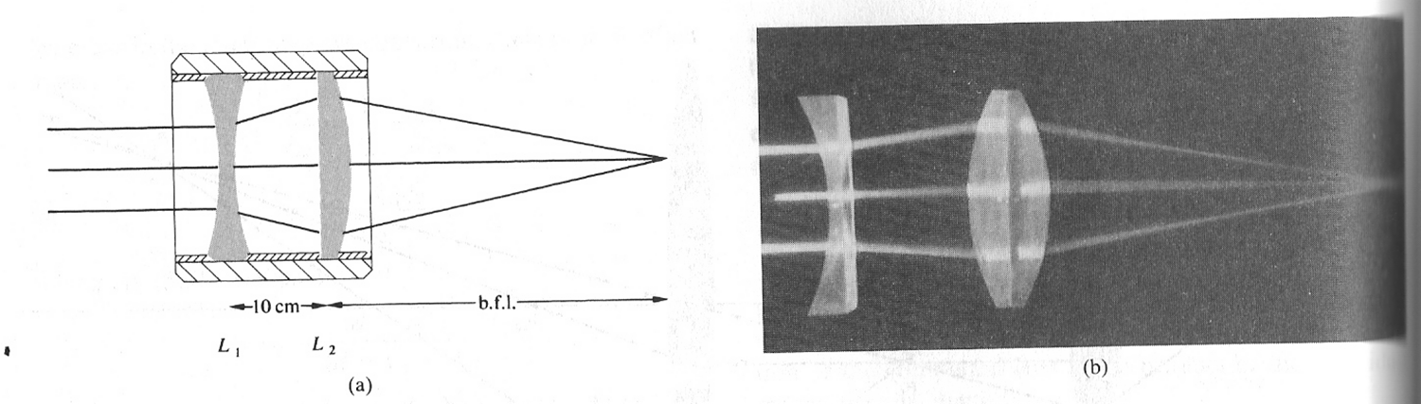
Q13:Imagin a compound lens consisting of thin positive lens followed at an interval of 20 cm by a thin negative lens. If these have focal length of 40 cm and -40 cm respectively ,determine the front focal length and the back focal length?

Slide 7

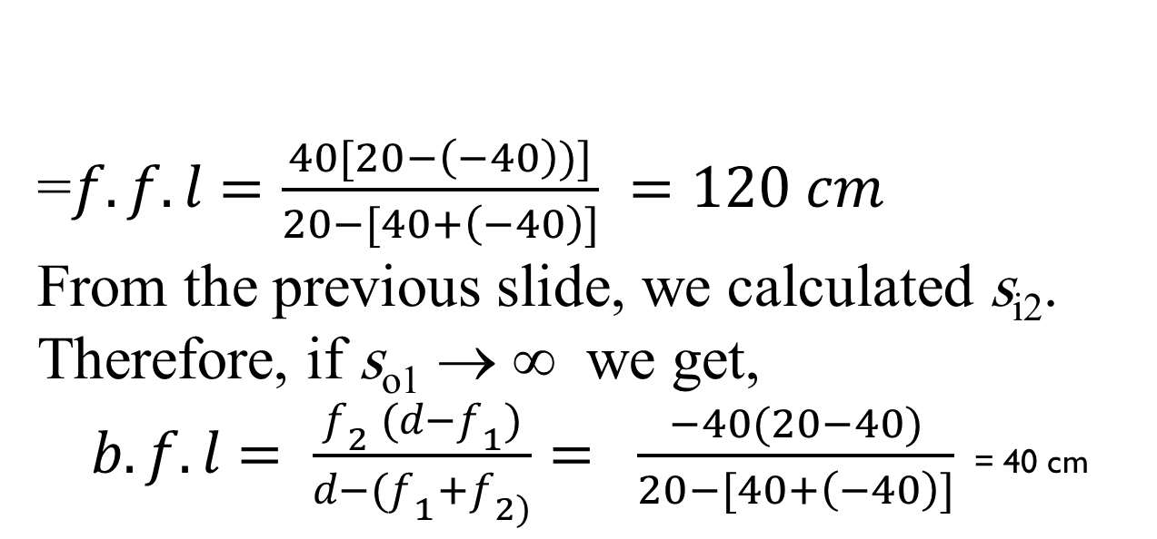
solution
=$f.f.l=\frac{40[20−\left(−40\right))]}{20−[40+\left(−40\right)]} =120 cm$
From the previous slide, we calculated s_{i2}. Therefore, if s_{o1} → ∞ we get,
$b.f.l= \frac{f_{2} (d−f_{1})}{d−(f_{1}+f_{2)}}= \frac{−40(20−40)}{20−[40+\left(−40\right)]}$ = 40 cm

Slide 8
Note that d > s_{i1}, so that the object for Lens 2 (L₂) is real.
For the compound lens system, s_{o1} is the object distance and s_{i2} is the image distance.
The total transverse magnification (M_{T}) is given by

Slide 9
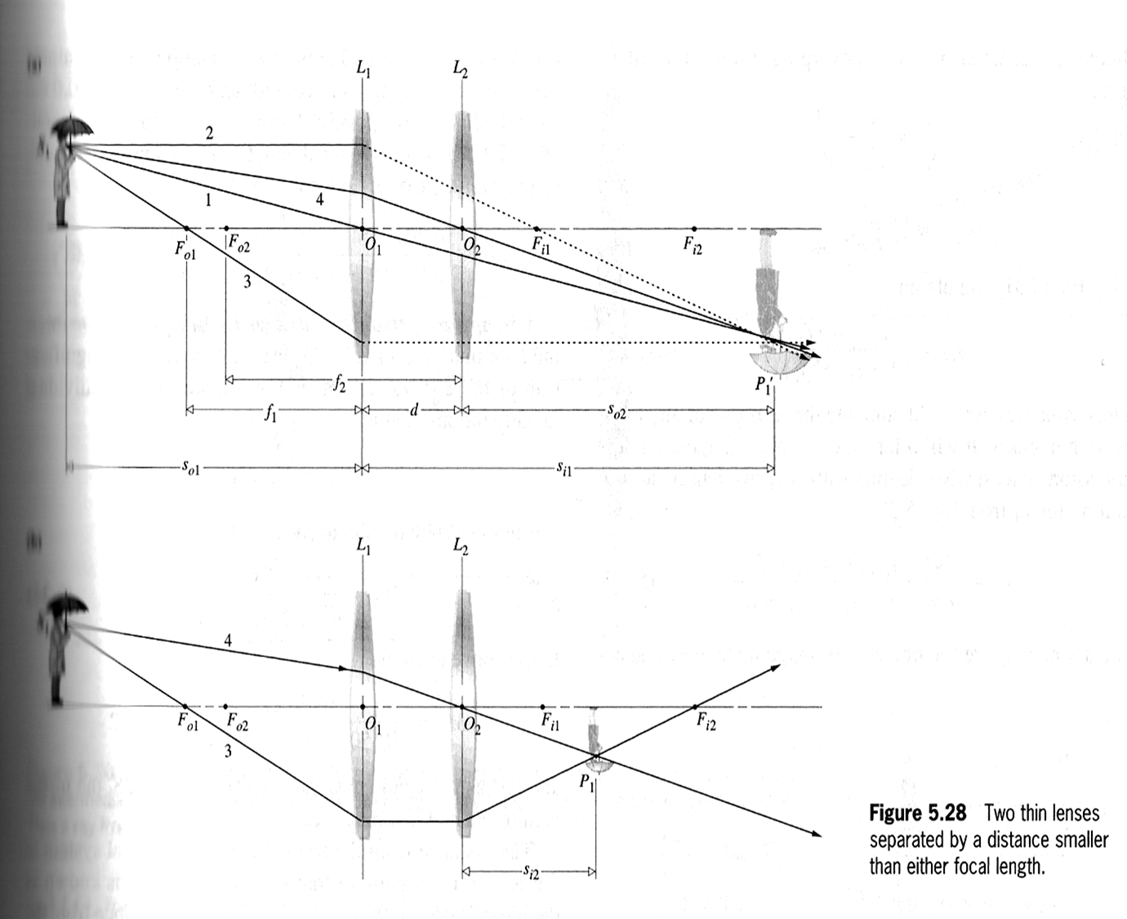

Slide 10
Q12: A compound lens consists of two thin-bi-convex lenses L₁ and L₂ of focal lengths 10 cm and 20 cm , separated by a distance of 80 cm. describe the mage corresponding to a 5 cm tall object 15 cm from the first lens.

Slide 11
For the compound lens system, s_{o1} is the object distance and s_{i2} is the image distance.
بعد الجسم يعطى بالعلاقة
The total transverse magnification (M_{T}) is given by

Slide 12
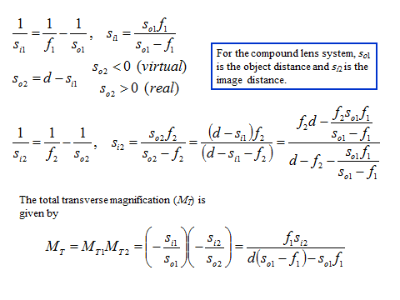
solution

Slide 14


