Slide 1
Thin lenses
Lec. three

Slide 2
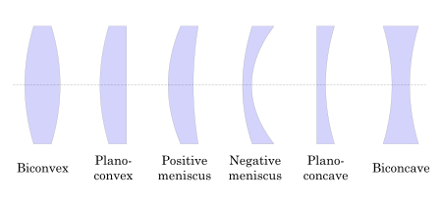
Types of lenses
A thin lens may be defined as one whose thickness is considered small in comparison with the distances generally associated with its optical properties. Such distances are, for example, radii of curvature of the two spherical surfaces, primary and secondary focal lengths, and object and image
distances.

Slide 3
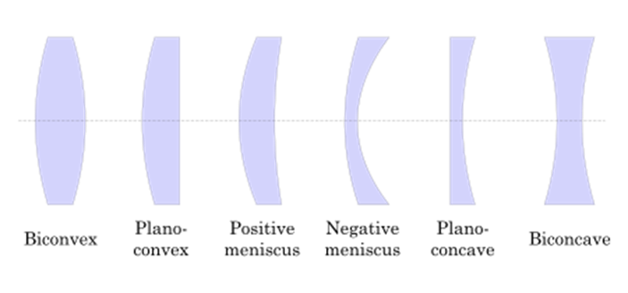
EXAMPLE 3 : A plano-convex lens having a' focal length of 25.0 cm [Fig. 3A(b)] is to be made of glass of refractive index n = 1.520. Calculate the radius of curvature of the grinding and polishing tools that must be used to make this lens.

Slide 4
thin-lens equation, or the Lens maker’s formula
As the rays travel from left to right through a lens, all convex surfaces are taken as having a positive radius and all concave surfaces a negative radius. For an equiconvex lens like the one in Fig. 3A(a), r1 for the first surface is positive and r2 for the second surface negative. Substituting the value of l/f.

Slide 5
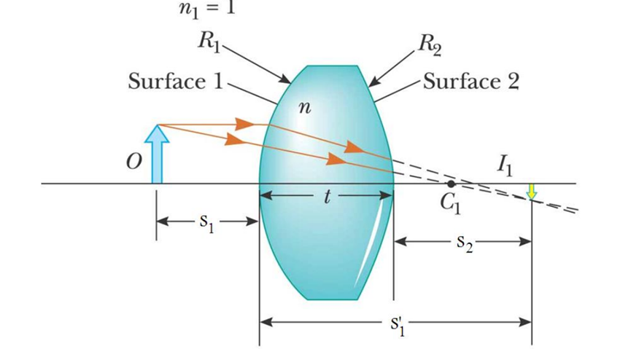
The combination of various surfaces of thin lenses will determine the signs of the corresponding spherical radii.

Slide 6
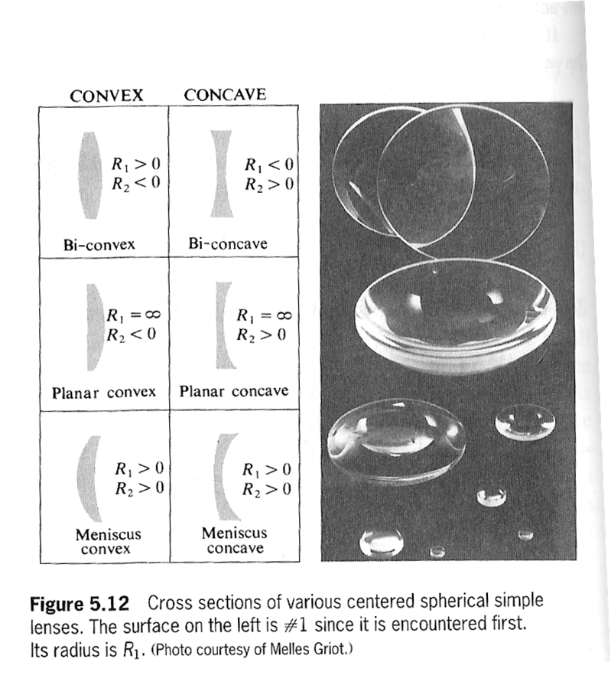
1

Slide 7
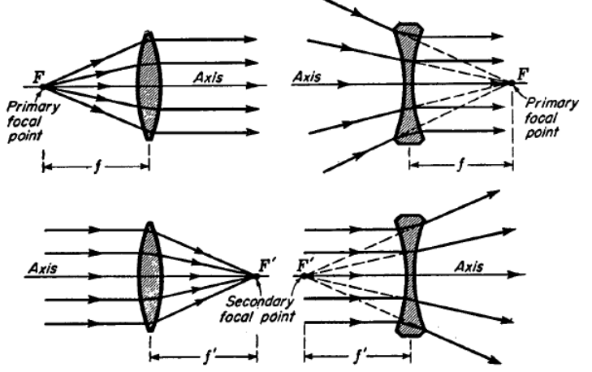
4.1 FOCAL POINTS AND FOCAL LENGTHS
Diagrams showing the refraction of light by an equiconvex lens and by an equiconcave lens are given in figure 4.2. The axis in each case is a straight line through the geometrical center of the lens and perpendicular to the two faces at the points of intersection. For spherical lenses this line which joins the centers of curvature of the two surfaces. Ray diagrams shown in the figure 4.2 illustrates the primary and secondary focal points F and F' and the corresponding focal lengths f and f' of thin lenses.

Slide 8
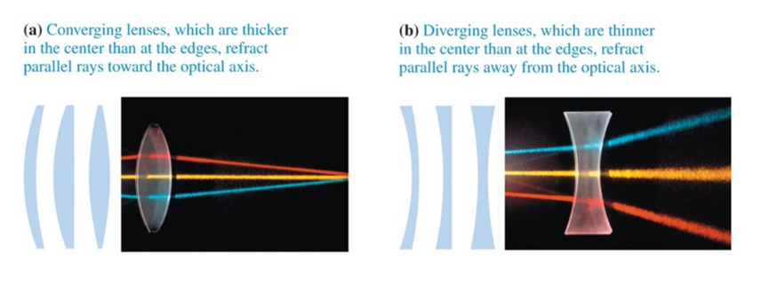

Slide 9
4.2 CONJUGATE POINTS AND PLANES

Slide 10
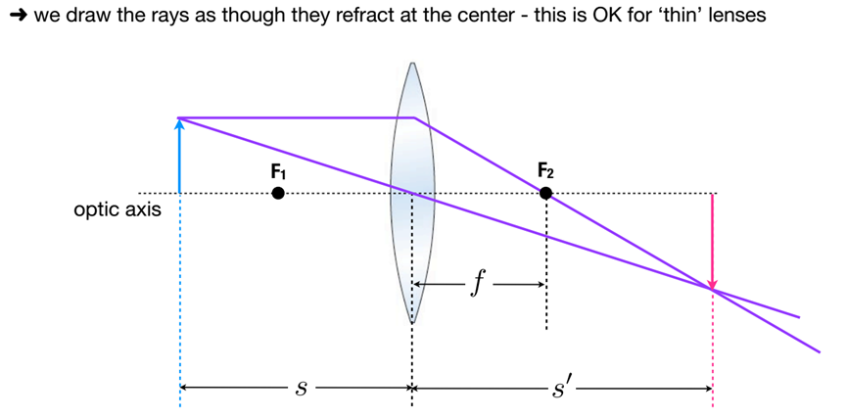
If we know the focal length of a thin lens and the position of an object, there are
three methods of determining the position of the image: (1) graphical construction, (2) experiment, and (3) use of the lens formula
Here s is the object distance, s' is the image distance, and f is the focal length, all measured to or from the center of the lens. This lens equation will be derived later in this chapter.

Slide 11
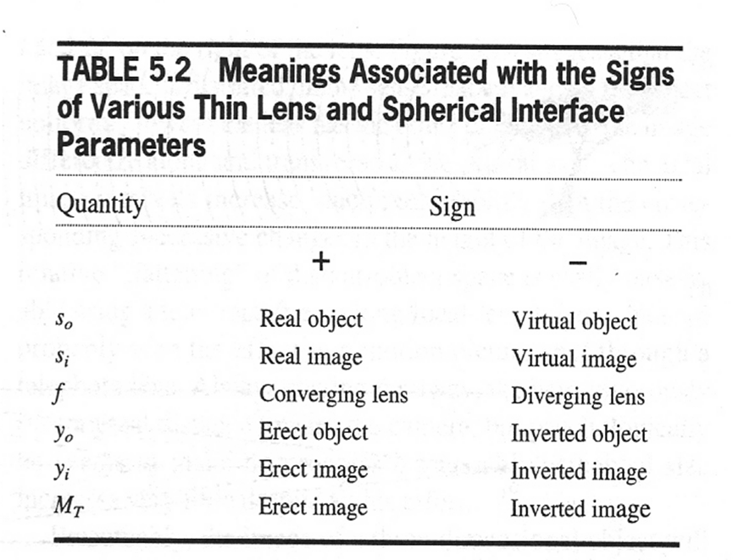
4.3 Sign Conventions for Thin Lenses
1: object distance (s) is positive if object is in front of lens and is a negative if object is in back of lens.
2: image distance (s') is positive if image is in back of lens and is negative if image is in front of lens.
3: r1 and r2 are positive if center of curvature is in back of lens.
4: r1 and r2 are negative if center of curvature is in front of lens.
5: focal length ( f ) is positive if the lens is converging and is negative if the lens is diverging.
2

Slide 12
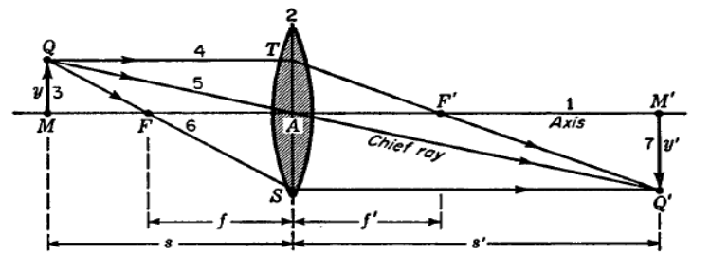
4.4 THE PARALLEL-RAY METHOD
a: For Convex Lens
Figure 4.4b: The parallel-ray method for graphically locating the image formed by a concave lens.

Slide 13
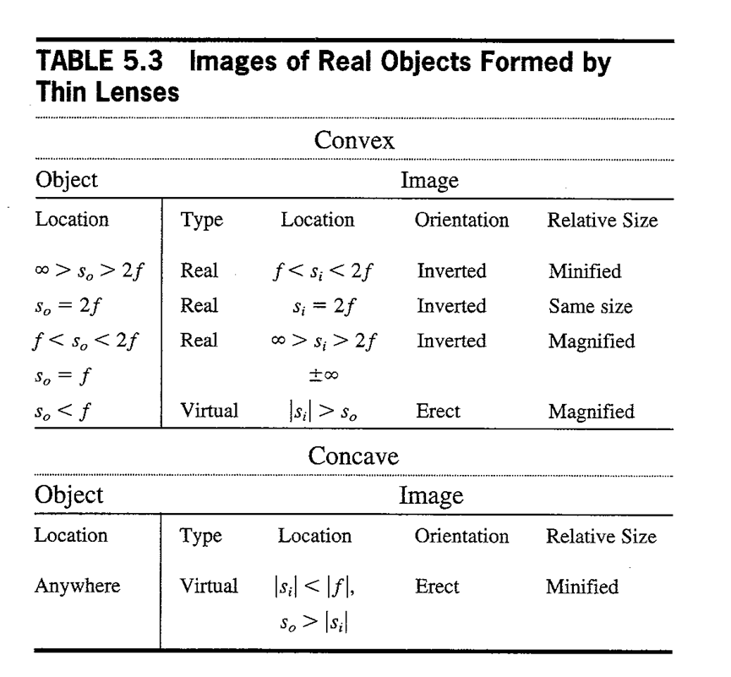
4.5 LATERAL MAGNIFICATION
A simple formula for the image magnification produced by a single lens can be derived from the geometry of figure 4.4a. By construction it is seen that the right triangles QMA and Q'M'A are similar. Corresponding sides are therefore proportional to each other, so that
3

Slide 14
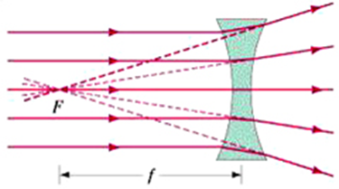
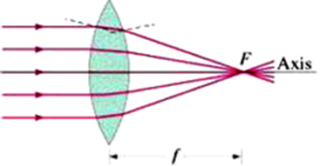
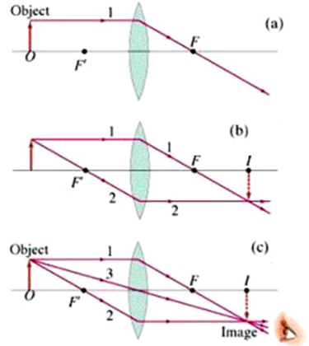
1) construction graphically to determine state of image form in convex lens

Slide 16
4.7 LENS MAKERS' FORMULA
If a lens is to be ground to some specified focal length, the refractive index of the glass must be known. Supposing the index to be known, the radii of curvature
must be so chosen as to satisfy the equation
(4.4)
As the rays travel from left to right through a lens, all convex surfaces are taken as having a positive radius and all concave surfaces a negative radius. For an equiconvex lens, r1 for the first surface is positive and r2 for the second surface negative. Substituting the value of l/f from equation(4.1), we can write
If a lens is to be ground to some specified focal length, the refractive index of the glass must be known. Supposing the index to be known, the radii of curvature must be so chosen as to satisfy the equation
(4.5)
As the rays travel from left to right through a lens, all convex surfaces are taken as having a positive radius and all concave surfaces a negative radius. For an equiconvex lens, r1 for the first surface is positive and r2 for the second surface negative. Substituting the value of l/f from equation(4.1), we can write

Slide 17
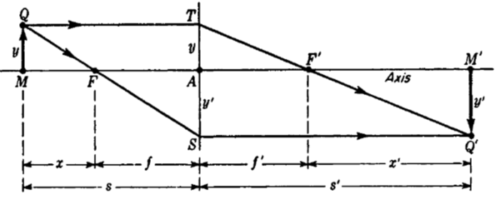
4.8 DERIVATION OF THE LENS FORMULA
From similar triangles Q'TS and F' TA the proportionality between corresponding sides gives

Slide 18
Note that y - y' is written instead of y + y' because y', by the convention of signs,
is a negative quantity. From the similar triangles QTS and FAS, The sum of these two equations is
(4.8)
Since f = f ' ,the two terms on the right can be combined and y - y' canceled out,yielding the desired equation,
(4.9)
This equation is called Gaussian form or the lens equation of thin lenses, can be used to relate the image distance and object distance for a thin lens.
Another form of the lens formula is the Newtonian form, is obtained in an analogous way from two other sets of similar triangles, QMF and FAS on the one hand and TAF' and F'M'Q' on the other. We find
(4.10)
Multiplication of one equation by the other gives

Slide 19
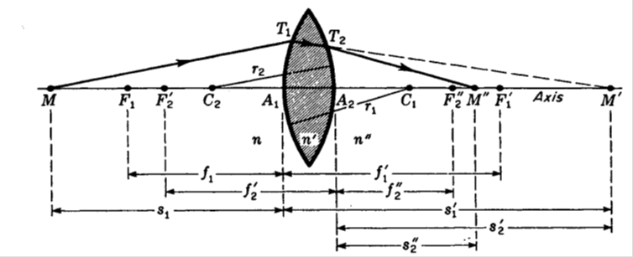
The newtonian lens formula then takes the symmetrical form
The result is that the object and image must be on the opposite sides of their respective focal points.
4.9 DERIVATION OF THE LENS MAKERS' FORMULA

Slide 20
". For this second surface the object ray T1 T2 has for its object distance s2', and the refracted ray gives an image distance of s2''. When the following equation determined in chapter 3 is applied to second refracting surface
As a consequence we can set s1' = - s2' and write
If we now call s1 the object distance and designate it s as in figure (4.8) and call
s2". the image distance and designate it s", we can write equation (4.14) as

Slide 21
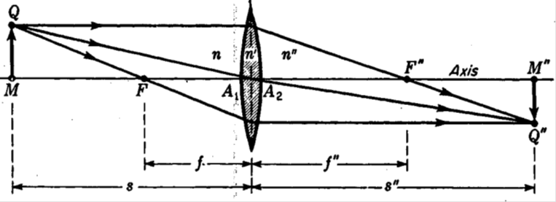
This is the general formula for a thin lens having different media on the two sides. By setting s or s" equal to infinity. When this is done, we obtain
In words, the focal lengths have the ratio of the refractive indices of the two media n and n" , see figure(4.8)
(4.17)

Slide 22
If the medium on both sides is the same, n = n" , equation (4.15) reduces to
Finally, if the surrounding medium is air (n = 1), we obtain the lens makers' Formula
4.10 POWER OF LENS
If the distances are measured in meter, the unit of power of lens is called diopter (D). the power of lens may be calculated by the relation

Slide 23
written as
where
where P is the power of the lens and is equal to the sum of the powers of the two surfaces:

Slide 24
Examples
EXAMPLE I: If an object is located 6.0 cm in front of a lens of focal length + 10.0 cm, where will the image be formed?
The given quantities are s = + 6.0cm, and f = + 10.0cm, while the unknown quantities are s' and m.
1/s +1/s'= 1/f

Slide 25
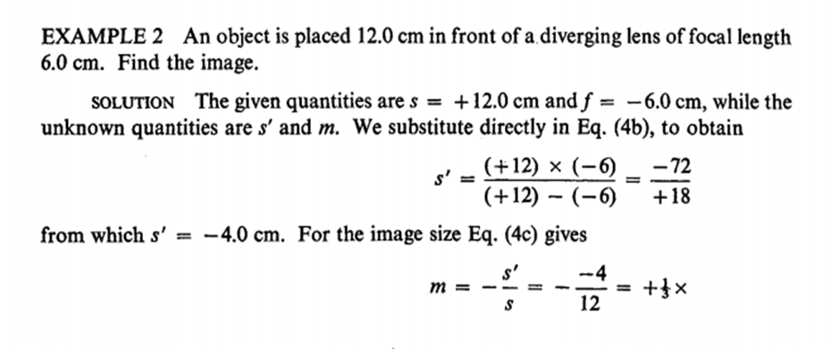
Examples

Slide 26
EXAMPLE 3: A plano-convex lens having a' focal length of 25.0 cm.
is to be made of glass of refractive index n = 1.520. Calculate the radius of curvature of the grinding and polishing tools that must be used to make this lens.
SOLUTION: - Since a plano-convex lens has one flat surface, the radius for that surface is infinite, and r1 in Eq. (4d) is replaced by 00. The radius r2 of the second surface is the unknown. Substitution of the known quantities in Eq.

Slide 27
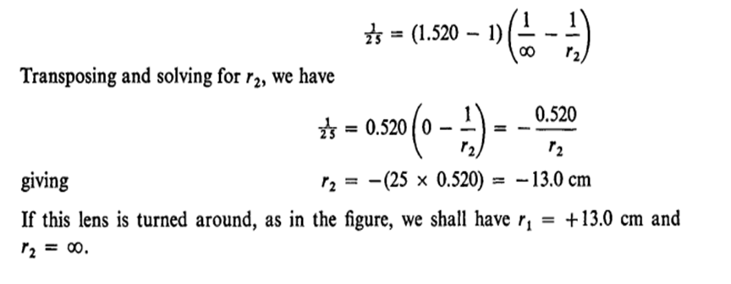
EXAMPLE 4: - The radii of both surfaces of an equiconvex lens of index 1.60 are equal to 8.0 cm. Find its power.
SOLUTION: n = 1.60, r1 = 0.080 m, and r2 = -0.080 m (see table 1 and fig1 for the shape of an equiconvex lens).
ملاحظة : ضروري وضع علامة + او – امام نواتج power lens , radii and object and image distance

