Slide 1
Technical Aspects in Subtitling/ Part Two Lect. Dr. Jalil Naser Hilu

Slide 2
Temporal Constraints
Given that subtitles need to be synchronised with the dialogue and displayed for sufficient time for viewers to read them, subtitlers are highly constrained in their choices when translating the text and timing it. While subtitling may be considered an art by some subtitlers, there are certain standards and rules that most people agree on.

Slide 3
Duration and Spotting
First of all , spotting, also known as timing and cueing,has to keep pace -temporal synchrony- with the utterances. This means that a subtitle should appear (in-time) when a person starts speaking, and should disappear (out-time) when the person stops speaking.

Slide 4
Duration and Spotting
Studies indicate that if a subtitle stays on screen longer than the time the viewer actually needs to read it, there is a tendency to read it again in order to avoid this, six seconds is the recommended maximum exposure time to keep a full two-liner. ( Diaz Cintas and Remael, 2006:134-135).

Slide 5
Duration
Any titles should ideally remain on screen for at least one second so that ‎the eye of the viewer can register its presence .Subtitles that are kept on ‎screen for a shorter period of time risk appearing or disappearing like a ‎flash and therefore not being read by the viewer .

Slide 6
Duration
On the other hand , if a ‎very short subtitle remains on screen too long , the viewers will have time ‎to read it repeatedly , which is equally irritating and can break the reading ‎rhythm .

Slide 7
Duration and Spotting
When there are too many words used in the subtitle to fit within the ‎duration , the software shows a red alarm , warning the subtitler that the ‎subtitle has gone over the limit –that is , that their subtitle is too long in ‎terms of duration.

Slide 8
Duration and Spotting
The spotting of the dialogue has to mirror the rhythm of the film and the performance of the actors , and the mindful of pauses , interruptions , and other prosodic features that characterize the original speech .

Slide 9
Delay function between subtitles
‎A slight , clear pause has to exist between two consecutive ‎subtitles if the viewer is to register that a change of written material ‎has taken place on screen .If a subtitle is immediately followed by ‎another one without leaving any frames between the two , the eye ‎finds it difficult to realize that new information has presented .The ‎changes of this mishap occurring are greater when the two subtitles ‎share a similar layout .‎

Slide 10
Problem of delay function
‎To avoid this problem , many subtitling programs have an ‎automatic delay function that creates a small pause immediately after ‎the out-time of every subtitle , before the next one can be cued in .This ‎function can be manipulated and various values can be selected , but in ‎order to be effective a minimum of two or three frames are needed .‎

Slide 11
Frame
One of the many still images which compose a complete moving picture .
" Frame " can also be used as a unit of time , but the actual duration of it depends on the frame rate at which it is displayed .

Slide 12
Frame Rate
The frequency at which consecutive video images ( frames ) are displayed , in rapid succession , to create the visual effect of motion expressed in frames per second , or fps .Common frame rates include 24 fps , 25 fps and 30 fps .

Slide 13
Timecodes
A timecode generator assigns an 8-digit figure to every single frame of the film or program .It is a sort of identity sign unique to each frame , making it easy for any professional to identify a particular frame within the whole program .The code is engraved at the top or the bottom of the working copy , where a TCR-Time Code Reader – indicates the hours , minutes , seconds and frames .( Diaz Cintas and Remael , 2014 : 93 )

Slide 14
Timecodes

Slide 15
Reading speed
Studies on ‎the reading speed of viewers seem to indicate that the greater the number ‎of words in one subtitle , the less time is then spent reading each one of ‎these words .
That is , viewers need more time to read short subtitles than ‎longer ones ".( Ivarsson and Carroll 1998 : 64 ) ‎

Slide 16
Reading speed
It is preferable to utilize one-liners because they are easier to be read than ‎two-liners .There is also some caution that if one-liners contain greatly ‎condensed information , coupled with a high degree of implied information ‎‎, it is quite conceivable that they may be more difficult to interpret than ‎two-liners .‎

Slide 17
‎Max. and min. number of characters
The number of characters per line has evolved with time and technological developments, and now usually falls within the range of 38– 42 characters per line There is no fixed rule as to the minimum number of characters ‎a subtitle must have , but subtitles counting less than 4 to 5 characters are ‎rare .‎In some cases , a one-word subtitle can just as well be ‎incorporated into the preceding or following one .‎

Slide 18
Field of digital video
‎In the field of digital video , any picture is made up of ‎individual dots known as pixels –literally picture elements .Each frame of ‎the video is a picture 720 pixels wide and 576 pixels high , known in the ‎profession as broadcast resolution .Written text and graphics shown on ‎screen may get distorted if they appear too close to the edges because TV ‎manufactures deal with the screen edges differently. This is why all text ‎must be centrally positioned within a safe area .‎

Slide 19
Safe area of the text
The safe area of the text is usually 10% with each frame edge , e.g. 72 pixels in from the right and left edges and 57 pixels from the top and bottom . They should always be respected when working with subtitling program .

Slide 20
Movement of the subtitles
‎Subtitles can be moved from the bottom of the screen to another ‎position if the need arises .Such a move can occur if :‎
( 1 ) The background at the bottom of the screen is so light that the subtitles are illegible .
( 2 ) Some important action is taking place at the bottom of the screen .
( 3 ) Some essential data are displayed at the bottom of the screen while dialogue continues and must therefore be subtitle.
( examples are : other subtitles , inserts with dates or information about a speaker , or the broadcaster's logo ) .

Slide 21
Movement of the subtitles

Slide 22
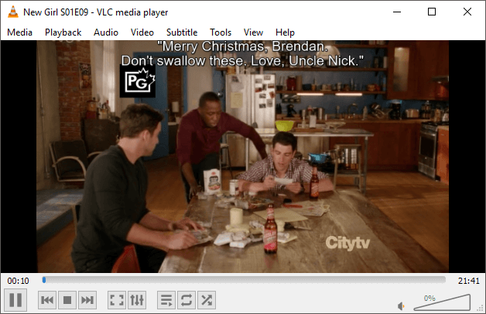
Movement of the subtitles

Slide 23
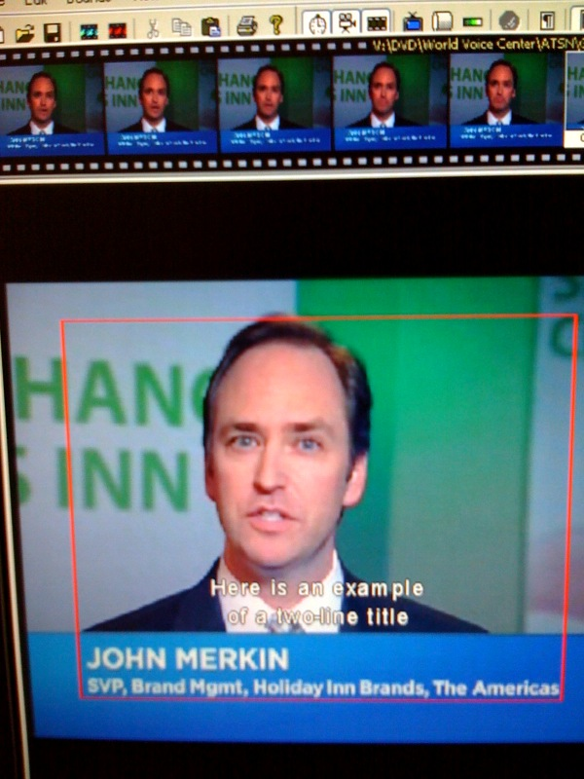

Slide 24
Multiple voices in subtitling
As opposed to oral speech , written texts , including subtitles , are ‎sequential and can only present dialogue exchanges one after the other‎‎.This makes the spotting of the overlapping dialogue especially tricky ‎‎.When there is more than one person speaking at the same time the ‎spotter has to make the difficult decision of deciding which information ‎will make it to the target language and which will have to be deleted .‎

Slide 25
Multiple voices in subtitling
In addition , the timing will have to be done in as clear a way as possible ‎so as not to confuse the viewer , who can hear several voices at the ‎same time and may not know who is saying what .In these cases , good ‎layout of the subtitles is also essential . When spotting , the faster the ‎pace of the dialogue exchanges , the more challenging the task ‎becomes .‎

Slide 26
Shot changes
‎There is another golden rule in spotting which recommends that a ‎subtitle should not be maintained over a cut .The subtitle should leave ‎the screen just before the cut occurs and a new subtitle spotted after ‎the cut , which functions as a dividing frontier between subtitles .This ‎recommendation is based on eye movement that have shown that if a ‎subtitle is kept on screen when there is a cut exchange , the viewer is ‎led to believe that a change of a subtitle has also taken place and starts ‎re-reading the same onscreen text .‎

Slide 27
Text reduction
The written version of a speech in subtitles is almost always a reduced ‎form of the oral source text. Indeed, subtitling can never be a ‎complete and detailed rendering and nor should it be. Because of its ‎multiple channels a complete translation is not required. However, ‎this does not mean that viewers do not have the right to high quality ‎translation (Diaz Cintas and Remael, 2006: 146).‎

Slide 28
Concept of text reduction
‎( 1 ) because viewers can grasp a speech more quickly than they can read, so ‎subtitles must give them enough time to register and understand ‎what is written at the bottom of the screen. ‎
‎( 2 ) viewers must also watch what is happening on the screen, so they ‎must have the time to combine reading with watching.
‎( 3 ) subtitles are limited to a maximum of two lines. How much text ‎they contain depends on the time available, the subtitling reading ‎speed, and the speed at which the source text is actually pronounced ‎‎(Diaz Cintas and Remael , 2006:146).‎

Slide 29
Concept of text reduction
1- Intrasemiotic redundancy draws on what can by and large be considered redundant verbal elements typical of natural spoken language, such as repetitions, false starts, or hesitations. These elements are not essential to understanding the gist of the message and as such may undergo reduction.

Slide 30
Concept of text reduction
2- Intersemiotic redundancy relies on elements which can be inferred from image or sound, and as such can be omitted in the subtitle or condensed, for instance by using a deictic expression, such as “here” or “this”.

Slide 31
Concept of text reduction
3- viewers’ common knowledge about the world. According to Tomaszkiewicz (2006, p. 128), an average viewer has a working knowledge of conversational routines, such as greeting-greeting, suggestion-acceptance, or question-answer; therefore, such elements may be reduced if necessary.

Slide 32
Concept of text reduction

Slide 33
THANK YOU

