Slide 1
Subtitling Lect. Dr. Jalil Naser Hilu

Slide 2
Subtitling
All subtitled programmes are made up of three main components: the spoken word, the image and the subtitles. The interaction of these three components, along with the viewer’s ability to read both the images and the written text at a particular speed, and the actual size of the screen, determine
the basic characteristics of the audiovisual medium. Subtitles must appear in synchrony with the image and dialogue, provide a semantically adequate
account of the SL dialogue, and remain displayed on screen long enough for the viewers to be able to read them.

Slide 3
Subtitling
A translation practice that consists of rendering in writing, usually at the bottom of the screen, the translation into a target language of the original dialogue exchanges uttered by different speakers, as well as all other verbal information that appears written on screen (letters, banners, inserts) or is transmitted aurally in the soundtrack (song lyrics, voices off). (Díaz Cintas, 2020, p. 150)

Slide 4
Subtitling
“a translation practice”,
“rendering in writing”
Subtitles are typically positioned at the bottom of the screen

Slide 5
Subtitling
Apart from spoken utterances, subtitles also contain translations of plot- pertinent on- screen text, such as text messages, signs, and letters. In recent years, we have also witnessed a trend referred to as “creative” subtitles or “integrated titles” (Fox, 2018; O’Sullivan, 2011), whereby subtitle placement, colour, typeface, and other characteristics are more attuned to the scene: for instance a blood- dripping typeface in a horror film.

Slide 6
Types of Subtitling
-interlingual subtitles contain a translation from one language into another (e.g. from English to Arabic), and
-intralingual subtitles, which consist of a transcription of spoken text within the same language (e.g. from Spanish to Spanish).

Slide 7
Types of Subtitling
Subtitles typically contain text in only one language (monolingual subtitles).In some multilingual settings and countries, subtitles may be displayed in two languages at the same time – in which case they are known as bilingual. If you go to the cinema in Switzerland, for instance, you may end up watching two sets of subtitles: one in German and one in French, displayed simultaneously.

Slide 8
Bilingual Subtitling

Slide 9
Types of Subtitling
When it comes to the time of preparation, subtitles can either be prepared earlier, i.e. before they are shown to viewers, or they can be made and/ or displayed in real time. Subtitles that are created before the broadcast are referred to as pre-recorded, offline, or post- production subtitles, as they are added to the final product after the production process has been completed.

Slide 10
Types of Subtitling
Semi-live subtitles are typically used on pre- scripted programmes, such as television news, where the text is known and available beforehand – it is read out by the news anchor from a prompter. In this case, the subtitle text is prepared in advance, but it is not timed: it does not have any time codes.
When it comes to live subtitles, as opposed to semi- live subtitles, no previously prepared text is available as subtitles are created in real time, using speech recognition technology or stenography

Slide 11
Types of Subtitling
Speaking of technology, subtitles have traditionally been created by human subtitlers. However, automatic subtitles are becoming more and more common. “Automatic” may refer to the fact that subtitles have been machine translated or that they have been automatically transcribed and timed using speech recognition and artificial intelligence (AI) technology – or both.

Slide 12
Types of Subtitling
Subtitles can either be visible to all viewers, in which case they are known as “open”, or be activated by the user on their device, in which case they are referred to as “closed”, hence the term “closed captions”. A good example of open subtitles are those you can see in the cinema, whereas closed subtitles are the ones you can activate yourself through a menu, for instance on streaming platforms, YouTube, or digital TV.

Slide 13
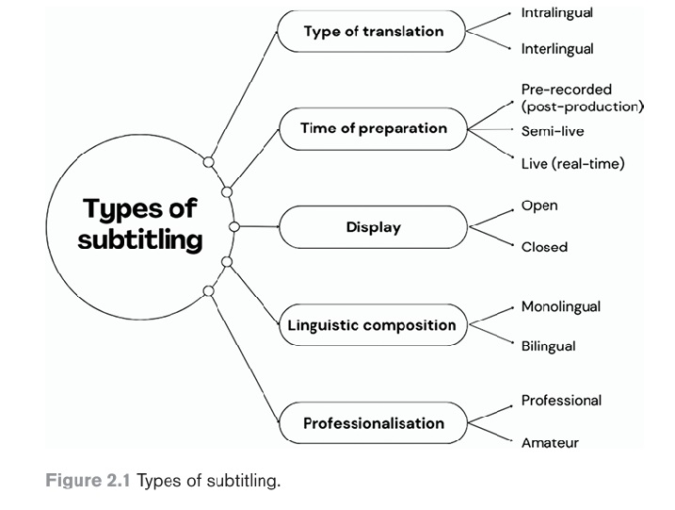
Types of Subtitling

Slide 14
Characteristics of subtitling
Subtitling has famously been referred to as a “constrained” type of translation (Mayoral et al., 2002). Unlike a printed book, where the length and layout of the translated text is not subject to such strict limitations, when translating films, we are bound by two major requirements: the subtitles we create need to fit the limited space on screen and need to be synchronised with the dialogue, while at the same time allowing viewers sufficient time to read them.

Slide 15
Characteristics of subtitling
This largely corresponds to two groups of constraints – or, as some people prefer to call them, “limitations” or “dimensions” (Díaz Cintas & Remael, 2021) – spatial and temporal.

Slide 16
Spatial constraints
Spatial constraints refer to the limited space on screen that subtitles can occupy and to how the text in the subtitles should be structured to facilitate reading for viewers. Although in some countries and on some TV programmes, such as news or talk shows, you may encounter three- or even four- line subtitles, a subtitle typically consists of one or two lines of text.

Slide 17
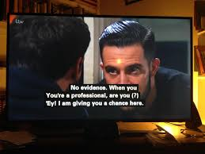
Spatial Constraints

Slide 18
Spatial constraints
The number of characters per line has evolved with time and technological developments, and now usually falls within the range of 38– 42 characters per line for languages with Latin and Cyrillic alphabets, as well as Semitic languages, such as Arabic or Hebrew, and around 16 characters for Chinese, Korean, or Japanese.

Slide 19
Spatial constraints
Other important spatial considerations include the font type and size, subtitle colour, and background. To improve legibility, displaying subtitles in a font with no serifs, such as Arial or Helvetica is recommended.

Slide 20
Spatial constraints
Subtitles are usually displayed in light colours, such as white. They can be displayed against a black background, against a semi- transparent background, or no background at all. The text may be shown with a black outline and/ or a shadow.

Slide 21
Spatial constraints
An important spatial consideration in subtitling is text segmentation, which includes two aspects: (1) how the dialogue is segmented into consecutive subtitles (sometimes referred to as “subtitle events”) and (2) how words are distributed between the lines in a two- line subtitle (known as “line breaks”).

Slide 22
Spatial constraints
Good text segmentation is based on keeping linguistic units together and not splitting them between the lines or subtitle events. A well- segmented subtitle should contain a meaningful semantic unit, for instance a full sentence, or a question and answer.

Slide 23
‎ Line splitting (Line Breaks)
In subtitling , lines need to be split Syntactically-cued text and ‎reading. When reading, people make sense of words by grouping them ‎into phrases – a process known as parsing (Warren, 2012). Parsing is ‎done incrementally, word by word: readers do not wait until the end of ‎the sentence to interpret it, but try to make sense of it while they are ‎reading. To understand a sentence, readers must “first identify its ‎syntactic relations” . ( Rayner et al., 2012, p. 223 )‎

Slide 24
‎ Line splitting
1- Article and noun/adjective:
Who knows why the
dog ate the chicken?
It should be:
Who knows why
the dog ate the chicken?

Slide 25
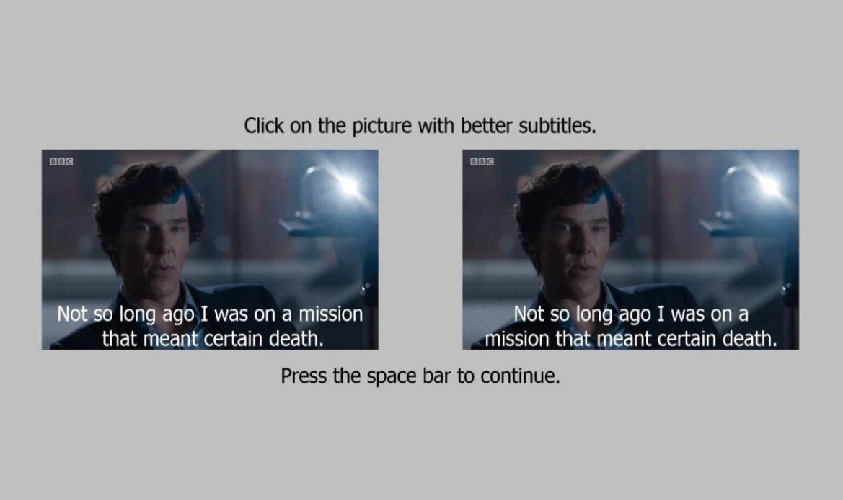

Slide 26
‎ Line splitting
2. Adjective and noun it modifies
I drove here in the red
car with big wheels.
It should be:
I drove here in the red car
with big wheels.

Slide 27
‎ Line splitting
3. Adverb and verb it modifies
I was happily
walking down the street.
It should be:
I was happily walking
down the street.

Slide 28
‎ Line splitting
4. Verb and subjective pronoun
Don’t tell me you
ate all the pizza.
It should be:
Don’t tell me you ate
all the pizza.

Slide 29
‎ Line splitting
5. First name and last name
The 18th president, Abraham
Lincoln, was born in a log cabin.
It should be:
The 18th president, Abraham Lincoln,
was born in a log cabin.

Slide 30
‎ Line splitting
6. Negative verbs
Although I was hungry, I did
not want to eat too early.
It should be:
Although I was hungry,
I did not want to eat too early.

Slide 31
THANK YOU

