Slide 1
Translational Aspects in AVT

Slide 2
acronyms
Acronyms /are one of the challenges in AVT, in subtitling in particular. They are used abundantly in the English language. Such a feature is uncommon in Arabic.
However, when acronyms are used in the ST, the TL (Arabic) superordinate/hypernym is used.

Slide 3
acronyms
Returning to the issue of acronyms, another more complex example from the episode Sleuths is when the bear, which has been sedated, wakes up immediately after being injected with a microchip in order to track it in the wild:

Slide 4
acronyms
The acronym RFID tracker has been translated in its full version, with eight words in the TT when it has only two words in the ST. The best strategy is to explicate it the first time it occurs in a film, and then use the short form—that is, “the tracker” would suffice.

Slide 5
Multilingualism
is another challenge in this episode, because the subtitler has to translate an English translation of some French sentences and phrases.
Ça va? هل انت بخير

Slide 6
Multilingualism
The subtitler has no choice but to translate both the French and English phrases successively into Arabic. Obviously, translation loss occurs and this cannot be compensated in this instance. The foreign element in the original has been lost in the TT. This issue is inescapable as there is not enough time to indicate that the original has some French lexical items.

Slide 7
Multilingualism
According to O'Sullivan (2011:192), the use of various fonts (bold, ‎italics) or colors in subtitles can be a reasonable option of signalising the different ‎linguistic and cultural identities on the screen.

Slide 8
Superordinates/Hypronyms
Subtitlers and indeed AV translators use the strategy of equivalence, sometimes employing a more general item (a superordinate) for a more specific item (a hyponym) and vice versa. Superordinates are sometimes useful when they are shorter, a strategy used at times in subtitling in order to reduce the number of words displayed on screen, as they are in the
written and not spoken form.

Slide 9
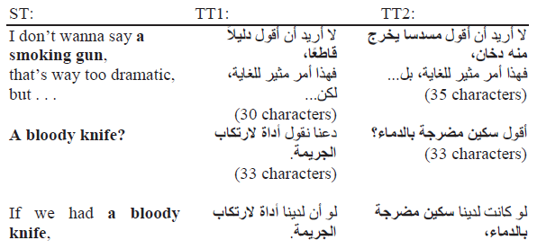
Superordinates/Hypronyms

Slide 10
Puns
Pun is one of the most popular forms of verbal humour. It has always been, ‎and continues to be, one of the most problematic issues in translation ‎‎(Aleksandrova 2018a: 5). Puns based on the use of homonyms or paronyms ‎cause the greatest difficulties for translators. The translation of polysemic words, ‎one of the meanings of which in the source language is not represented in the ‎target language, or idioms, which do not have a direct match-idiom in the TL, is ‎also problematic. ‎

Slide 11
Puns
Coke refreshes you like no other can
An emperor is a ruler
Sure, I used to carry an emperor to school with me.
You look pretty dirty, susie
Thank you. I look pretty when I’m clean, too

Slide 12
Puns
ما مات من كرم الزمان فأنه يحيا لدى يحيى بن عبد الله
اذا ملك لم يكن ذا هيبة فدعه فدولته ذاهبة
قالت يا اسماعيل صبرا
قلت لها يا أسما عيل صبري

Slide 13
THANK YOU

