Slide 1
Translational Aspects in AVT

Slide 2
‎Introduction ‎
In this presentation we will try to shed light on issues related to translation ‎studies and how they can be applied in the field of AVT. As it is known, AVT is ‎one of several overlapping umbrella terms that include ‘media translation’, ‎‎‘multimedia translation’, ‘multimodal translation’ and ‘screen translation’. These ‎different terms all set out to cover the inter-lingual transfer of verbal language ‎when it is transmitted and accessed both visually and acoustically. This can create ‎many issues on the transfer of linguistic factors from the SL to TL like the level of ‎formality in which standard language and dialect can overlap. ‎

Slide 3
‎Translation theory and audiovisual translation
Delabastita‘s (1989) model is one of the earliest and most important in AVT ‎that tried to frame film translation within translation theory. He claims that his ‎model “is an organized inventory of questions and hypotheses that should direct ‎any future work” (1989: 194) and that film establishes a multi-channel (acoustic ‎and visual channels) and multi-code (the verbal, the literary and theatrical, the ‎cinematic code, politeness codes, moral codes, and so forth) type of ‎communication. ‎

Slide 4
‎Translation theory and audiovisual translation
Any transfer of film signs from the source to the target set of codes needs to ‎respect the material parameters within which any such translation process is ‎necessarily accomplished. He then puts a scheme of potential translational ‎relationships between a source film and a target film.‎

Slide 5
‎Translation theory and audiovisual translation
Diaz-Cintas and Remael (2007) talk about AVT with reference to subtitling. ‎They do not adopt a specific model or theory of translation which might be ‎applied to this kind of language transfer. They talk about the translation of ‎marked speech such as dialect, the translation of culture-bound terms, songs, ‎swearwords, and humour.‎

Slide 6
‎Translation theory and audiovisual translation
Some of the strategies that the authors recommend for subtitling culture-bound issues ‎are loan, calque or literal translation, explicitation, substitution, transposition, ‎lexical recreation, compensation, omission and addition. All these strategies are ‎noticeably related to translation in general and not to AVT and cannot be said to ‎constitute a model.‎

Slide 7
‎Translation theory and audiovisual translation
Karamitroglou (2000: 11) presents the following set of reasons to emphasize on ‎the inclusion of AVT as a part of translation studies:‎
a) Audiovisual translation has more in common with written translation than one ‎might primarily assume (Whitman-Linsen, 1992:103). Most audiovisual ‎translations at the present time are performed with a written form of the original ‎source text in hand, sometimes even without any further access to the film ‎product itself.‎

Slide 8
‎Translation theory and audiovisual translation
b) Typological studies in audiovisual translation have previously managed to ‎present the various audiovisual language transfer methods within the general ‎frame of translation studies and along with the other 'traditional' language transfer ‎methods, in a coherent and scientific way, on the basis of the multiplicity of the ‎semiotic channels involved and the relative time of presentation of the source and ‎target products.

Slide 9
‎Translation theory and audiovisual translation
c) Audiovisual translation was born out of the same drive that conducted literary ‎translation: the necessity to overcome the communication barriers imposed by ‎linguistic fragmentation (Luyken et al., 1991:3).‎

Slide 10
‎Translation theory and audiovisual translation
d) Just as "it is the discovery of the hierarchy of factors (constraints, parameters) ‎which operate in translation processes, procedures and products which constitutes ‎a major task for translation theory" (Even-Zohar & Toury, 1981:ix), the ‎discovery of a similar chain of the factors that function within audiovisual ‎translation is also the task of audiovisual translation theory. ‎

Slide 11
‎Standard language VS dialects
Written English is in many cases more formal than spoken English, and the ‎same can be said about other languages including Arabic. So how is it possible to ‎reflect less formal or informal English language in a formal Arabic style when ‎film translation into Arabic? Before we answer this question, it is important to ‎understand the mechanism of both dialects or language varieties of English and ‎Arabic. ‎

Slide 12
‎Standard language VS dialects
Dickins et al (2002: 165) argue that sociolect is defined in terms of sociological ‎notions of class, and that sociolectal features can convey important speaker-related ‎information. Consequently, if they are salient features of the ST, the translator ‎cannot ignore them. On the other hand, the situations of Arabic is referred to as ‎one of diglossia. Diglossia, as Dickins et al maintain, can be defined as a situation ‎where two varieties of a language co-occur throughout a community of speakers, ‎each having a distinct range of social functions.‎

Slide 13
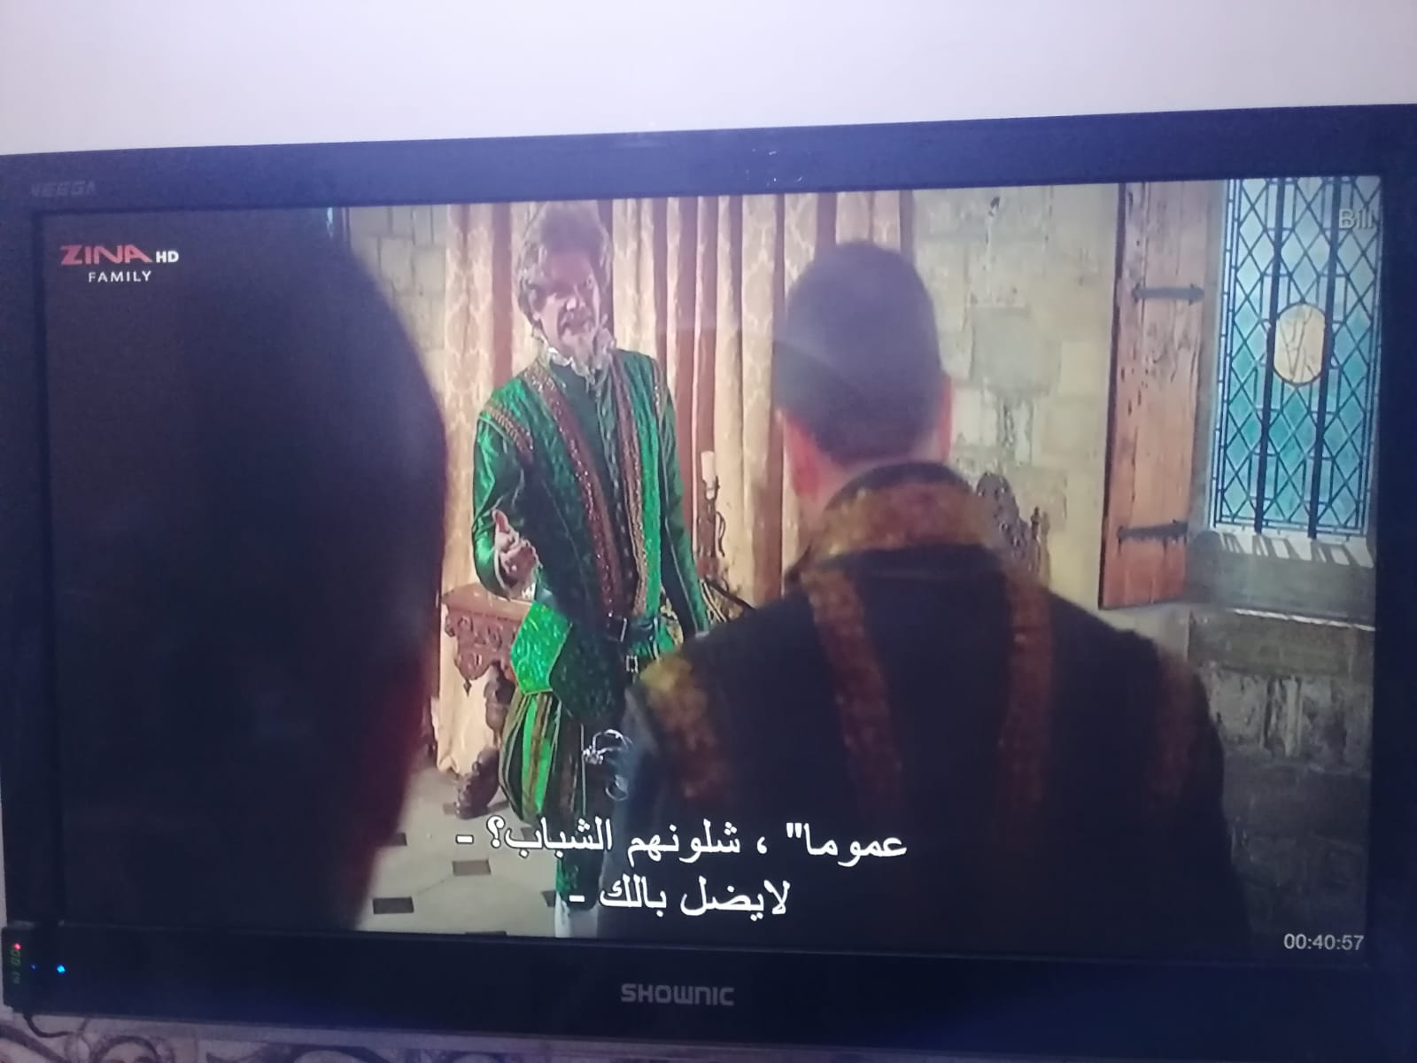
‎Standard language VS dialects

Slide 14
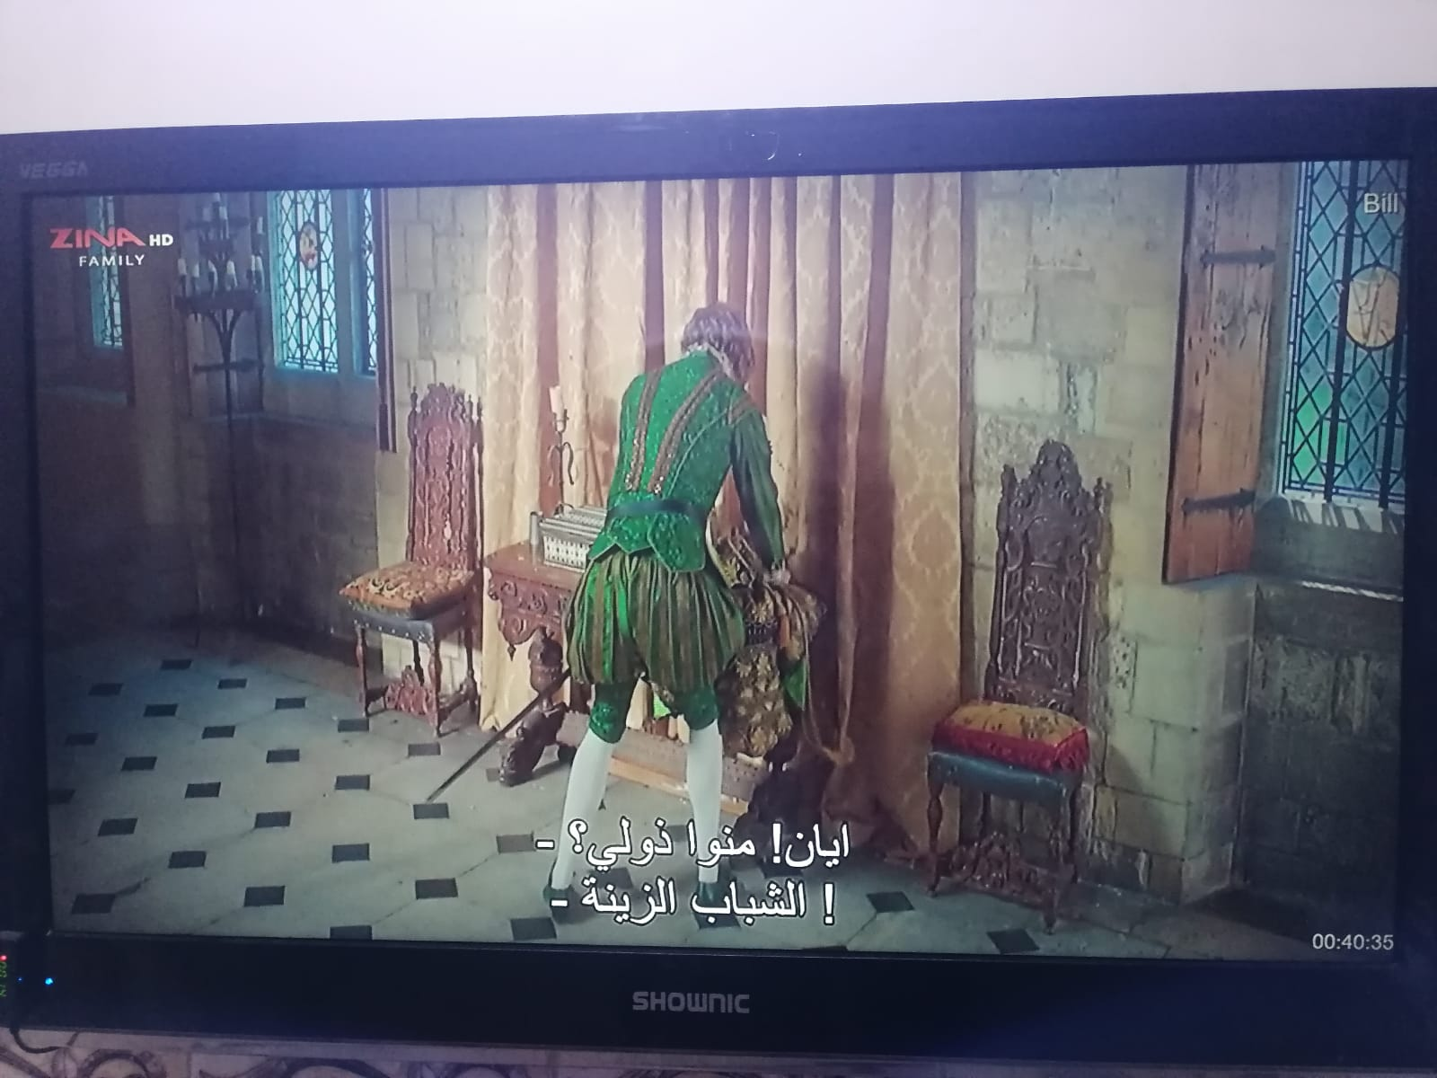
‎Standard language VS dialects

Slide 15
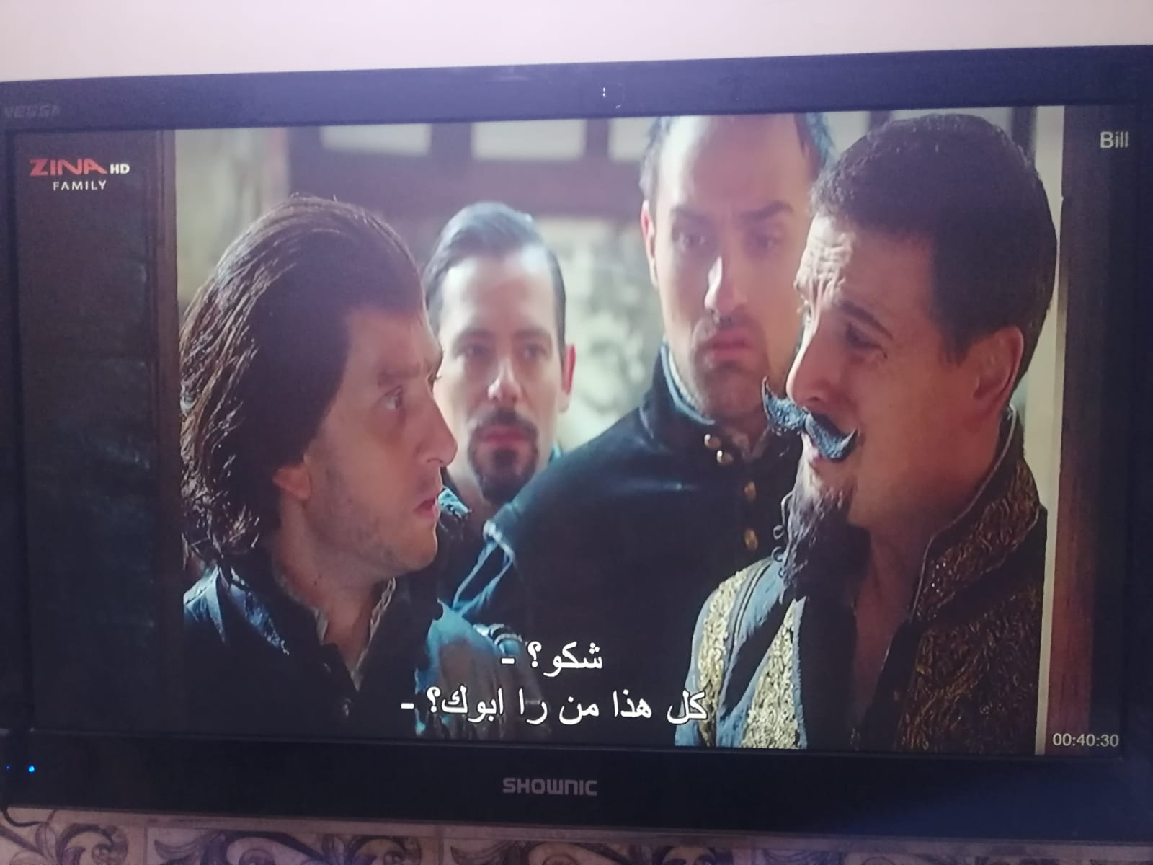
‎Standard language VS dialects

Slide 16
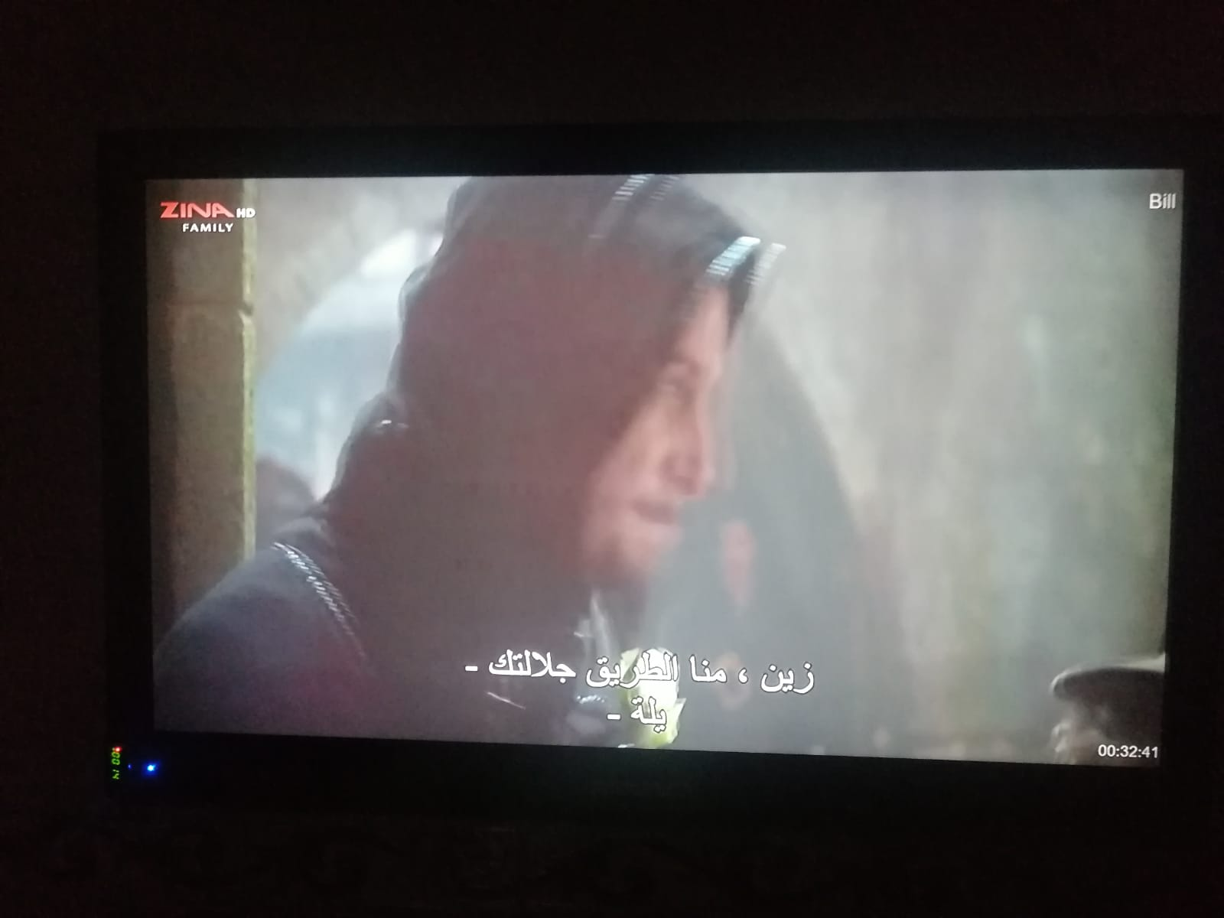
‎Standard language VS dialects

Slide 17
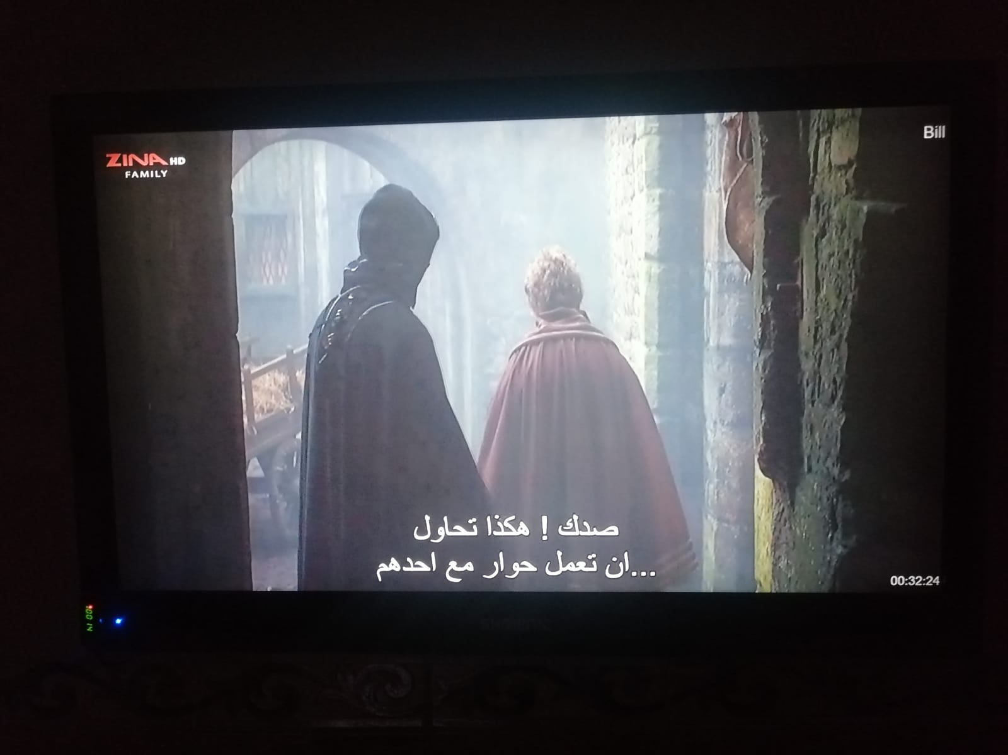
‎Standard language VS dialects

Slide 18
THANK YOU

