Slide 1
Technical Aspects in Subtitling

Slide 2
Concept of characters
For the Roman alphabet the maximum number of characters allowed on a ‎one line TV subtitle is usually 37 , including blank spaces and typographical ‎signs which will take up one space .Occasionally , clients will ask for a ‎maximum of 33 or 35 characters per line , or allow up to 39 to 41 ‎characters depending on their guidelines and software used .Exceptionally ‎‎, some film festivals will go as high as 43 characters per line .

Slide 3
Font type and number of characters per line
most subtitles are white , although occasionally yellow is used when ‎subtitling black and white films , so that the contrast between image and ‎text is sharper.
WinCAPS ‎
The font we recommend to use is 32 .‎
Please note that 32 refers to pixels , not points .‎
‎The characters are always shadowed or black contoured , which ‎solves legibility problems.‎

Slide 4
Font type and number of characters per line
When the subtitles appear against a very light background , one of the ‎solutions may be to encase them in a grey or black box . The boxes are ‎standard in subtitling software and can be made to appear throughout the ‎film or simply whenever they are required in concrete subtitles‎.

Slide 5
‎Max. and min. number of characters
It is recommended using a maximum ‎of 39 characters per line .The total for a two –liner is , therefore , 78 ‎characters .There is no fixed rule as to the minimum number of characters ‎a subtitle must have , but subtitles counting less than 4 to 5 characters are ‎rare .‎

Slide 6
Duration
Any titles should ideally remain on screen for at least one second so that ‎the eye of the viewer can register its presence .Subtitles that are kept on ‎screen for a shorter period of time risk appearing or disappearing like a ‎flash and therefore not being read by the viewer .On the other hand , if a ‎very short subtitle remains on screen too long , the viewers will have time ‎to read it repeatedly , which is equally irritating and can break the reading ‎rhythm .In some cases , a one-word subtitle can just as well be ‎incorporated into the preceding or following one .‎

Slide 7
Style guides
In addition to a dialogue list of the program to be translated , subtitlers ‎also must receive a style guide , or equivalent , from the broadcasting ‎or subtitling company , in which they can find the main parameters to ‎be applied in their subtitles . Unfortunately , it is not a common ‎occurrence in the profession and many translators are left to their ‎devices when producing subtitles . Some companies have their ‎guidelines , but they tend to be for internal use only and are not very ‎detailed .( Diaz Cintas and Remael , 2014 : 79 ) ‎

Slide 8
Multiple voices in subtitling
As opposed to oral speech , written texts , including subtitles , are ‎sequential and can only present dialogue exchanges one after the other‎‎.This makes the spotting of the overlapping dialogue especially tricky ‎‎.When there is more than one person speaking at the same time the ‎spotter has to make the difficult decision of deciding which information ‎will make it to the target language and which will have to be deleted .‎

Slide 9
Multiple voices in subtitling
In addition , the timing will have to be done in as clear a way as possible ‎so as not to confuse the viewer , who can hear several voices at the ‎same time and may not know who is saying what .In these cases , good ‎layout of the subtitles is also essential . When spotting , the faster the ‎pace of the dialogue exchanges , the more challenging the task ‎becomes .‎

Slide 10
Shot changes
‎There is another golden rule in spotting which recommends that a ‎subtitle should not be maintained over a cut .The subtitle should leave ‎the screen just before the cut occurs and a new subtitle spotted after ‎the cut , which functions as a dividing frontier between subtitles .This ‎recommendation is based on eye movement that have shown that if a ‎subtitle is kept on screen when there is a cut exchange , the viewer is ‎led to believe that a change of a subtitle has also taken place and starts ‎re-reading the same onscreen text .‎

Slide 11
Delay function between subtitles
‎A slight , clear pause has to exist between two consecutive ‎subtitles if the viewer is to register that a change of written material ‎has taken place on screen .If a subtitle is immediately followed by ‎another one without leaving any frames between the two , the eye ‎finds it difficult to realize that new information has presented .The ‎changes of this mishap occurring are greater when the two subtitles ‎share a similar layout .‎

Slide 12
Problem of delay function
‎To avoid this problem , many subtitling programs have an ‎automatic delay function that creates a small pause immediately after ‎the out-time of every subtitle , before the next one can be cued in .This ‎function can be manipulated and various values can be selected , but in ‎order to be effective a minimum of two or three frames are needed .‎

Slide 13
Text reduction
The written version of a speech in subtitles is almost always a reduced ‎form of the oral source text. Indeed, subtitling can never be a ‎complete and detailed rendering and nor should it be. Because of its ‎multiple channels a complete translation is not required. However, ‎this does not mean that viewers do not have the right to high quality ‎translation (Diaz Cintas and Remael, 2006: 146).‎

Slide 14
Concept of text reduction
‎( 1 ) because viewers can grasp a speech more quickly than they can read, so ‎subtitles must give them enough time to register and understand ‎what is written at the bottom of the screen. ‎
‎( 2 ) viewers must also watch what is happening on the screen, so they ‎must have the time to combine reading with watching.
‎( 3 ) subtitles are limited to a maximum of two lines. How much text ‎they contain depends on the time available, the subtitling reading ‎speed, and the speed at which the source text is actually pronounced ‎‎(Diaz Cintas and Remael , 2006:146).‎

Slide 15
‎ Line splitting
In subtitling , lines need to be split Syntactically-cued text and ‎reading. When reading, people make sense of words by grouping them ‎into phrases – a process known as parsing (Warren, 2012). Parsing is ‎done incrementally, word by word: readers do not wait until the end of ‎the sentence to interpret it, but try to make sense of it while they are ‎reading. To understand a sentence, readers must “first identify its ‎syntactic relations” . ( Rayner et al., 2012, p. 223 )‎

Slide 16
‎ Line splitting
1- Article and noun/adjective:
Who knows why the
dog ate the chicken?
It should be:
Who knows why
the dog ate the chicken?

Slide 17
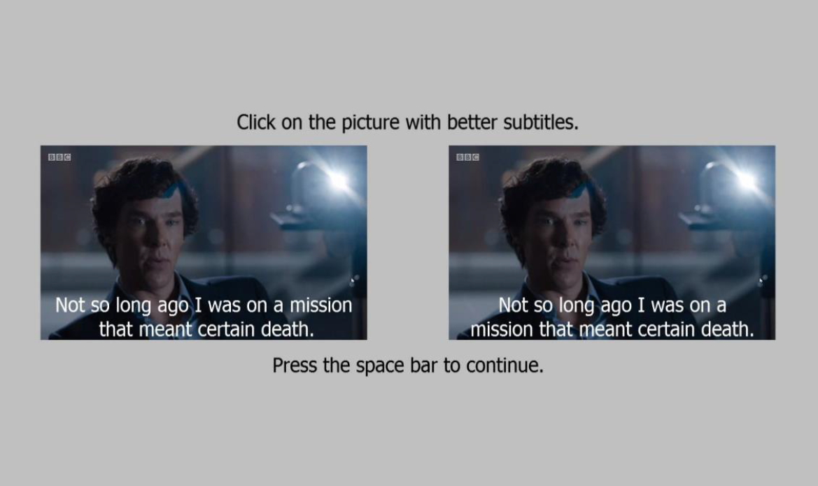

Slide 18
‎ Line splitting
2. Adjective and noun it modifies
I drove here in the red
car with big wheels.
It should be:
I drove here in the red car
with big wheels.

Slide 19
‎ Line splitting
3. Adverb and verb it modifies
I was happily
walking down the street.
It should be:
I was happily walking
down the street.

Slide 20
‎ Line splitting
4. Verb and subjective pronoun
Don’t tell me you
ate all the pizza.
It should be:
Don’t tell me you ate
all the pizza.

Slide 21
‎ Line splitting
5. First name and last name
The 18th president, Abraham
Lincoln, was born in a log cabin.
It should be:
The 18th president, Abraham Lincoln,
was born in a log cabin.

Slide 22
‎ Line splitting
6. Negative verbs
Although I was hungry, I did
not want to eat too early.
It should be:
Although I was hungry,
I did not want to eat too early.

Slide 23
THANK YOU

