Slide 1
Technical Aspects in AVT

Slide 2
Duration and Spotting
First of all , spotting has to keep pace -temporal synchrony- with the utterances. This means that a subtitle should appear when a person starts speaking, and should disappear when the person stops speaking.

Slide 3
Duration and Spotting
Studies indicate that if a subtitle stays on screen longer than the time the viewer actually needs to read it, there is a tendency to read it again in order to avoid this, six seconds is the recommended maximum exposure time to keep a full two-liner. ( Diaz Cintas and Remael, 2006:134-135).

Slide 4
Duration and Spotting
When there are too many words used in the subtitle to fit within the ‎duration , the software shows a red alarm , warning the subtitler that the ‎subtitle has gone over the limit –that is , that their subtitle is too long in ‎terms of duration.

Slide 5
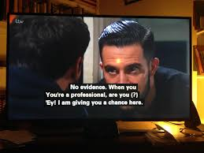
Duration and Spotting

Slide 6
Duration and Spotting
The spotting of the dialogue has to mirror the rhythm of the film and the performance of the actors , and the mindful of pauses , interruptions , and other prosodic features that characterize the original speech .

Slide 7
Frame
One of the many still images which compose a complete moving picture .
" Frame " can also be used as a unit of time , but the actual duration of it depends on the frame rate at which it is displayed .

Slide 8
Frame Rate
The frequency at which consecutive video images ( frames ) are displayed , in rapid succession , to create the visual effect of motion expressed in frames per second , or fps .Common frame rates include 24 fps , 25 fps and 30 fps .

Slide 9
Timecodes
The introduction of timecodes in the subtitling process brought about changes that have altered virtually all stages in the profession , from the timing of the subtitles to their engraving or projection on screen , including the way they can be archived , revised and amended

Slide 10
Timecodes
A timecode generator assigns an 8-digit figure to every single frame of the film or program .It is a sort of identity sign unique to each frame , making it easy for any professional to identify a particular frame within the whole program .The code is engraved at the top or the bottom of the working copy , where a TCR-Time Code Reader – indicates the hours , minutes , seconds and frames .( Diaz Cintas and Remael , 2014 : 93 )

Slide 11
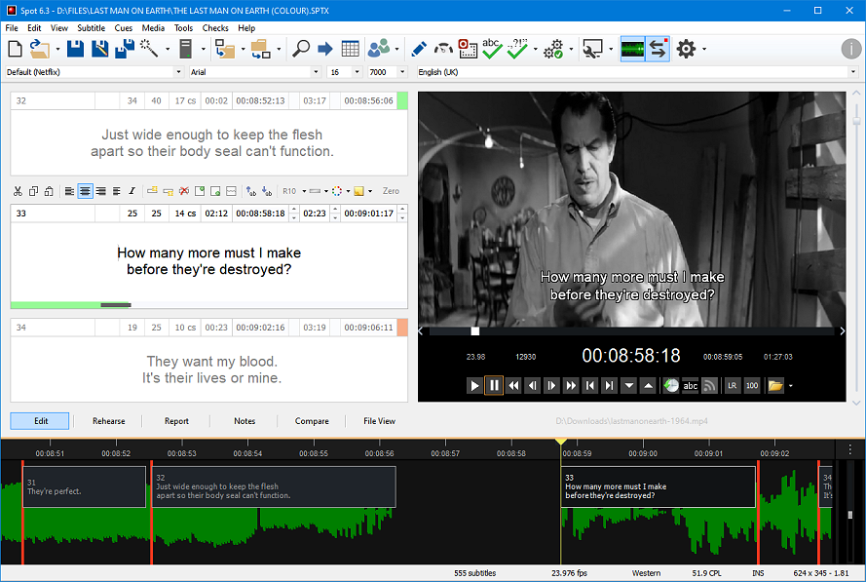
Timecodes

Slide 12
Reading speed
Studies on ‎the reading speed of viewers seem to indicate that the greater the number ‎of words in one subtitle , the less time is then spent reading each one of ‎these words .
That is , viewers need more time to read short subtitles than ‎longer ones ".( Ivarsson and Carroll 1998 : 64 ) ‎

Slide 13
Reading speed
It is preferable to utilize one-liners because they are easier to be read than ‎two-liners .There is also some caution that if one-liners contain greatly ‎condensed information , coupled with a high degree of implied information ‎‎, it is quite conceivable that they may be more difficult to interpret than ‎two-liners .‎

Slide 14
Field of digital video
‎In the field of digital video , any picture is made up of ‎individual dots known as pixels –literally picture elements .Each frame of ‎the video is a picture 720 pixels wide and 576 pixels high , known in the ‎profession as broadcast resolution .Written text and graphics shown on ‎screen may get distorted if they appear too close to the edges because TV ‎manufactures deal with the screen edges differently. This is why all text ‎must be centrally positioned within a safe area .‎

Slide 15
Safe area of the text
The safe area of the text is usually 10% with each frame edge , e.g. 72 pixels in from the right and left edges and 57 pixels from the top and bottom . They should always be respected when working with subtitling program .

Slide 16
Movement of the subtitles
‎Subtitles can be moved from the bottom of the screen to another ‎position if the need arises .Such a move can occur if :‎
( 1 ) The background at the bottom of the screen is so light that the subtitles are illegible .
( 2 ) Some important action is taking place at the bottom of the screen .
( 3 ) Some essential data are displayed at the bottom of the screen while dialogue continues and must therefore be subtitle.
( examples are : other subtitles , inserts with dates or information about a speaker , or the broadcaster's logo ) .

Slide 17

Movement of the subtitles

Slide 18
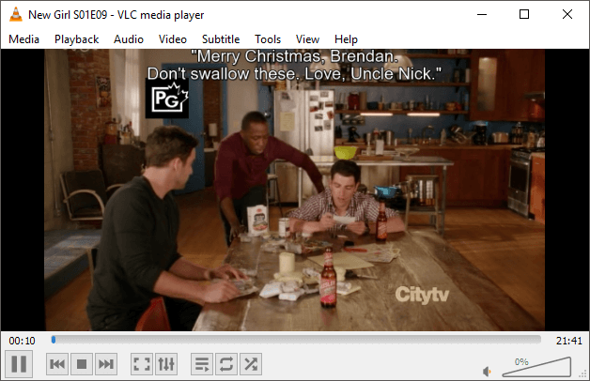
Movement of the subtitles

Slide 19
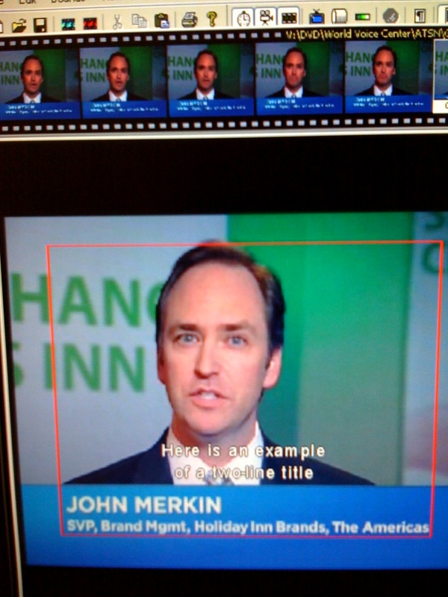
Movement of the subtitles

Slide 20
THANK YOU

