Slide 1
Subtitling

Slide 2
Subtitling
All subtitled programmes are made up of three main components: the spoken word, the image and the subtitles. The interaction of these three components, along with the viewer’s ability to read both the images and the written text at a particular speed, and the actual size of the screen, determine
the basic characteristics of the audiovisual medium. Subtitles must appear in synchrony with the image and dialogue, provide a semantically adequate
account of the SL dialogue, and remain displayed on screen long enough for the viewers to be able to read them.

Slide 3
Subtitling
New and innovative professional activities such as subtitling for the deaf and the hard-of-hearing (SDH) and Audio Description for the blind and the partially sighted (AD) are also making a place for themselves within AVT.
In societies that aim at being more just and inclusive, accessibility has a social function and means making an audiovisual programme available to people that otherwise could not have access to it. In this sense, to lip-sync, to subtitle or to voiceover a programme shares as much the idea of accessibility as SDH or AD. Only the intended audiences are different.

Slide 4
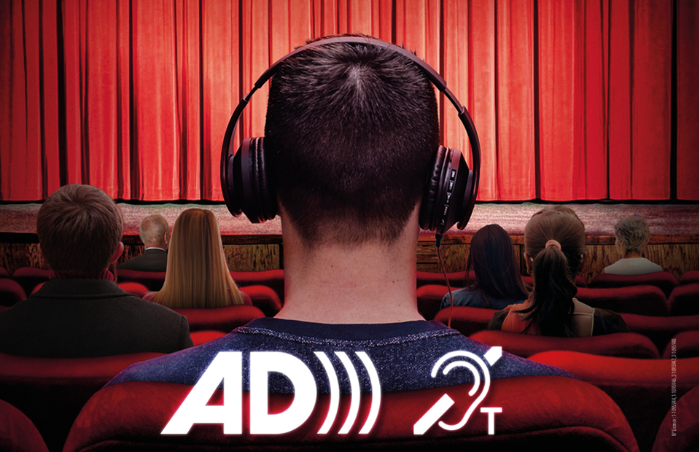
Audio Description

Slide 5
Subtitling
Finally, computer games and interactive software programmes are taking subtitling to the borders between AVT and localization since these games travel not only subtitled, but also adapted to the cultural sensibilities of the target gamers.

Slide 6
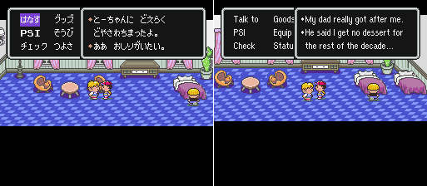
Computer Games

Slide 7
Technical parameters
Open subtitles: the subtitles are burned or projected onto the image and cannot be removed or turned off. The programme and the subtitles cannot be disassociated from each other, allowing the viewer no choice as to their presence on screen.
Closed subtitles: the translation can be added to the programme at the viewer’s will. The subtitles
are hidden and can only be seen with an appropriate decoder or when the viewer activates them on DVD.

Slide 8
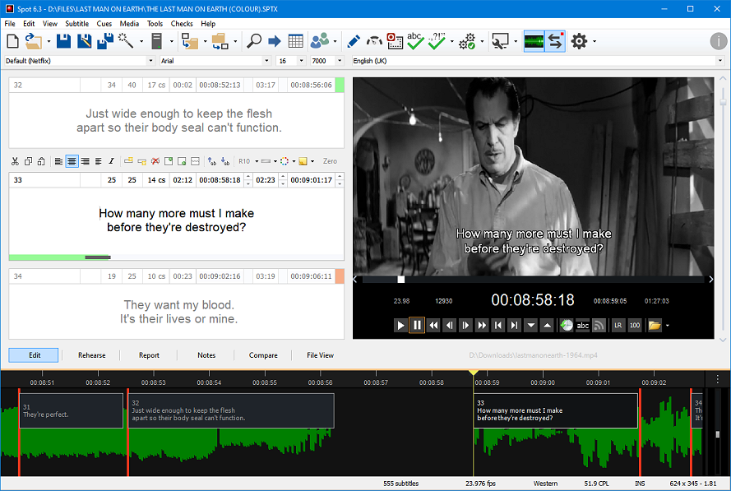
_{Electronic subtitling}

Slide 9
The subtitling process
‎ The subtitling process usually starts when a client contacts the subtitling company ‎with a commission. The client could be a distribution company, a television station, etc. ‎In the first stage general details are discussed. First, the subtitling company has to watch ‎the film to make sure that the copy is not damaged, decide the dialogue list and check if ‎there is something else that needs translating too, (such as songs or inserts).‎

Slide 10
The subtitling process
Watching the film or programme in its entirety before proceeding to translate is highly advisable. If time allows for it, and the translator works from a written dialogue list, it may be a good idea to take notes of the points and issues that could prove problematic at a later stage. Torregrosa (1996) suggests three areas that the translator ought to take into account during the first viewing of the programme, to which we add a further two:

Slide 11
The Subtitling Process
1- Words and phrases that lend themselves to a polysemous reading in the original. The French encore du rouge can be translated as ‘a bit more of red colour’ or ‘a bit more red wine’ depending on the image. ‘Funny’ in English can have a myriad of meanings, even opposed ones, depending on the context and the intonation.

Slide 12
The Subtitling Process
2- The gender and number of some nouns, pronouns and adjectives that are not marked in English. ‘You are great’ can have many different translations into other languages, depending on whether the addressee is male or female, whether we are talking to one or several people, or whether we are being polite or informal.

Slide 13
The Subtitling Process
3- The degree of familiarity shown among the characters, to decide whether a formal or informal form of address is required, and their identity when being referred to by pronoun. The English ‘you’ can refer to several people in a language like Spanish: tú (singular, informal), Usted (singular, formal), Ustedes (plural, formal), vosotros (plural, informal, masculine) and vosotras (plural, informal, feminine).

Slide 14
The Subtitling Process
4- Deictic units as ‘this/these’, ‘that/those’, ‘here/there’, etc. may have referents that appear on screen and do not need to be translated. Alternatively, obscure or long terms that are difficult to translate may refer to objects that appear on screen and can be rendered by means of a deictic.
5. Exclamations with no fixed meaning that can only be appreciated in a given context, such as ‘oh, my’, ‘Christ’, ‘blimey’, and the like.

Slide 15
The subtitling process
The next stage is spotting, also known as timing and cueing. It consists in deciding the ‎precise moment when a subtitle should appear on screen (in-time) and when a subtitle ‎should disappear from the screen (out-time). This is usually done by technicians who ‎usually do not have a good knowledge of the language spoken in the film.‎

Slide 16
The subtitling process
A copy of the film and the dialogue is then sent to the translator. Moreover, translator ‎sometimes work without having any access to the screen version of the film or from a ‎soundtrack without a copy of the written text. This occurs when clients are afraid that ‎illegal copies will be made or perhaps when there are tight deadlines.‎

Slide 17
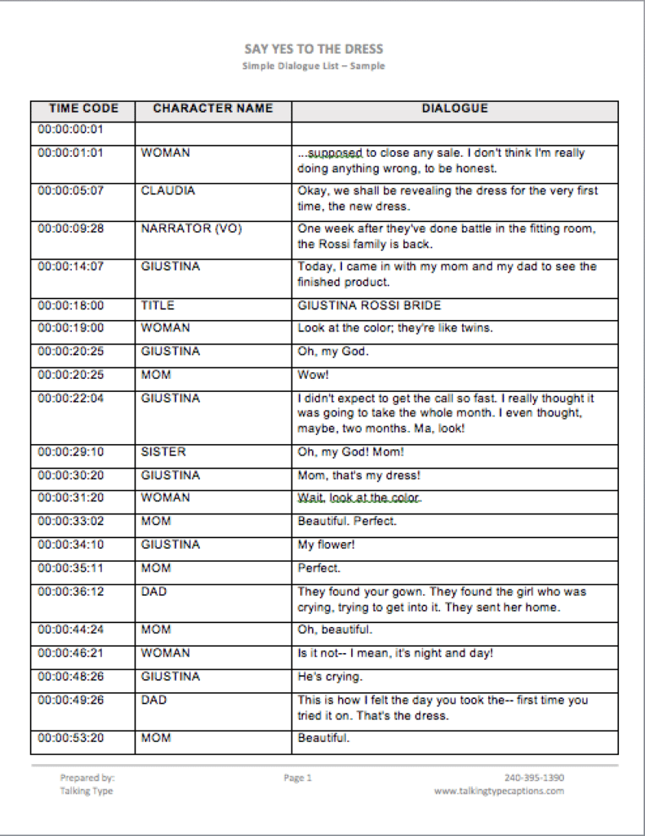

Slide 18
The subtitling process
In the third stage the translator can start translating the text from the source to the target ‎language. Once the translation is over it is sent to the client. The translator was not ‎asked to produce the actual subtitles, but rather the text translation, the translation undergoes an adaptation process. Due to the constraints imposed by the medium a ‎technician or adaptor has to adjust the translation to an appropriate subtitling ‎length. (Diaz Cintas & Remael, 2006:98).‎

Slide 19
The Subtitling Process
Revision and proofreading of the subtitles (in a printed version) is done to detect any possible mistakes and guarantee a final product of high quality. Ideally, a different person should be responsible for this task. Any mistranslations or typos must be corrected. Spelling mistakes seem to be more noticeable on a screen than on a page, and they must be avoided at all costs. Their presence in a subtitle may not only be irritating but may also distance the viewer from the whole process.

Slide 20
The Subtitling Process
As a matter of principle, translators should have a say in the proposed changes and be entitled to a copy of the final, revised subtitles to see the type of amendments and alterations that have been made to their translations. It helps not only to improve one’s work but also to become familiar with the likes and
dislikes of the clients.

Slide 21
The Subtitling Process
Before inserting the subtitles on the celluloid, a simulation of what the film is going to look like with the subtitles on it is carried out in the presence of the client. If needed, amendments or changes are incorporated at this stage.
Some of the big distribution companies have the figure of the supervisor, responsible for this, well enshrined in their working routines.

Slide 22
The Subtitling Process
It is important not to forget that both translators and subtitlers do nothing more than come up with a subtitling proposal for the client, who at any moment can change, delete, substitute… whatever s/he wants, in terms of text or spotting .
The traditional, academic perception of translation as an individual activity clashes here head-on with professional reality.

Slide 23
THANK YOU

