Slide 1
AVT
Definition, History and Characteristics

Slide 2
Definition of Audiovisual Translation
Audiovisual translation (AVT) is the term used to refer to the transfer from one language to another of the verbal components contained in audiovisual works and products. Feature films, television programs, theatrical plays, musicals, opera, web pages, and video games are just some examples of the vast array of audiovisual products available and that require translation. As the word suggests, audiovisuals are made to be both heard (audio) and seen (visual) simultaneously but they are primarily meant to be seen (Sanderson, 2005: 4).

Slide 3
Definition of Audiovisual Translation
AVT is actually one of the fastest growing areas in the field of Translation Studies (TS). Due to the unprecedented surge in interest in Translation Studies (TS), the AVT is experiencing the expansion and consolidation as an academic discipline (Diaz Cintas, 2008:1).

Slide 4
Definition of Audiovisual Translation
Terms such as “film translation” or “cinema translation” were often used, but these terms were restricted because this kind of activity takes into account also other types of programmes (sitcoms, documentaries, cartoons, etc..) A term that could be a good alternative to the ATV term is “screen translation”, because it refers to all products distributed on screen. (Diaz Cintas and Remael, 2006:12).

Slide 5
History of AVT
It can be said that AVT beginnings started through looking at the translated intertitles and film explainers of the silent era. It goes on to look at the transition to sound and then at the development of subtitling and dubbing.
Audiovisual translation studies has been experiencing a resurgence in interest in historical approaches since the early 2010s. ‘film translation’ was widely used in the pre-TV era before using the up-to-date term of AVT.

Slide 6
History of AVT
Pre-sound era: films were silent, but not speechless: mouths could be seen speaking on the screen and title cards conveyed narration and the gist of dialogues actually or seemingly spoken by the actors. The AVT researchers have tended to write off this field on the grounds that the translation of silent film is unproblematic, at least by comparison with the problems which accompanied the coming of sound. Even during the silent film area it was very important to convey to the viewers the dialogue of the actors on screen.

Slide 7
History of AVT
This problem was solved by the now call intertitles: the predecessors of the subtitles. They were texts, printed on paper and placed between the sequences of the film. Their first appearance was in 1903 as descriptive titles in Edwin S. Porter's Uncle Tom's Cabin. Translating such dialogues was quite easy: the original titles were removed, translated, filmed and re-inserted. Alternatively, a translator used to give a simultaneous translation to the audience. The very first sub-titles first appeared in 1909. In fact, M. N. Topp registered a patent for “device for the rapid showing of titles for moving pictures other than those on the film strip” (Ivarsson, 2004:1). By using some kind of a slide projector, subtitles were shown on screen below the intertitles.

Slide 8
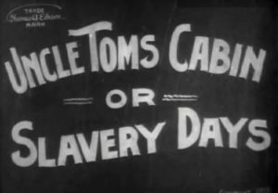
History of AVT

Slide 9
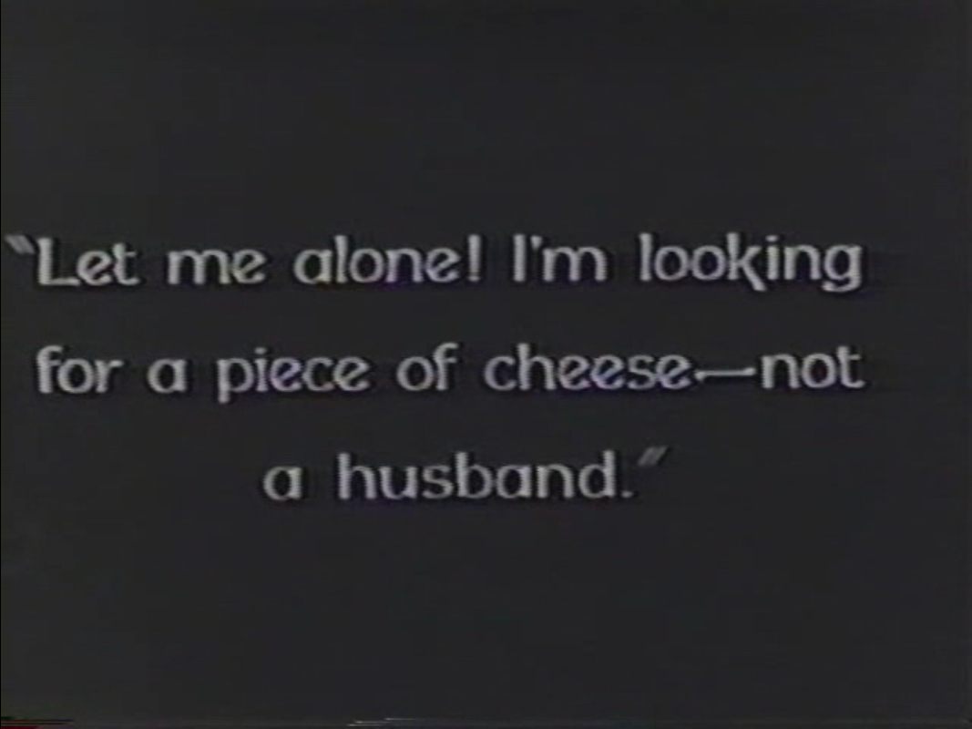
History of AVT

Slide 10
History of AVT
Audiovisual translation and the transition to sound: synchronized speech was first introduced in American films, and solutions quickly needed to be devised to successfully maintain the worldwide distribution of Hollywood product of movies and other types of media.
The first talking film to be released internationally was Warner Brothers’ The Jazz Singer (Crosland 1927). Although mainly a silent film with a musical sound-track and only a few ‘live’ talking scenes, it heralded the talking era and continues to be perceived as its starting point to this day.

Slide 11
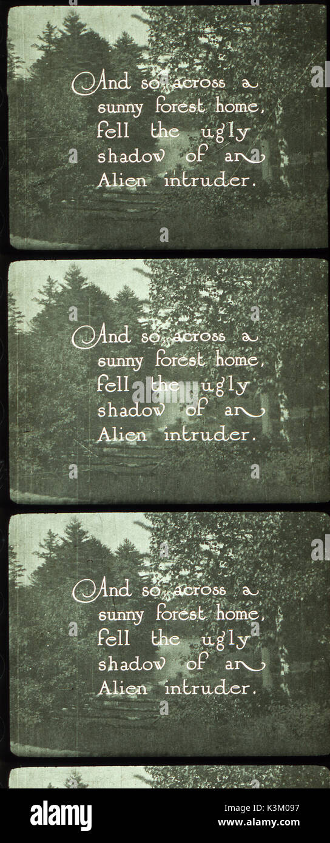
History of AVT

Slide 12
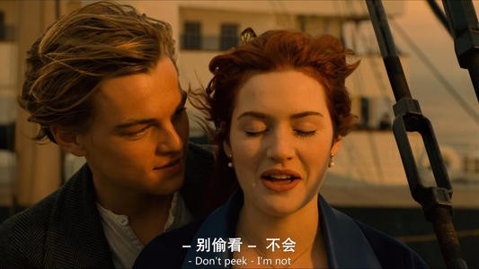
History of AVT

Slide 13

History of AVT

Slide 14
Characteristics of AVT
1. The use of images: this type of translation differs from other types of translation since it's always shown alongside the images being broadcast, so the text needs to tie in with the image.

Slide 15
Characteristics of AVT
2. Short deadlines: for the most part, translation projects have tight delivery lead times, but it goes even further in the case of audiovisual translation. For example, if episodes of a series are being shown with little time in between, there's even less time for translation, and margin for error.

Slide 16
Characteristics of AVT
3.The use of specialization of different fields: another defining feature a translator needs to have is that in addition to having mastery of the source and target languages, they also need to specialize in a number of sectors. After all, audiovisual works can cover a number of different subjects: medicine, legal, IT, etc.

Slide 17
Characteristics of AVT
4. Speech: with this characteristic we refer to the ability to symbolize a previously translated natural and spontaneous dialogue. It might sound easy, but it is not. What is logical to one person in a certain context might seem totally out of place for another person. For that reason, a translator should be able to transfer written language to the screen without adding strange expressions or demanding an unreasonable, unnatural effort on part of the character who is speaking (Orero, 2004: 13).

Slide 18
THANK YOU

