Slide 1
Prepared by: Ali Abbas Kadhim
Semantics in linguistics

Slide 2
Contents
Introduction
Semantics and Semiotics.
Three challenges in Doing semantics.
Meeting the challenges.
Word meaning and sentence meaning.
Some Important Assumptions.

Slide 3
Introduction
Semantics: Is the study of meaning in a language. The meaning of words, phrases, and sentences.
Many words may contain more than one meaning, across a different context.
For instance: The word (human) means adult, woman, man, son, etc.
The basic assumption is that: A person’s linguistics abilities are based on knowledge that they have. Including how to pronounce words, construct sentences.

Slide 4
Levels of analysis:
Phonology: Is the study of how sounds are organized and used in language and form words.
For instance: The words (bakes) and (waves) the ending letter of both is (s) but the sound is different.
Semantics: Is the study of meaning in a language. The meaning of words, phrases, and sentences.
Syntax: Is the study of how words are put together to form sentences, words.
For instance: The can sat on the mat. The cat(subject) + sat (Verb)+ on(Preposition)+ the mat(Object).

Slide 5
Entailment
Entailment: The property of proposition.
Characteristics of ideas conveyed by sentences.
1: If the truth of proposition (B) follows necessarily from the truth of proposition (A).
For instance: Mary killed Scofield. Scofield is dead.
2: Bilateral.
For instance: He is from Baghdad. He is from Iraq.
3: (A) Entails (B) (likewise) Ali looks like Ahmed. Ahmed looks like Ali.

Slide 6
Semantics and Semiotics
Semiotics: Is the study of signs and symbols including how they are created and used to deliver meanings and messages.
Signifier and Signified
Signifier: Is the physical object or idea that represents something else.
Signified: Is the concept or meaning that the signifier represents.
For instance: In the word (Dog) the signifier is the combination of letters D_O_G.
The signified is the idea of a four-legged animal that barks.

Slide 7
Icon: This is a sign that signifier resembles.
For instance: An artistic painting of a specific place and the actual place in the real world.
Index: Casual relation between Signifier and Signified.
For instance: If there is smoke then there is a fire.
Symbol: When the signifier has an arbitrary relationship with the signified.

Slide 8
The challenges in doing Semantics.
1:Circularity: Determine the meaning of the word, except for the other words and sentences.
2: exact meaning: Differences between linguistics knowledge and encyclopedic knowledge for instantce: the word (whale) you believe it is a (fish) or you believe it is a (mammal)so does our thinking in this word affect the meaning of this word.
3: utterances in context: What a particular utterance means in a specific context for instantce: (dying) might mean someone who is sick in the hospital or a stand up comedian fails at making you laugh.

Slide 9
Meeting the chalenges
1: solution to circularity: Metalanguage.
We use the language to express the language, so in the grammar of Arabic written in French, Arabic is the object language. French is the Metalanguage.
2: solution to encyclopedic: If we get back to the previous instance about the whale, if you knew that the word is a mammal or not, does that affect our thinking of the word whale, and if we knew he is an animal living in the sea is that enough for an answer? Does the amount of knowledge that we should have affect how we use a word?
3: conventional or literal. pragmatics.
The listener has a great role, in addition to his knowledge to communicate, and to conclude about what the speaker is talking about.

Slide 10
Word meaning and sentence meaning
1: Lexicon: A collection of words or phrases, along with their meaning, and grammatical properties.
for instance: A lexicon of English contains thousands and thousands of words starting from house and cat to more complicated words, like defenestrate.
2: productivity: Create new words by using affixes for instance: The word work = walker.

Slide 11
3:Recursive: It is the repeated use of a particular type of linguistic element or grammatical structure. for instance relative clauses:
I saw [the cat [which killed the bird [which ate the rat...]
we use embedded sentences. another instance: that clause.
4:compositional: This term means that the meaning of an expression is determined by the meaning of its component parts, and the way in which they are combined. One simple example of a compositional meaning in semantics is the phrase "black cat." The meaning of the phrase can be derived from the meanings of its component words. "Black" refers to a color, and "cat" refers to a small carnivorous animal. Therefore, "black cat" refers to a small carnivorous animal that has black fur. The meaning of the phrase is composed of the meanings of its individual words.

Slide 12
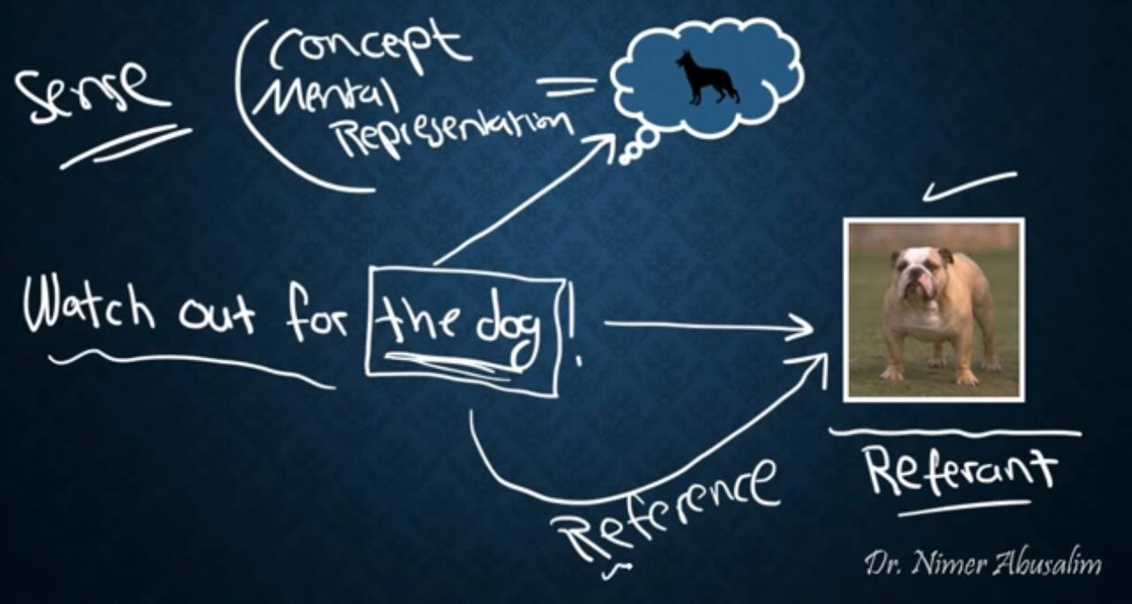
Reference and sense

Slide 13
Any Questions?

