Slide 1
Semantic principles
Idioms VS Collocations
Presented by: Halla Mohammed

Slide 2
Idioms VS Collocation
Idioms:
Unlike collocations, which “are fairly flexible patterns of language which allow several
variation in form”, idioms allow no variation (Baker 1992: 63).
Idioms like: to be yellow – to get the wind up , cannot be respectively modified into
something like to be red – to get the storm up.
Idiomatic expressions allow almost no variation in form under normal circumstances and
“present particular difficulties because they are restricted collocations which cannot normally be understood from the literal meaning of the words which make them up” (Carter 1998: 65).
language users and translators cannot rely on the open choice principle, that is to say, relying
on the meanings of its components. Rather, they need to resort to the idiom principle by treating the idiomatic expression as one unit.

Slide 3
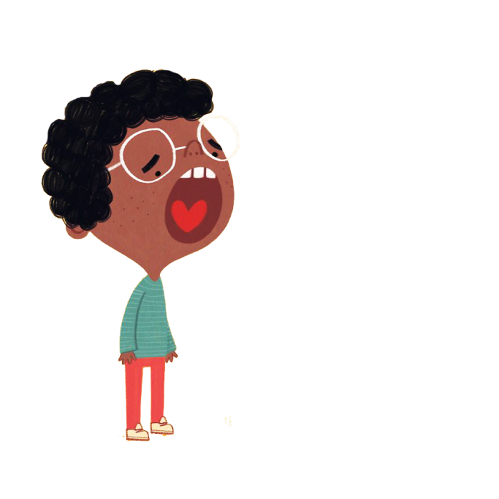
Examples about idioms:
ST:
When he was surrounded by the enemy, he showed the white feather and surrendered.
ST:
When he heard the explosion, he had his heart in his mouth.
TT:
عندما حاصره العدو,خاف فسلم نفسه
TT:
عندما سمع صوت الانفجار, وقع قلبه في قدميه
These idiomatic expressions, viz. To show the white feather, and to have your heart in your mouth cannot be understood without treating them as units. They are fear-related
idioms meaning, to exhibit cowardice, and to be extremely afraid respectively.

Slide 4
Idioms VS Collocation
Collocations:
Collocation means the tendency of two or more lexical items to co-occur together in certain
contexts
Adjectives like fast and quick, for instance, are synonyms as they share the sense of “doing something at speed”. However, the adjective fast collocates well with nouns like food and train, but not meal or shower.
Collocations are language-specific, that is, what is considered as collocation cannot be taken for granted in another. Further, they are not governed by fixed rules.
patterns of collocation are largely arbitrary and independent of meaning. This is so both within and across languages. The same degree of mismatch that can be observed when comparing the
collocational patterns of synonyms and near-synonyms within the same language is evident in the collocational patterning of “dictionary equivalents/near equivalents” in two languages. (Baker1992:48)

Slide 5
Idioms VS Collocations
Collocations:
In a direct link with translation, it is essential that translators while translating collocation give full consideration to the degree of predictability of lexical co-occurrence, that is, the degree of its markedness, as opposed to unmarkedness.
Combinations like :رغيف خبز – قطعة حلوى are labeled unmarked as they are natural combination for native speakers of Arabic. Similarly, combinations like bright face, bright idea, bright future, and so on are unmarked collocations as they sound natural for native speakers of English. Marked collocations, however, are unnatural combinations that are deliberately used by the speaker/writer to create new images (Baker 1992: 51).

Slide 6
The following example quoted from Lubna Mahmūd Yāsīn’s story (n.d.) بصمة مواطن (A Citizen’s Fingerprint)
ST:
TT:
يبتلعه المساء.. فيوغل في احشاء الصمت .. ومن ذا الذي
يستطيع فراراً اذا عسعس الالم داخل النفس .. وتوغلت الاحزان
في حنايا الفؤاد .. يتآكل قلبه تتساقط اشلاؤه..يتمزق صوته
على حدود الزمان ولا من مجيب
The night swallows him so he delves ever
deeper into the heart of silence. Who can,
then, escape if the pain is densely settled
inside the self and sadness penetrates the
depths of the heart? … His heart erodes; his
limbs fall off; his voice gets torn away at the
boundaries of time, yet no response comes.
In this example, the original writer deliberately uses an unnatural combination احشاء الصمت
(lit. the intestines of silence) to create a new image. So, it is an example of marked collocation.
To reflect the same degree of markedness, the translators may exclude unmarked collocations,
such as wall of silence or a vow of silence.
In this regard, Trotter (2000: 351) rightly comments: “Translation requires invariance in the
markedness of collocates, rather than replacing abnormal usage in an original with normal
usage in translation

Slide 7
The following example from Muhsin Al-Ramlī’s story (2009: 29) البحث عن قلب حي (searching for a live heart).
ST:
TT:
“Take all of me, my flesh and my fat,” he cries,
impersonating the drunkard. He laughs and says, “No, no, he didn’t say that, for he had neither
flesh nor fat. He was just a bag of skin and
bones, drenched in sweat
يقلده : خذني كلي بلحمي وشحمي (يضحك) لا..لا.. لم يقل ذلك
لأنه بلا لحم ولا شحم , لم يكن الا كيساً من الجلد المبلل بالعرق
وفيه بضعة عظام.
The phrase لحمي وشحمي (my flesh and my fat) is used in Arabic for emphasis to mean “all” or
“personally”, thus it may be translated into an expression like body and soul, which is an expression used in English to mean “completely”. However, repeating the components of the phrase in the text many times, such as بلا لحم ولا شحم and the like, leaves us with no alternative but the literal translation
Baker (1992: 72) rightly comments that translators should take into account “the significance of the specific items which constitute the idiom, i.e., whether they are manipulated elsewhere in the
source text” or not.

Slide 8
Idioms VS Collocations
Idioms | Collocations
An expression that cannot be understood from the meanings of its separate words but that has a separate meaning of its own. | Means the tendency of two or more lexical items to co-occur together in certain contexts.
Idiomatic expressions allow almost no variation in form under normal circumstances and present particular difficulties | They are fairly flexible patterns of language which allow several variation in form.
“they are restricted collocations which cannot normally be understood from the literal meaning of the words which make them up” (Carter 1998: 65). | They are language-specific, that is, what is considered as collocation cannot be taken for granted in another. They are not governed by fixed rules
Language users and translators cannot rely on the open choice principle, that is to say, relying on the meanings of its components. Rather, they need to resort to the Idiom principle by treating the idiomatic expression as one unit. | In a direct link with translation, it is essential that translators while translating collocation give full consideration to the degree of predictability of lexical co-occurrence, that is, the degree of its markedness, as opposed to unmarkedness.
Example: To get the wind up , To be yellow | Example: Quick shower, Fast food

Slide 9
THANK
YOU

