Slide 1
Phrasal verbs
Prepared By: Shahad Hadi M. Hussain

Slide 2
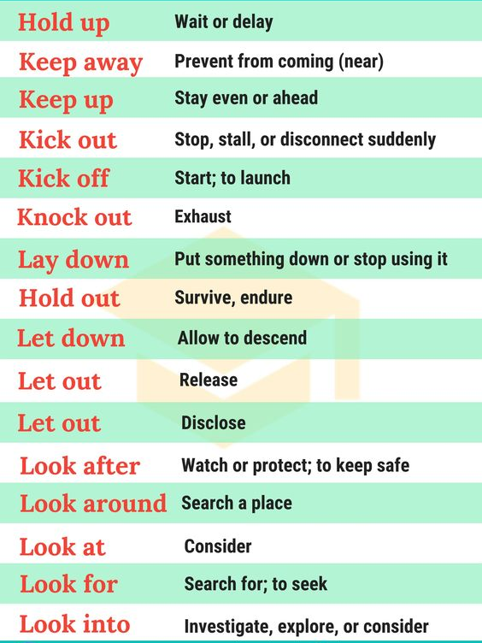
Phrasal verbs
Phrasal verbs are an essential part of spoken and written English at all levels, and nobody planning to master the language can afford to overlook them, it is one of the major difficulties English learners , as well as translators and interpreters, have to contend with.
phrasal verbs consist of a verb, followed by an adverbial particle.
These adverbials have a less than literal meaning, making the phrasal verb as a whole idiomatic in meaning.
The idiomatic meaning that allows the phrasal verb to be replaced with a single word verb.

Slide 3
Phrasal verbs classification
According to Celce-Murcia and Larsen-Freeman (1999: 432–433), phrasal verbs are divided into three categories:
1- literal (e.g., sit down, stand up, pass through, etc.),
2- Aspectual (e.g., read though, set out, write over, etc.),
3- Idiomatic (e.g., chew out, run up, tune out, etc.).
They rely on the criterion of compositionality, as opposed to noncompositionality. They hold that literal phrasal verbs are compositional while others are noncompositional.
This classification is problematic as sometimes we have phrasal verbs which are noncompositional.
For instance, to look up.
According to this classification, its meaning may be restricted to “gaze upwards”. However, it has many other meanings.
Look up to visit somebody
to seek somebody or something out
to seek information about somebody or something in a book

Slide 4
Phrasal verbs classification
Phrasal verbs in this study are divided into four categories:
1- Literal
2- Aspectual
3- Idiomatic
4- Polysemous
1- Literal phrasal verbs
Literal phrasal verbs are very easy to understand, their meanings are obvious, most commonly, literal phrasal verbs are verbs + directional particles
such as, pick up, bend down, put down, pass through, fall down, climb up, and so on.
I ran out of the room.
I put my keys in my bag. Then I took them out again.

Slide 5
2- Aspectual phrasal verbs
They are phrasal verbs whose meanings are not as transparent as literal phrasal verbs; however, their meanings are not idiomatic either.
For example, set up, take off, start out, and so forth.
Aspectual phrasal verbs classification
Semantic classes | The particle’s semantic contribution | Examples
1- Inceptive | signaling a beginning state | take off, set out, start up
2- Continuative | emphasizing the continuity of the action | hurry along, skim through, think through, work away
3- Iterative | emphasizing the repetition of the action | turn over and over, write over, think over
4- Completive | emphasizing the completion of the action | close up, wind up, fade out, wear out, blow out, check over, cut off,

Slide 6
3- Idiomatic phrasal verbs
They are phrasal verbs whose meanings are not easy to predict. To put this differently, the meaning of the whole phrasal verb is not related to the meanings of its constituents. Such as, keep up, brush off, zero in on, close in on.
Examples:
- I just zoned out for a moment
- I'll run up a dress for you

Slide 7
4- Polysemous phrasal verbs
The final type of phrasal verbs is polysemous. As the name suggests, polysemous phrasal verbs can have multiple meanings, such as check out, look up, make up, go out, and set off.
Examples on the different uses of phrasal verb “go off”
"the pistol suddenly went off"
"the fire alarm went off at the first hint of smoke"
"if you got in an argument with him, he'd just go off"
"milk went off so quickly in hot weather

Slide 8
Not giving full consideration to the unitary nature of these phrasal verbs and relying on the meanings of their constitutes may seriously affect the whole process of understanding, and then, translation.
ST:
Jehad burst out of the editing suite screaming. He sprinted down the stairs, his head in his hands, his face ripped with anguish.
TT 1:
خرج جهاد من مكتب التحرير صارخا. وركض بأقصى سرعة إلى الطابق السفلي وكان منفزعا ووجهه حاملا علامات الألم.
TT 2:
اندفع جهاد من قسم التحرير منفجرا بالصراخ والعويل وراكضا بأقصى سرعته إلى الطابق السفلي ويده على رأسه.
TT 3:
خرج جهاد من قسم التحرير بأقصى سرعته وهو يصرخ ويده على رأسه وبدت على وجه علامات الحزن.
Here, two phrasal verbs are used in the original text, viz. burst out and sprint down.
First phrasal verb to burst out, has been translated into خرج (to go out) once which is different in Arabic thanاندفع (to burst out) that was used twice.
the verb خرج(to go out) does not indicate that the actor of the action Jehad has gone with all haste, therefore translator has followed by بأقصى سرعته (with his top speed), to create a similar mental image.
second phrasal verb to sprint out, it has been translated into ركض (to run) followed by بأقصى سرعته (with his top speed) twice, while it has been merged with the verb خرج (to go out) into one verb once.

Slide 9
Thank you

