Slide 1
Grice’s theory of implicature (types, properties and diagnostic tests)
Prepared by: Shahad Hadi M. Hussain

Slide 2
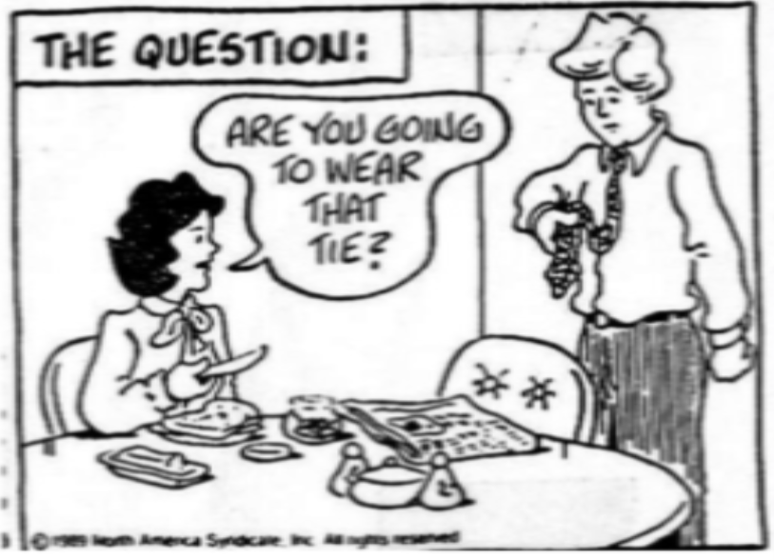
Types of Implicatures
Conversational Implicatures
Conventional Implicatures
pragmatic context-depedent inference;
and motivated by the conversational maxims
They are not context-dependent or pragmatically explainable
They must be learned on a word-by-word basis
Particularized conversational implicatures
Generalized conversational implicatures
the intended inference depends on particular features of the specific context of the utterance
is normally implied by any use of the triggering expression in ordinary contexts
they are both not “inevitable” i.e., they are not logically necessary

Slide 3
Generalized conversational implicatures
are motivated by the Grice’s maxims of conversation
they typically do not involve a violation of the maxims.
the implicature arises precisely because the hearer assumes that the speaker is obeying the maxims; if the implicated meaning were not true, then there would be a violation
Example (1) :
- She gave him the key and he opened the door.
Implicature: She gave him the key and then he opened the door.
the semantic content of English and is simply logical, the implicated sequential meaning (‘and then’) is motivated by the maxim of manner (sub-maxim: Be orderly).
If the actual order of events was not the one indicated by the sequential order of the conjoined clauses, the speaker would have violated this maxim; therefore, unless there is evidence to the contrary, the hearer will assume that the sequential meaning is intended.

Slide 4
Scalar implicatures : widely discussed type of generalized conversational implicature involves non-maximal degree modifiers, that is, words which refer to intermediate points on a scale
Example (2) :
- The water is warm.
Implicature: The water is not hot.
The word warm belongs to a set of words which identify various points on a scale of temperature:
frigid, cold, cool, lukewarm, warm, hot, burning/sizzling/scalding, etc.
The choice of the word warm implicates ‘not hot’ by the maxim of quantity.
If the speaker knew that the water was hot but only said that it was warm, he would not have been as informative as would be appropriate in most contexts.
This inference does not depend on particular features of the context, but is normally triggered by any use of the word warm unless something in the context prevents it from arising.

Slide 5
- The indefinite article
It can trigger generalized conversational implicatures concerning the possessor of the indefinite noun phrase, with different implicatures depending on whether the head noun is:
1- alienable as in:
- I walked into a house.
Implicature: The house was not my house.
2- inalienable as in:
- I broke a finger yesterday.
Implicature: The finger was my finger.
- But how to account for this difference is somewhat puzzling.

Slide 6
Conventional Implicatures
They are part of the conventional meaning of a word or construction
They are not context-dependent or pragmatically explainable
They must be learned on a word-by-word basis.
They do not contribute to the truth conditions of a sentence
They have been sometimes regarded as involving pragmatic rather than semantic content.
- It illustrated by using the conjunction therefore; as this word does not affect the truth value of a sentence.

Slide 7
Examples of conventional implicatures (CI)
- I was in Paris last spring too
CI: some other specific/contextually salient person was in Paris last spring.
- Even Bart passed the test
CI: Bart was among the least likely to pass the test.
Conventional implicatures turn out to have very similar properties to certain kinds of presuppositions, and there has been extensive debate over the question of whether it is possible or desirable to distinguish conventional implicatures from presuppositions.

Slide 8
Distinguishing features of conversational implicatures
Grice’s analysis of conversational implicatures (both particularized and generalized) implies that they will have certain properties which allow us to distinguish them from other kinds of inference:
1- Defeasible
2- Suspendable
3- Calculable
4- Indeterminate
5- Nondetachable
6- Reinforceable

Slide 9
1- Defeasible:
It means that the inference can be cancelled by adding an additional premise.
Conversational implicatures can be explicitly negated or denied without giving rise to anomaly or contradiction
For Examples:
- He has been paying a lot of visits to New York lately, but I don’t think he has a girlfriend there, either.
- John has most of the documents; in fact, he has all of them.

Slide 10
2- Suspendable:
- the speaker may explicitly choose not to commit to the truth or falsehood of the inference, without giving rise to anomaly or contradiction.
For Examples:
- The water must be warm by now, if not boiling.
- The water must be warm by now, if not cold.

Slide 11
3- Calculable, that is, capable of being worked out on the basis of :
The literal meaning of the utterance,
The Cooperative Principle and its maxims,
The context of the utterance,
Background knowledge,
(v) the assumption that (i)–(iv) are available to both participants of the
exchange and that they are both aware of this.
4- Indeterminate: sometimes multiple interpretations are possible for a given utterance in a particular context.

Slide 12
5- Nondetachable: it refers to that:
Conversational implicatures are not part of the conventional meaning of the linguistic expression, and;
They are triggered by the semantic content of what is said rather than its linguistic form, replacing words with synonyms, or a sentence with its paraphrase, will generally not change the conversational implicatures that are generated, assuming the context is identical.
A: Smith doesn’t seem to have a girlfriend these days.
B1: He has been paying a lot of visits to New York lately.
B2: He travels to New York quite frequently, I have noticed.
.

Slide 13
6- Reinforceable: it mean that the implicature can be overtly stated without creating a sense of anomalous redundancy.
- John is a capable fellow, but I wouldn’t call him a genius.
- Some of the boys went to the soccer match, but not all.
- Some of the boys went to the soccer match, but not none.

Slide 14
How to distinguish between inferences (Diagnostic Tests)
Two general comments need to be kept in mind:
First: ask whether there is in fact a linguistic inference to be tested. The question : if a speaker whom we believe to be truthful and well-informed says p, would this utterance in and of itself give us reason to believe q? )
If yes: we can apply the tests to determine the nature of the inference from p to q.
If not: applying the tests will only cause confusion.
For example: My bank manager has just been murdered
(it seems reasonable to assume that the bank will soon be hiring a new manager. this expectation is based on our knowledge of how the world works, and not the meaning of the sentence itself; there is no linguistic inference involved. If the bank owners decided to leave the position unfilled, it would not render the speaker’s statement false or misleading)
Second: it is important to use several tests whenever possible, and choose the analysis that best explains the full range of available data.
Because any one test may give unreliable results in a particular example, because so many complex factors contribute to the meaning of an utterance.

Slide 15
Stated: John killed the wasp.
Inferred: The wasp died.
a. # John killed the wasp, but the wasp did not die.
b. # John killed the wasp, but I’m not sure whether the wasp died.
c. ?# John killed the wasp, and the wasp died.
d. Did John kill the wasp?
e. John did not kill the wasp (and the wasp did not die).
Cancellable/ Defeasible
The result is a contradiction.
Suspended
The result is quite unnatural
Reinforceable
The result is unnaturally redundant
Negation Questioning
We can demonstrate this by showing that it would not be a contradiction to assert, in the same sentence, that the wasp did not die
All four tests in this example produce negative results. This pattern matches the profile of entailment; so we conclude that John killed the wasp entails The wasp died.

Slide 16
A: I am out of petrol.
B: There is a garage around the corner.
Inferred: You can buy petrol there.
There is a garage around the corner, but they aren’t selling petrol today.
b. There is a garage around the corner, but I’m not sure whether they sell petrol.
c. There is a garage around the corner, and you can buy petrol there.
d. Is there a garage around the corner?
e. There is no garage around the corner (any more).
Defeasible
Suspendable
Reinforceable
Negation Questioning
These would not give any reason to believe that he could buy petrol around the corner.
The first three tests produce positive results, while the last
one is negative. This pattern matches the profile of conversational implicature; so we conclude that: There is a garage around the corner

Slide 17
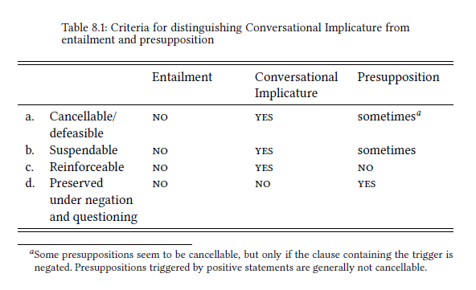

Slide 18
Thank you

