Slide 1
Connotative meaning and translation issues By: Mohammed A. Ayad

Slide 2
Allusive meaning
is an intertextual feature.
It occurs when an expression evokes an associated saying or quotation in such a way that the meaning of that saying or quotation becomes part of the overall meaning of the expression.

Slide 3
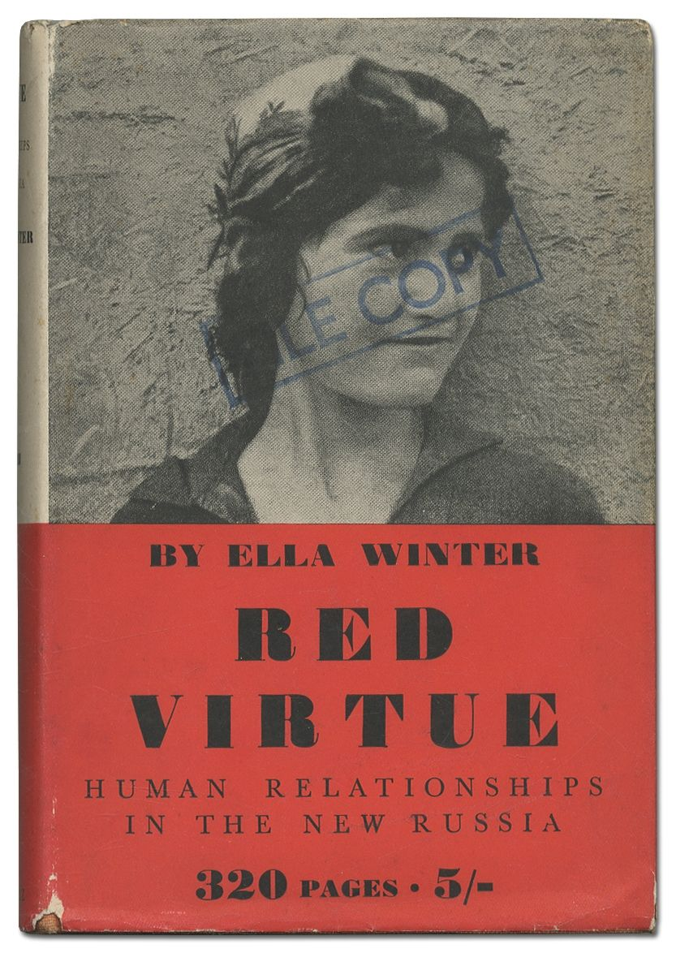
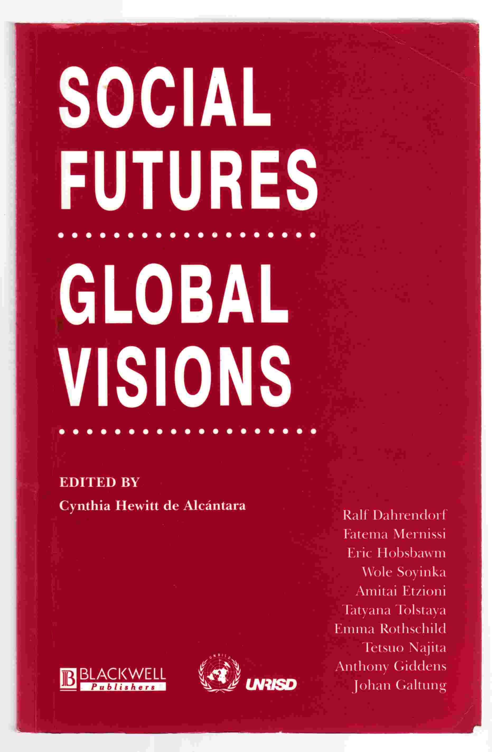
I’ve seen the future and it works

Slide 4
In Arabic (التلميح)
قعد رجل على جسر بغداد ،فأقبلت امرأة بارعة في الجمال من جهة الرُّصافة إلى الجانب الغربي ،فاستقبلها شاب، فقال لها : رحم اللّه عليَّ بنَ الجهم ،فقالت له: رحم اللّه أبا العلاء المعري، وما وقفا ،بل سارا : مُشرِّقاً ومُغَرِّبةً ،قال الرجل : فتبعت المرأة فقلت لها: واللّه إن لم تقولي ما أراد بابن الجهم فضحْتُكِ ، قالت أراد به:
عيون المها بين الرُّصافة والجسرِ ** جلَبْنَ الهوى من حيثُ أدري ولا أدري
وأردت بأبي العلاء قوله:
فيا دارها بالكَرْخ إن مزارها ** قريب ولكن دون ذلك أهوالُ

Slide 5
Another example of allusive meaning is from the oath that members of the Muslim Brotherhood swore to حسن البنا and that reads (( الالتزام التام بالأخلاق والثقة والسمع والطاعة في العسر واليسر والمنشط والمكره)) This perhaps contains an allusion to the Quran سورة الشرخ , verse 5 فأن مع العسر يسرا and verse 6 .إِنَّ مَعَ العُسْرِ یُسْرًا

Slide 6
Collocation and collocative meaning
The term ‘to collocate’ means ‘to typically occur in close proximity with’; hence, a collocation is an occurrence of one word in close proximity to another.
Pretty & Handsome
Pretty
boy
Man
Car
Vessel
Overcoat
Typewriter
girl
boy
woman
flower
garden
colour
Handsome

Slide 7
The importance of finding appropriate collocations in translation can be illustrated by the following examples:
التعاون والتوثيق ‘close cooperation’ (not, for example, ‘firm cooperation’)
الذكاء التجاري commercial acumen’ (cf. the slight oddity of ‘commercial intelligence’),
ابتسامة مصطنعة forced smile’ (cf. the oddity of ‘artificial smile’).

Slide 8
An important area for collocation is the use of conjoined phrases on the pattern ‘X and Y’.
English tends to say ‘knives and forks’ rather than ‘forks and knives’ and ‘pots and pans’ rather than ‘pans and pots’;
أصحاب النفوذ واهل الود one would expect ‘the rich and powerful’ (rather than ‘the powerful and rich’);

Slide 9
Some collocations of this kind have become established idioms. Thus, من دمه ولحمه has to be translated as ‘his own flesh and blood’, rather than the reverse.

Slide 10
Collocative meaning
This is the meaning given to an expression over and above its denotative meaning by the meaning of some other expression with which it collocates to form a commonly used phrase.
Intercourse
sexual intercourse

Slide 11
The translator must be able to recognize and render ST collocative meanings. But it is just as important to avoid unwanted collocative clashes in the TT.
الایام الماضیة بكل دفقھا الدموي الشدید الحرارة
the past with all its extremely hot bloodshed
‘The past with all its hot bloodshed’
A more plausible translation of this phrase is something like: ‘[. . .] the past with all its terrible bloodshed

Slide 12
Reflected meaning
Reflected meaning is the meaning given to an expression over and above the denotative meaning that it has in that context by the fact that it also calls to mind another meaning of the same word or phrase.
Leech (1981:16) holds that “conceptual meaning is the meaning arises in cases of multiple conceptual meaning, when one sense of word forms part of our response to another sense”
Richard Nixon was a rat’
using ‘rat’ in the sense of ‘a person who deserts his friends or associates

Slide 13
Reflected meaning is normally a function of polysemy – that is, the existence of two or more denotative meanings for a single word.
The simplest forms of reflected meaning are when a single word has two or more senses, and its use in a particular context in one of its senses conjures up at least one of its other senses.
A similar example in Arabic is calling someone حمارIn colloquial Arabic, حمار applied to a person means ‘stupid’. However, this metaphorical meaning also very strongly calls to mind the more basic sense of حمار ‘donkey’.

Slide 14
Reflected meanings do not usually occur spontaneously to the listener or reader. When an expression is taken in isolation, its reflected meaning or meanings are usually merely latent.
It is the textual context that triggers these latent reflected meanings.

Slide 15
ثم شد الغطاء على جسمها الهرم
The reader has, in fact, learnt earlier in the book that the mother of the central character صابر is old. The statement that her body is old, therefore, does not provide any information in this context.
In order to extract some meaning, or, more technically, to find some relevance for this comment, the reader therefore looks for another interpretation of ‘old’ in this context.
One possible interpretation that presents itself is that based on another sense of ‘old’, namely, ‘former’. That is to say, ‘old’ is polysemous, having senses ‘not new’ and ‘former’, amongst other senses (cf. Section 7.1.3). Thus, the interpretation ‘former body’ (i.e. not the one in which the lady is now incarnated) momentarily presents itself as a possibility. This is, of course, rejected in the context.

Slide 16
However, this reflected meaning of ‘old’ has enough of an influence here, in combination with the oddity of ‘old’ in the sense of ‘not new’ (discussed earlier), to make the reader feel that ‘old’ is odd in this context.

Slide 17
Other types of connotative meaning
we consider three major additional types of connotative meaning.
These are emphasis, presentation of information as predictable or unpredictable and presentation of information as foregrounded or backgrounded.
Predictability and unpredictability are typically a function of the formal properties of theme and rheme, while foregrounding and backgrounding are typically a function of the formal features of mainness and subordination.

