Slide 1
The Study of Evaluation and Ideology in Translation

Slide 2
Evaluation is an integral part of meaning.
‘Each element in a living utterance not only has a meaning but also has a value’.
Writers/speakers use language to communicate with the world; to reflect these values and they ‘intrude’ into the communicative situation where they express their ‘attitudinal’ meaning or ‘intersubjective’ position.
Accentuates, deletion or substitution.

Slide 3
‘Evaluation’, ‘Stance’, and ‘Appraisal’
‘Evaluation’, ‘stance’, and ‘appraisal’ are among the most common terms that are currently used to refer to the linguistic study of evaluation. They share one common characteristic - that is, their focus on the functionality of language in use.

Slide 4
Why Appraisal?
1- ‘appraisal’ deals with modality as an independent system where both, of course in addition to mood, compose the interpersonal level of meaning. (easy). It distinguishes among positive or negative attitudes towards people (‘affect’), their behaviour (‘judgement’), as well as the valuation of things (‘appreciation’)
2- ‘Evaluation’ and ‘stance’, on the other hand, cover both modality and attitudinal meaning (difficult)

Slide 5
3- ‘appraisal’ provides elaborative sets of parameters such as ‘affect’, which classifies feelings in terms of ‘un/happiness’, ‘in/security’, ‘dis/satisfaction, and ‘dis/inclination.
‘Evaluation’ and ‘stance’ do not offer the same detailed branching of parameters but one single, that is, good-bad, to which the other three (certainty, expectedness, and importance) ‘can be seen to relate’

Slide 6
4- ‘appraisal’ proposes a network of semantic resources that expresses and inspects how attitudes are amplified (either sharpened or softened) as well as how strongly the writer/speaker is aligned to these attitudes, under the subsystems ‘graduation’ and ‘engagement’ respectively

Slide 7
appraisal is relevant to the study of ideology in the way that it provides a set of resources that can be used to express as well as analyse writer/speaker and translator/interpreter outcomes to see how and why s/he is intruding.

Slide 8
The Appraisal Theory
1. The interpersonal in language, with the subjective presence of writers/speakers in texts as they adopt stances towards both the material they present and those with whom they communicate.
2. How writers/speakers approve and disapprove, enthuse and abhor, applaud and criticise, and how they position their readers/listeners to do likewise.
3. The construction by texts of communities of shared feelings and values, and the linguistic mechanisms for the sharing of emotions, tastes and normative assessments.
4- How writers/speakers construe for themselves particular authorial identities or personas, how they align or dis-align themselves with actual or potential respondents, and how they construct for their texts an intended or ideal audience.

Slide 9
How to Convey Interpersonal Meaning
when the writer/speaker expresses his/her positive or negative attitudes, s/he shapes the features of his/her identity from which his/her stand is judged – that is, the point at which recipients are invited to share, or reject, these evaluations and occupy the same, or an opposite, position.
Taking whole texts not small segments.
Appraisal is a means-end.
It is about ideology

Slide 10
Translator’s position to the text
‘Compliant’, ‘Resistant’, and ‘Tactical’
linguistic analysis throughout the use of appraisal semantic resources is carried out in both the source and target texts to see whether they, roughly speaking, correspond or not in terms of the ideology intended by the speaker/writer as compared to the one depicted by the translator / interpreter.

Slide 11
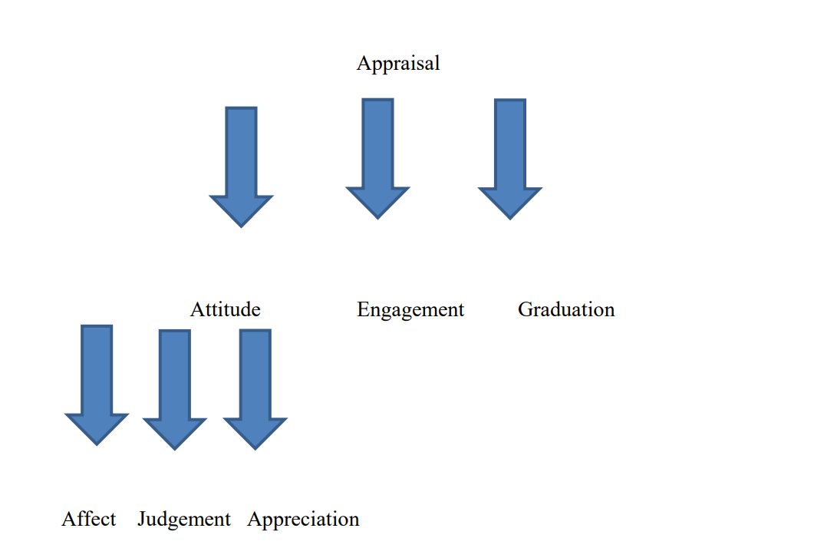

Slide 12
Affect
AFFECT, it is fundamentally concerned with ‘emotional reactions’. Moreover, depending on the surge of feeling, ‘un/happiness’, ‘dis/satisfaction’, ‘in/security’, and ‘dis/inclination’

Slide 13
Example
Mere words cannot fully express the profound remorse I feel for what our country is going through and for what members of both parties in Congress are now forced to deal with (Clinton, I am profoundly Sorry, December 11, 1998).

Slide 14
Judgment
JUDGEMENT, the second sub-type of attitude, evaluates people’s behavior in relation to ‘social esteem’: their ‘normality’, ‘capacity’ and ‘tenacity’, and ‘social sanction’: their ‘veracity’ and ‘propriety’

Slide 15
Example
a murderous tyrant, who has already used chemical weapons to kill thousands of people. This same tyrant has tried to dominate the Middle East, has invaded and brutally occupied a small neighbor, has struck other nations without warning, and holds unrelenting hostility towards the United States (Bush, Speech to America, July 9, 2002).

Slide 16
Appreciation
APPRECIATION conveys our estimation of things or natural phenomena according to three variables, which are ‘reaction’, ‘composition’, and ‘valuation’.

Slide 17
Example
We come to Berlin, we American presidents, because it's our duty to speak in this place of freedom. But I must confess, we're drawn here by other things as well: by the feeling of history in this city, more than 500 years older than our own nation; by the beauty of the Grunewald and the Tiergarten; most of all, by your courage and determination (Reagan, Tear Down this Wall, June 12, 1987).

Slide 18
In fact, the speaker/writer adopts a particular stance towards each of the kinds of attitude set out above. These stances are crucially revealed to the audience using lexico-grammatical choices that strategically designed to drive him/her take a similar, contrary or undecided position.

Slide 19
Engagement
Disclaim (‘denial’ or ‘counter-expectancy’). ex. (war on terror)
Proclaim (‘concurring’, ‘pronouncement’, or ‘endorsement’),
Attribute (‘acknowledgement’ and ‘distancing’),
Entertain.

Slide 20
Example
This is not, however, just America's fight. And what is at stake is not just America's freedom. This is the world's fight. This is civilization's fight. This is the fight of all who believe in progress and pluralism, tolerance and freedom (Bush, Address to Congress, September 20, 2001).

Slide 21
Graduation
Force and Focus;
Force: ‘intensification’ or ‘quantification’.
You have lost too much, but you have not lost everything. And you have certainly not lost America, for we will stand with you for as many tomorrows as it takes (William Jefferson Clinton, Oklahoma Bombing Memorial Prayer Service Address, April 23, 1995).

Slide 22
Thank you

