Slide 1
Multimodal Discourse Analysis
Tutor Prof . Ahmed Q. Abed, Ph.D Student: Sura jarjees

Slide 2
Multimodality
When was it first used?
In the 1920s, the term 'multimodality' was first used not in linguistics, but it was used in psychology to refer to the relations between the sensory perceptions (van Leeuwen, 2011).
What does it mean?
the approaches that understand communication and representation to be more than about language, and which attend to the full range of communicational forms people use—image, gesture, gaze, posture and so on—and the relationships between them" (Jewitt, 2009, p. 14). van Leeuwen (2011) defines multimodality as “the integrated use of different semiotic resources (e.g. language, image, sound and music) in texts and communicative events” (p. 281).

Slide 3
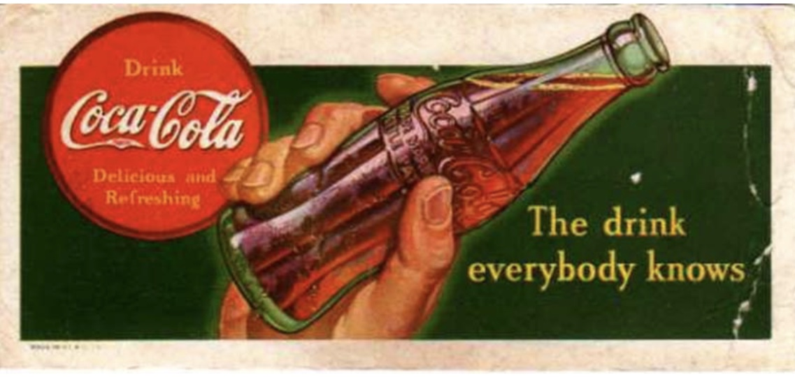
Jewitt et al. (2016) identifies three important processes that characterize any multimodal research:
Meaning-making is done by different symbiotic resources , each one offers special limitation and potentialities.
The production of multimodal wholes is involved via the meaning-making process.
The complete whole is found out via all semantic resources.

Slide 4
Lyons (2016) describes three main assumptions that multimodal studies are based on:
The first assumption is that communication includes the use of multiple modes (image, writing, speech, gestures and others), and the intermodal relationships all these modes are engaged in meaning making.
The second assumption is that meaning is formed through the selection and configuration of several modes in interactions.
The final assumptions is that this interaction uses resources which are socially shaded over time to make a culturally- shared scene, in the way in which they can deliver the meaning.

Slide 5
Snell- Horny (2009) suggests that multimodal text can be traced into four different genres:
Multimodal texts are delivered by electronic or technical media including both sound and sight (as in material for film, television, or sub-/subtitling).
Multimodal text includes several modes of nonverbal and verbal expressions involved both sound and sight (e.g. opera and drama).
Multimodal texts have several graphic design systems, nonverbal and verbal, as in advertising brochures and comics.
Audiomedial texts can be spoken or written, as in political speeches.

Slide 6
Mode:
Forceville (2009) considers mode as an interpretable sign system due to a specific perception process. Besides, he mentions four different modes: pictorial, spoken, written, and sound music.
Price and Jewitt (2013) point out that scholars who work on multimodal communication focus on instances of interactions between several communicated modes and challenge the usual view that language (spoken or written) is considered as the most important tool of meaning making
Hart (2014a) explains the similarity between images and written language by saying that, “although they are iconic […] images also perform a symbolic function as they can ‘stand for’ particular people, places and time periods which may, in turn, invoke attitudes and emotions”

Slide 7
Semiotics:
Kress (2010) believes that semiotic resources are socially made, and carry distinguished regularities of social events; occasions and a specific stability, according to that symbiotic resources are never fixed.
Michin (2013) maintains that the visual elements and the linguistic devices are similar because they both convey and create attitude and modes. To illustrates, van Leeuwen (2005) holds that resources involve symbiotic modes (e.g. images, language, gestures and music) and along with everyday objects like food and dresses because they have cultural value and importance.

Slide 8
Image centricity
Image centricity implies the perception and compositional dominance of the image over. Accordingly the image size, quality and layout structures show images as a perceptual entry pointing to the cognitive points of departure and reading paths for the structural of multimodal meaning.
2.Images are not only formal and dominant, but they are also semantically-central, in that they constitute independent core of the meaning that can frame the text to be the conceptual core and the object of interest, interpretation and verbal commentary.

Slide 9
Genre-based Multimodality
Boese (2005) believes that “The three underlying concepts that appear consistently in the definitions of the term ‘genre’ are: style, form, and content of a document. The purpose of a document is subsumed by these features” (p. 6).
Paltridge (2008) defines genre as the way in which people “get things done” by the use of written and spoken discourse (p. 84).

Slide 10
Translating Advertisements
Garcia (2000) believes that:
"[m]ore than anyone else, the translator of advertising will feel a special predilection for creating neologisms, knowing not only that they will be well received by the public – who are always entertained by these formulations, but will also serve to support the objectives of a message that is full of novelty and able to attract the reader’s attention"
Christelle (2012) believes that “the translation of advertisements requires particular skills and marketers should be aware of the advantage of translating their advertisements in order to reach a larger audience”
Sullivan (2013), translation is usually considered to be about the printed words, but the multimodal environment translators have to take account of other elements (still or moving images, music, page, layouts and typography).

Slide 11
Christelle (2012) states that the translator has to be familiar with cultural and ideological background of the targets settings. She adds that this will give the translator the right strategies to use or not use some suppression (e.g. some expressions have bad connotations for the targets consumers). She believes that “cultural, ideological and sociological factors therefore determine the success of translated advertising copy and should be given special attention if the translator does not want to produce a distorted message in the target setting” .
One of the distinguishing factors to attract or persuade people is cultural states i.e., translators have to bridge the small or big gaps between two cultures. For example, Andriunaite and Liubineine (2006) show that several texts in Ads do not fit the same norms which are shown in the source text. They add that in translating Ads, the translator should be aware of the cultural differences which do not allow the same brand or product to be presented in the same one.

Slide 12
Example
The Spanish retired model Judit Masco, she is known for being a good
role model and a natural beauty who has a traditional family and a successful career
the English copy features an actress with a similar profile: Thandie Newton

Slide 13
Translating Advertisements
Christelle (2012) denotes that translators, in their choice of words, have to be in a motive and they can suit the consumers to recognize themselves in that advertising. Therefore, she states that the multisemiotic nature of Ads has an important role because different consumers or audiences have different values, for different pictures, different symbols as well as different colours; and in translating Ads symbols in the original Ads are sometimes required in the campaign to new consumers or audiences.
Guidere (2001) committing on the texual level and visual level, states that when it comes to translating, the equivalence occurs on the syntagm level, and not at word level. Also affirm that "the emphasis is not on staying close to the text, but on the advertisement's ability to communicate meaning and create the necessary effect on the target audience" (P. 65). He then classifies levels to assess the effectiveness of the Ads translation:

Slide 14
changes in the translated Ads
Al-sherhar (2001) shows that particular changes made to Ads translated for Arabic countries, such as removing tattoos and making the model appear more Arabic; instances of freely, literally or idiomatically-translated advertisements can be found as image changes.
example

Slide 15
Four basic rules for translating Ads
In terms of the related literature, Arens and Bovee (1994) gave four basic rules for translating Ads:
The translator has to be a copywriter in an influential way; the issue is not a matter of rewriting ST Ads in TT Ads.
Translators have to understand market and features of the product.
Translators should render the Ads into TT native tongue consumers.
Advertisers should give the translators of Ads an easy translatable language, with no space for idiomatic expressions or double meaning expression.

Slide 16
De Pedo (1995) mentions the following Ad translation strategies for words and images:
The words can be:
Literally-translated: literal meaning of the words, is out of context, of course taken directly from dictionary.
Idiomatically-translated: this kind of translation the content of the text is preserved, taking into account that the form is framed by devices and patterns of the TL.
Freely-translated: it occurs where both the ST and the TT are only of global correspondence.
The images can be:
No changes on them.
Changes related to actor or actress who should act similarly to their target audience in each version of the commercial.
Change altogether.

Slide 17
Multimodality and Translation
In Translation, the translator faces not only verbal text but also nonverbal text. According to that, Petrilli and Ponzia (2012) state that "the translator must navigate in the iconic dimension of language and move beyond the conventions and obligations of the dictionary to enter the live dialogue among national languages, among languages internal to a given national language, and among verbal signs and nonverbal signs"

Slide 18
Damaskinidis (2012) states that it is important to illustrate the interdisciplinary movement between translation, semiotics and visual literacy.
Ferraz (2014) Visual literacy approaches of statics, dynamic images, or mixed, so as to examine their relevance and significance in all fields, and to question the issues of the possibility of representation, images as a process of meaning-making, expanding prospective, and the relationship between translation and knowledge.
Damaskinidis (2013) explains that the translations of multimodal texts should consider visual literacy as the possibility to render verbal and nonverbal semiotic elements for the purpose of delivery ST culture to the TT audience.
Avgerinou and Prttersson (2011) believe that images, whenever provided with a caption with that information delivered, became more complicated and difficult to manage, where the caption of the image is coordinated into a diverse non-verbal elements.

Slide 19
Semiotic Approaches to Translation
According to Kourdis (2015, p. 303), translation "from a perspective of semiotics, is studied as a simply semiotic act that includes the translation from one semiotic system (SL) to another semiotic system (TL)"
Multimodality or multimodal approaches still new in Translation Studies; nonetheless, their main meaning is shared with the term ‘intersemiotic’ translation, and this term is proposed by Jakobson (1959/2004)
Petrilli (2003) argues that the process of translation occurs between verbal and non-verbal languages, also between various non-verbal languages. Therefore, she concludes that the act of translation is to render or to interpret, and accordingly occurs when signs exist

Slide 20
Systematic Functional Theories in Multimodal Translation
SFL three metafunctions: the ideational, the interpersonal and the textual which are proposed by halliday (1978) for verbal language. This approach fortunately extends to be applied to all modes.
The metafunctional analysis of images is established on social-semiotic account of the way that meaning is realized visually as presented by Kress and van Leeuwen (2006).

Slide 21
Visual Grammar
Kress and van Leeuwen (2006), based on this orientation, have their own concept of Visual Grammar, which depends on the idea that the language of images has the same type of rules with words and sentence syntax. They (2006) confirm that images could be analysed by using the visual grammar and analyse their relations to words. Besides, they argue that images are governed by the same principles applied to written texts. This approach has been the motivation to visual social semiotics (Jewitt & Oyama, 2001).
Smith (2008) affirms that typography or layout has to be considered with caution, especially in cross-cultural translations. He (P.54) continues his argument to state that while translating, the layout of the ST shows a specific constrains for in the making of TT, because most of the time the client asked to keep the original version of them as a close as possible . He also mentions that when it comes to issues of layout and illustrations, translators are supposed to post to be consulted on the suitability of visual designs.

Slide 22
Multidimensional Approaches to Translation
Gerzymisch-Arbogast (2005) describes thus term as:
“a form of translation which transfers - with a specific purpose - a speaker or hearer's concern expressed in a sign system, formulated in a medium, via the same medium or a medium, or a combination of media into another sign or semiotic system” (p. 5).
He (2005) also proposes that interpretation and the translation dimensions "involve a change in the sign system"; for example, "transferring visuals/symbols to written discourse or transferring written text to visual/symbols or transferring visual/symbols to visual/symbols" (e.g. international electronic advertising). So, the translator may need to move to towards translation from a multifaceted viewpoint, and accordingly translation is significantly orientated multimedia.

Slide 23
Translation as a Form of Multiple Literacy Practice
Oittinen (2008) states that the translator has to put into consideration the external translational process, which includes the translator’s primary activity, for example, from the electronic respective of the ST to its arranging as an eventual outcome in the computer. Analysing the visual elements could help the translator's decision-making of the appropriateness of the general framwork of the multimodal text (Smith 2008).
In order to translate a picture book or a film, the translator does not only need visual literacy, but there is a need for something more specific, like media literacy.

Slide 24
Translation as a Form of Multiple Literacy Practice
while translating the same multimodal text into several languages, the translator has to pay attention to the visuals which have to be arranged in relation to several verbal components. For instance, Risku and Pircher (2008) examine how the translators, working in the field of technical communication where focus is on both text and images, have mastered new skills during translation training.
To elaborate on their point of view, in technical communication, the translator has to take decisions about the suitability of the ST visual element, in terms of the context of particular verbal element in the TT, it results, significant in the TT are to yield the wanted result in the target culture.

Slide 25
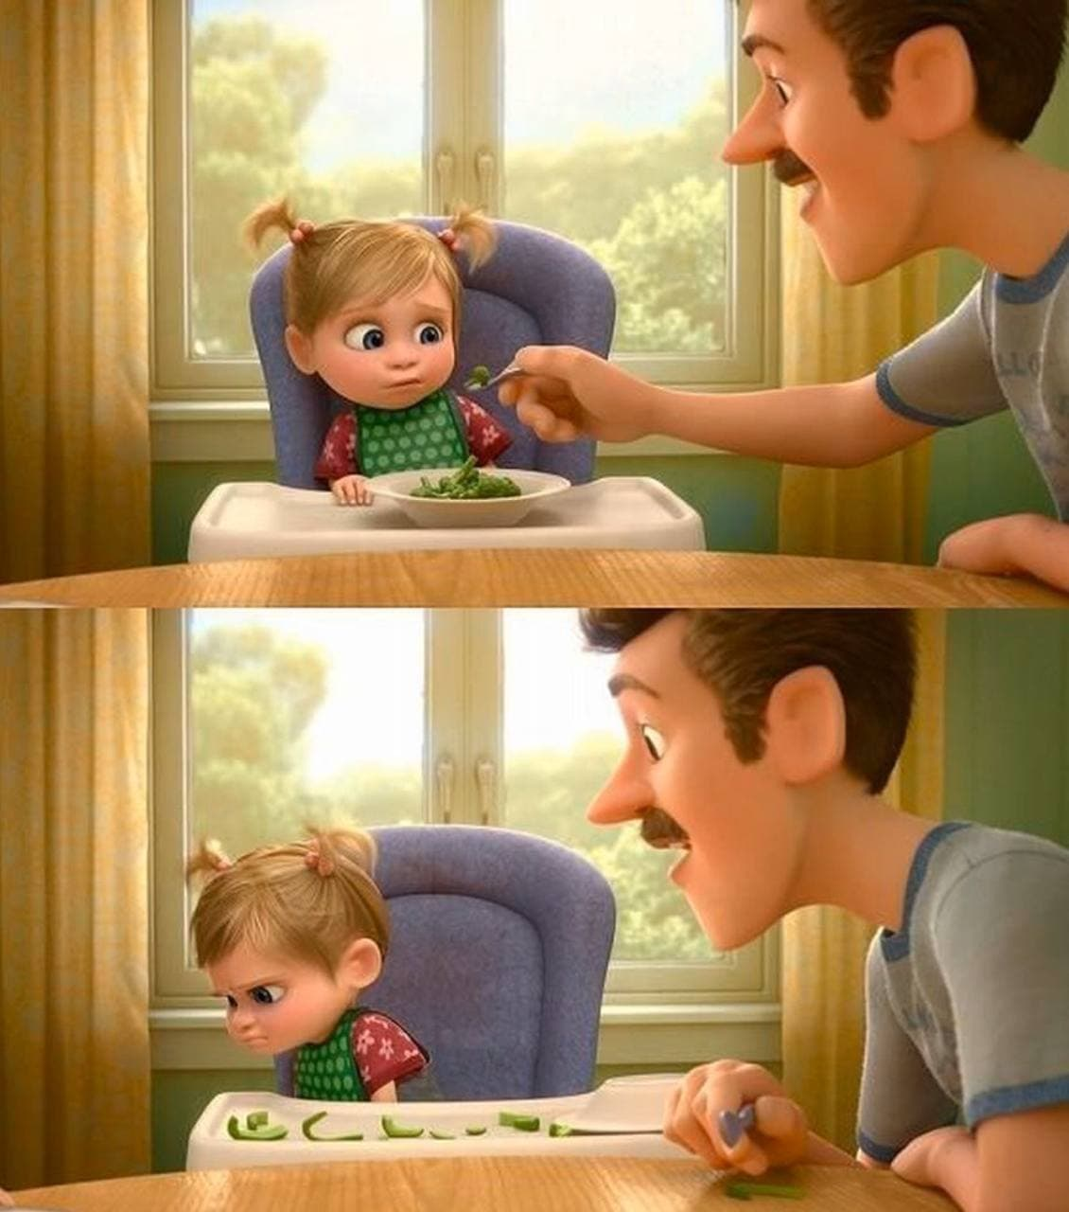
example
For example, in the original version of the movie “Inside out”, the child refuses to eat broccoli because it is hated by children, but it was replaced green papers in the Japanese version because they are more hated by the Japanese children (Richter 2015).

Slide 26
Mediation in Translation
Torop (2008) approaches his ideas from a semiotic perspective. He illustrates that the only way to understand translations is to examine mediation and translational processes. He adds that translation semiosis can be used to manage the mediation processes between different signs system.
Dendrinos (2007) mentions that there are two kinds of mediation with strong semiotic aspects:
Visual mediation: the message can depend on the visual text via a photograph, a graph, etc. This is done to readers, who may not understand the visual text either partially or completely, to clarify or just report the visual information by guiding the leaders to specific aspects of the visual, or by directing the leaders to the way of interpreting a visual.
Multimodal mediation: this type of mediation is relayed similarly in a text of single or multiple modalities example.

Slide 27
Thank you

