Slide 2
As a reader and a rewriter, a translator is constantly making choices on variouslinguistic levels, namely words, collocations, fixed expressions, clauses and structures. Whathappens during the process is that a translator reads and then reproduces the text in the targetlanguage, within his personal, social and cultural parameters. As such, the translated text, is but
“
one of many possible texts
”
and shall be seen as an evidence of a communicative transaction thana final product (Hatim and Mason, 1990).

Slide 3
It is worth noting that the dual role that a translator plays, as being both a reader and arewriter, is very essential in the decision-making process of choosing linguistic features. The latter allow target language readers to identify a text as a unit (one connected structure)

Slide 4
According to Widdowson (2007), discourse analysis is a branch that attempts to studylanguage beyond the limits of the sentence. It studies the relationship between language and thecontext in which it is used. The author points out that discourse analysis deals with how peopleunderstand each other, make sense of what they read or hear, recognize whether a text ismeaningful, understand the nature of a text (is a unit well-structured or not), and how theydifferentiate between what is communicated and said

Slide 5
Generally, any piece of language, whether written or spoken, involves forms and structures

Slide 6
McCarthy (1991) notes that, any type of discourse is usually assumed to be meaningful, well-structured, and leads to a successful communication. This mean
s that its words and sentences “
areinterrelated in conventional formulae
”
. These conventional formulae involve all those norms andrules people follow when they speak or write.

Slide 7
Beaugrande (1981) and Madoui (2004) suggestseven criteria that have to be fulfilled to qualify any type of discourse. These include

Slide 8
Cohesion:
it refers to formal surface relations between the sentences that make up the text;-
Coherence:
it refers to the underlying relations that hold between the sentences making upthe text. The latter establish their relevance to the central thought of the text;-
Intentionality:
i
t refers to the text producer’s attempt at handling
the linguistic resources ofthe text in a way that meets their intentions and communicates the message to be conveyed,in an appropriate and successful way;-

Slide 9
Acceptability:
it
refers to the receiver’s ability to perceive any relevance of the text in
question, which help the reader to recognize the textuality of the text materials and itsproperties;-
Informality:
it
refers to the newness or the giveness of the information presented in the text,i.e. whether the information in the text is known or not to the receiver. A text to be informativemust assure a balance between giveness and newness;-
Situationality:
it concerns the factors that make up a text relevant to a situation of occurrence.So, it is important to determine what is said, by whom, why, when, and where;

Slide 10
Intertextuality:
it deals with the factors that make the use of one text dependent uponknowledge of previous texts. A text, in fact, belongs to a wider universe of discourse, thusthe text receiver is able to perceive the intended message.

Slide 11
Types of cohesive devices:A
device or a tie is a term which involves the meaning of connection.
. It is a term “for one occurrence of a pair of cohesively related items” (Halliday and Hasan, 1976).

Slide 12
Halliday and Hasan (1976) distinguish five types of ties, namely reference,conjunctions, ellipses, substitution, and lexical cohesion. These lexico-grammatical devices aresummarized by Williams (1983) and Kennedy (2003) in the following diagram:

Slide 13
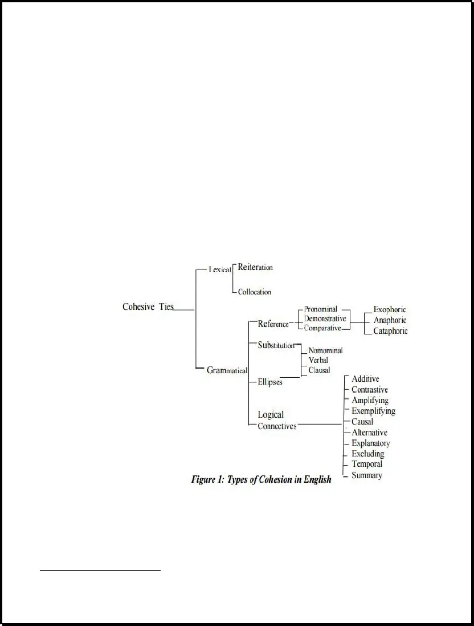

Slide 14
Grammatical Cohesion
Halliday and Hasan classify the categories of grammatical cohesion into four types: reference, substitution, ellipsis, and conjunction

Slide 15
Reference
Reference can be identified as the situation in which one element cannot be semantically interpreted unless it is referred to another element in the text. Pronouns, articles, demonstratives, and comparatives are used as referring devices to refer to items in linguistic or situational texts. Reference may either be exophoric or endophoric (M. Bloor & T. Bloor, 2013).

Slide 16
Exophoric reference requires the reader to infer the interpreted referent by looking beyond the text in the immediate environment shared by the reader and writer. For example in the sentence: That is a wonderful idea! To retrieve the meaning of that, the reader must look outside the situation

Slide 17
On the other hand, endophoric reference lies within the text itself. It is classified into two classes: anaphoric and cataphoric. According to Paltridge (2012), “Anaphoric reference is where a word or phrase refers back to another word or phrase used earlier in the text” (p. 115).

Slide 18
In the previous example: Amy went to the party. She sat with Sara. She refers back to Amy; therefore, she is an anaphoric reference. Cataphoric reference looks forward to another word or phrase mentioned later in the text. For instance in the following sentence, he is a cataphoric reference that looks forward to Mike:
As soon as he arrived, Mike visited his parents.

Slide 19
Substitution
Substitution occurs when an item is replaced by another item in the text to avoid repetition. The difference between substitution and reference is that substitution lies in the relation between words, whereas reference between meanings. There are three types of substitution: nominal, verbal, and clausal. Nominal substitution is substituting a noun or a nominal group with another noun. Elements of this type are one, ones, and same. In the following example, one substitutes car. This car is old. I will buy a new one.

Slide 20
Verbal substitution involves substituting a verb or a verbal group with another verb. The verb element used to replace items in this type is do. For example: I challenge you to win the game before I do! Here, do is the substitution for win the game.

Slide 21
Clausal substitution is substituting clauses by so or not. This is illustrated by the following:
A: Do you think the teacher is going to be absent tomorrow?
B: No. I don’t think so.
In this example, so substitutes the clause going to be absent.

Slide 22
Ellipsis
Ellipsis is the process of omitting an unnecessary item, which has been mentioned earlier in a text, and replacing it with nothing. It is similar to substitution because “Ellipsis is simply substitution by zero” (Halliday & Hasan, 1976). Normally, it is considered as an anaphoric relation because the omission takes place within a text.

Slide 23
When ellipsis occurs, the item that is omitted from the structure of the text, can still be understood. Alike substitution, ellipsis has three types: nominal, verbal, and clausal. In nominal ellipsis, the noun is omitted. This is exemplified by: My brothers like sports. In fact, both [0] love football. [0: My brothers] In the second sentence, the nominal my brothers is omitted.

Slide 24
Verbal ellipsis involves the omission of the verb. In the following example, the verb been studying is left out in B.
A: Have you been studying?
B: Yes, I have[0]. [0: been studying]

Slide 25
Clausal ellipsis occurs when the clause is omitted. In the example mentioned below, the clause writing on the board is excluded in B.
A: Who is writing on the board?
B: Alice is [0]. [0: writing on the board]

Slide 26
Conjunction
Conjunction words are linking devices between sentences or clauses in a text. Unlike the other grammatical devices, conjunctions express the ‘logical-semantic’ relation between sentences rather than between words and structures (Halliday & Hasan, 1976). In other words, they structure the text in a certain logical order that is meaningful to the reader or listener. Conjunctions are divided into four types, namely additive, adversative, causal, and temporal.

Slide 27
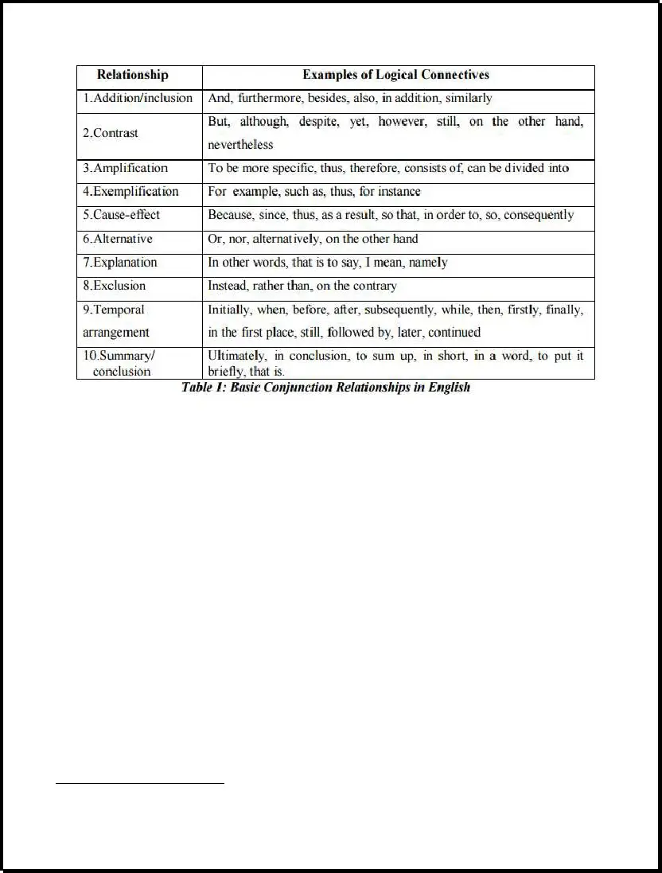

Slide 28
Lexical cohesion
Lexical Cohesion involves the choice of vocabulary. It is concerned with the relationship that exists between lexical items in a text such as words and phrases. Lexical cohesion includes two types, reiteration and collocation.

Slide 29
Reiteration
Halliday and Hasan (1976) define reiteration as two items that share the same referent and could either be repeated or have similar meanings in a text. The forms of reiteration are repetition, synonymy, antonymy, and superordination (hyponymy and meronymy).

Slide 30
Repetition is the restatement of the same lexical item. This is illustrated by the following: Anna ate the apple. The apple was fresh. Synonymy is used to refer to items of similar meaning just as, attractive and beautiful.

Slide 31
Antonymy is the relation between items of opposite meanings such as, hot and cold. Hyponymy refers to items of ‘general-specific’ or ‘an example of’ relationship (Paltridge, 2012: 119). For example, vehicle is the co-hyponym of car. Meronymy is a ‘whole-part’ relationship between items. For instance, cover and page are co-meronyms of the item book. In other words, book is the superordinate item of cover and page

Slide 32
Collocation
Collocation is a combination of vocabulary items that co-occur together. It includes combinations of adjectives and nouns such as, ‘fast food’, verbs and nouns such as, ‘run out of money’, and other items such as, ‘men’ and ‘women’.

Slide 33
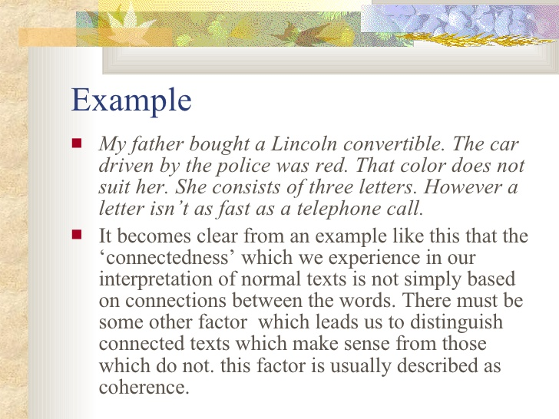

Slide 34
Lexical Cohesion The lexical devices (Repetition, Synonymy,, Antonymy Meronymy) are highlighted in the following text
. I agree the government policy of all of the citizens should learn two foreign languages. The world is getting more closer than before. It is very easy for us to travel to another country. Students can go to another country for study. Business man can find a parent from other country to improve their business. Also, there are more and more information can find on the internet. All of these are base on languages. There are more and more students travel to another country for study. They travel to another country because they want learn other language. If the students can speak more languages, then they can talk to someone easier, and also can learn more. Also, they can make some friends easily. There are more and more information can find on the internet. Some people will translate the information into their language. But sometimes they will lose some important information. If we can know other language, then we can find more resources for the information, and also more detail. Learning more languages can also learn more knowledge.

Slide 35
These are the advantages for learing more languages. International business is getting common. There are more and more companines located in whole world. If the boss of the company can speak more than one language, then the boss can find some parnets from different countries, then the boss can have a successful business easily. Learning two languages is also good for the people who is working. There are more and more information can find on the internet. Some people will translate the information into their language. But sometimes they will lose some important information

