Slide 1
Cohesive Devices
Chapter 5

Slide 2
Cohesive Devises
Cohesive devices, sometimes called linking words, linkers, connectors, discourse markers or transitional words
Cohesive devices tell the reader what we are doing in a sentence and help to guide them through our writing. They signal to the reader what the relationships are between the different clauses, sentences and paragraphs

Slide 3
The public transport in this city is unreliable and it’s cheap.
The public transport in this city is unreliable but it’s cheap.
There are two cohesive devices in the sentences above: ‘and’ and ‘but’. Both give the reader different signals and change the meaning of the sentence.

Slide 5
Overusing Cohesive Devices
The biggest mistakes many students make is to use cohesive devices in nearly every sentence.

Slide 10
Cohesive devices are words or phrases used to connect ideas between different parts of text. There are three main types of cohesive devices:
Pronouns that refer back to a previously mentioned noun.
Example: Jim went out to the playground. He played on the swings.
Substitution of a synonym for a previously mentioned noun.

Slide 11
Example: There was a lot of food, but she only ate the bread.
Transition words and inter-clausal connectors such as so or because
Example: Jim played on the swings. Later, Jim played ball.
Example: Mary was late, so she took the bus. Mary was late, because she took the bus.

Slide 12
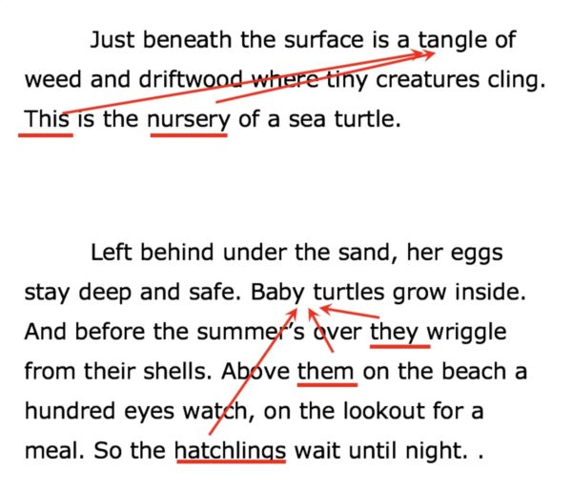

Slide 13
Cohesive devices affect comprehension because they help readers integrate information between sentences in a text. The pronoun, synonym, or transition word is tied to a previous word, phrase or clause (the antecedent).

