Slide 1
Transitivity System
Nabaa Jassim Mohammed

Slide 2
.
Transitivity is simply the study of what people are depicted as doing and refers broadly, to who does what to whom, and how ( Machin & Mayr,2012.P104).

Slide 3
.
1.Location circumstances construe the extent of the unfolding of the process in space and/or time and
Temporal # Last year, I travelled to the UK. When?
Spatial # I have lived in London for two years. Where?

Slide 4
.
2.EXTENT CIRCUMSTANCES. answer questions like ‘for how long’, ‘how far’ or ‘how many times’, as in:
a. Duration # I have slept for an hour. For how long?
b. Distance # I drove 20 miles yesterday. How far?
c. Frequency # I visit my family three times a year. How many times?

Slide 5
.
3. Manner circumstances construe the way in which the process is actualized and presented
a. Quality # He threw the ball to his friend strongly. How?/With what?
b. Means # He opened the door with a tea spoon. By what means?
c. Comparison # Try to do your job as professionally as you can. How?
d. Degree # All his friends love him deeply. How much?

Slide 6
.
4.Cause circumstances construe the reason, in its boarder sense, why the process is actualized
a. Reason # I have left early as I have a lot of things to do. Why?
b. Purpose # I went to the mall to buy a new laptop. For what purpose?
c. Behalf # He said sorry on behalf of his son. On whose behalf

Slide 7
.
5.Contingency circumstances specify certain elements on which the actualization of the process depends.
Condition # In case of emergency, the students can leave the exam room .
b. Default # In the absence of the teacher, the head of the department can ask any teacher to cover him/her.
c. Concession # Despite his illness, he has managed to complete his studies.

Slide 8
.
5. Accompaniment circumstances are forms of joint participation in the process and answer questions like ‘with whom’ and ‘without whom’, as in:
a. Company # She goes to school with her dad. With whom?
b. Lack of company # She can live in this city without him. Without whom?

Slide 9
.
6. Role circumstances construe the meanings to be and to become circumstantially, thus answering the question ‘what as’ and ‘what into’, as in:
a. Guise # I have worked as a translator for many years. What as?
b. Product # She cut the cake into many small pieces. What into?

Slide 10
7. Matter circumstances
can be replaced in verbal processes with the Verbiage of the process. Matter circumstances are typically expressed by prepositions, such as about, concerning, regarding, with reference to
Focusing # Do not think about these silly issues if you want to ease your mind. What about?

Slide 11
8. Angle circumstances
can represent the Sayer’s source of information in verbal processes with the sense of ‘as . . . says’, answering the questions ‘according to whom’. Similarly, angle circumstances can represent the Senser’s viewpoint in mental processes with the sense of ‘as . . . thinks’, as in:
a. Source # According to our teacher, we are not allowed to use dictionaries . According to whom?
b. Viewpoint # It seems to me she won’t come to the party. What’s your opinion?

Slide 12
.
To show how (not) paying extra attention to the circumstances employed by the writer may affect the translation accuracy,
أصعدني الحلاج إلى أعلى تل في بغداد وأراني كل مآذنها ومعابدها
Al-Hallaj lifted me to the highest hill in all Baghdad to show me its minarets and temples

Slide 13
.
by the effect of the non-finite clause of purpose introduced by to, the scope of intention becomes greater than the extent of causation in the target text, thereby creating a different mental image.
عاد من جديد يسترق النظر إليها عله يجد شيئا في ملامحها يضيء ما اعتراه من حيرة وذهول.
Once again he glanced over at her, and noticed something in her features that shed light on what had baffled him.

Slide 14
.
Here, two main material processes along with an adverbial subordinate clause are employed by the writer.
عندما صفر القطار صفرته الثانية الحادة المتقطعة فكت أمي عقدة فوطتها وسلمتني الدينار الوحيد الذي تملكه...
When the train gave its second, sharp shrill whistle, my mother untied the knot of her apron and gave me the only dinar she had . .

Slide 15
.
To discuss the effect of changing the process or its elements on the mental image conjured up in our minds, these two examples extracted from BBC
According to Ekho Moskvy, the alleged attacker’s name is Boris Grits. It describes the attacker as an Israeli, citing ‘informed sources’.
وقالت إذاعة إيكو موسكوفي إن منفذ الهجوم هو بوريس غريتس، ووصفته بأنه إسرائيلي الجنسية، وفقا لما أطلقت عليه ’مصادر مطلعة‘

Slide 16
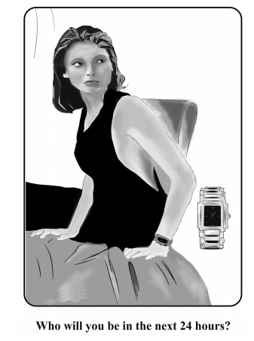

Slide 17
.
Existential process There is an attractive girl,
Relational process She looks sexy
Relational process She is ready to go out,
Behavioral process She is looking somewhere,
Possessive attributive process She wears a watch,
Behavioral process She is sitting on a bed, an
Existential process There is a watch, as well as others.
Here, the woman, the represented participant, is depicted from a low angle, that is, she is viewed from below. This indicates that the represented participant, the woman, is in a position of power, thus indicating her strength and other related qualities

Slide 18
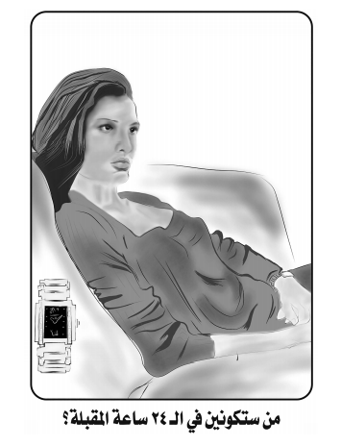

Slide 19
.
There is an attractive girl (existential process)
She is looking somewhere (behavioral process)
She wears a watch (possessive attributive process)
She is sitting on a sofa (behavioral process)
There is a watch (existential process)
Here, the model is depicted from a low angle, thus indicating her strength and other related qualities.

Slide 20
Thanks for listening

